Slide 1
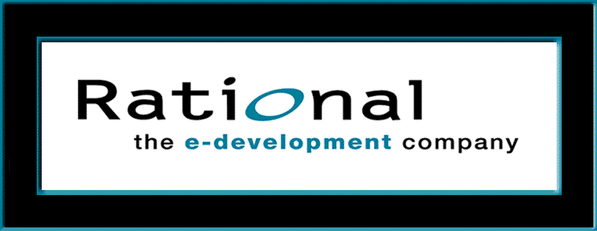
Requirements Management
with Use Cases
Module 4: Understand Stakeholder Needs

Slide 2
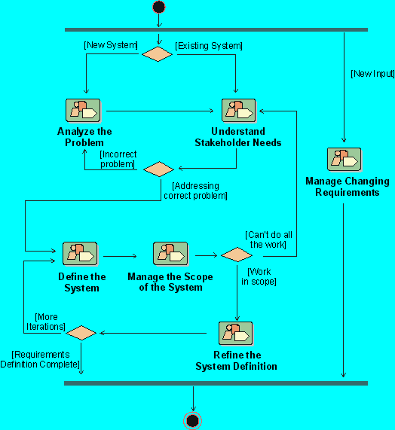
Where Are We in The Requirements Workflow?
Notes:
Where does the Understand Stakeholder Needs detail workflow fit in our development process? The Workflow Detail “Understanding Stakeholder Needs” in the Rational Unified Process represents activities that we undertake early in the requirements gathering process.
Where is this workflow detail done in your own software development process?
If presenting this course on-site at a company not using RUP, discuss the activities they use to accomplish this objective.

Slide 3
Understand Stakeholder Needs: Module Objectives
Recognize sources for needs/requirements
Learn techniques to elicit needs/requirements
Continue our use-case model: find use cases
Manage dependencies

Slide 4
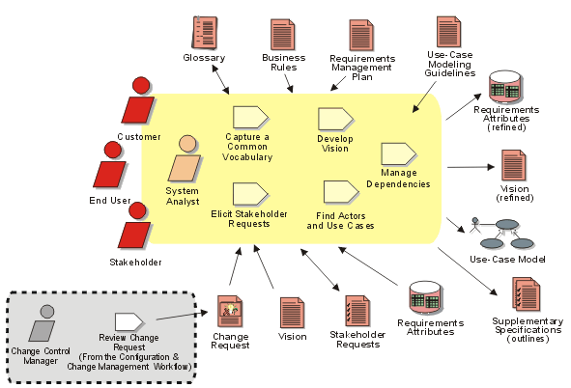
Understanding Needs : Activities and Artifacts
Notes:
In RUP, the objective now is to collect and elicit information from stakeholders in the project. This information can be regarded as a "wish list" that will be used as primary input in defining use cases and supplementary requirements.
This workflow detail is performed mainly during iterations in the Inception and Elaboration phases. However, you should be aware of incoming stakeholder requests throughout the product lifecycle, to make sure you continue to address your stakeholders’ real needs.
The key activity is to elicit stakeholder requests and determine the requested features of the system. The primary outputs are collection(s) of prioritized Stakeholder Needs and Features, as well as the attributes which should be associated with them. These outputs will be recorded in the Vision document. Also, during this workflow, you may start discussing the system in terms of its use cases and actors.
Another important output is an updated Glossary of Terms to facilitate a common vocabulary among team members.
The key stakeholder needs will be documented in the Vision Document.

Slide 5
Understand Needs: Focus on Needs
I need …
Problem
Problem Space
Needs
Solution Space
Features
Traceability
The Product To Be Built
Software
Requirements
Test Procedures
Design
User Docs
Notes:
At this point, we will work on making sure that we have considered all stakeholder requests, what needs are addressed by these (relating to the problem we have agreed to address), and what features in the system we might use to address these needs.
Stakeholder requests come in at many different levels of detail -- often not expressed as a real need, but sometimes as a feature of the system, or even as a change to a software requirement.
In this unit, we will discuss how we can effectively communicate with our stakeholders to figure out what their “real needs” are.
Use this slide to explain where we are in the class:
At this point, we will work on making sure that we have considered all stakeholder requests, what needs and goals are addressed (in the problem space), and what features in the system might address the needs.

Slide 6
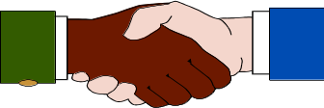

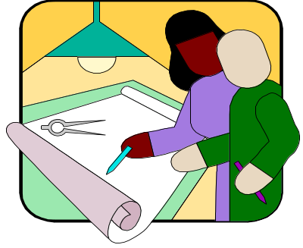

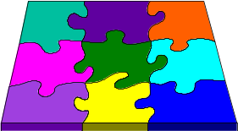
What Are Sources for Our Requirements?
Requirement Specs
Business Plans
Personal Goals
Business Models
Partners
Customer
Analyst
Bug Reports
Change Requests
Domain Experts
Industry Analysts
Site Visits
Competitive info.
Problem Domain
Users
Notes:
We need to capture requests from all stakeholders, and specify how these requests will be addressed. Although the system analyst is responsible for gathering this information, many people will contribute to it: marketing people, end users, customers -- anyone who is considered to be a stakeholder in the project.
Other examples of external sources for requirements are:
Statement of work
Request for proposal
Mission statement
Problem statement
Business rules
Laws and regulations
Legacy systems
Business models
Any results from requirements elicitation sessions and workshops

Slide 7
What Are The Characteristics of Our Customers?
Technology Adoption
Profile
“Crossing the
35%
CHASM”
30%
25%
20%
% of Target Domain Customers
15%
10%
5%
0%
Time
(the lifecycle of the technology)
INNOVATORS
Technical Influence
No Money
Discontinuous innovation
Company specific
EARLY ADOPTERS
Have money
Strong Influence
Specific features
EARLY MAJORITY
Pragmatists
Mission critical systems
Reliability
Whole product solutions
LATE MAJORITY
Conservatives
Price sensitive
Simplify
Commodity
Demanding
LAGGARDS
Skeptics
Price
Moore, 1991
Notes:
This chart comes from the book Crossing the Chasm, by Geoffrey Moore. As a technology progresses through its lifecycle, it appeals to different types of customers.
Notice that there is a gap in the bell curve in moving from each type of customer to the next. The biggest problem most products encounter (the chasm) is moving from early adopters to early majority. What is the key to getting across the gaps (making the transitions from one type of customer to the next)? Even if you have a good (or great) product -- the key is marketing -- getting the word out.
It is important to know the characteristics of the customers that will be purchasing your product. Where do they fit on this curve in relationship to the technology of your product? Are you appealing to the proper characteristics of your target customers?
The implication for gathering requirements is that each group will have different kinds of needs. In gathering and prioritizing requirements, be sure to understand what market segment or segments your customer requests come from. Also, pay particular attention to the requirements of the groups to which you want to appeal.
This chart comes from the book Crossing the Chasm, by Geoffrey Moore.
See student notes for points to emphasize.

Slide 8
What Problems Might Be Encountered?
Stakeholders know what they want but may not be able to articulate it.
Stakeholders may not know what they want.
Stakeholders think they know what they want until you give them what they said they wanted.
Analysts think they understand user problems better than users.
Everybody believes everybody else is politically motivated.
Notes:
What are some of the problems you have encountered in determining your stakeholder needs?
Ask: What are some of the problems you have encountered in determining your stakeholder needs? Keep the discussion relatively short.

Slide 9
What Does This Process Look Like?
Ad hoc requirements
Requirements Spec
Rejected
Reworked Spec
Rejected
Customer
Reworked again
Development
Approved !
Notes:
Continuous discussions should occur between development and the customer until an agreement is reached on the requirements of the system.
Expect to rework the requirements until you gain agreement with the customer and the other stakeholders in the project.
Some people tend to see each rejection as a failure to get the requirements correct. We encourage you to think instead of the advantages of having the requirements rejected: every time your specifications are rejected, you get new information! When a client says what they DO NOT LIKE, they are giving you important information about what they want instead. This process of rejection helps the client focus on what is important to their organization.
Emphasize that gathering requirements is an iterative process. It is a process of exploration and discovery, both for the development team and for the client.
Emphasize that every time the requirements specifications are rejected, you get new information! One consultant we know sometimes begins the process by giving his customer a specification that is purposely wrong. The customer is then forced to think through his requirements in order to correct it. We’re not recommending such an extreme strategy, but it is interesting to hear that it often works very well.

Slide 10
Techniques for Eliciting Stakeholder Needs
Interviews
Questionnaires
Requirements Workshop
Brainstorming & Idea Reduction
Use Cases
Role Playing
Business Modeling
Storyboarding
Prototyping
Reviewing Customer Requirement Specifications
Notes:
We will discuss briefly each of these techniques in the following slides. These techniques are useful for gathering information about stakeholder needs. The techniques can also be used very effectively for gathering information about feature requirements or detailed software requirements.
Many of these techniques can be used together. For example, a requirements workshop brings stakeholders together. At the requirements workshop, the participants may brainstorm for new ideas, or they may sketch out the use cases for the system to be built.
What follows is a crash course in elicitation techniques. We have selected the techniques on our list because of their usefulness in our experience. We will briefly discuss each topic in turn.
Beyond the techniques we will discuss there are many other techniques such as:
Production software
Task analysis
...
Most techniques will be very useful in some situations, but none will be useful in all situations.
Note:
Storyboarding and prototyping are included in this module. In the previous version they were in Module 7: Refining the System Definition. While they are both very good for obtaining detailed software requirements, they are also very useful in eliciting needs and features. Most of the techniques discussed in this module are useful for eliciting many types of requirements, and at many levels of detail.

Slide 11
Interviews
A direct technique that can be used in both problem analysis and requirements elicitation
Designed to gain an understanding of real problems and potential solutions from the perspectives of the users, customers, and other stakeholders
Notes:
Interviewing is probably the most useful technique to directly get needs from your stakeholders. It is helpful to interview key stakeholders for your project.
Refer back to the interview exercise we did at the beginning of the class to determine their needs for this class.

Slide 12
Interviews: The Context-Free Question
The context-free question is a high-level, abstract question that can be posed early in a project to obtain information about global properties of the user’s problem and potential solutions.
Context-free questions:
  Are always appropriate
  Help you understand stakeholder perspectives
  Are not biased with solutions knowledge
Gause & Weinberg, 1989
Notes:
Four types of interview questions will be considered:
User
Process
Product
Meta-questions
The context-free question is discussed in the book Exploring Requirements:Quality Before Design by Gause & Weinberg that is listed as recommended reading in the appendix.

Slide 13
Interviews: Context-Free User Questions
Who is the customer?
Who is the user?
What are their key responsibilities?
What are their backgrounds, capabilities, environments?
Use as input when defining actors for Use Cases
Gause & Weinberg, 1989
Notes:
One of the 4 types of interview questions:
User
Process
Product
Meta-questions

Slide 14
Interviews: Context-Free Process Questions
What is the problem?
What is the value of a successful solution?
How do you solve currently the problem?
How would you like to solve the problem?
Where else can the solution to this problem be found?
Gause & Weinberg, 1989
Notes:
One of the 4 types of interview questions:
User
Process
Product
Meta-questions

Slide 15
Interviews: Context-Free Product Questions
What problem does this product solve?
What business problems could this product create?
What hazards could exist for the user?
What environment will the product encounter?
What are your expectations for usability?
What are your expectations for reliability?
What performance/precision is required?
Gause & Weinberg, 1989
Notes:
One of the 4 types of interview questions:
User
Process
Product
Meta-questions

Slide 16
Interviews: Context-Free Meta-questions
Am I asking too many questions?
Do my questions seem relevant?
Are you the right person to answer these questions?
Are your answers requirements?
Can I ask more questions later?
Would you be willing to participate in a requirements review?
Is there anything else I should be asking you?
Gause & Weinberg, 1989
Notes:
One of the 4 types of interview questions:
User
Process
Product
Meta-questions

Slide 17
Interviews: Non-Context-Free Examples
Leading questions
  You need a larger screen, don’t you?
Self answering questions
  Are fifty items about right?
Controlling statements
  Can we get back to my questions?
Too long-too complex
  I have a three part question, ...
What are better questions to ask?
Notes:
It is easy to fall into some potholes if context-free questions are not used in the interview.
Discuss each of these types of questions briefly.
What might be a better way to ask each of these?

Slide 18
Interviews: Caveats
Don't ask people to describe things they don’t usually describe
  Assumes that users can describe complex activities
  Example: tying your shoelace
  In general, people can do many things they cannot describe
Avoid “Why…?” questions
  They can make people defensive
Ask open-ended questions
  Don’t expect simple answers
  Don’t rush the interviewee for answers
Listen, listen, listen!
Notes:
Here are some hints to help you avoid the dangers of unproductive interviews.

Slide 19
Template For A Generic Interview: Handout
Handout
TP3: Stakeholder Requests: Interview Template

Slide 20
Questionnaires
Widely used
Appear scientific because of statistical analysis
Applicability to broad markets where questions are well defined
Assumptions
  Relevant questions can be decided in advance
  Phrased so reader hears in intended way
  Suppresses much that is good about analysis
Can be powerful, but not a substitute for an interview
© 1994 by Alan M. Davis
Notes:
A questionnaire can be useful for gathering data, but it should often be prefaced by interviews to determine the correct questions to ask. How many customers should be interviewed to determine a good cross-section of questions? Usually 12-15 is adequate.
Most items should be categorized to allow for statistical analysis.
Always leave some open-ended questions to allow for new ideas.
Questionnaires should often be prefaced by interviews to determine the correct questions to ask. How many customers should be interviewed to determine a good cross-section of questions? Usually 12-15 is adequate.
Most items should be categorized to allow for statistical analysis.
Always leave some open-ended questions to allow for new ideas.

Slide 21

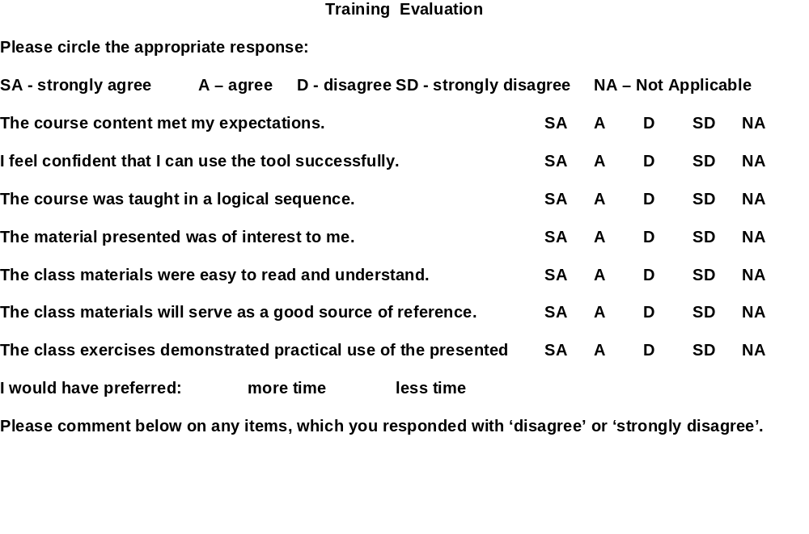
Course Feedback Questionnaire: Handout
Notes:
This questionnaire was created to elicit feedback on the delivery of this course. It provides Rational University with customer requirements for enhancements to the course.
The full questionnaire is included at the end of the manual for you to complete at the end of class
Here is an example questionnaire.
Point out the different types of questions included.

Slide 22

Requirements Workshops
Accelerate the elicitation process
Gather all stakeholders together for an intensive, focused period
Facilitator runs the meeting
Everyone gets their say
Results immediately available
Provide a framework for
applying other elicitation
techniques
Notes:
A requirements workshop is one of the most cost-effective and time-efficient means to get feedback. The same concepts are used in JAD (Joint Application Development) or RAD (Rapid Application Development) sessions.
Ask: “Has anyone participated in a similar workshop?”
This section is much more effective if it is presented in the context of a real (or close to real) workshop in which you have actually participated -- or at least in the context of an imaginary one which you might want to set up.

Slide 23
Workshops: Planning and Executing
PRE
WORKSHOP
SESSION
PRODUCTION
FOLLOW-UP
Sell the workshop
Establish team
Handle logistics
Issue warm-up
material
Prepare agenda
Facilitate
Keep on track
Record findings
Summarize conclusions
Synthesize findings
Condense info
Present to customer
Determine next steps
Notes:
Here are some suggestions on planning and executing a requirement workshop. Make sure you gather the right stakeholders. Who will they be?
Give example of a workshop like this that you have attended or facilitated.
Or perhaps get a student to share an example.
If you don’t have your own example, you can tell about the workshop that was pulled together with the 3 amigos at Rational, Phillipe Krutchen (Process group), and Walker Royce (process guru), with the Requisite executive managers to determine how RequisitePro should fit into the Rational product line and process.

Slide 24
Workshops: Tricks of the Trade
Problem
Solution
Hard to get restarted after
“Late From Break” ticket,
breaks
Kitchen timer, Charitable
contribution box ($1 after
ticket used)
Pointed criticism - petty
biases, turf wars, politics
“1 Free Cheap Shot”
ticket, “That’s a Great
and cheap shots
Idea!!” ticket
Grandstanding,
Trained facilitator, “Five
domineering positions,
Minute Position
uneven input from
Statement”
participants
Flagging energy after
Light lunches, breaks,
lunch
coffee, soda, candies,
cookies, rearrange room,
change temperature
Notes:
What are some of the problems you encounter when running a session such as this? How do you handle them?
Switch back and forth between this slide and the next to show how the Workshop tickets can be used to help with these problems.

Slide 25
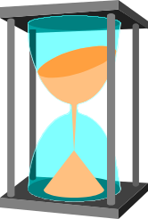



Workshop Tickets
Late From
Break
1 Free
Cheap Shot
That’s a
Great Idea!!
That’s a
Great Idea!!
Five Minute
Position
Statement
Five Minute
Position
Statement
Notes:
Here is an idea of how you can be creative in finding ways to control the Requirement Workshop meeting.
Can tell how these were effective with the 3 Amigos workshop referred to earlier.
Each of the top two tickets are thrown into a box as used, afterwards, it costs $1.
Bottom 2 tickets are for 5-minute position statements in which the user is given the floor for 5 minutes; can use white board or easel to explain position; no questions or comments from the floor except for clarification.
Middle two tickets: Original owner puts their initials on their two tickets. Give to someone else when you recognize a great idea they have shared. Goal at the end of the day is to have only tickets with other’s initials on them. Be open to recognizing as well as sharing great ideas.

Slide 26
Brainstorming
Rules for Brainstorming
Clearly state the objective of the session
Generate as many ideas as possible
Let your imagination soar
Do not allow criticism or debate
Mutate and combine ideas
Notes:
Brainstorming is a way to quickly generate as many ideas as possible. In the idea generation phase, the emphasis is on quick generation of ideas. In the idea reduction phase, emphasis is on combining ideas and focusing on the most promising ideas.
In order to encourage people to contribute ideas, it is important to finish with idea generation before doing any pruning or criticizing of ideas.
Ideas may start to mutate as people hear ideas and come up with variations on them. This is good, as some of the best ideas are those which build on the expertise and creativity of many people in the group.

Slide 27
Exercise: Brainstorming
Idea Generation Phase
  1. Prepare
    Stack of Post-Its for each participant
    Large markers for all
  2. Gather Ideas
    Shout it out
    Write it down
    Facilitator posts on board
  3. Clarify and organize ideas
    Describe each idea
    Move the notes around
    Could organize by FURPS
Notes:
The purpose of this exercise is to help you experience and try some useful techniques that can be used with brainstorming.
Take the class project that you determined in Module 3 and come up with some high-level features that people would like to see in the system.
Prepare. Give each student a post-it note pad and a large marker. Discuss directions for brainstorming on this page and the next.
Gather ideas. The main exercise is the idea generation phase. Have the students shout out the idea to the facilitator and also write a short description (3 to 4 words on a post-it note with a large marker so all can read). The facilitator collects these and places them on the easel.
If ideas start to mutate as people hear ideas and come up with variations, encourage and comment on it. Continue gathering ideas until the easel is filled with features (20 or so).
Clarify ideas. Go through each idea to make sure everyone understands it. If there are any questions, have the original requestor explain. After everyone understands the ideas, move the notes around to organize like ideas. In the exercise, only briefly demonstrate clarifying, organizing and pruning a few example ideas.
Prune ideas. (See next page). Combine similar ideas and discard redundant or outrageous ideas. Store ideas that we are not ready to develop.
Prioritize ideas. (See next page). If you have time, have the class actually vote.
RECOMMENDED:
Whole-class exercise.
Estimated Time:
10-15 minutes for brainstorming.
10 minutes for idea reduction

Slide 28
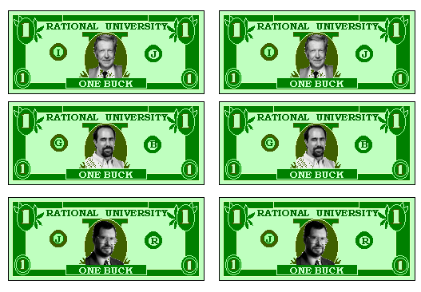
Brainstorming: Idea Reduction Phase
4. Prune Ideas
  Discard redundant/ outrageous ideas
  Store “needs more development” ideas
  Combine like ideas
5. Prioritize remaining ideas
  Vote
    Single vote
    Cumulative votes
      Buy features
  Apply evaluation criteria
    Non-weighted
    Weighted
RU “bucks”
Notes:
Now, what do you do after you have gathered all these “great ideas”?
After the idea gathering and pruning are over, what do we do with the ideas from the brainstorming? We organize and evaluate them.
There are many ways to evaluate them Go through all the prioritizing methods.
The “RU bucks” are a cute way to do cumulative voting. Each person in the requirements workshop would receive a fixed number of dollars. A person gives one “vote” for an idea by putting a dollar on a particular idea.
The faces on the dollars are (from top to bottom): Ivar Jacobson, Grady Booch and Jim Rumbaugh. Of course, if students want to use bucks in their own organizations, they would use faces from prominent people in their own organizations.
If you have time in the class, demonstrate one way of prioritizing idea by having students vote on them. Use cumulative voting, where each student gets 3 votes. Have students raise their hands for each item they vote for, and write the number of votes on each idea’s post-it note.
What are some ways cumulative voting can be “cheated”?
Someone puts all their money on their pet item which is unpopular with everyone else.
What would have been better ways to pay for the features in the previous exercise?
Perhaps using “critical”, “important”, “useful” and weighting the 9-3-1.

Slide 29
Use Cases: How Can They Help Elicit Needs?
Discuss with stakeholders what the system will do
  Who will interact with the system (actors)
  What the users want to use the system for (use cases)
  What interfaces the system should have
Stakeholders give needs from their point of view
Use-Case Model
Notes:
Uses cases are ideal for discussing requirements with stakeholders, because use cases express the user perspective: what do the users want to use the system for?
As an elicitation technique, use cases and actors should be identified. This gives us a context for finding the needs of the stakeholders: the ways they want to use the system, and their interfaces to the system.
In conjunction with identifying use cases, we might need to use our other elicitation techniques. For example, it is common to hold a requirements workshop for the purpose of identifying use cases.
In the previous module, we discussed finding actors. Now we will look at finding use cases. We’ll touch on the activity of finding actors lightly in this module, and then look at it in more depth in the next module.

Slide 30
Use Cases Show User Needs
A Simple Phone System
Caller
Place Local Call
Callee
Place Long Distance Call
Long Distance
Provider
Customer
Bill Customer
Billing Manager
A model of what the system does and who it does it for
Notes:
The use-case model describes the system, its environment, and how the system and its environment are related. It tells us WHAT the system should do (and not HOW the system should do it).
A use-case diagram shows actors, use cases, use-case packages, and their relationships.
This sample shows a use-case model for a simple phone system.
The important point here is that the simple overview of the use-case model gives you an idea of what this system is doing -- and it has to be from the user’s point of view. The manager of a store can understand the scope of the system from a picture like this.

Slide 31
What Is a Use Case? Key Words and Phrases
A
use case
defines a sequence of
actions
performed by a system that yields an observable result of value to an actor
  A use case describes a set of possible executions of the system
    A specific execution (instance) of a use case is a scenario
  Sequence of atomic activities, decisions, and requests
    May be performed fully or not at all
    Started by actor
Notes:
15
This slide and the following slide point out the key principles that should be kept in mind when defining use cases. There are many pitfalls that can be avoided by keeping these key words and phrases in mind.
Keep in mind that a use case describes “complete” flows through the system until the resulting value is achieved.
Emphasize the importance of each of the key phrases in the definition of a use case.
There may be a discussion of automatic processes: Are they started by an actor? What about functions that start due to a change in the state of the system?
In general, all use cases should be initiated by an actor. If a use case is initiated at a certain time (for example at the end of the day or the end of the month) this can be modeled with a special actor, the system clock (Father Time?). In rare instances, you may have a use case that starts because of some internal change to the system. But in most instances, an actor does something to start the use case.

Slide 32
What Is a Use Case? Key Words and Phrases
A use case defines a sequence of actions
performed by a system
that yields an
observable result of value
to
an actor
Describes functions of the system
To avoid too detailed use cases
To avoid too complex use cases
Notes:
16
Often the sequence of interactions in a use case involves several actors. But one actor receives the result of value. The actor receiving the value is sometimes called the primary actor.
The actor receiving the value is most often the one that initiated the use case, but this is not necessary.
However, the use case must result in an observable result of value for some actor(s). If nobody receives value from the use case then the use case is probably too small. Why would anybody do that use case if it does not achieve a result of value? It probably needs to be combined with other use cases to provide a complete set of steps for achieving some goal for an actor.
On the other hand, if many actors receive value from a use case, it may be an indication that the use case is too big -- it tries to do too much for too many actors. For example, for an ATM system, we could have just one use case, called “Operate the ATM”. It would achieve a variety of results for a variety of actors. It is so big that it is hard to represent and understand. It probably needs to be broken up into smaller use cases such as “Withdraw Cash”, “Transfer Funds”, and “Maintain ATM”.

Slide 33

A “Scenario” Is A Use-Case Instance
Withdraw Cash
Bank
Customer
Bank
Consortium
Scenario 2
Insert card
Approve card
Enter PIN
Wrong account
Reenter account
Approve PIN
Enter account, amount
Get approval from consortium
Dispense cash
Print receipt
Return card
Scenario 1
Insert card
Approve card
Enter PIN
Approve PIN
Enter account, amount
Get approval from consortium
Dispense cash
Print receipt
Return card
Notes:
A use case instance is simply one particular flow of events in the system, a specific sequence of actions that illustrates the behavior of the system. This is also called a scenario. In the example here, the sketch of Scenario 1 for the Withdraw Cash Use Case shows a Bank Customer interacting with the ATM and successfully get the cash the first time. Scenario 2 shows another Bank Customer interacting with the ATM and enter his PIN number wrong; that customer must reenter the PIN before he can successfully get the cash.
A use case defines a set of related scenarios. A use case represents all the possible sequences that might happen until the resulting value is achieved (or until the system terminates the attempt). The Withdraw Cash Use Case represents both of these sequences, and all the other possible sequences of interactions that may occur when a Bank Customer tries to withdraw cash.
Users and stakeholders can often identify the sequence of actions they want to perform to obtain a result. Asking stakeholders for the sequence of actions they perform is a good way to start identifying the steps in a use case.
.
We’ve touched on the term “scenario” before, but this slide gives an example. Explain the two scenarios for the same use case. Mention that there are dozens of other scenarios for this use case. Ask for a few more examples of scenario for the Withdraw Cash Use Case.
See student notes for additional points to emphasize.

Slide 34
Useful Questions for Identifying Use Cases
What are the tasks of each actor?
  What does the actor want to use the system for?
  Will the actor create, store, change, remove or read data in the system?
  Will the actor need to inform the system about external events or changes?
  Will the actor need to be informed about certain occurrences in the system?
Does the system supply the business with all of the correct behavior?
  What information must be modified or created?
  What use cases are needed for system startup, termination or maintenance?
Notes:
This is an important slide because it gives questions for identifying use cases. Suggest that the students mark this slide (tick the corner or place a sticky note) for easy access later.
Here are some questions that are useful for helping you find the use cases in your system. The best way to find use cases is to consider what each actor requires of the system. Go through each actor and identify the needs of each particular actor.
For an information system, a business model may provide valuable input, since it will probably clarify how the system is to be used.
There are many possible use-case models for a system. You could develop alternative models and choose the one you prefer.
Try to keep all use cases at approximately the same level of importance. The above questions may help get the right granularity (refer also to the definition of a use case):
Would you ever want to perform a particular activity as an end result in itself?
Are there any activities that should be kept together so you can review, modify, test, and document them together?
If a use case turns out to be too complex, you may want to split it (a use-case report significantly longer than 10 pages may be a candidate).
When you have made your first list of use cases, verify that all required functionality has been treated.
Give each use case a name that indicates what an instance of the use case does. To be comprehensible, the name may have to consist of several words.

Slide 35
Exercise: Identify Possible Use Cases
Our System
Notes:
For each of the actors we identified in the last module, think of the types of interactions each might have had with our system.
Remember, this is at a very high level.
Don’t spend too much time on this yet. We will be going into this in more depth in the next module, including interactions, etc. For now, let’s just sketch a diagram of 4 or 5 use cases.
Do this as a class exercise.
Look back at the actors defined in the exercise in the previous module.
For 2 or 3 actors, get the students to suggest the types of interactions each might have with our system.
Remember, this is at a very high level.
Don’t spend too much time on this yet. We will go into this in more depth in the next unit (including interactions, etc.) Just sketch a diagram of 4 or 5 use cases.
This will provide a context in which we might use our other elicitation techniques.
RECOMMENDED:
Whole-class exercise.
Estimated Time: 8-10 minutes.

Slide 36
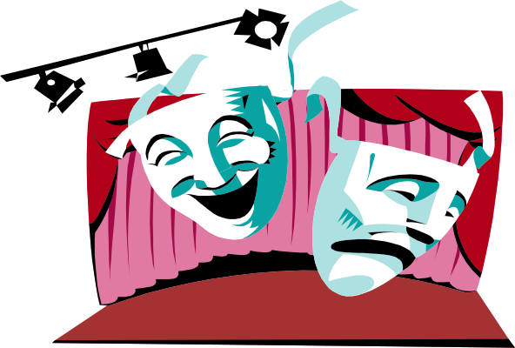
Role Playing
Tools and Techniques
  Analyst learns and performs user’s job
  Analyst performs a scripted walkthrough
Advantages
  Gain real insights into the problem domain
  Understand problems users may face
Notes:
Since users often cannot explain the complex activities they need to do in their job, one technique for learning about their needs is to DO their job with them. Doing the job alongside of the users provides real insight into the problems they face, and into the problem domain.
There are many variations on the role playing technique. Being a “fly on the wall: and just observing the users doing their own job can provide significant insights. Having a stakeholder write out a script and then having the analyst do a scripted walkthrough is another role playing technique.
Role playing is often a good way to see what users will use a system for (use cases). Also, the steps in performing a job will be the basis for developing the steps in a use case.
If the people you are getting requirements from are not the actual user, sometimes it can be useful to have them take on the role of a user and walk through some user scenarios. The stakeholder will gain insight into the needs of the user.
Ask group if they’ve used this technique.

Slide 37
What About Business Modeling?
From a business perspective, a business model may be used to:
  Understand the organization
  Visualize the organization and its processes
  Find ways to make the organization more efficient
  Re-engineer the organization
  Provide proof that the software system adds value
Notes:
The approach to business modeling presented in the Rational Unified Process includes a concise and straightforward way to generate requirements on supporting information systems. A good understanding of business processes helps you to build the right systems.
Even more value is added if you also use people's roles and responsibilities, as well as definitions of what "things" are handled by the business, as a basis for building the system. It is from this more internal view of the business (captured in a business object model) that you can see its tightest link to other models of the system and how they should appear.

Slide 38
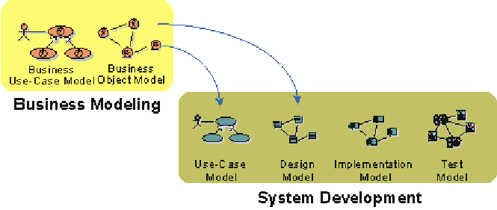
Business Models Provide Input to Systems
What should business models show?
  Business Processes
  Organizational structure
  Roles and responsibilities
Products
Deliveries
Events
Notes:
From an architectural perspective, having business models in place is particularly useful if you intend to build one of the following systems:
Customized systems for one or more companies in a particular type of industry (banks, insurance companies)
A family of applications for the open market (order handling systems, billing systems, air-traffic control systems)
The business models would give input to the use-case view and the logical view as presented in the analysis model. You would also be able to find the key mechanism at the analysis level (analysis mechanisms).

Slide 39
Storyboarding
Movies, cartoons, and animated features all begin with storyboards that tell
  Who the players are (actors)
  What happens to them
  How it happens
Shurtleff ‘94
Notes:
In RUP, a use-case storyboard is a logical and conceptual description of how a use case is provided by the user interface, including the interaction required between the actor(s) and the system.
Storyboarding is often a good way to get the users talking about the sequence of actions that will become the steps in a use case.
The following people use the use-case storyboards:
Requirements analysts, who want to understand how the system carries out the flow of events.
User-interface designers, to build a model of the user interface.
Designers of the boundary objects participating in the use-case storyboard, to understand the objects' roles in the use cases and how the objects interact. They use this information to design and implement the boundary object to construct the user interface
Those who test to test the system's use cases
The manager, to plan and follow up the analysis and design work
We’ve been talking for most of this module about ways to specify detailed requirements. Now we’ll talk more about ways to ELICIT detailed requirements. Many of the techniques in the module Understanding Stakeholder Needs will be useful. Here we talk about two additional techniques that are particularly well suited for eliciting detailed requirements:
Storyboarding
Prototyping

Slide 40
Storyboarding: Benefits
Help gather and refine customer requirements in a user friendly way
Encourage creative and innovative solutions
Encourage team review
Prevent features no one wants
Ensure that features are
implemented in an accessible
and intuitive way
Ease the interviewing process
Avoid the blank-page syndrome
Shurtleff ‘94
Notes:
Use-case storyboards in RUP are used to understand and reason the requirements of the user interface, including usability requirements. They represent a high-level understanding of the user interface, and are much faster to develop than the actual user interface. The use-case storyboards can thus be used to create and reason about several versions of the user interface before it is prototyped, designed, and implemented.

Slide 41
Prototyping
An early demonstration of some or all of the externally observable behaviors of a system
Used to
  Gain feedback on proposed solution
  Demo the problem domain
  Validate known requirements
  Discover unknown requirements
Prototyping tools
  Demo programs
  Simulations
Notes:
In RUP, the user-interface designer leads and coordinates the prototyping and design of the user interface, by:
Capturing requirements on the user interface, including usability requirements
Building user-interface prototypes
Involving other stakeholders of the user interface, such as end-users, in usability reviews and use testing sessions
Reviewing and providing the appropriate feedback on the final implementation of the user interface (as created by other developers, designers and implementers)
The following people use the user-interface prototype:
Use-case authors, to understand the user interface for a use case
Object analysts, to understand how the user interface influences the analysis of the system
Designers, to understand how the user interface impacts and what it requires from the "inside" of the system
Those who test the classes, to plan testing activities
Prototyping will probably be familiar to most of your students, so you can touch on it lightly. You might ask the students for examples from their own experience of successful prototyping.

Slide 42
Prototyping: Types
Throwaway
  Serves solely to demonstrate that the technological or user interface risks of the proposed solution are feasible
  Throw away - everything except knowledge gained
Evolutionary
  Demonstrates viability of technology approach employed and user interface
  Throw away - as much as necessary, saving knowledge gained and core technologies applied
Operational prototype
  Final form, function, and fit, as well as technology
  Throw away - as little as possible
Davis ‘95
Notes:
The user-interface prototype is built early, either during Inception or in the beginning of the Elaboration phase, and before the whole system (including its "real" user interface) is analyzed, designed, and implemented.
Note that the main purpose of creating a user-interface prototype is to be able to expose and test both the functionality and the usability of the system before the real design and development starts. This way you can ensure that you are building the right system, before you spend too much time and resources on development.
In order to achieve this early testing, it follows that the prototype should be significantly cheaper to develop than the real system, while still having enough capabilities to be able to support a meaningful use test.

Slide 43
Prototyping: Selecting Type to Use
For what purpose?
  To elicit and understand requirements?
  To prove and understand technology?
  Both of the above?
Benefits of prototyping
  Reduce risk
  Enhance shared understanding
  Improve cost and schedule estimates
  Improve feature definition
    Often, important features are found to be of little value - and vice versa
Notes:
The following are different aspects of designing the user-interface prototype:
Identify the Primary Windows
Design the Visualization of the Primary Windows
Design the Operations of the Primary Windows
Design the Property Windows
Design the Operations Involving Multiple Objects
Design Miscellaneous Features
A project does not need to consider all of these aspects in the prototype. Instead, it can often be appropriate to leave some aspects to the implementers, and thus not deal with them in the prototype. In this case, we recommend that you leave the lower aspects in the list, and focus on the upper aspects.
While you design the prototype, you should continuously implement your design and expose it to others; take into consideration any project-specific User-Interface Guidelines.

Slide 44
Reviewing Customer Requirement Specs
How to identify requirements
  Look for and label:
    Application behaviors
    Behavioral attributes
    Issues and assumptions
  Verify with the customer
If you don’t know whether something is a requirement, ask the customer!
Notes:
Project teams sometimes receive their requirements in a document directly from their customer, especially when contracting to do a job.
In this case, it is important to review the customer’s specification to determine what we believe to be the stated requirements. The identified requirements then need to be taken back to the customer to be verified; any issues noted must be addressed and resolved.
Keep in mind who wrote the specification. The specification will inevitably be written from the author’s perspective.
Introductory and overview sections of the specification are important for general understanding of the specifications. Those sections are less likely to contain requirements, but keep in mind that there might be “misplaced” requirements.

Slide 45
Exercise: Reviewing Requirements Specs
Identify and itemize Requirements
  Review the 2001 Elevator SRS that has been given to you by your customer
  Mark and number each requirement you find
  How many requirements did you find?
Handout
Requirements Spec. at end of module
Notes:
Look at the 2001 Elevator Spec included at the end of this module. Note that the Spec is not complete.
What do you do with a requirement spec that you received from your customer? (especially when you have no control of the content or the format?)
The goals of this exercise are for students to become familiar with requirements expressed in traditional format, and for them to begin to identify declarative requirements.
Ask them to look at the 2001 Elevator Spec included at the end of this module. Note that the Spec is not complete.
Ask participants to read through it and mark what they believe are requirements.
Ask each how many requirements they found.
Write numbers on easel (usually range from about 8 to 46) in approximate ascending order.
Why are the numbers so different?
What do we do to resolve?
Walk through the beginning of a spec review, with goal to identify requirements, issues, questions -- these will be taken back to customer to verify -- final determination should come from the customer.
Discuss the benefits of standard documents, identification methods for requirements. For example, “shall”, delimiters, and so on.
RECOMMENDED:
Individual exercise followed by whole-class discussion.
Estimated Time:
15-20 minutes to read and mark requirements. Or have them do it as homework at the end of the first day of class.
10-15 minutes to discuss the specification and the students’ results.

Slide 46
Eliciting Needs: Which Tools to Use?
Requirements
Workshop
Brainstorming
Use Cases
Interviews
Questionnaires
Role Playing
Business Modeling
Storyboarding
Prototyping
Requirement Reviews
Hi
“Catch Up”
“Mature”
Customer/User
Experience
“Fuzzy problem”
“Selling/Teaching”
Low
Low
Developer Experience
Hi
Which of these tools might you use for each quadrant of the graph?
Adapted from Alan Davis
Notes:
Which of these tools might you use for each quadrant of the graph?
The experience level of the customer or user and the experience level of the development team can often be critical factors in determining which techniques you might want to apply in your project. For example, if the customer has a lot of experience in building software for a particular kind of application but the developer has little experience, then the developer must “Catch Up” with the customer. What techniques would be particularly good to help an inexperienced developer to catch up with the very knowledgeable customer?
The selection of elicitation techniques can also be related to experience in different dimensions:
The problem domain
The development methodology (Object Oriented)
The tools being used, etc.
Use this slide as a review of the different elicitation techniques and their applicability to different types of problems -- can be used on morning of the 2nd day to help review.
The selection of elicitation techniques can also be related to experience in different dimensions:
The problem domain
The development methodology (Object Oriented)
The tools being used, etc.

Slide 47
Review: Understanding Stakeholder Needs
1. What are some problems encountered in trying to understand user needs?
2. What are some elicitation techniques for understanding user needs?
  What are advantages/drawbacks of each?
3. How can a requirements workshop accelerate the elicitation process?
4. What is the basis of the “context-free” question?
  What are four categories of “context-free” questions?
  Give example questions in each category
5. How are use cases helpful in eliciting user needs?
6. What is a scenario?
7. What would you look for in a customer-generated requirement specification?
Notes:
1.
2.
3.
4.
5.
Use these questions to monitor the students’ level of understanding and to help them review.
Tell them they can look back through the material to get the answers.
Give them time to answer Don’t be afraid to stand quietly while they look up the answer.
Remind the students that they can get more detail on this topic by reading Team Skill 3, “Understanding User Needs” in Managing Software Requirements, by Dean Leffingwell and Don Widrig.
RECOMMENDED:
Finish, or almost finish, Module 4 by the end of Day 1.
If you get to the Requirements Review exercise at the end of Day 1, give them the exercise as homework. Then complete Module 4 at the beginning of Day 2.

