Slide 1

Requirements Management
with Use Cases
Module 5: Define The System To Be Built

Slide 2
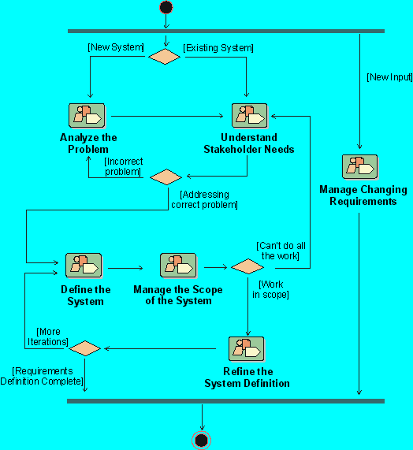
Where Are We in The Requirements Workflow?
Notes:
Where does the Define the System workflow detail fit in our development process? The workflow details in the Rational Unified Process represent the steps we may take while developing the initial requirements for the system we are building. In this module, we discuss the activities to accomplish Defining the System.
Where is this done in your own software development process?

Slide 3
Define the System: Module Objectives
Define major requirements for the system
  Document and further define product features
  Write the Vision Document
Continue our use-case model
  Define the use cases
  Write the Use-Case-Model Survey

Slide 4
Define the System: Focus on Features/Use Cases
Problem
Problem Space
Needs
Solution Space
Features
Traceability
The Product To Be Built
Software
Requirements
Test Procedures
Design
User Docs
Notes:
In this module, we will focus on specifying the features for our product. We will also continue to develop the use-case model for our system.
Use this slide to explain where we are in the class:
In this module we will define the system, at a high-level.

Slide 5
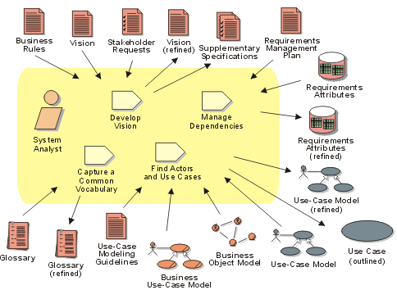
Define The System : Activities and Artifacts
Notes:
The purpose of this workflow detail is to:
Align the project team in their understanding of the system
Perform a high-level analysis on the results of collecting stakeholder needs
More formally document the results in models and documents
Typically, the Defining The System workflow detail is only performed in iterations during the Inception and Elaboration phases.
Problem Analysis and Understanding Stakeholder Needs create early iterations of key system definitions, including the Vision Document, a first outline to the use-case model, and the requirements attributes. In Defining the System, you focus on identifying features, actors and use cases more completely, and add supplementary specifications.
The key definitions of the system will be the features in the Vision Document and the use-cases and actors in the use-case model..

Slide 6
Develop or Adopt Standard Templates
Benefits of Standardization
  Leverages the work of others
  Quicker start, avoid reinventing the wheel
  Make sure things don’t fall through the cracks
  Everyone knows where to look for information
  Documents appear familiar and un-intimidating
  Documents are easier to read
Notes:
Each company should have a set of standard templates suited to fit their own needs.
There is a sample set of document templates included in the Student Handouts.
Each company should have a set of standard document templates suited to fit their own needs.
Point out the set of standard templates that are included in the Student Handouts.

Slide 7
Specifications: Focus on Vision
Needs
Vision Document
Features
Software
Requirements
Supplementary
Specification
Use-Case Model
Test
Specifications
Design Specifications
User Documentation Specifications
Notes:
Here is the requirement structure we will use in the class and the specification artifacts in which they will be captured. We will focus first on the Vision Document -- which will contain the Key Needs and Features of the System -- and then on how to specify the details in the the Software Requirement Specification, or SRS Package (made up of Use Cases and Supplementary Specifications).
Understand that these documents feed the lower level documents: Test, Design, and User Doc Specs.
In this module, we will focus on defining the high level documents: the Vision Document and the Use-Case-Model Survey.
In this module, we will focus on defining the high level documents: the Vision Document and the Use-Case-Model Survey.

Slide 8

The Vision Document
System-level document that describes the “Whats” and “Whys” of the product or application
Focus
  User needs
  Goals and objectives
  Target markets
  User environments and platforms
  Product features
Vision
Document
Notes:
The Vision Document provides a high-level (sometimes contractual) basis for the more detailed technical requirements. There can also be a formal requirements specification. The Vision captures very high-level requirements (features) and design constraints. It gives the reader an understanding of the system to be developed. It provides input to the project-approval process, and is therefore intimately related to the Business Case. It communicates the fundamental "whys and whats" related to the project, and it is a gauge against which all future decisions should be validated.
In general, the Vision Document will be read by managers, funding authorities, workers in use-case modeling, and developers.

Slide 9
Roles of the Vision Document
Communicate between management, marketing, and the project team
Provide for initial customer feedback
Foster general understanding of the product
Establish scope and priority of high-level features
Record future features and ideas
A document that gets
“all parties working from the same book”
Notes:
The primary purpose of “any” document is communication. We should always be aware of who will be reading the document and ensure that they understand its content.
Start to stress here that the primary purpose of *any* document is communication!
If not, then why have it?
Who is the audience?

Slide 10
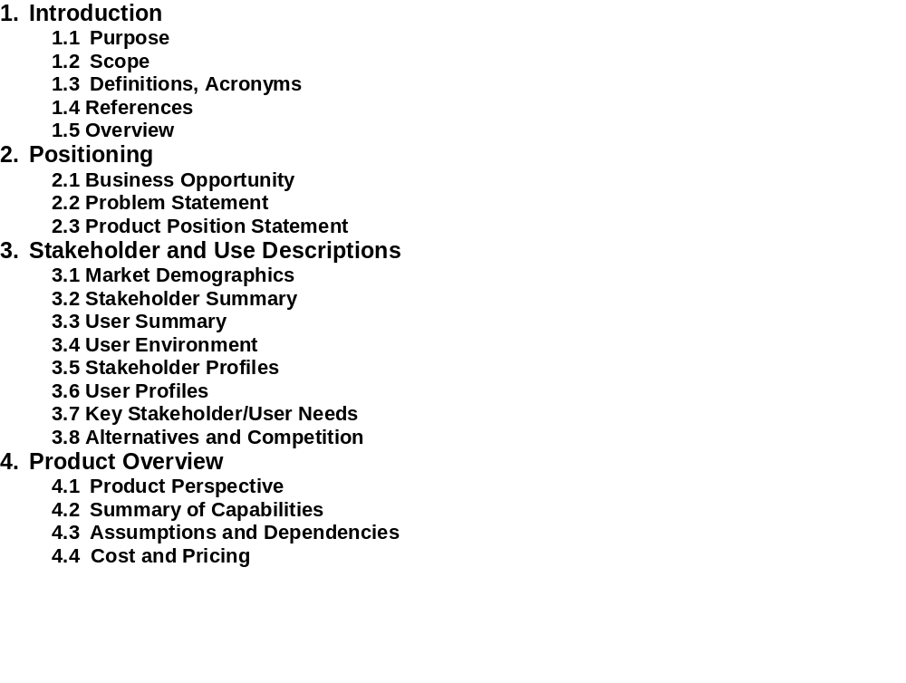
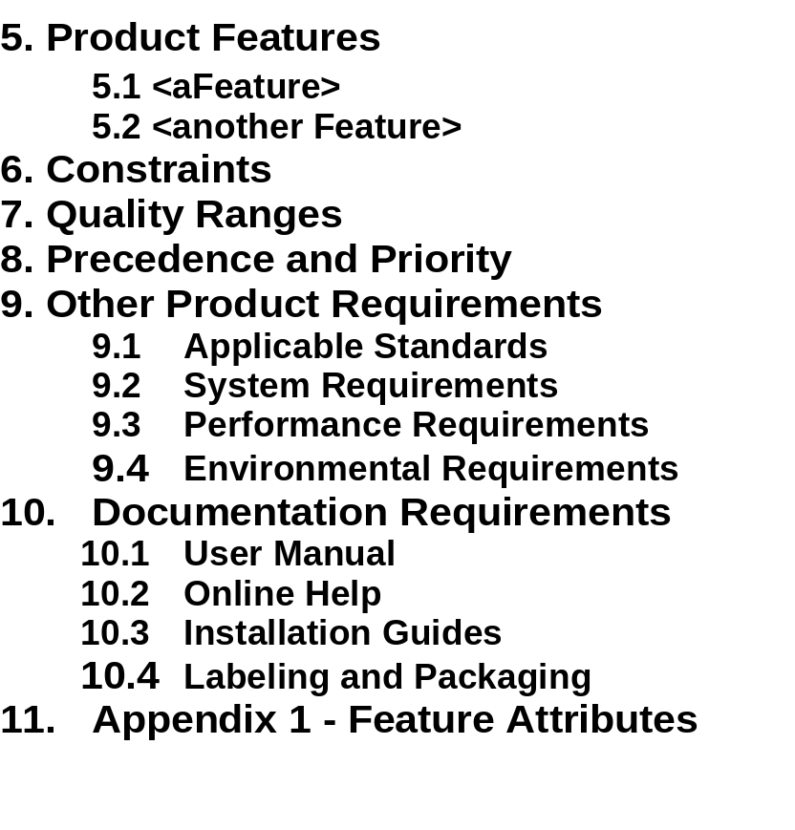
Vision Document: Template
Handout
TP4: Vision Document Template
Notes:
A sample template for the Vision Document can be found in the student handouts.

Slide 11
Exercise: Section 2.3 Product Position Statement
Communicates Intent and Importance
For
(target customer)
Who
(statement of the need or opportunity)
The
(product name)
Is a (product category)
That
(statement of key benefits - that is -
compelling reason to buy)
Unlike
(primary competitive alternative)
Our
product
(statement of primary differentiation)
Hint: Use Problem (Analysis) Statement as a starting point!
Moore ‘91
Notes:
Facilitate development of the Product Position statement for the sample project that will be worked on in the class.
Sometimes we call the Product Position Statement an “elevator statement” because of the following scenario:
You are stepping into an elevator (have 2 minutes) with your V.P. and want to spark his interest in this product; you want him to look at the Vision Document when it shows up on his desk.
The complete statement should fit on one page of the easel paper.
RECOMMENDED:
Whole-class exercise.
Estimated time: About 10 minutes.
Example:

Slide 12
Section 5: Product Features
A feature is a capability or characteristic of the system that directly fulfills a stakeholder need.
Examples
The Defect Tracking System will provide trending information to help the project manager assess project status.
The ATM will allow a customer to transfer funds between accounts.
The graphical user interface will provide context-sensitive help.
Notes:
Features are a type of requirement that directly fulfills a stakeholder need. These are the types of statements that came out in the class brainstorming session about features.
The features shows exactly what the system to be built will do. The features will be listed in the Vision Document.
Note that much of the detail is left out so that we can see a relatively concise list of features. As we continue to develop the requirements in Module 7, we will discuss how to write the detailed software requirements.
Make a point that these are similar to the types of statements that came out in the brainstorming session earlier.
Point out that one definition of “feature” listed in Webster’s Dictionary is “an advertised benefit.” The types of items we will consider as features are those that could be advertised as benefits.
Each feature directly fulfills a stakeholder need. Often there are many lower-level software requirements that trace back to a single feature.
What is similar between the use cases and the features? [Answer: System functionality]
What is different about the perspective on the functionality? [One of many answers: Features are described from the system perspective, use cases are named from the user perspective]

Slide 13
Section 11: Appendix 1 - Feature Attributes
Attributes
  Information about features
  Used to evaluate, track, prioritize, and manage
Appendix 1
  Defines the attributes to record for each feature
  For use in your requirements repository
11. Feature Attributes
  Status
    Proposed
    Approved
    Incorporated
  Benefit - How important is this to the customer/user
    Critical
    Important
    Useful
  Effort
  Risk
  Stability
  Target Release
  Assigned To
  Reason
Notes:
Information about feature attributes should be specified in the Requirements Management Plan. It is useful to repeat the information about feature attributes in the Vision Document, due to its wide audience.
Attributes are a key concept for requirements management. They can be used to ask management questions such as: “What features are critically important to the customer but are not yet approved?” Of course, you can only ask this question if you have defined the attributes Benefit and Status.
Explain that an attribute provides additional project information about each feature.
Use the example to show the importance of attributes for keeping track of and managing the features.
Discuss possible values of the “Benefit” attribute:
Mandatory/Critical = don’t do product without feature
(might want to distinguish between Safety Critical and Market Critical)
Important = potential loss of sales if omitted
Relevant = may not impact sales
Useful = state of the art, helpful
Relate the idea of feature attributes to the class project. What attributes we should record for features in the class project? Which features in our list of features (from the brainstorming exercise) would we consider to be critical?

Slide 14

Specifications: Focus on Use-Case Model Survey
An ATM
Use-Case-Model Survey
- survey description
- list of all actors
- list of all use cases
Bank Customer
Withdraw Cash
Bank Consortium
Transfer Funds
Withdraw Cash
- brief description
- flow of events
Deposit Funds
Cashier
Transfer Funds
- brief description
- flow of events
Maintain ATM
Maintenance
Crew
Deposit Funds
- brief description
- flow of events
Maintain ATM
- brief description
- flow of events
Notes:
The important part of the use-case model is the text. Frequently, many people get the wrong idea of the word “modeling” and believe use-case modeling is only about drawing figures and arrows. The use case diagram is a wonderful overview but a very small part of the entire use-case model .
The documents in a use-case model include the Use-Case-Model Survey, which gives the overview of the use-case model; and a Use-Case Report for every use case. The use-case reports may actually be separate documents, or may be “chapters” in a single document.
You may want to look again at the sample ATM use-case model included in the student handouts: UC 1 and UC 3.
Now let’s leave the Vision Document and move on to discuss the documents in the use-case model.
Point out the relationships between the different reports and the use-case-model artifacts. There is a single Use-Case-Model Survey, which gives the overview of the use-case model. There is a “Use-Case Report” for each use case. These Reports may actually be separate documents, or may be “chapters” in a single document.

Slide 15
Use-Case-Model Survey: Template
Use-Case-Model Survey
  Gives a complete functional overview of the model
  Shows a system’s intended functions and environment
  May serve as a contract between the customer and the developers
  Is input to activities in analysis, design, and test
Use-Case-Model Survey
1. Introduction
    Purpose of the system
2. Survey Description
    Overview of the use-case model
3. Use-Case-Model Hierarchy
    The packages in the model, representing a hierarchy. For each package, give its
    Package name, brief description, role in the system, and what it contains:
Actors
    Name and brief description of each actor and its relationships
Use Cases
    Name and brief description of each use case and its relationships
4. Use-Case Diagrams
A list of all actors
A list of all use cases
Notes:
The Use-Case-Model Survey describes the use-case model comprehensively in terms of how the model is structured. Its main purpose is to list and briefly describe the actors, use cases.and relationships between them.
A model may too large to view as a single unit. A package is a grouping mechanism to break your model into smaller pieces. If you are using packages, the Use-Case-Model Survey will have a separate subsection in Section 3 for each package. Each subsection contains an overview of the package and the lists of Actors and Use Cases in the package.
If your model is small, then you may not need to use packages. Then Section 3 of your Use-Case-Model Survey would contain the Actors and Use Cases in the entire model. For example, the Sample (ATM) Use-Case Model has no packages.
The Use-Case-Model Survey can be used to describe the entire use-case model at different stages:
During Inception, when you define the scope of the system
During Elaboration, when the use-case model is more stable
During Construction, when requirements are complete
The Use-Case-Model Survey is used by various people interested in the use-case model, such as the customer, users, architects, use-case authors, designers, use-case designers, testers, managers, reviewers, and writers.
The Use-Case-Model Survey is the overview of the Use-Case Model. Emphasize that its main purpose is to list and briefly describe the actors and use cases.
This is the first time we have mentioned “packages”. Explain, as in the student notes, that packages are simply a grouping mechanism that allows you to break your model into smaller pieces. Lead in to the discussion of packages on the next slide.

Slide 16
Packages: Grouping The Use-Case Model
The Use-Case Model
Top-Level Package
Use-Case Packages
Actors
Use Cases
Use-Case Packages
Notes:
A package is a general-purpose grouping mechanism is UML.
If your model may too large to view as a single unit, you can break your model into packages. A package in a use-case model may contain use cases, actors and relationships; and perhaps other, smaller packages.
There are many ways to organize your packages. For example, one package may contain a particular actor and all the use cases that the particular actor can perform. Another popular grouping is to have each package contain all the use cases related to a particular feature.
If you are using packages, the Use-Case-Model Survey will have a separate subsection in Section 3 for each package. Each subsection contains an overview of the package and the lists of Actors and Use Cases in the package.
A model may too large to view as a single unit. A package is a grouping mechanism to break your model into smaller pieces. Illustrate the idea of grouping a use-case model into packages with a real example.
If you don’t have a real example, you may use the ATM example. We could formally break it into two packages as illustrated in the two diagrams in UC1: primary use cases are the customer-oriented use cases, and secondary use cases are the maintenance-oriented use cases.

Slide 17
Section 2. Survey Description for ATM System
The Automated Teller Machine is a remote unit connected to the bank computer systems. The purpose of the system is to bring regular bank services closer to the customer and increase the working hours to around the clock. It is also important to decrease the number of bank tellers. An ATM withdraw is less expensive for the Bank than a withdraw from a teller.
Notes:
Here we see a survey description for the ATM System.

Slide 18
Actor Properties in the Use-Case-Model Survey
Text description of an actor
  Name
  Brief description
    What or who the actor represents
    Why the actor is needed
    What interests the actor has in the system
    A few lines only
  Relationships between actor and use cases
Use-case diagrams
Notes:
This is the information used to describe each actor in the Use-Case-Model Survey.
Some information about the actors is also shown on use-case diagrams in the Use-Case-Model Survey. The use-case diagrams show the name of the actor and the actor’s relationships with use cases.

Slide 19
Examples: Brief Description of an Actor
Bank Customer
  A person who wishes to access funds in a previously established bank account.
Bank Consortium
  An entity that validates Bank Customers, authorizes transactions and records completed transactions.
Maintenance Crew
  A person who maintains the ATM, refills paper and replenishes cash on hand when needed.
Notes:
Note: The Actor name is a “label”, which can be used to refer to it throughout the model. The brief description should clarify any ambiguity that the name might suggest.
Suggestion: Try to avoid an actor called “User” -- try instead to figure out the role of that particular user.
All actors are from the ATM example.
Emphasize that the actor name is a “label” which can be used to refer to it throughout the model. The brief description should clarify any ambiguity that the name might suggest.
Suggestion: Try to avoid an actor called “User”, rather try to figure out what is the role of that particular user.

Slide 20
Use-Case Properties in the Use-Case-Model Survey
Text description of a Use-case
  Name
  Brief description
    Role and purpose of the use case
  Relationships between the use case and actors
Use-case diagrams
Notes:
These are properties of the use cases that are included in the Use-Case-Model Survey:
Name: The name of the use case.
Brief Description: A brief description of the role and purpose of the use case.
Relationships: The relationships, such as communicates-associations, uses-and extends-relationships, in which the use case participates.
Some information about the use cases is also shown on use-case diagrams in the Use-Case-Model Survey. The use-case diagrams show the name of the use case and the relationships with actors.
The use case has other properties, too, which are included in the Use-Case Report, which we will discuss in Module 7: Refining the System Definition. In the Use-Case-Model Survey describe the use case only briefly. It will later be fully described in the Use-Case Report
On an easel paper, start making a list of the use-case properties, so you can refer to them throughout the course. Here are the use-case properties that are included in the Survey. Further properties of the use case will be specified in the Use-Case Report.

Slide 21
Examples: Brief Description of a Use Case
Withdraw Cash
  The Bank Customer withdraws money from his or her bank account with the ATM.
Deposit Cash
  The Bank Customer deposits money into an account. Bills or checks are accepted.
Notes:
Two samples from the ATM system.

Slide 22
How Should I Name a Use Case?
Each use case should have a name that indicates what is achieved by its interactions with the actor(s).
Examples of variations
  Dispense Cash
  Withdraw Cash
  Withdrawing Cash
  Cash Withdrawal
  Receive Cash
  Use ATM
Which variations show the value to the actor? Which do not?
Which would you choose as the use-case name? Why?
Notes:
A good rule of thumb (but not dictated by any standard) is to attach the actor’s name (of the primary actor) at the beginning of the use-case name and see if it makes a meaningful sentence. For example, does it make sense to say “The Bank Customer dispenses cash?” Does it make sense to say “The Bank Customer withdraws cash?”
Another approach is to ask, “What does the actor do while using the system?”
Point out the ambiguity of some of these names, for example,
“Receive Cash” -- who is doing the receiving? The customer? The ATM?
The best answer here would probably be to “Withdraw Cash.” But is this really what is happening? (Perhaps from the customer’s perspective…)
What about “Use ATM”?
Try to seed some discussion in this area. It is a good idea for each company to have a standard of how they will name their use cases.
The main thing is to BE CONSISTENT!

Slide 23
Useful Questions for Identifying Use Cases
What are the tasks of each actor?
  What does the actor want to use the system for?
  Will the actor create, store, change, remove or read data in the system?
  Will the actor need to inform the system about external events or changes?
  Will the actor need to be informed about certain occurrences in the system?
Does the system supply the business with all of the correct behavior?
  What information must be modified or created?
  What use cases are needed for system startup, termination or maintenance?
Notes:
This list of questions was first presented in the previous module. It is repeated here so that students will have it handy for the exercises that follow. You don’t need to go through it again, but a few examples or reminders may be helpful.
This list of questions was first presented in the previous module. It is repeated here so that you will have it handy for the exercises that follow.
These questions are useful for helping you find the use cases in your system. The best way to find use cases is to consider what each actor requires of the system. Go through each actor and identify the needs of each particular actor.
For an information system, a business model may provide valuable input, since it will probably clarify how the system is to be used.
There are many possible use-case models for a system. You could develop alternative models and choose the one you prefer.
Try to keep all use cases at approximately the same level of importance. The above questions may help get the right granularity (refer also to the definition of a use case):
Would you ever want to perform a particular activity as an end result in itself?
Are there any activities that should be kept together so you can review, modify, test, and document them together?
If a use case turns out to be too complex, you may want to split it (a use-case report significantly longer than 10 pages may be a candidate).
When you have made your first list of use cases, verify that all required functionality has been treated.
Give each use case a name that indicates what an instance of the use case does. To be comprehensible, the name may have to consist of several words.

Slide 24
Exercise: Course Registration System
At the beginning of each semester, the RU Registrar’s office will provide a list of courses to all students through a new on-line registration system. Information about each course, such as professor, department, and prerequisites, will be included to assist the students in making an informed decision.
The new system will allow students to review available courses and select four of them for the coming semester. In addition, each student will indicate two alternative choices, in case a course becomes filled or canceled. No course will have more than ten students. No course will have fewer than three students. Should a course have fewer than three students, then the course will be canceled. If there is enough interest in a course, then a second offering will be established.
Notes:
The purpose of this exercise is to practice looking at a fairly complex problem description and to determine the actors and use cases that might be needed. Write your solution in the form of a use-case diagram.
This slide and the following slide describe a course registration system. First, look at the “Useful Questions When Identifying Actors” (on page 3-22) and spend 5 minutes identifying actors. Then, look at the “Useful Questions In Identifying Use Cases” (on page 5-23) and spend 5-10 minutes trying to identify use cases for this system.
REOMMENDED:
Small group exercise (3 to 5 people) followed by whole-class discussion.
Estimated time:
20-30 minutes to make diagrams.
10-20 minutes for whole-class discussion.
In small groups, students can talk through their decisions about what is/is not a use case. But it can also be run as an individual or whole-class exercise.
Have each group write their use-case diagram on easel paper. You can post the papers together on a wall and compare the solutions.
Note that the requirements are ambiguous (on purpose). For example, the requirements are not complete about how the billing process works, or who actually assigns faculty to teach each course. Don’t let groups get too deeply into arguing about how to run the registration -- tell them to pick one way and focus on how to model that way.
Ask students not to turn the page -- there is a sample solution there. Once they have completed theirs, they may want to then go ahead and compare.

Slide 25
Course Registration System (cont.)
Professors must be able to access the on-line system to indicate which courses they want to teach. They will also need to see which students have signed up for their courses.
The registration process will stretch out over three days. The first day will be freshmen orientation and registration. All other students will arrive on the second day of the semester to register. The third day will be used to resolve any outstanding course assignment conflicts.
Once the course registration process is completed for a student, the registration system sends information to the billing system so the student can be billed for the semester.
As a semester progresses, the students must be able to access the on-line system to add or drop courses.
Notes:
Continue to identify use cases and actors.

Slide 26



Course Registration System: Sample Solution
Review and
select courses
Assign and
Alter Staff
Post and alter
registration information
Registrar
Student
Alter course
selection
Resolve registration
conflicts
Billing
System
Alter course selection
after registration period
Get class list
for a course
Transfer billing information
Select courses
to teach
Professor
Notes:
Here is a sample (not necessarily optimal) solution, which brings up a lot of questions that will need to be answered by the customer or user:
What changes are you going to make to the bill if someone cancels three weeks before the start of a course? Is it due to medical reasons, such as a broken leg?
What if a course suddenly in the middle of the semester is under-booked? Is it then canceled?
What does the resolve process look like? How does the Registrar inform the professor that an extra offering for a course is needed? There are a lot of question that have to be asked in this case. This is just a starting outline.
‘Add course’ and ‘Drop course’ should not be specified as separate use cases. They are lower level functions within other use cases.
(See also the notes for running the exercise, on the first slide of the Registration System exercise)
The sample solution is not necessarily the best, but it is good for stimulating discussion.
There are usually some very interesting points for comparison. For example, there are at least 4 ways that the billing information may be sent to the billing system:
1. The registrar initiates a Transfer Billing Use Case (as in the sample solution).
2. The clock/father time initiates a Transfer Billing Use Case at the end of the registration period.
3. The billing system initiates a Transfer Billing Use Case when it is ready for the information.
4. There is no separate Transfer Billing Use Case. Billing info is transferred whenever a student registers/alters registration, as a step in the “review and select” and “alter course selection” use cases.
Other questions to address:
Are the use cases too small? For example, should we combine “Alter course selection” and “Alter course selection after registration period” and have an alternative flow for after the registration period?
Does the diagram cover all activities? For example, in which use case do you think canceling too-small classes is done?
How do you know what is done in each use case? [Answer: You don’t know, from the diagram. ] This is a good lead-in to developing the textual description and flow of events.

Slide 27
Avoiding Functional Decomposition
Symptoms
  Very small use cases
  Too many use cases
  Uses cases with no result of value
  Names with low-level operations
    “operation” + “object”
    “function” + “data”
    Example: “Insert Card”
  Difficulty understanding the overall model
Corrective Actions
  Search for larger context
    “Why are you building this system?”
  Put yourself in user’s role
    “What does the user want to achieve?”
    “Whose goal does this use case satisfy?”
    “What value will this use case add?”
    “What is the story behind this use case?”
Notes:
Use cases are not functional decomposition. We want to avoid functional decomposition. Use cases describe the complete usage of the system to achieve a goal.
“Small” names are usually a symptom of too small use cases -- tiny things that are operations. Nobody understands what the system can do for them by reading a lot of small, tiny bits that are not in context or in order.

Slide 28
Special Use Cases Not to Forget
System start and stop
Maintenance of the system
Maintenance of information
  Example: automatic jobs checking the database
  Usually addressed in later iterations
Adding new functionality to the running system
  Important for real-time systems with no down time
Porting the running system to a new environment
  Use cases where actor is the development organization
Notes:
Don’t forget to include use cases for automatically scheduled events. For example, a time-initiated job may run the payroll at midnight on the last day of every month. For another example, a time-initiated job may synchronize duplicated information across multiple databases at midnight every night.
Use cases that concern automatically scheduled events are usually initiated by a special actor, the Clock.

Slide 29
Exercise: Describing the Use-Case Model
1. Review the information you have gathered so far on your class project:
  Stakeholders, Actors, and Problem Statement (M. 3)
  Features, Use Cases, and Priorities (Module 4)
  Product Position Statement (Module 5)
2. Now create a diagram of
actors and use cases:
  Identify actors and use cases
  Use lines or arrows to show the communicates-associations
  Write a name and brief description of each use case and actor
  Use easel paper so you can present your solution to the rest of the class
Notes:
Use your class project for this exercise. The deliverables will be:
A use-case diagram, drawn on easel paper
Name and brief description for each actor, written down for discussion but not displayed on easel paper
Name and brief description for each use case, written down for discussion but not displayed on easel paper
Use the class project for this exercise.
Create a list of concepts, similar to a glossary, during the exercise.
Let the class work in groups.
Post the use-case diagrams on a wall. Let each group present their solution. It is important that you as the teacher are interested in their solution.
RECOMMENDED
Small group exercise followed by whole-class discussion.
Estimated time:
20-30 minutes for each group to do its work.
10-20 minutes for discussion and comparison.

Slide 30
Describing a Use Case: Step-by-Step Outline
(Usually just handwritten at this point)
Withdraw Cash
Brief Description
  The Bank Customer withdraws money from his or her bank account with the ATM.
Outline for Flow of Events [Basic Flow, step-by-step format]
  1. Insert and validate bank card
  2. Enter pin
  3. Select withdraw
  4. Enter account and amount
  5. Send transaction
  6. Receive ok
  7. Dispense money
  8. Eject card
.
Handout
UC 2 (ATM)
Notes:
The example of a step-by-step outline example is from the ATM example. Note how it gives the basic events in outline form.
Developing a use case sequence of actions is an iterative process. We’ll start by developing an outline, or sketch, such as the one on this page. Later we will fill in the details.
Now look at Handout UC2, which give the sample step-by-step outlines for all the use cases in the ATM example. The outlines are not official documents, but a start toward developing a document. The outlines would probably be sketched on easel paper at a Requirements Workshop.

Slide 31
Use Case: Different Flows of Events
One Basic Flow
Happy-Day Scenario
Many Alternative Flows
  Regular variants
      Example: Withdraw Cash
      from Savings or Checking
  Odd cases
      Example: Withdraw Cash
      over a million dollars
  Exceptional (error) flows
      Example: Cash bin is empty
Notes:
The description should cover all the flows, the normal as well as the alternative and exceptional ones. Structure the description in such a way that it is easy to follow the different flows and to be able to understand what happens when.
Use lots of examples to illustrate the differences between the types of alternative flows. Point out that there is a different question to identify each type.
“What variations or options do we need to consider?”
“What unusual circumstances must be handled a bit differently?
“What can go wrong?”
The point is to be able to identify all of the alternatives needed in a use case.

Slide 32
Identify Alternative Flow of Events
Purpose:
  Find all possible scenarios for the use case
  List all questions to ask the user
Procedure:
  Work on paper with the users
  Ask - what may go wrong?
  Ask - what may not happen?
  Ask - what kind of resources can be blocked?
  Enumerate them A1, A2, A3, and so on
  Identify all the alternatives
Notes:
Alternative flows describe how the system should behave when things go wrong or when unusual things happen. Alternative flows are important, among other reasons, for determining the system architecture.
When working on the alternative use cases, questions regarding the behavior of the system are bound to surface. List these questions and have the users answer what the system is supposed to do, and how they expect to interact with the system in each scenario. Understanding the alternatives is an important step in clarifying the requirements. At this point in the process, however, it is enough to identify the alternatives without describing them each in detail.

Slide 33
Exercise: Write a Step-by-Step Outline
For each of the use cases agreed upon in your class project, write a step-by-step outline for the flow of events
Use case name
Brief description
Basic Flow
1. First step
2. Second step
3. Third step
A1 Alternative flow 1
A2 Alternative flow 2
A3 Alternative flow 3
Notes:
Use the ATM Sample step-by-step outline as an example of the level of detail that should be attained. Remember, this is just a “brief” step-by-step outline to help understand what functions are contained in the use case. We will further describe these steps in Module 7, Refining the System.
Have them work in the same groups that they used for the last exercise.
Before you break into groups, decide which uses cases to outline. Pick from the use-case diagrams that they did in the last exercise. You can let each group pick different use cases (to get more coverage of the class project) or you can pick the same ones for all groups (to allow comparison of different ways of handling the same use case). I usually have them do the same ones so that we can compare.
Have them write their outlines on notebook paper, and (if possible) make copies for the entire class.
How many use cases should each group outline? It depends on the amount of time you have available. I often limit it to one use case per group. Two or three per group is better, if you have time.
RECOMMENDED:
Small group exercise followed by whole-class discussion.
Estimated time:
20-30 minutes to work in small groups.
10-20 minutes for reading the outlines and discussion with the full class.

Slide 34
Review: Define the System
1. What are some benefits of standardizing documentation?
2. What is the primary purpose of a Vision Document? What are some other purposes?
3. What is a product feature?
4. What is a feature attribute? How can attributes be used?
5. Which properties of actors and use cases are specified in the Use-Case-Model Survey?
6 What are some questions that help identify use cases?
7. What are some symptoms of functional decomposition? What are some corrective actions to avoid decomposition?
8. Why would you write a step-by-step outline?
9. What is a basic flow of events? An alternative flow?
Notes:
1.
2.
3.
4.
5.
6.
7.
8.
9.
10.
Use these questions to monitor the students’ level of understanding and to help them review.
Tell them they can look back through the material to get the answers.
Give them time to answer. Don’t be afraid to stand quietly while they look up the answer.
Remind the students that they can get more detail on this topic by reading Team Skill 4, “Defining The System” in Managing Software Requirements, by Dean Leffingwell and Don Widrig.

