Slide 1
中保無限家 資料概念驗證
技術說明
SIGMU My-Vita Data POC Technical Notes
感測器之低電量警示預測
Low power Prediction of Devices

Slide 2
  Abstract
Phase I : Data Cleansing Step
  Extract XML raw data from 24-days DB into SQL
  A. Fetch sensor types of which happened “getReportEvent” “code384-電池低電量”
  B. Fetch device records which sensor type is in the types above
  C. Append “getReportEvent” of “code384-low power” time to device records above
  D. Aggregate accumulated times of “getReportEvent”
  E. Aggregate accumulated times of “getReportEvent” “code147-設備回報異常”
  F. Aggregate accumulated times of “getDeviceStatus”
  G. Aggregate accumulated times of “getDevices”
Phase II : Machine Learning Modeling
  Predictive Maintenance
  Survival Analysis

Slide 3
Phase I :
Data Cleansing Step

Slide 4
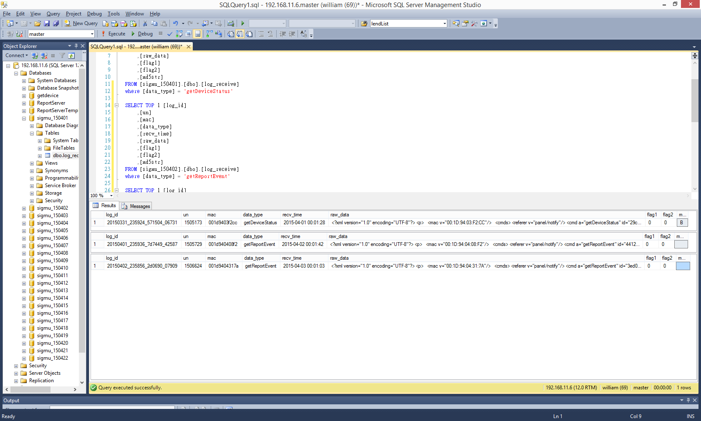
  Data Description
SIGMU Original 24 days DB:
  un : Client identifier
  mac : Media Access Control Address
  recv_time : Receive time
  data_type : [getDevices, getDeviceStatus”, getReportEvent …… ]
  raw_data : Device detail attributes or statuses in XML

Slide 5
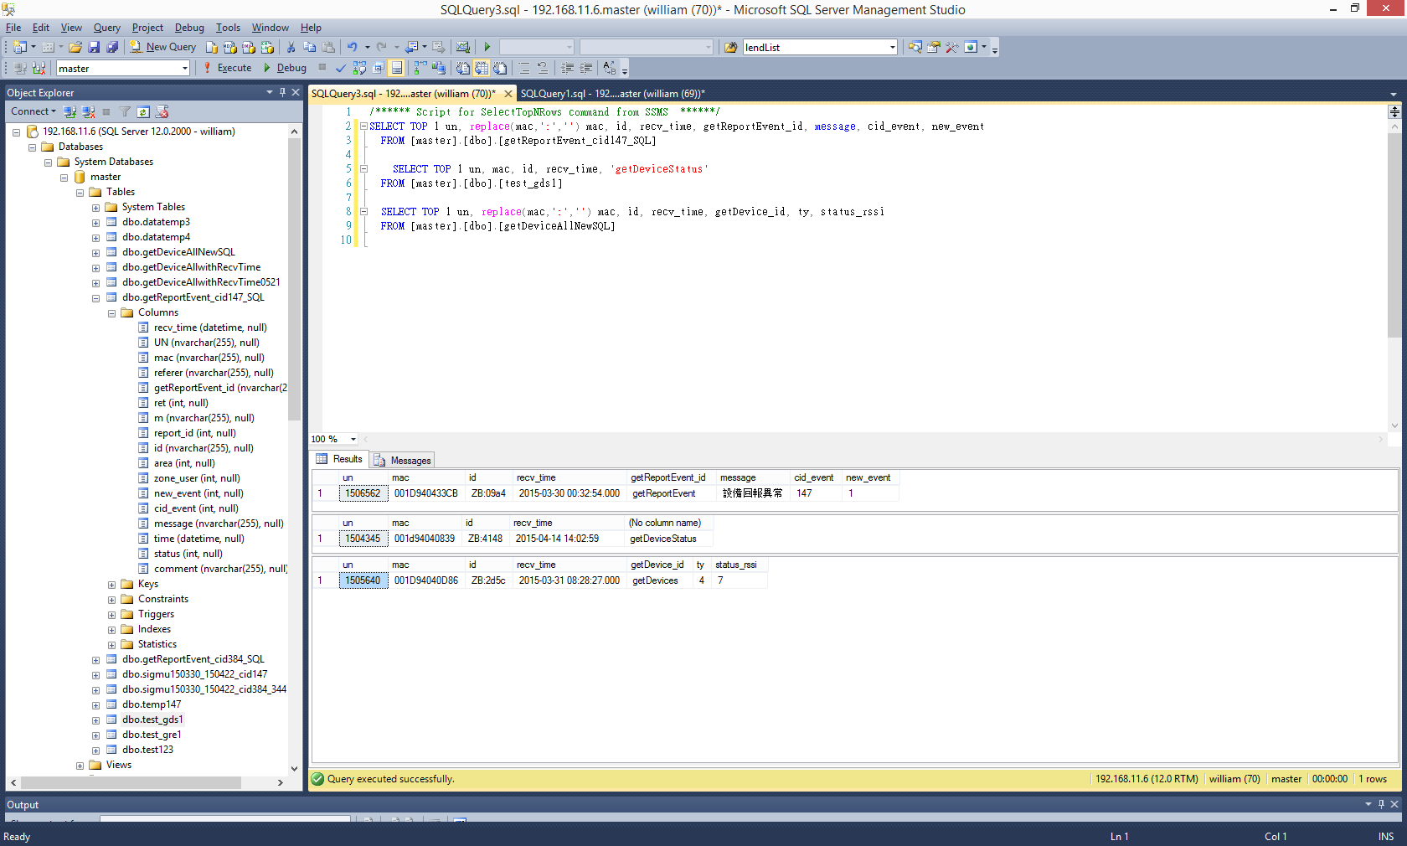
Data Description
Parse 24-days SIGMU DB data and XML data into SQL format
Parsing Target : data_type in “getDevices, getDeviceStatus, getReportEvent”
Parsing Attributes :
  getDevices : id, ty, status_rssi [#records: 399,760 ]
  getDeviceStatus : id (for count purpose) [#records: 28,767,775]
  getReportEvent : id, cid_event, new_event [#records: 68,579]
    cid_event: Code 384(電池低電量), 147(設備回報異常), 158(高溫警報), 344(干擾偵測), 354(網路裝置錯誤)” ……

Slide 6
Predict Target:
Code 384(電池低電量)
感測器之低電量警示預測
Low power Prediction of Devices

Slide 7
Phase I-A
Fetch sensor types which happened “getReportEvent” “code384-電池低電量”
Fetch sensor “id” which getReportEvent code (cid_event) is 384 -*See Notes 1.
Fetch sensor “ty” in the sensor types of above Id
Notes:
  The events above refer to its “new_event = 1” (事件發生) 電池低電量
  rather than “new_event = 0” (事件恢復) 電池電量恢復
  Same “un”, “mac”, “id” happen several times at same time in XML
  Since “code384-電池低電量” XML has no “ty”, need go through “getDevice” to find out “ty”
  Exclude “un” = 0 records because it’s for test only

Slide 8
  Phase I-B
  Fetch all device records in Phase I-A sensor types
Fetch device records “getDevices” in Phase I-A sensor types over 24-days DB
  Fetch “un, mac, id, ty, rssi, recv_time” column from “getDevices” datatype
  Notes:
    Time value of “status_time” in XML is not correct in each record
    Time value of “recv_time” in original “log_receive” Table is correct in total
    So use “recv_time” to represent the record time instead of “status_time”
    Exclude “un” = 0 records because it’s for test only

Slide 9
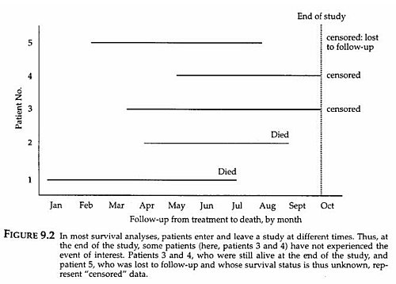
Phase I-C
Append “getReportEvent” “code384-電池低電量” time to Phase I-B Device Records
Fetch “un, mac, recv_time, id (in XML)” of “getReportEvent” -*See Notes 1.
Join by “un, mac, id” to device records and
replace NULL time result with ‘-1’ -*See Notes 2.
Notes:
  Time value of “status_time” in XML is not correct in each record
  Time value of “recv_time” in original “log_receive” Table is correct in total
  So use “recv_time” to represent the record time instead of “status_time
  Not all device records (“getDevices”) have “code384-low power”
  “Time in Cycle” is critical feature in Survival Analysis
  In this 24-days data, we observed left censored data which start time and cycle are both unknown, so we replace “Time in Cycle” with “days remained”, which is the difference between the records time and expired (“code384-電池低電量”) time, for Survival Analysis
  Transform numeric “days remained” field into 5 “level”
  1: 0-5 days
  2: 6-10 days
  3: 11-15 days
  4: 16–30 days
  5: “code384-low power” not happened
Reference: Lang (2006). How to Report Statistics in Medicine

Slide 10
Phase I-D
Aggregate times of all “getReportEvent”
Fetch “un, mac, recv_time, id (in XML)” of “getReportEvent” -*See Notes 1.
Calculate ‘RowNumber’ as accumulated “getReportEvent” times
Partition by “un, mac, id” Order by “recv_time”
Join maximum ‘RowNumber’ to device records,
By “un, mac, id”,
On records time >= “recv_time” of “getReportEvent”
Group by “un, mac, id, recv_time”
Since not all device records have “code384-電池低電量,
so there would be ‘0’ times “getReportEvent” -*See Notes 2.
Notes:
  Time value of “status_time” in XML is not correct in each record
  Time value of “recv_time” in original “log_receive” Table is correct in total
  So use “recv_time” to represent the record time instead of “status_time
  Not all device records “un, mac, id” (“getDevices”) have “code384-電池低電量”, so there would be ‘0’ times “getReportEvent”
  Exclude “un” = 0 records because it’s for test only

Slide 11
Phase I-E
Aggregate times of “getReportEvent”
“code147-設備回報異常”
Fetch “un, mac, recv_time, id (in XML)” of “getReportEvent” -*See Notes 1., 2.
Calculate ‘RowNumber’ as accumulated “getReportEvent” times
Partition by “un, mac, id” Order by “recv_time”
Join maximum ‘RowNumber’ to device records,
By “un, mac, id”,
On records time >= “recv_time” of “getReportEvent”
Group by “un, mac, id, recv_time”
Since not all device records have “code384-電池低電量,
so there would be ‘0’ times “getReportEvent” -*See Notes 3.
Notes:
  Time value of “status_time” in XML is not correct in each record
  Time value of “recv_time” in original “log_receive” Table is correct in total
  So use “recv_time” to represent the record time instead of “status_time
  The events above refer to its “new_event = 1”(事件發生) rather than “new_event = 0” (事件恢復)
  Not all device records “un, mac, id” (“getDevices”) have “code384-電池低電量”, so there would be ‘0’ times “getReportEvent”
  Exclude “un” = 0 records because it’s for test only
  “Code 147(設備回報異常), 158(高溫警報), 344(干擾偵測), 354(網路裝置錯誤)” are all considered potential factor; however, there are no records in these events except for “code147(設備回報異常);
  thus, we only aggregate times of “code147”but not aggregate other report events

Slide 12
Phase I-F
Aggregate times of “getDeviceStatus”
Fetch “un, mac, recv_time, id (in XML)” of “getDeviceStatus” -*See Notes 1.
Calculate ‘RowNumber’ as accumulated “getReportEvent” times
Partition by “un, mac, id” Order by “recv_time”
Join maximum ‘RowNumber’ to device records,
By “un, mac, id”,
On records time >= “recv_time” of “getDeviceStatus”
Group by “un, mac, id, recv_time”
Since not all device records have “code384-電池低電量,
so there would be ‘0’ times “getReportEvent” -*See Notes 2.
Notes:
  Time value of “status_time” in XML is not correct in each record
  Time value of “recv_time” in original “log_receive” Table is correct in total
  So use “recv_time” to represent the record time instead of “status_time
  Not all device records “un, mac, id” (“getDevices”) have “getDeviceStatus”, so there would be ‘0’ times “getDeviceStatus”
  Some of the “getDeviceStatus” XML have no “id” (主機定時回報)
  Exclude “un” = 0 records because it’s for test only

Slide 13
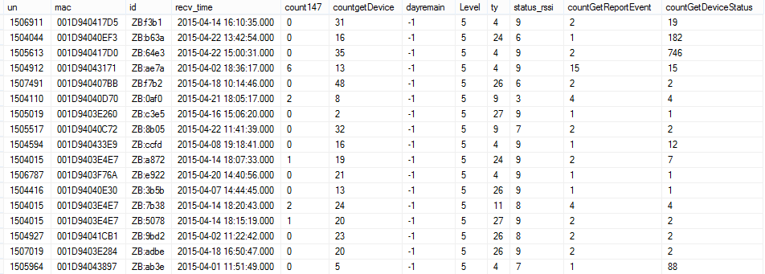
Phase I-G
Aggregate times of “getDevices”
Calculate ‘RowNumber’ in Phase I-B device records
Partition by “un, mac, id” Order by “recv_time”
The ‘RowNumber’ represents accumulated “getDevices” times for each record

Slide 14
Phase II :
Machine Learning Modeling

Slide 15
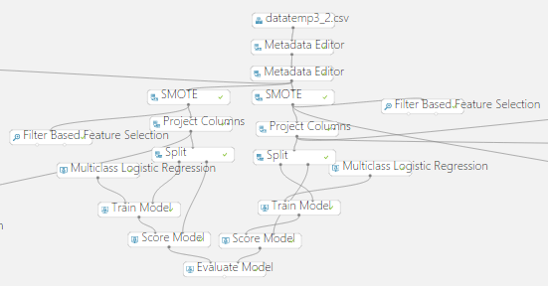
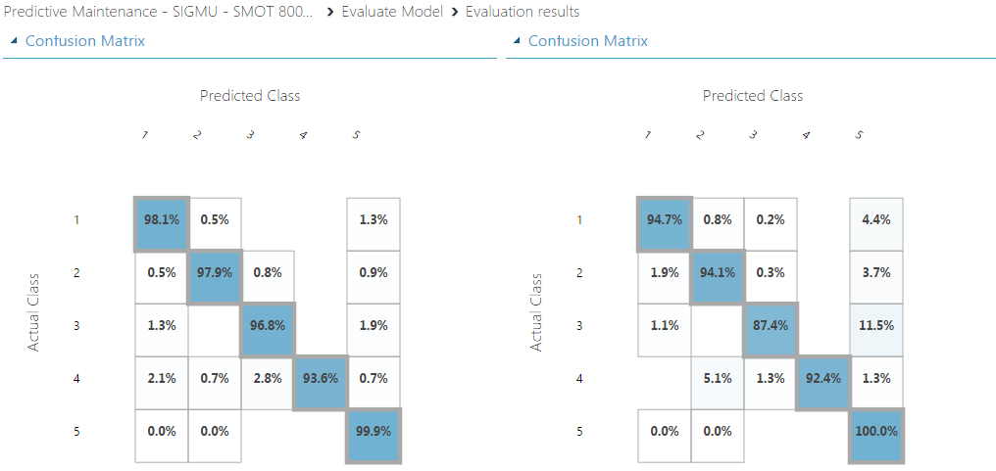
Phase II : Machine Learning Modeling

