Slide 1
Chapters 10&11: Cluster Analysis
What is Cluster Analysis?
Types of Data in Cluster Analysis
A Categorization of Major Clustering Methods
Partitioning Methods
Hierarchical Methods
Density-Based Methods
Grid-Based Methods
Model-Based Methods
Clustering High-Dimensional Data
Constraint-Based Clustering
Outlier Analysis
Summary

Slide 2
What is Cluster Analysis?
Cluster: a collection of data objects
  Similar to one another within the same cluster
  Dissimilar to the objects in other clusters
Cluster analysis
  Finding similarities between data according to the characteristics found in the data and grouping similar data objects into clusters
Unsupervised learning: no predefined classes
Typical applications
  As a stand-alone tool to get insight into data distribution
  As a preprocessing step for other algorithms

Slide 3
Clustering: Rich Applications and Multidisciplinary Efforts
Pattern Recognition
Spatial Data Analysis
  Create thematic maps in GIS by clustering feature spaces
  Detect spatial clusters or for other spatial mining tasks
Image Processing
Economic Science (especially market research)
WWW
  Document classification
  Cluster Weblog data to discover groups of similar access patterns

Slide 4
Examples of Clustering Applications
Marketing: Help marketers discover distinct groups in their customer bases, and then use this knowledge to develop targeted marketing programs
Land use: Identification of areas of similar land use in an earth observation database
Insurance: Identifying groups of motor insurance policy holders with a high average claim cost
City-planning: Identifying groups of houses according to their house type, value, and geographical location
Earth-quake studies: Observed earth quake epicenters should be clustered along continent faults

Slide 5
Quality: What Is Good Clustering?
A good clustering method will produce high quality clusters with
  high intra-class similarity
  low inter-class similarity
The quality of a clustering result depends on both the similarity measure used by the method and its implementation
The quality of a clustering method is also measured by its ability to discover some or all of the hidden patterns

Slide 6
Measure the Quality of Clustering
Dissimilarity/Similarity metric: Similarity is expressed in terms of a distance function, typically metric: d(i, j)
There is a separate “quality” function that measures the “goodness” of a cluster.
The definitions of distance functions are usually very different for interval-scaled, boolean, categorical, ordinal ratio, and vector variables.
Weights should be associated with different variables based on applications and data semantics.
It is hard to define “similar enough” or “good enough”
  the answer is typically highly subjective.

Slide 7
Requirements of Clustering in Data Mining
Scalability
Ability to deal with different types of attributes
Ability to handle dynamic data
Discovery of clusters with arbitrary shape
Minimal requirements for domain knowledge to determine input parameters
Able to deal with noises and outliers
Insensitive to order of input records
High dimensionality
Incorporation of user-specified constraints
Interpretability and usability

Slide 8
Chapters 10&11: Cluster Analysis
What is Cluster Analysis?
Types of Data in Cluster Analysis
A Categorization of Major Clustering Methods
Partitioning Methods
Hierarchical Methods
Density-Based Methods
Grid-Based Methods
Model-Based Methods
Clustering High-Dimensional Data
Constraint-Based Clustering
Outlier Analysis
Summary

Slide 9
Data Structures
Data matrix
  (two modes)
Dissimilarity matrix
  (one mode)

Slide 10
Type of data in clustering analysis
Interval-scaled variables
Binary variables
Nominal, ordinal, and ratio variables
Variables of mixed types

Slide 11
Interval-valued variables
Standardize data
  Calculate the mean absolute deviation:
  where
  Calculate the standardized measurement (z-score)
Using mean absolute deviation is more robust than using standard deviation

Slide 12
Similarity and Dissimilarity Between Objects
Distances are normally used to measure the similarity or dissimilarity between two data objects
Some popular ones include: Minkowski distance:
  where i = (x_{i1}, x_{i2}, …, x_{ip}) and j = (x_{j1}, x_{j2}, …, x_{jp}) are two p-dimensional data objects, and q is a positive integer
If q = 1, d is Manhattan distance
If q = infinity, d(i,j) = max{xi1-xj1} = max {直的虛線, 橫的虛線}
虛線距離轉彎q=1
Manhattan distance
實線距離q=2
Notes:
直線距離 d when q =1 > d when q =2 > d when q = infinity
周圍距離

Slide 13
Similarity and Dissimilarity Between Objects (Cont.)
If q = 2, d is Euclidean distance:
  Properties
    d(i,j) ≥ 0
    d(i,i) = 0
    d(i,j) = d(j,i)
    d(i,j) ≤ d(i,k) + d(k,j)
Also, one can use weighted distance, parametric Pearson product moment correlation, or other disimilarity measures

Slide 14
周遭距離＝圓
If q = 1, d = 符合的點 = 正方形

Slide 15
Binary Variables
Object j
A contingency table for binary data
Distance measure for symmetric binary variables:
Distance measure for asymmetric binary variables:
Jaccard coefficient (similarity measure for asymmetric binary variables):
Object i

Slide 16
Dissimilarity between Binary Variables
Example
  gender is a symmetric attribute
  the remaining attributes are asymmetric binary
  let the values Y and P be set to 1, and the value N be set to 0

Slide 17
Nominal Variables
A generalization of the binary variable in that it can take more than 2 states, e.g., red, yellow, blue, green
Method 1: Simple matching
  m: # of matches, p: total # of variables
Method 2: use a large number of binary variables
  creating a new binary variable for each of the M nominal states

Slide 18
Ordinal Variables
An ordinal variable can be discrete or continuous
Order is important, e.g., rank
Can be treated like interval-scaled
  replace x_{if} by their rank
  map the range of each variable onto [0, 1] by replacing i-th object in the f-th variable by
  compute the dissimilarity using methods for interval-scaled variables

Slide 19
Ratio-Scaled Variables
Ratio-scaled variable: a positive measurement on a nonlinear scale, approximately at exponential scale, such as Ae^{Bt} or Ae^{-Bt}
Methods:
  treat them like interval-scaled variables—not a good choice! (why?—the scale can be distorted)
  apply logarithmic transformation
y_{if} = log(x_{if})
  treat them as continuous ordinal data treat their rank as interval-scaled

Slide 20
Variables of Mixed Types
A database may contain all the six types of variables
  symmetric binary, asymmetric binary, nominal, ordinal, interval and ratio
One may use a weighted formula to combine their effects
  f is binary or nominal:
    d_{ij}^{(f)} = 0 if x_{if} = x_{jf} , or d_{ij}^{(f)} = 1 otherwise
  f is interval-based: use the normalized distance
  f is ordinal or ratio-scaled
    compute ranks r_{if} and
    and treat z_{if} as interval-scaled

Slide 21
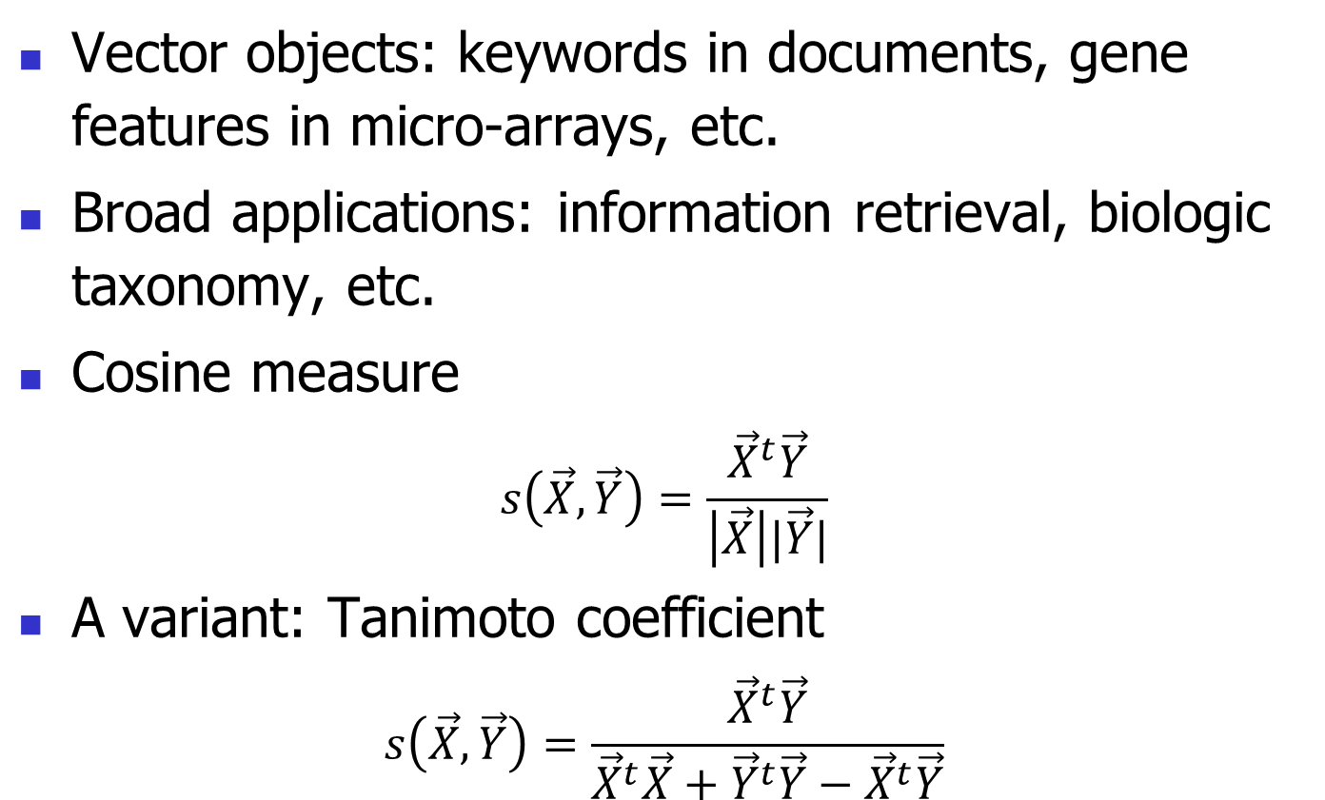
Vector Objects
Vector objects: keywords in documents, gene features in micro-arrays, etc.
Broad applications: information retrieval, biologic taxonomy, etc.
Cosine measure
$$s\left(\vec{X},\vec{Y}\right)=\frac{{\vec{X}}^{t}\vec{Y}}{\left|\vec{X}\right||\vec{Y}|}$$
A variant: Tanimoto coefficient
$$s\left(\vec{X},\vec{Y}\right)=\frac{{\vec{X}}^{t}\vec{Y}}{{\vec{X}}^{t}\vec{X}+{\vec{Y}}^{t}\vec{Y}−{\vec{X}}^{t}\vec{Y}}$$

Slide 22
Typical Alternatives to Calculate the Distance between Clusters
Single link: smallest distance between an element in one cluster and an element in the other, i.e., dis(K_{i}, K_{j}) = min(t_{ip}, t_{jq})
Complete link: largest distance between an element in one cluster and an element in the other, i.e., dis(K_{i}, K_{j}) = max(t_{ip}, t_{jq})
Average: avg distance between an element in one cluster and an element in the other, i.e., dis(K_{i}, K_{j}) = avg(t_{ip}, t_{jq})
Centroid: distance between the centroids of two clusters, i.e., dis(K_{i}, K_{j}) = dis(C_{i}, C_{j})
Medoid: distance between the medoids of two clusters, i.e., dis(K_{i}, K_{j}) = dis(M_{i}, M_{j})
  Medoid: one chosen, centrally located object in the cluster

Slide 23
Chapters 10&11: Cluster Analysis
What is Cluster Analysis?
Types of Data in Cluster Analysis
A Categorization of Major Clustering Methods
Partitioning Methods
Hierarchical Methods
Density-Based Methods
Grid-Based Methods
Model-Based Methods
Clustering High-Dimensional Data
Constraint-Based Clustering
Outlier Analysis
Summary

Slide 24
Major Clustering Approaches (I)
Partitioning approach:
  Construct various partitions and then evaluate them by some criterion, e.g., minimizing the sum of square errors
  Typical methods: k-means, k-medoids, CLARANS
Hierarchical approach:
  Create a hierarchical decomposition of the set of data (or objects) using some criterion
  Typical methods: Diana, Agnes, BIRCH, ROCK, CAMELEON
Density-based approach:
  Based on connectivity and density functions
  Typical methods: DBSACN, OPTICS, DenClue

Slide 25
Major Clustering Approaches (II)
Grid-based approach:
  based on a multiple-level granularity structure
  Typical methods: STING, WaveCluster, CLIQUE
Model-based:
  A model is hypothesized for each of the clusters and tries to find the best fit of that model to each other
  Typical methods: EM, SOM
Frequent pattern-based:
  Based on the analysis of frequent patterns
  Typical methods: pCluster
User-guided or constraint-based:
  Clustering by considering user-specified or application-specific constraints
  Typical methods: COD (obstacles), constrained clustering

Slide 26
Centroid, Radius and Diameter of a Cluster (for numerical data sets)
Centroid: the “middle” of a cluster
Radius: square root of average distance from any point of the cluster to its centroid
Diameter: square root of average mean squared distance between all pairs of points in the cluster

Slide 27
Chapters 10&11: Cluster Analysis
What is Cluster Analysis?
Types of Data in Cluster Analysis
A Categorization of Major Clustering Methods
Partitioning Methods
Hierarchical Methods
Density-Based Methods
Grid-Based Methods
Model-Based Methods
Clustering High-Dimensional Data
Constraint-Based Clustering
Outlier Analysis
Summary

Slide 28
Partitioning Algorithms: Basic Concept
Partitioning method: Construct a partition of a database D of n objects into a set of k clusters, s.t., min sum of squared distance
Given a k, find a partition of k clusters that optimizes the chosen partitioning criterion
  Global optimal: exhaustively enumerate all partitions
  Heuristic methods: k-means and k-medoids algorithms
  k-means (MacQueen’67): Each cluster is represented by the center of the cluster
  k-medoids or PAM (Partition around medoids) (Kaufman & Rousseeuw’87): Each cluster is represented by one of the objects in the cluster

Slide 29
The K-Means Clustering Method
Given k, the k-means algorithm is implemented in four steps:
  Partition objects into k nonempty subsets
  Compute seed points as the centroids of the clusters of the current partition (the centroid is the center, i.e., mean point, of the cluster)
  Assign each object to the cluster with the nearest seed point
  Go back to Step 2, stop when no more new assignment

Slide 30
The K-Means Clustering Method
Example
10
10
9
9
8
8
7
7
6
6
5
5
4
Assign each objects to most similar center
Update the cluster means
4
3
3
2
2
1
1
0
0
0
1
2
3
4
5
6
7
8
9
10
0
1
2
3
4
5
6
7
8
9
10
reassign
reassign
K=2
Arbitrarily choose K object as initial cluster center
Update the cluster means

Slide 31
Comments on the K-Means Method
Strength: Relatively efficient: O(tkn), where n is # objects, k is # clusters, and t is # iterations. Normally, k, t << n.
Comment: Often terminates at a local optimum. The global optimum may be found using techniques such as: deterministic annealing and genetic algorithms
Weakness
  Applicable only when mean is defined, then what about categorical data?
  Need to specify k, the number of clusters, in advance
  Unable to handle noisy data and outliers
  Not suitable to discover clusters with non-convex shapes

Slide 32
Variations of the K-Means Method
A few variants of the k-means which differ in
  Selection of the initial k means
  Dissimilarity calculations
  Strategies to calculate cluster means
Handling categorical data: k-modes (Huang’98)
  Replacing means of clusters with modes
  Using new dissimilarity measures to deal with categorical objects
  Using a frequency-based method to update modes of clusters
  A mixture of categorical and numerical data: k-prototype method

Slide 33
What Is the Problem of the K-Means Method?
The k-means algorithm is sensitive to outliers !
  Since an object with an extremely large value may substantially distort the distribution of the data.
K-Medoids: Instead of taking the mean value of the object in a cluster as a reference point, medoids can be used, which is the most centrally located object in a cluster.
10
10
9
9
8
8
7
7
6
6
5
5
4
4
3
3
2
2
1
1
0
0
1
2
3
4
5
6
7
8
9
10
0
0
1
2
3
4
5
6
7
8
9
10

Slide 34
The K-Medoids Clustering Method
Find representative objects, called medoids, in clusters
PAM (Partitioning Around Medoids, 1987)
  starts from an initial set of medoids and iteratively replaces one of the medoids by one of the non-medoids if it improves the total distance of the resulting clustering
  PAM works effectively for small data sets, but does not scale well for large data sets
CLARA (Kaufmann & Rousseeuw, 1990)
CLARANS (Ng & Han, 1994): Randomized sampling
Focusing + spatial data structure (Ester et al., 1995)

Slide 35
A Typical K-Medoids Algorithm (PAM)
Total Cost = 20
10
9
8
Arbitrary choose k object as initial medoids
Assign each remaining object to nearest medoids
7
6
5
4
3
2
1
0
0
1
2
3
4
5
6
7
8
9
10
K=2
Randomly select a nonmedoid object,O_{ramdom}
Total Cost = 26
Do loop
Until no change
10
10
9
Compute total cost of swapping
9
Swapping O and O_{ramdom}
If quality is improved.
8
8
7
7
6
6
5
5
4
4
3
3
2
2
1
1
0
0
1
2
3
4
5
6
7
8
9
10
0
0
1
2
3
4
5
6
7
8
9
10

Slide 36
Fuzzy C-Means Clustering
Input: Unlabeled data set U={x₁, x₂, …, x_{n}}
Output:
A c-partition of U
Additional output:
A set of vectors V={v₁, v₂, …, v_{c}}, where v_{i} is called a cluster center

Slide 37
Fuzzy C-Means Clustering (Cont.)
Optimization of an objective function
Constraint:
Distance: 離中心點的距離
Degree of fuzzification: m>1

Slide 38
Fuzzy C-Means Clustering (Cont.)
Compute memberships with respect to V
Compute centers with respect to U

Slide 39
Fuzzy C-Means Clustering (Cont.)
Initial Choices
  Number of clusters 1<c<n
  Maximum number of iterations (typ.: 100)
  Weighting exponent (fuzziness degree) m
    m=1: crisp
    m=2: Typical
  Termination measure
  Termination threshold (typ. 0.01) ε
Notes:
1-norm (X) = max(sum(abs(X))) (the largest column sum of X)

Slide 40
Fuzzy C-Means Clustering (Cont.)
Advantages
  Unsupervised
  Always converges
Disadvantages
  Long computational time
  Sensitivity to the initial guess (speed, local minima)
  Sensitivity to noise
    One expects low (or even no) membership degree for outliers (noisy points)

Slide 41
Chapters 10&11: Cluster Analysis
What is Cluster Analysis?
Types of Data in Cluster Analysis
A Categorization of Major Clustering Methods
Partitioning Methods
Hierarchical Methods
Density-Based Methods
Grid-Based Methods
Model-Based Methods
Clustering High-Dimensional Data
Constraint-Based Clustering
Outlier Analysis
Summary

Slide 42
Hierarchical Clustering
Use distance matrix as clustering criteria. This method does not require the number of clusters k as an input, but needs a termination condition 距離最接近的點併起來
複雜度Cn_2 , O(n^2)
Step 0
Step 1
Step 2
Step 3
Step 4
agglomerative
(AGNES)
a
a b
b
a b c d e
c
c d e
d
d e
e
divisive
(DIANA)
Step 4
Step 3
Step 2
Step 1
Step 0

Slide 43
AGNES (Agglomerative Nesting)
Introduced in Kaufmann and Rousseeuw (1990)
Implemented in statistical analysis packages, e.g., Splus
Use the single-link method and the dissimilarity matrix.
Merge nodes that have the least dissimilarity
Go on in a non-descending fashion
Eventually all nodes belong to the same cluster

Slide 44
Dendrogram: Shows How the Clusters are Merged
  Decompose data objects into a several levels of nested partitioning (tree of clusters), called a dendrogram.
  A clustering of the data objects is obtained by cutting the dendrogram at the desired level, then each connected component forms a cluster.

Slide 45
DIANA (Divisive Analysis)
Introduced in Kaufmann and Rousseeuw (1990)
Implemented in statistical analysis packages, e.g., Splus
Inverse order of AGNES
Eventually each node forms a cluster on its own

Slide 46
CHAMELEON: Hierarchical Clustering Using Dynamic Modeling (1999)
CHAMELEON: by G. Karypis, E.H. Han, and V. Kumar’99
Measures the similarity based on a dynamic model
  Two clusters are merged only if the interconnectivity and closeness (proximity) between two clusters are high relative to the internal interconnectivity of the clusters and closeness of items within the clusters
  Cure ignores information about interconnectivity of the objects, Rock ignores information about the closeness of two clusters
A two-phase algorithm
  Use a graph partitioning algorithm: cluster objects into a large number of relatively small sub-clusters
  Use an agglomerative hierarchical clustering algorithm: find the genuine clusters by repeatedly combining these sub-clusters

Slide 47
Overall Framework of CHAMELEON
Construct
Sparse Graph
Partition the Graph
Data Set
Merge Partition
Final Clusters

Slide 48
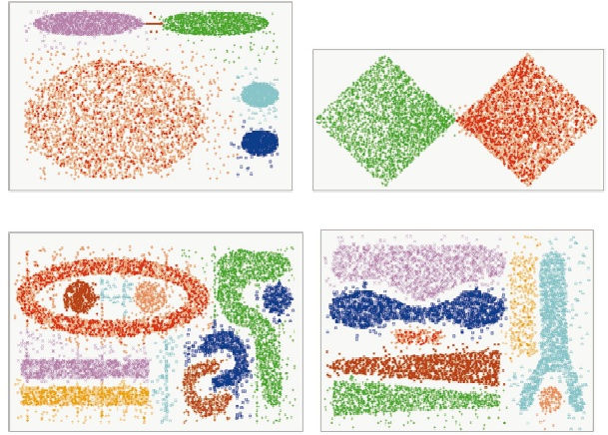
CHAMELEON (Clustering Complex Objects)

Slide 49
Chapters 10&11: Cluster Analysis
What is Cluster Analysis?
Types of Data in Cluster Analysis
A Categorization of Major Clustering Methods
Partitioning Methods
Hierarchical Methods
Density-Based Methods
Grid-Based Methods
Model-Based Methods
Clustering High-Dimensional Data
Constraint-Based Clustering
Outlier Analysis
Summary

Slide 50
Density-Based Clustering Methods
Clustering based on density (local cluster criterion), such as density-connected points
Major features:
  Discover clusters of arbitrary shape
  Handle noise
  One scan
  Need density parameters as termination condition
Several interesting studies:
  DBSCAN: Ester, et al. (KDD’96)
  OPTICS: Ankerst, et al (SIGMOD’99).
  DENCLUE: Hinneburg & D. Keim (KDD’98)
  CLIQUE: Agrawal, et al. (SIGMOD’98) (more grid-based)

Slide 51
Density-Based Clustering: Basic Concepts
Two parameters:
  Eps: Maximum radius of the neighbourhood
  MinPts: Minimum number of points in an Eps-neighbourhood of that point
N_{Eps}(p): {q belongs to D | dist(p,q) <= Eps}
Directly圓內density-reachable: A point p is directly density-reachable from a point q w.r.t. Eps, MinPts if
  p belongs to N_{Eps}(q)
  core point condition:
  |N_{Eps} (q)| >= MinPts
p
MinPts = 5
Eps = 1 cm
q

Slide 52
Density-Reachable and Density-Connected
Density-reachable:
  A point p is density-reachable from a point q w.r.t. Eps, MinPts if there is a chain of points p₁, …, p_{n}, p₁ = q, p_{n} = p such that p_{i+1} is directly density-reachable from p_{i}
Density-connected
  A point p is density-connected to a point q w.r.t. Eps, MinPts if there is a point o such that both, p and q are density-reachable from o w.r.t. Eps and MinPts
p
p₁
q
p
q
o

Slide 53
DBSCAN: Density Based Spatial Clustering of Applications with Noise
Relies on a density-based notion of cluster: A cluster is defined as a maximal set of density-connected points
Discovers clusters of arbitrary shape in spatial databases with noise
Outlier
Border
Eps = 1cm
MinPts = 5
Core

Slide 54
DBSCAN: The Algorithm
Arbitrary select a point p
Retrieve all points density-reachable from p w.r.t. Eps and MinPts.
If p is a core point, a cluster is formed.
If p is a border point, no points are density-reachable from p and DBSCAN visits the next point of the database.
Continue the process until all of the points have been processed.

Slide 55
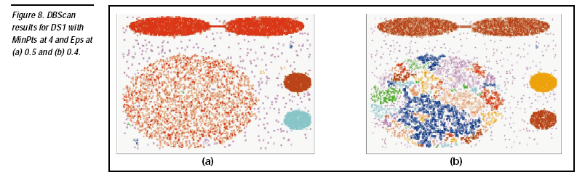

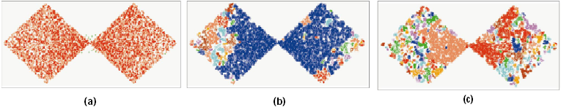
DBSCAN: Sensitive to Parameters

Slide 56
Chapters 10&11: Cluster Analysis
What is Cluster Analysis?
Types of Data in Cluster Analysis
A Categorization of Major Clustering Methods
Partitioning Methods
Hierarchical Methods
Density-Based Methods
Grid-Based Methods
Model-Based Methods
Clustering High-Dimensional Data
Constraint-Based Clustering
Outlier Analysis
Summary

Slide 57
Grid-Based Clustering Method
Using multi-resolution grid data structure
Several interesting methods
  STING (a STatistical INformation Grid approach) by Wang, Yang and Muntz (1997)
  WaveCluster by Sheikholeslami, Chatterjee, and Zhang (VLDB’98)
    A multi-resolution clustering approach using wavelet method (dimension 越低 越粗 細節不清)
  CLIQUE: Agrawal, et al. (SIGMOD’98)
    On high-dimensional data (thus put in the section of clustering high-dimensional data

Slide 58
WaveCluster: Clustering by Wavelet Analysis (1998)
Sheikholeslami, Chatterjee, and Zhang (VLDB’98)
A multi-resolution clustering approach which applies wavelet transform to the feature space
How to apply wavelet transform to find clusters
  Summarizes the data by imposing a multidimensional grid structure onto data space
  These multidimensional spatial data objects are represented in a n-dimensional feature space
  Apply wavelet transform on feature space to find the dense regions in the feature space
  Apply wavelet transform multiple times which result in clusters at different scales from fine to coarse

Slide 59
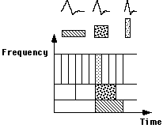
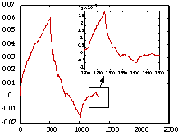
Wavelet Transform
Wavelet transform: A signal processing technique that decomposes a signal into different frequency sub-band (can be applied to n-dimensional signals)
Data are transformed to preserve relative distance between objects at different levels of resolution
Allows natural clusters to become more distinguishable

Slide 60
The WaveCluster Algorithm
Input parameters
  # of grid cells for each dimension
  the wavelet, and the # of applications of wavelet transform
Why is wavelet transformation useful for clustering?
  Use hat-shape filters to emphasize region where points cluster, but simultaneously suppress weaker information in their boundary
  Effective removal of outliers, multi-resolution, cost effective
Major features:
  Complexity O(N)
  Detect arbitrary shaped clusters at different scales
  Not sensitive to noise, not sensitive to input order
  Only applicable to low dimensional data
Both grid-based and density-based

Slide 61
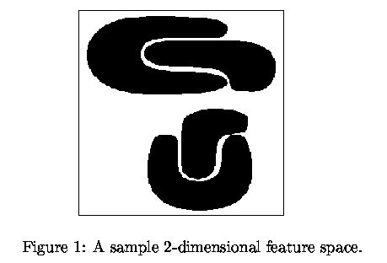
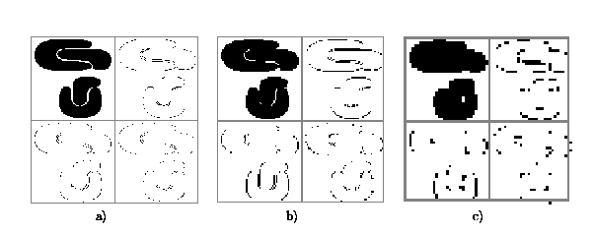
Quantization
& Transformation
First, quantize data into m-D grid structure, then wavelet transform
  a) scale 1: high resolution
  b) scale 2: medium resolution
  c) scale 3: low resolution

Slide 62
Chapters 10&11: Cluster Analysis
What is Cluster Analysis?
Types of Data in Cluster Analysis
A Categorization of Major Clustering Methods
Partitioning Methods
Hierarchical Methods
Density-Based Methods
Grid-Based Methods
Model-Based Methods
Clustering High-Dimensional Data
Constraint-Based Clustering
Outlier Analysis
Summary

Slide 63
Model-Based Clustering
What is model-based clustering?
  Attempt to optimize the fit between the given data and some mathematical model
  Based on the assumption: Data are generated by a mixture of underlying probability distribution
Typical methods
  Statistical approach
    EM (Expectation Maximization)
    LDA (Latent Dirichlet Allocation)
  Neural network approach
    SOM (Self-Organizing Map)

Slide 64
EM — Expectation Maximization
EM — A popular iterative refinement algorithm
An extension to k-means
  Assign each object to a cluster according to a weight (prob. distribution)
  New means are computed based on weighted measures
General idea
  Starts with an initial estimate of the parameter vector
  Iteratively rescores the patterns against the mixture density produced by the parameter vector
  The rescored patterns are used to update the parameters
  Patterns belonging to the same cluster, if they are placed by their scores in a particular component
Algorithm converges fast but may not be in global optima

Slide 65
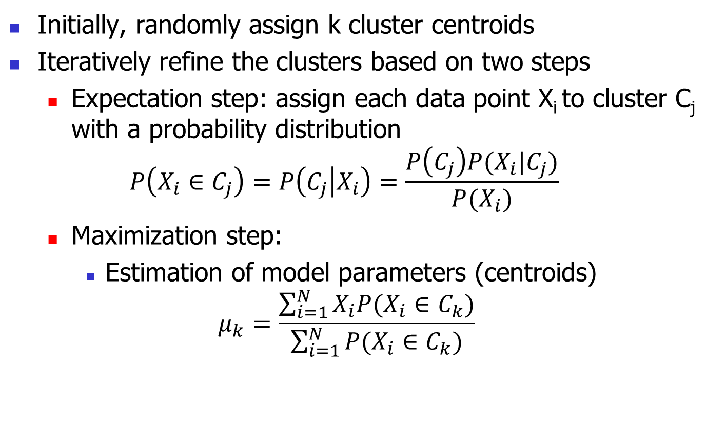
The EM (Expectation Maximization) Algorithm
Initially, randomly assign k cluster centroids
Iteratively refine the clusters based on two steps
  Expectation step: assign each data point X_{i} to cluster C_{j} with a probability distribution
  $$P\left(X_{i}∈C_{j}\right)=P\left(C_{j} | X_{i}\right)=\frac{P\left(C_{j}\right)P(X_{i}|C_{j})}{P(X_{i})}$$
  Maximization step:
    Estimation of model parameters (centroids)
  $$μ_{k}=\frac{\sum_{i=1}^{N}{X_{i}P(X_{i}∈C_{k})}}{\sum_{i=1}^{N}{P(X_{i}∈C_{k})}}$$

Slide 66
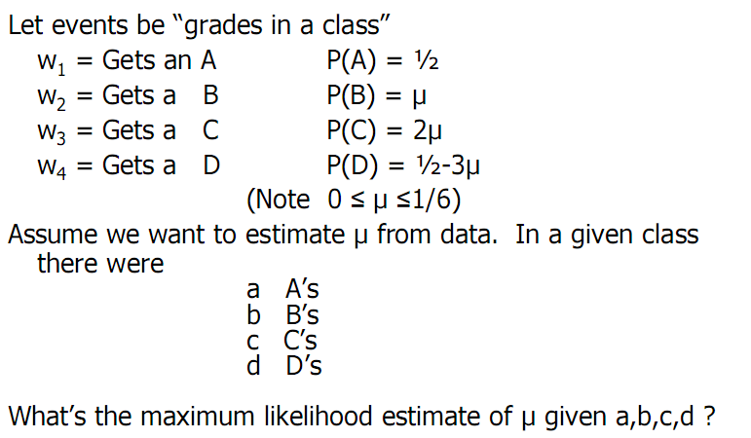
An example

Slide 67
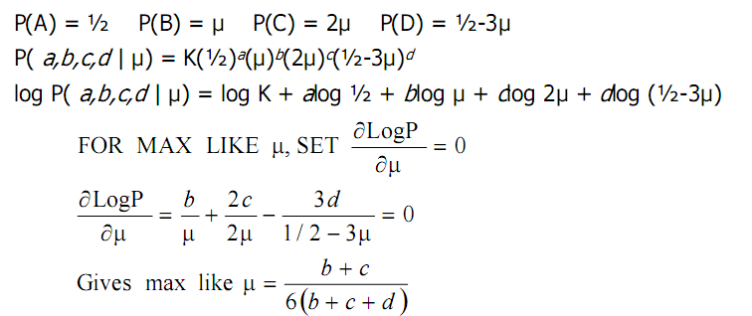
Maximize likelihood

Slide 68
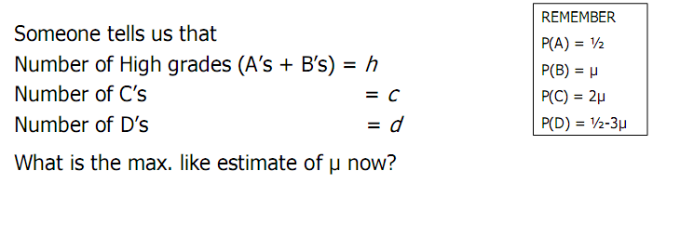
Same Problem with Hidden Information

Slide 69
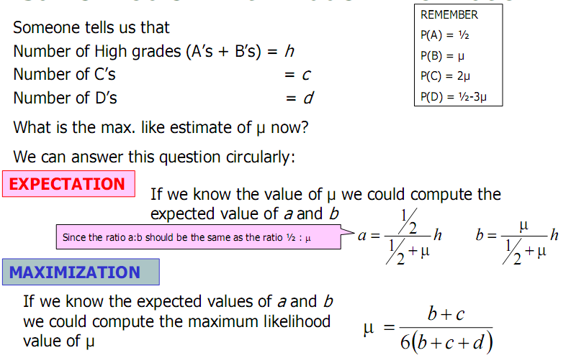
Same Problem with Hidden Information

Slide 70
Same Problem with Hidden Information

Slide 71
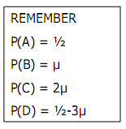
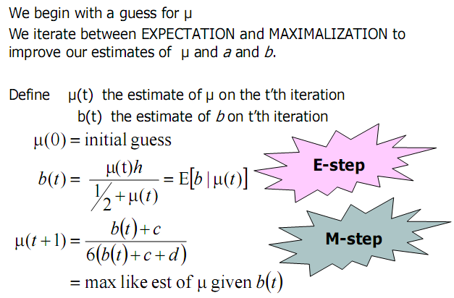
EM Steps

Slide 72
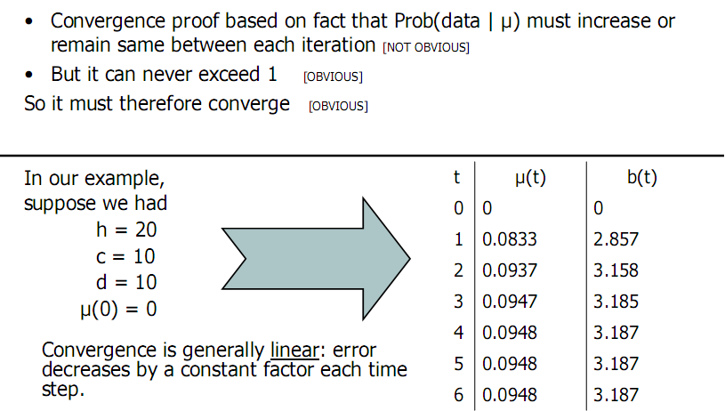
EM Convergence

Slide 73
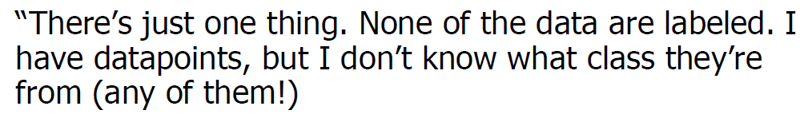
Gaussian Mixtures

Slide 74
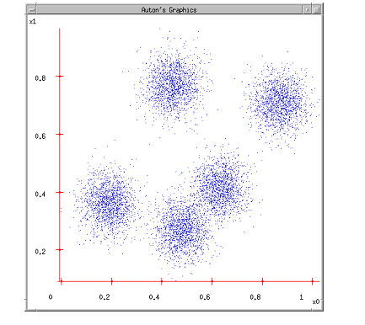

Gaussian Mixtures
Know
  Data
  -
  -
Don’t know
  Data label
Objective
  Estimate μ_{j}’s

Slide 75
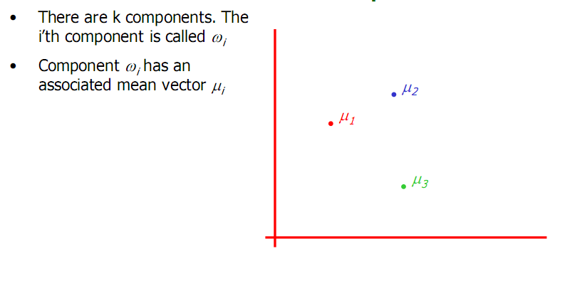
The GMM assumption

Slide 76
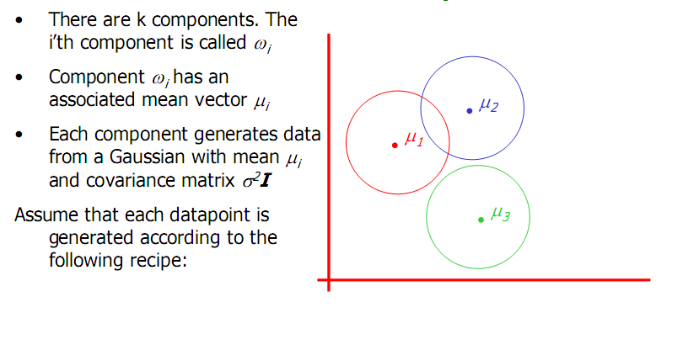
The GMM assumption

Slide 77
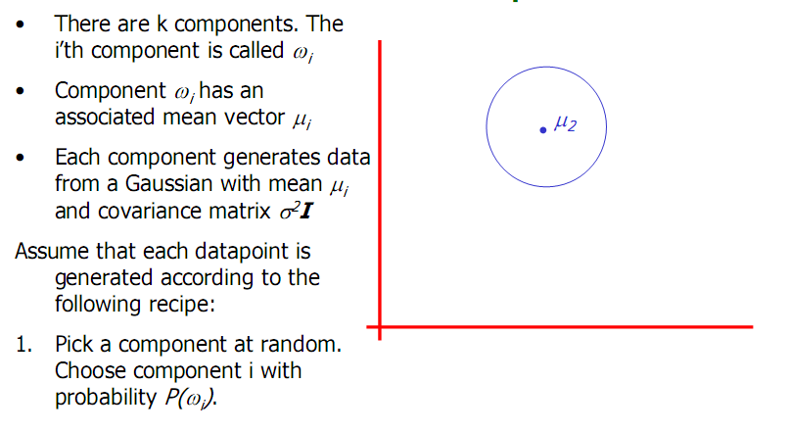
The GMM assumption

Slide 78
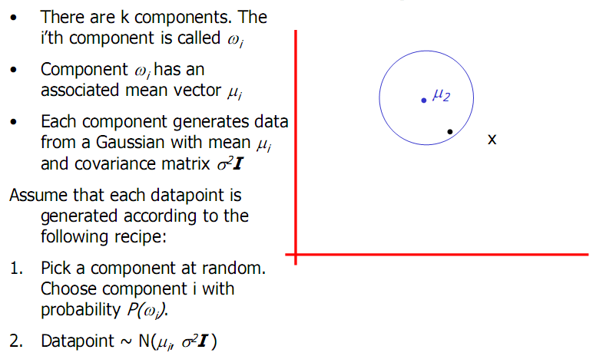
The GMM assumption

Slide 79
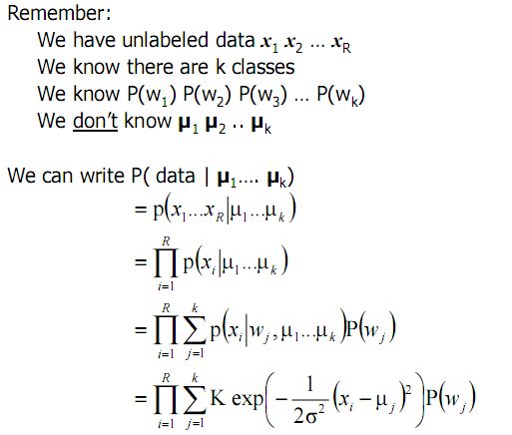
Computing the likelihood

Slide 80
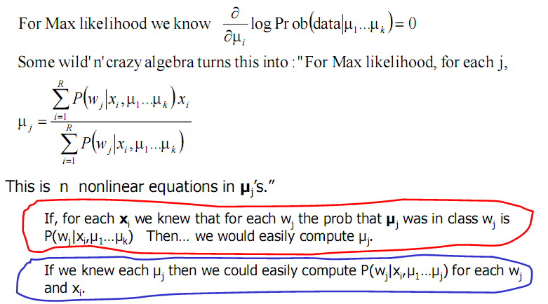
EM for GMMs

Slide 81
EM for GMMs

Slide 82
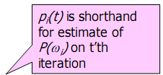
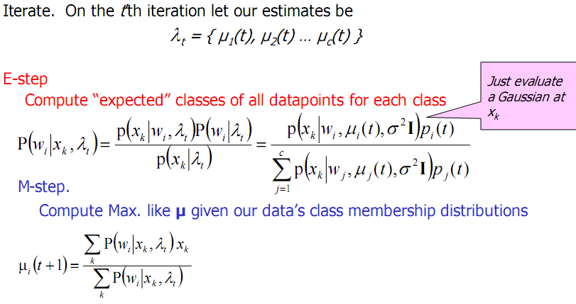
EM for GMMs

Slide 87
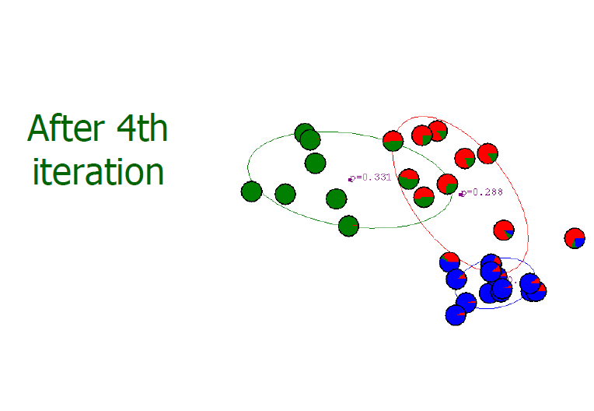

Slide 88
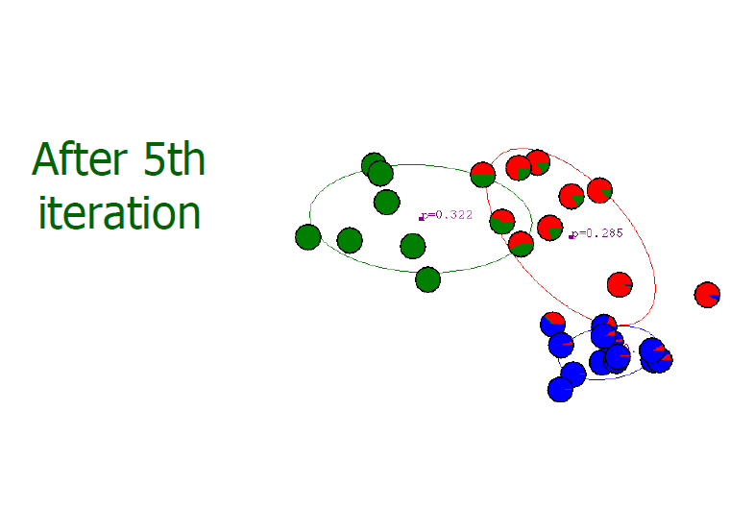

Slide 90
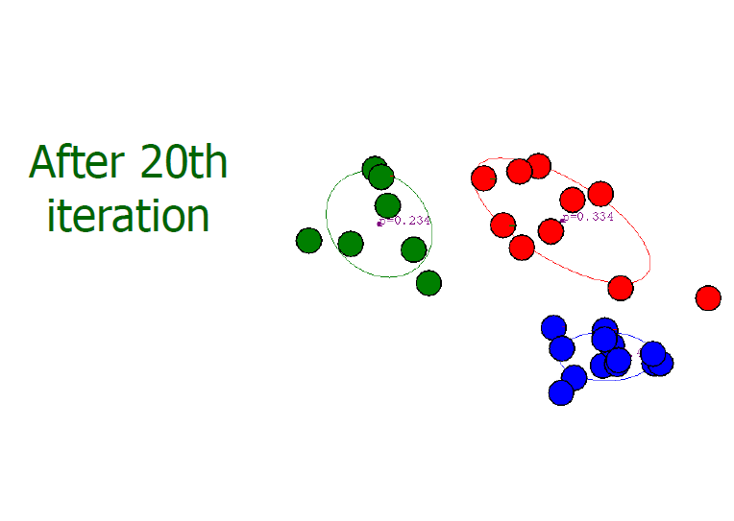

Slide 91
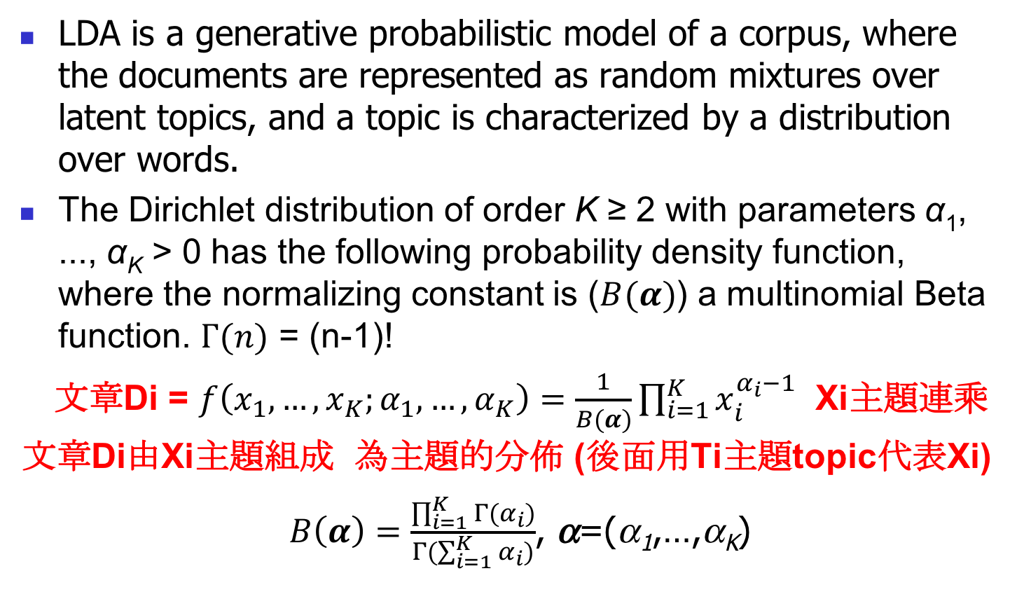
LDA (Latent Dirichlet Allocation) see MMF
LDA is a generative probabilistic model of a corpus, where the documents are represented as random mixtures over latent topics, and a topic is characterized by a distribution over words.
The Dirichlet distribution of order K ≥ 2 with parameters α₁, ..., α_{K} > 0 has the following probability density function, where the normalizing constant is ($B(α)$) a multinomial Beta function. $Γ(n)$ = (n-1)!
文章Di = $f\left(x_{1}, …,x_{K};α_{1},…,α_{K}\right)=\frac{1}{B(α)}\prod_{i=1}^{K}{x_{i}^{α_{i}−1}}$ Xi主題連乘
文章Di由Xi主題組成 為主題的分佈 (後面用Ti主題topic代表Xi)
$B\left(α\right)=\frac{\prod_{i=1}^{K}{Γ(α_{i})}}{Γ(\sum_{i=1}^{K}{α_{i}})}$, α=(α₁,…,α_{K})
Notes:
K topics, N words, M documents, V vocabularies
X1+x2+…+xk=1
Alpha I is called concentration parameters
Pólya's urn
Consider an urn containing balls of K different colors. Initially, the urn contains α₁ balls of color 1, α₂ balls of color 2, and so on. Now perform N draws from the urn, where after each draw, the ball is placed back into the urn with an additional ball of the same color. In the limit as N approaches infinity, the proportions of different colored balls in the urn will be distributed as Dir(α₁,...,α_{K}).

Slide 92
LDA (Cont.)
LDA defines topics on a word level
Documents
  D1: I eat fish and vegetables
  D2: Fish are pets
  D3: My kitten eats fish
LDA may cluster the red words into topic F which might label as “food”, the blue words into topic P which might label as “pet”.

Slide 93
LDA (Cont.)
Infer the topic proportions of each document
  D1 (100% topic F)
  D2 (100% topic P)
  D3 (67% topic F and 33% topic P)
Derive the proportions that each word constitutes in given topics
文件可以是主題的組成分部 (Dirichlet distribution)
主題又可以是文字的組成分部 (Dirichlet distribution)
哪些文字屬於哪些主題是由 LDA 隨機開始之後調整 assign
  Topic F: 40% eat, 40% fish, 20% vegetable
  Topic P: 33% fish, 33% pet, 33% kitten

Slide 94
LDA (Cont.)
In general, it is intractable to compute the posterior topic and word distributions.
Use collapsed Gibbs sampling algorithm to approximate the distributions
The topic assignment is updated based on the following criteria
文章D對主題T＆主題T對文字W都是Dirichlet distribution
W row * T col
T row * D col
  How prevalent is the word across topics?
    字出現在主題的頻率越高 越容易被assign到這主題
  How prevalent are the topics in the document?
    主題出現在文章的頻率越高 越容易被assign到這主題
Notes:
τηετα (τοπιχ διστριβυτιον) and fi(word distribution) will be integrated out by using the derivation of the equations for collapsed Gibbs sampling

Slide 95
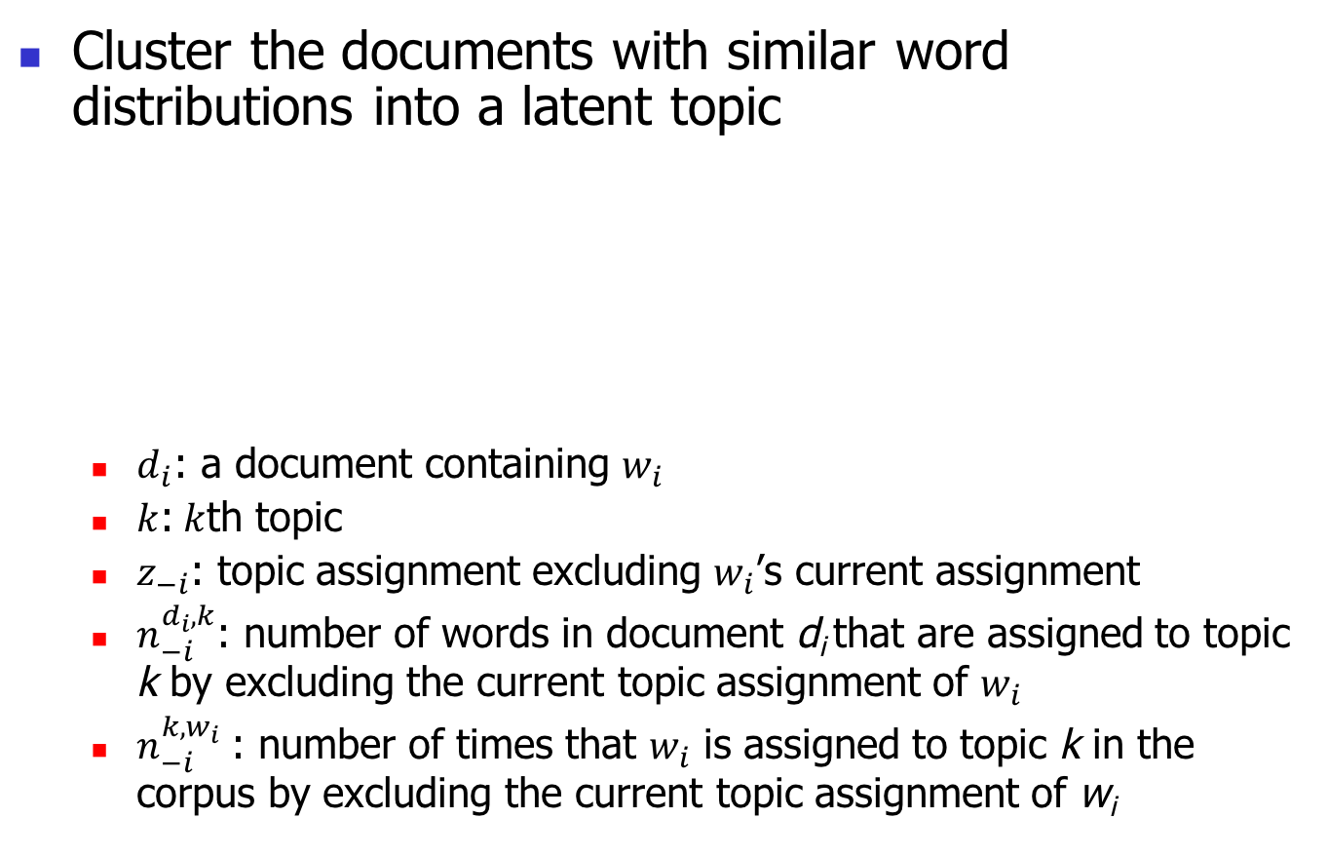
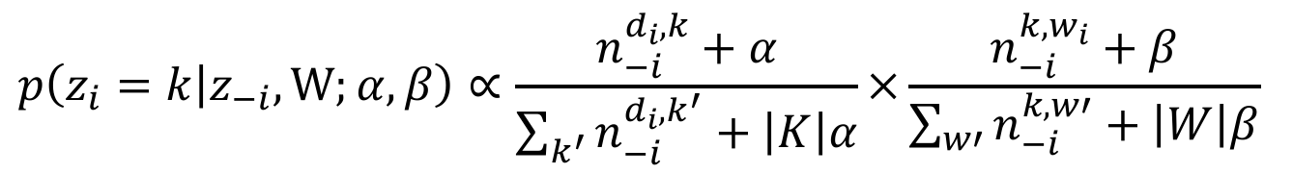
Topic clustering
Cluster the documents with similar word distributions into a latent topic
  $d_{i}$: a document containing $w_{i}$
  $k$:$k$th topic
  $z_{−i}$: topic assignment excluding $w_{i}$’s current assignment
  $n_{−i}^{d_{i},k}$: number of words in document d_{i} that are assigned to topic k by excluding the current topic assignment of $w_{i}$
  $n_{−i}^{k,w_{i}}$: number of times that $w_{i}$ is assigned to topic k in the corpus by excluding the current topic assignment of w_{i}
$$p\left(z_{i}=k | z_{−i},W;α,β\right)∝\frac{n_{−i}^{d_{i},k}+α}{\sum_{k^{′}}{n_{−i}^{d_{i},k^{′}}}+\left|K\right|α}×\frac{n_{−i}^{k,w_{i}}+β}{\sum_{w′}{n_{−i}^{k,w′}}+\left|W\right|β}$$
Notes:
D對k分配 k對w分配
將有類似的game term分布的thread cluster在一起
在原本的LDA字分配公式後加權重
P(z|T1) = (2+1)/(2+0+0+0+0+5*1) * ((10-1)+1) / (9+5+1+0+1+100*1) = 3/7 * 10/116
P(z|T1):P(z|T2):P(z|T3):P(z|T1):P(z|T1)

Slide 96
Graphical notation for smoothed LDA
β
φ
K
α
θ
Z
W
N
M
α : Dirichlet prior on the per-document topic distribution
  β : Dirichlet prior on the per-topic word distribution
  θ_{i} : topic distribution for document i
  φ_{k}: word distribution for topic k
  z_{ij}: a topic for the jth word in document i
  w_{ij}: a specific word
Notes:
collapsed Gibbs sampling, wij is observed variable and the others are latent variables.

Slide 97
Check-ins of San Francisco
Topic 1: goldengatebridge golden gate area bridge recreation national goldengate san Francisco
Topic 2: pier39 fishermanswharf francisco san travel vacation nikon pier
Topic 3: alcatraz date prison september 2015 francisco san alcatrazisland vacation island
Topic 4: 2015 september chadmagiera sanfranciscocityhall cityhall 47thfloorloewsregencyhotel pride sfpride 2014 art
Topic 5: race women guerrero market men missiondistrict nikon marathon friends nikond90
Topic 6: embarcadero chinatown restaurant bayarea ferrybuilding street city rokaakor 2015 2014

Slide 98
Dirichlet distribution
A K-dimensional Dirichlet random variable θ has the following probability density

Slide 99
Inference
Compute the posterior distribution of the hidden variables given a document
Unfortunately, it is intractable in general. Rewrite Eq. (3)

Slide 100
Parameter estimation
EM
  (E Step) For each document, find the optimizing values of the parameters (γ, φ) with α, β fixed.
  (M Step) Maximize variational distribution w.r.t. α, β for the γ and φ values found in the E step.

Slide 101
LDA – generative process
Choose w_{i} ~ Poisson(ξ)
Choose θ ~ Dir(α)
For each word w_{i}
  Choose a topic z_{i} ~ Multinomial(θ)
  Choose a word w_{i} from p(w_{i}|z_{i},β), a multinomial probability conditioned on the topic z_{i}

Slide 102
A geometric interpretation
word simplex

Slide 103
A geometric interpretation
topic 1
topic simplex
word simplex
topic 2
topic 3

Slide 104
A geometric interpretation
topic 1
topic simplex
word simplex
topic 2
topic 3

Slide 105
A geometric interpretation
topic 1
topic simplex
word simplex
topic 2
topic 3

Slide 106
Competitive Learning (SOM)
The Kohonen Map (Self-Organizing Map) was developed in 1981.
It uses the winner-take-all algorithm
It leads to a form of unsupervised learning known as competitive learning
Only one neuron provides the output of the network in response to a given input
The purpose is to cluster input data into a number of clusters.
It has only two layers
  Input layer
  Cluster layer

Slide 107
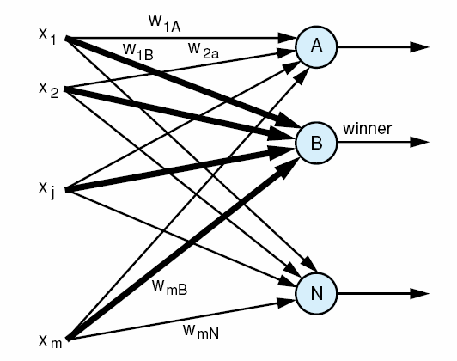
A layer of nodes for application of a winner-take-all algorithm.
17

Slide 108
Kohonen Map Algorithm
Initially all weights are set to to small random values.
The learning rate is also set usually to a small positive value
An input vector is presented to the input layer of the map
This layer feeds the input data to the cluster layer
The neuron in the cluster layer that most closely matches the input data is declared the winner
This neuron provides the output classification of the map and also has its weights updated

Slide 109
Kohonen Map Algorithm (Cont.)

Slide 110
Kohonen Algorithm
Kohonen learning is unsupervised
It is also know as a self-organizing network
Can use the Euclidean distance formula to compute the winner neuron

Slide 111
SOM algorithm: competition
Nodes should calculate similarity of input data to their parameters.
Input vector X is compared to node parameters W.
Similar = minimal distance or maximal scalar product.
Competition: find node j=c with W most similar to X.
Node number c is most similar to the input vector X
It is a winner, and it will learn to be more similar to X, hence this is a “competitive learning” procedure.
Brain: those neurons that react to some signals pick it up and learn.

Slide 112
SOM algorithm: cooperation
Cooperation: nodes on a grid close to the winner c should behave similarly. Define the “neighborhood function” O(c):
t – iteration number (or time);
r_{c} – position of the winning node c (in physical space, usually 2D).
||r-r_{c}|| – distance from the winning node, scaled by σ_{c}(t).
h₀(t) – slowly decreasing multiplicative factor
The neighborhood function determines how strongly the parameters of the winning node and nodes in its neighborhood will be changed, making them more similar to data X

Slide 113
SOM algorithm: dynamics
Adaptation rule: take the winner node c, and those in its neighborhood O(r_{c}), change their parameters making them more similar to the data X
Select randomly new sample vector X, and repeat.
Decrease h₀(t) slowly until there will be no changes.
Result:
W^{(i)} point to the center of local clusters in the X feature space
Nodes in the neighborhood point to adjacent areas in X space

Slide 114
SOM algorithm
X^{T}=(X₁, X₂ .. X_{d}), samples from feature space.
Create a grid with nodes i = 1 .. K in 1D, 2D or 3D,
each node with d-dimensional vector W^{(i)T} = (W₁^{(i)} W₂^{(i)} .. W_{d}^{(i)}),
W^{(i)} = W^{(i)}(t), changing with t – discrete time.
Initialize: random small W^{(i)}(0) for all i=1...K.
Define parameters of neighborhood function h(|r_{i}−r_{c}|/σ(t),t)
Iterate: select randomly input vector X
Calculate distances d(X,W^{(i)}), find the winner node W^{(c)} most similar (closest to) X
Update weights of all neurons in the neighborhood O(r_{c})
Decrease the influence h₀(t) and shrink neighborhood σ(t).
If in the last T steps all W^{(i)} changed less than ε stop.

Slide 115
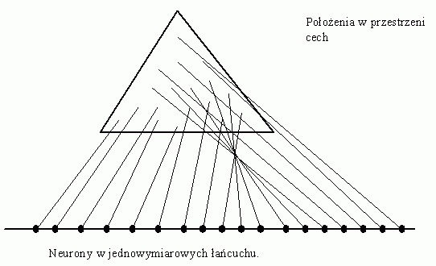
1D network, 2D data
Position in the feature space
Processors in 1D array

Slide 116
2D network, 3D data
o
'
'
'
feature space
o=data
oo
'
'
'
'
'
'
' = network W^{(i)}
parameters
''
'
'
'
o
o
'
'
'
'
'
o
o
'
'
'
'o
'
o'
x
y
z
input neurons
W assigned to
processors
2-D grid with
processors

Slide 117
Training process
Java demos: http://www.neuroinformatik.ruhr-uni-bochum.de/ini/VDM/research/gsn/DemoGNG/GNG.html

Slide 118
Semantic maps
How to capture the meaning of words, semantic relations?
16 animals: pigeon, chicken, duck, goose, owl, hawk, eagle,
fox, dog, wolf, cat, tiger, lion, horse, zebra, cow.
Use 13 binary features: small, medium, large, has 2 legs, 4
legs, hair, hoofs, mane, feathers, hunts, runs, flies, swims.
Form 76 sentences that describe 16 animals using 13 features.
Horse runs, horse has 4 legs, horse is big, ..., eagle fly, fox
hunt, ...
Assign a vector of properties to each animal:
V^{(horse)}= [small=0,medium=0,large=1,has 2 legs=0, 4 legs=1, ... ]
= [0,0,1,0,1,1,1,1,0,0,1,0,0]
Map these 13D vectors in 2D

Slide 119
Semantic maps: MDS & SOM

Slide 120
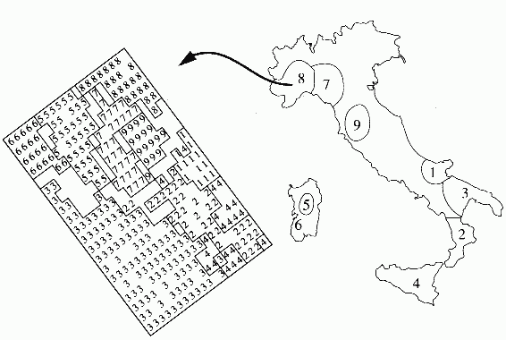
Italian olive oil (example)
572 samples of olive oil were collected from 9 Italian provinces.
Content of 8 fats were
was determine for each oil.
SOM 20 x 20 network,
Map 8D => 2D.
Classification accuracy was around 95-97%.
Note that topographical relations are preserve, region 3 is most diverse.

Slide 121
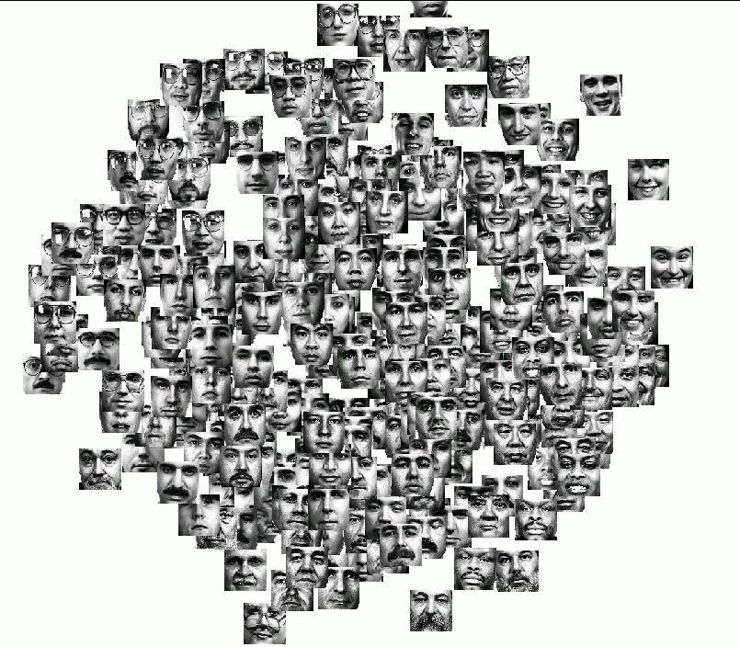
Similarity of faces
300 faces, similarity matrix evaluated and Sammon mapping applied (from Klock & Buhmann 1997).

Slide 122
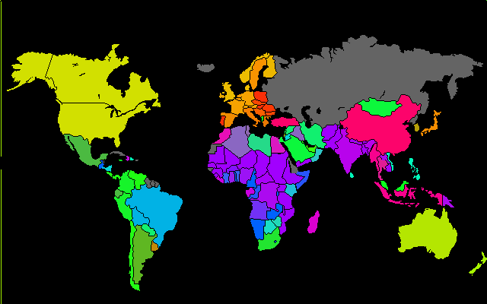
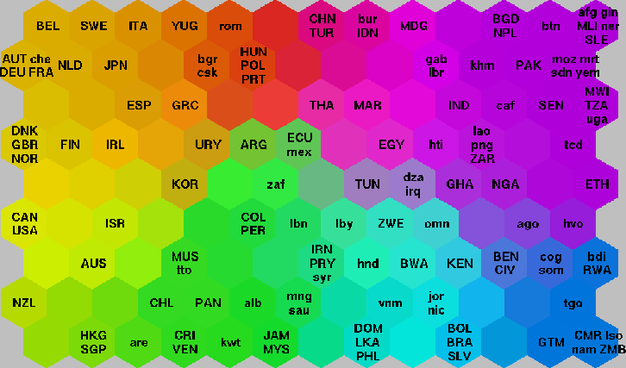
Quality of life data
WorldBank data 1992, 39 quality of life indicators. SOM map and the same colors on the world map. More examples of business applications from http://www.eudaptics.com/

Slide 123
Chapters 10&11: Cluster Analysis
What is Cluster Analysis?
Types of Data in Cluster Analysis
A Categorization of Major Clustering Methods
Partitioning Methods
Hierarchical Methods
Density-Based Methods
Grid-Based Methods
Model-Based Methods
Clustering High-Dimensional Data
Constraint-Based Clustering
Outlier Analysis
Summary

Slide 124
Clustering High-Dimensional Data
Clustering high-dimensional data
  Many applications: text documents, DNA micro-array data
  Major challenges:
    Many irrelevant dimensions may mask clusters
    Distance measure becomes meaningless—due to equi-distance
    Clusters may exist only in some subspaces
Methods
  Feature transformation: only effective if most dimensions are relevant
    PCA & SVD useful only when features are highly correlated/redundant
  Feature selection: wrapper or filter approaches
    useful to find a subspace where the data have nice clusters
  Subspace-clustering: find clusters in all the possible subspaces
    CLIQUE, ProClus, and frequent pattern-based clustering

Slide 125
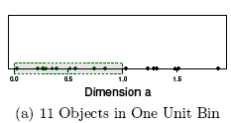
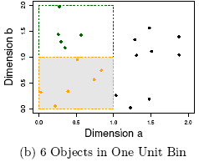
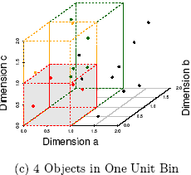
The Curse of Dimensionality
Data in only one dimension is relatively packed
Adding a dimension “stretch” the points across that dimension, making them further apart
Adding more dimensions will make the points further apart—high dimensional data is extremely sparse
Distance measure becomes meaningless—due to equi-distance

Slide 126
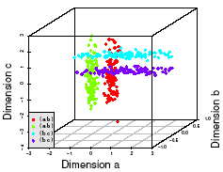
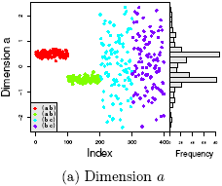
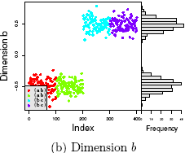
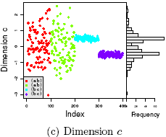
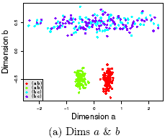
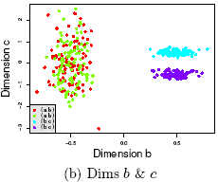
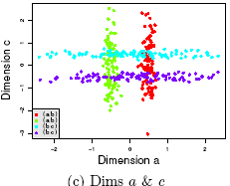
Why Subspace Clustering?
Clusters may exist only in some subspaces
Subspace-clustering: find clusters in all the subspaces

Slide 127
Frequent Pattern-Based Approach
Clustering high-dimensional space (e.g., clustering text documents, microarray data)
  Projected subspace-clustering: which dimensions to be projected on?
    CLIQUE, ProClus
  Feature extraction: costly and may not be effective?
  Using frequent patterns as “features”
    “Frequent” are inherent features
    Mining freq. patterns may not be so expensive
Typical methods
  Frequent-term-based document clustering
  Clustering by pattern similarity in micro-array data (pClustering)

Slide 128
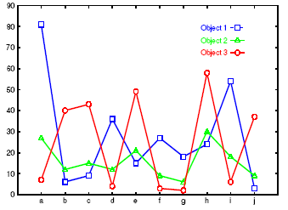
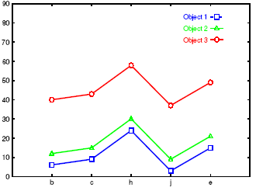

Clustering by Pattern Similarity (p-Clustering)
Right: The micro-array “raw” data shows 3 genes and their values in a multi-dimensional space
  Difficult to find their patterns
Bottom: Some subsets of dimensions form nice shift and scaling patterns

Slide 129

Why p-Clustering?
Microarray data analysis may need to
  Clustering on thousands of dimensions (attributes)
  Discovery of both shift and scaling patterns
Clustering with Euclidean distance measure? — cannot find shift patterns
Clustering on derived attribute A_{ij} = a_{i} – a_{j}? — introduces N(N-1) dimensions
Bi-cluster using transformed mean-squared residue score matrix (I, J)
  Where
  A submatrix is a δ-cluster if H(I, J) ≤ δ for some δ > 0
Problems with bi-cluster
  No downward closure property,
  Due to averaging, it may contain outliers but still within δ-threshold

Slide 130
p-Clustering: Clustering by Pattern Similarity
Given object x, y in O and features a, b in T, pCluster is a 2 by 2 matrix
A pair (O, T) is in δ-pCluster if for any 2 by 2 matrix X in (O, T), pScore(X) ≤ δ for some δ > 0
Properties of δ-pCluster
  Downward closure
  Clusters are more homogeneous than bi-cluster (thus the name: pair-wise Cluster)
Pattern-growth algorithm has been developed for efficient mining
For scaling patterns, one can observe, taking logarithmic on will lead to the pScore form

Slide 131
Chapters 10&11: Cluster Analysis
What is Cluster Analysis?
Types of Data in Cluster Analysis
A Categorization of Major Clustering Methods
Partitioning Methods
Hierarchical Methods
Density-Based Methods
Grid-Based Methods
Model-Based Methods
Clustering High-Dimensional Data
Constraint-Based Clustering
Outlier Analysis
Summary

Slide 132
What Is Outlier Discovery?
What are outliers?
  The set of objects are considerably dissimilar from the remainder of the data
  Example: Sports: Michael Jordon, Wayne Gretzky, ...
Problem: Define and find outliers in large data sets
Applications:
  Credit card fraud detection
  Telecom fraud detection
  Customer segmentation
  Medical analysis

Slide 133

Outlier Discovery: Statistical Approaches
Assume a model underlying distribution that generates data set (e.g. normal distribution)
Use discordancy tests depending on
  data distribution
  distribution parameter (e.g., mean, variance)
  number of expected outliers
Drawbacks
  most tests are for single attribute
  In many cases, data distribution may not be known

Slide 134
Outlier Discovery: Distance-Based Approach
Introduced to counter the main limitations imposed by statistical methods
  We need multi-dimensional analysis without knowing data distribution
Distance-based outlier: A DB(p, D)-outlier is an object O in a dataset T such that at least a fraction p of the objects in T lies at a distance greater than D from O
Algorithms for mining distance-based outliers
  Index-based algorithm
  Nested-loop algorithm
  Cell-based algorithm

Slide 135

Density-Based Local Outlier Detection
Distance-based outlier detection is based on global distance distribution
It encounters difficulties to identify outliers if data is not uniformly distributed
Ex. C₁ contains 400 loosely distributed points, C₂ has 100 tightly condensed points, 2 outlier points o₁, o₂
Distance-based method cannot identify o₂ as an outlier
Need the concept of local outlier
Local outlier factor (LOF)
  Assume outlier is not crisp
  Each point has a LOF

Slide 136
Summary
Cluster analysis groups objects based on their similarity and has wide applications
Measure of similarity can be computed for various types of data
Clustering algorithms can be categorized into partitioning methods, hierarchical methods, density-based methods, grid-based methods, and model-based methods
Outlier detection and analysis are very useful for fraud detection, etc. and can be performed by statistical, distance-based or deviation-based approaches
There are still lots of research issues on cluster analysis

Slide 137
Problems and Challenges
Considerable progress has been made in scalable clustering methods
  Partitioning: k-means, k-medoids, CLARANS
  Hierarchical: BIRCH, ROCK, CHAMELEON
  Density-based: DBSCAN, OPTICS, DenClue
  Grid-based: STING, WaveCluster, CLIQUE
  Model-based: EM, Cobweb, SOM
  Frequent pattern-based: pCluster
  Constraint-based: COD, constrained-clustering
Current clustering techniques do not address all the requirements adequately, still an active area of research

