Slide 1
Data Analytics on Singapore HDB resale flat
WONG QI YUAN, JEFFREY
Introduction to Programming for Data Science
Specialist Diploma in Data Science (Predictive Analytics)

Slide 2
Some research questions with different aspect of Singapore Resale HDB flats to be explore
To what extent do changes in the number of resale flat applications lead to fluctuations in the HDB resale flat index and the distribution of HDB resale prices?
How does the remaining lease term of an HDB resale flat affect its price, and how does this relationship vary across different towns and flat types?
Are there significant differences in the average HDB resale prices across different towns in Singapore? If so, can these differences be explained by factors like amenities, proximity to transportation, or historical trends?
Do different flat types (e.g., 3-room, 4-room, executive) within the same town exhibit distinct price trends over time? If so, what factors might contribute to these differences?

Slide 3
datasets
Focuses on the latest trends (i.e. from year 2016 to 2018) in the resale of the public housing in Singapore.
Dataset 1: Number of Resale Flat Applications
Source: https://data.gov.sg/dataset/number-of-resale-applications-registered-by-flat-type-quarterly
Dataset 3: HDB Resale Price
Source: https://data.gov.sg/dataset/resale-flat-prices
Dataset 2: HDB Resale Price Index
Source: https://data.gov.sg/dataset/hdb-resale-price-index

Slide 4
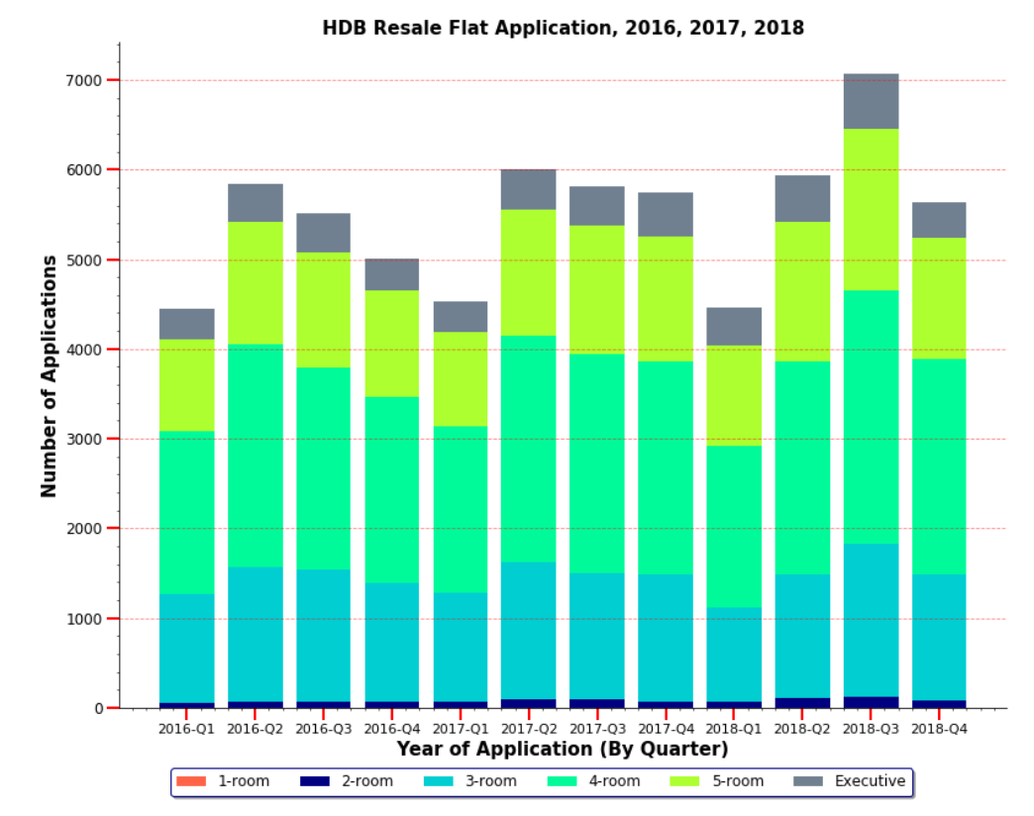
Number of Resale Flat Applications
In this dataset, the total number of resale flat applications are registered by flat type, and by quarterly.
Variables corresponding to this dataset: ‘quarter’, ‘flat type’, and ‘no of resale applications’.
The right bar graph shows the number of resale applications made over the years from 2016 to 2018.
Based on the bar chart, most applications made were for the flat type with 4-Room, followed by 3-Room and then 5-Room respectively.
Fig. 1: Number of Resale Flat Applications (by Stacked Bar Chart)

Slide 5
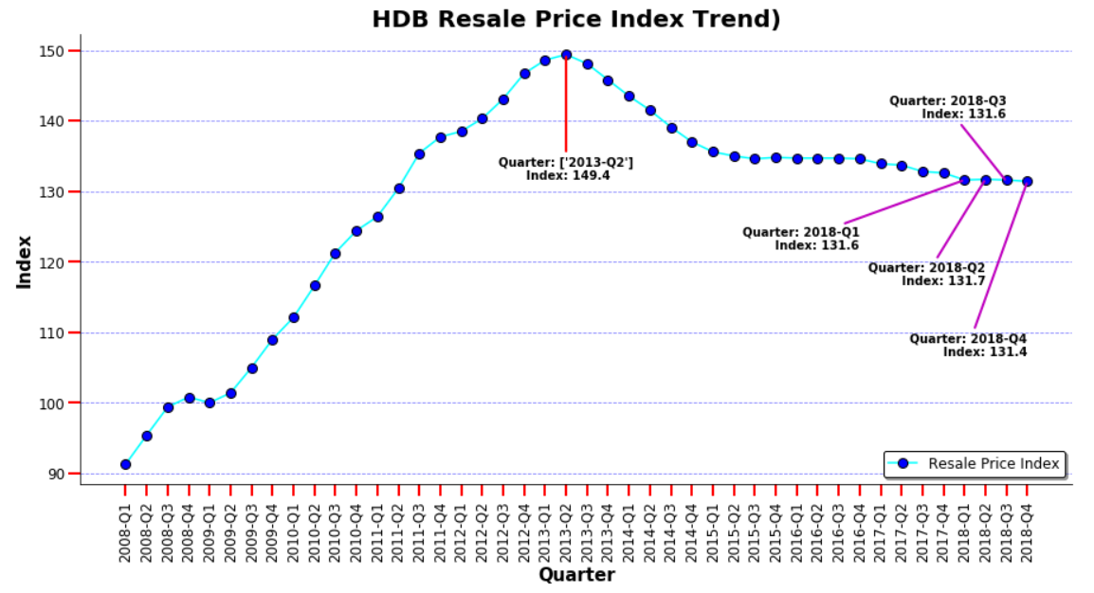
HDB Resale Price Index
The resale price index (dataset 2) tracks the overall price movement of the public residential market.
The index is based on the quarterly average resale price by date of registration.
Variables corresponding to this dataset: ‘quarter’ & ‘index’.
The graph on the right shows the resale price index pattern over the last 10 years (by quarter).
The price went up to the maximum in the year 2013-Q2 with index value of 149.4, but since then it follows a decreasing pattern.
As it is very clear that the price index has more or less stabilized in the last 4 quarters with less fluctuations.
Fig. 2: HDB Resale Price Index Over the Last 10 years (by Line Graph)

Slide 6
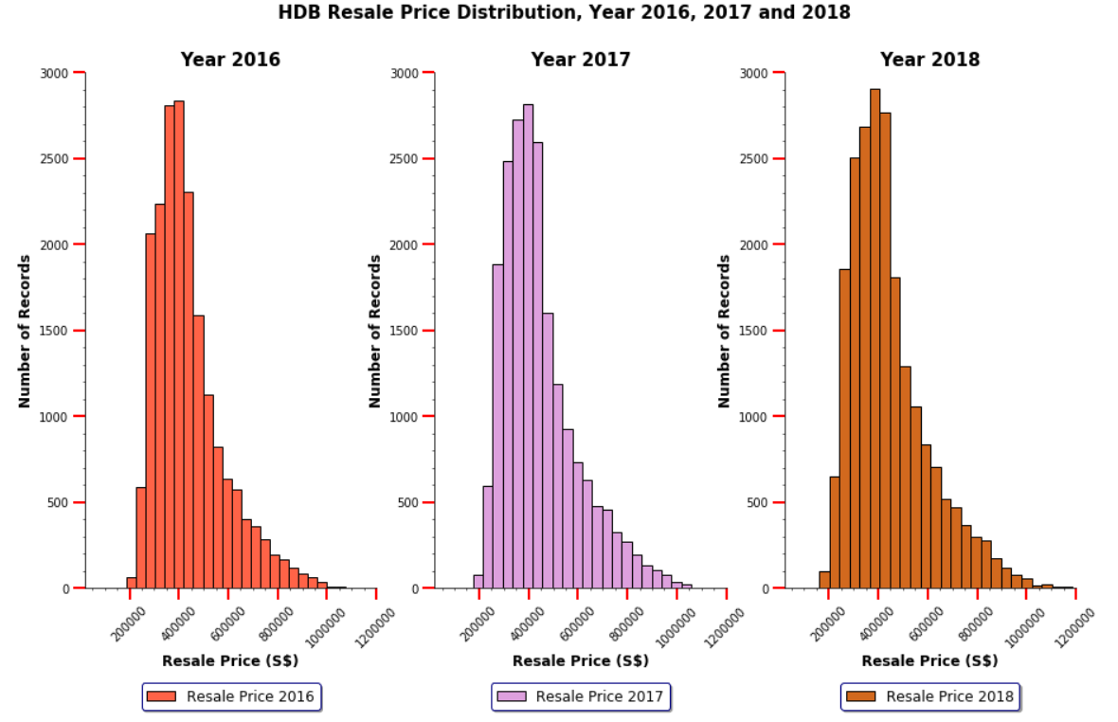
Distribution of HDB Resale price
The figure of the general distribution of the HDB Resale Price from year 2016 to 2018 are illustrated on the right.
Based on the histograms, it is very clear that the distributions for the HDB Resale Price are right-skewed over the last 3 years.
This means that the median price of the resale price is less than the average of the resale price.
Fig. 3: Distribution of HDB Resale Price (by Histogram)

Slide 7
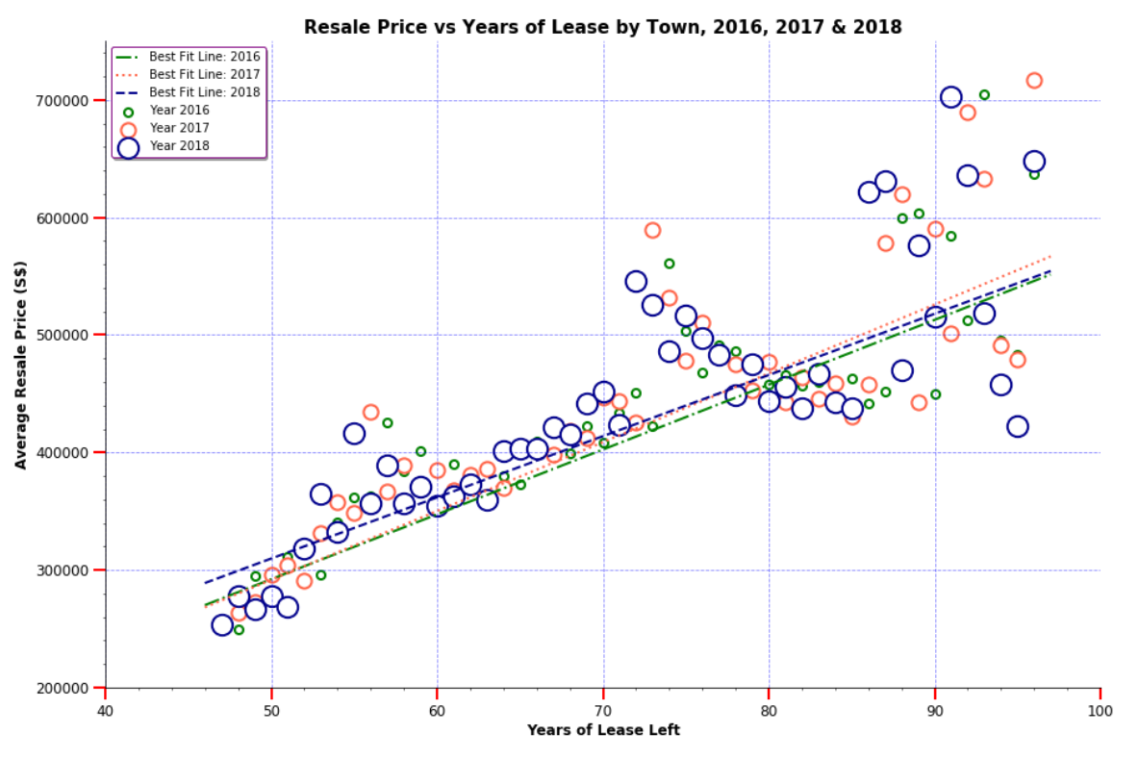
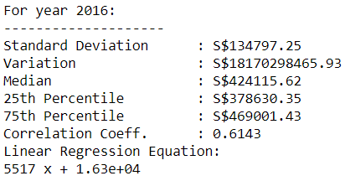
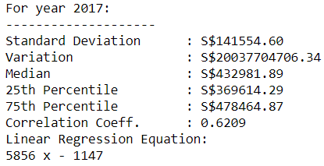
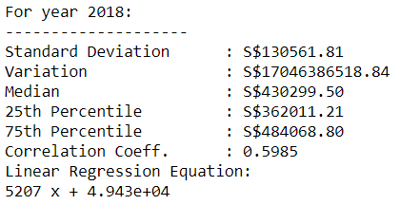
Relationship between the HDB Resale price and the lease left
The resale price are plotted against the years of lease left.
From the results shown on the right, there are multiple positive linear relationships between the HDB Resale Price and the years of lease left over the last years from 2016 to 2018.
The higher the number of years of lease, the higher the resale price.
Based on the computed correlation coefficient,
The linear relationships between the two variables corresponding to the last three years (i.e. from 2016 to 2018) are in moderately strong relationships.
Fig. 4: Relationship between the HDB Resale Price and The Lease Left (Scatter Plot)

Slide 8
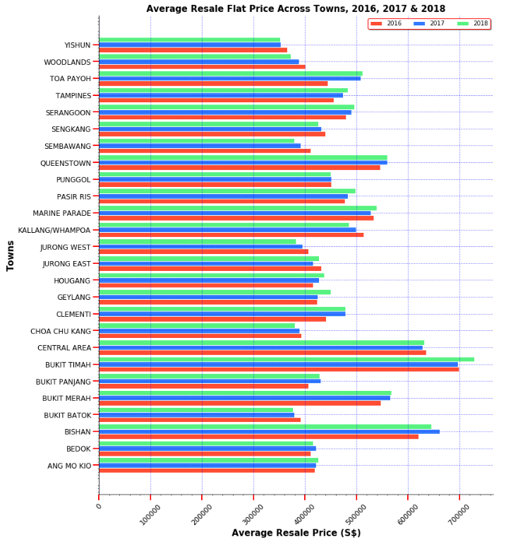
HDB Resale price across the towns
The bar chart shows the comparison between each towns from year 2016 to 2018.
In this instance, bar charts of average resale prices are used to make categorical comparisons across the towns.
The town variable is placed at the row, so that one can read off the name of the town easily.
Bukit Timah, Central Area, and Bishan are the top 3 towns which sees the highest average prices and followed by Queestown in the 4th position.
It also observes that the average resale prices generally increase slightly by comparing across the 2 years (i.e. from 2017 to 2018).
In addition, Yishun has the lowest average resale price over the last three years.
Fig. 5. HDB Resale Flat Across The Towns (by Grouped Bar Chart)

Slide 9
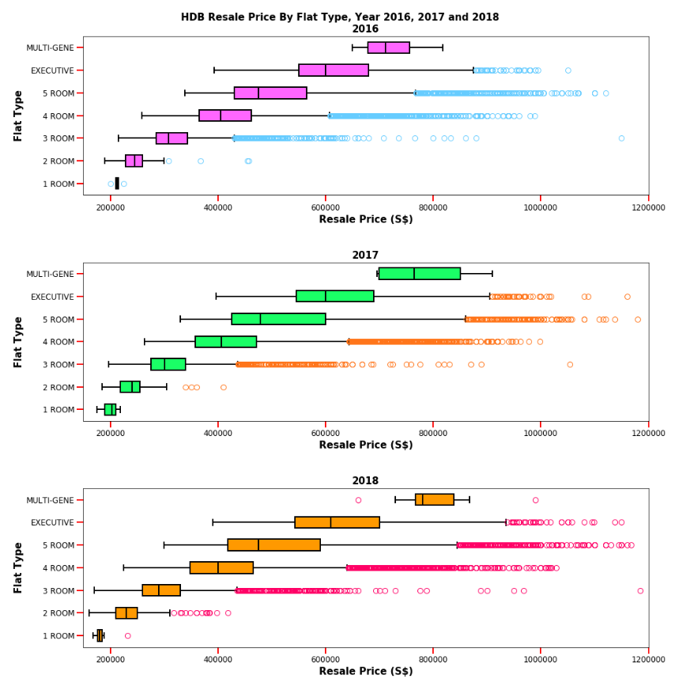
Hdb resale price by flat type
The box plot on the right shows the distribution of the HDB resale price by flat type over the last 3 years from 2016 to 2018.
It is very obvious that the median resale price is as per flat type.
The distribution of the resale prices per flat type are right-skewed, as the median price is less than the average values of each flat type across the three years.
Less fluctuations are seen over the last three years, but the variations for resale price increase as per flat type.
Fig. 6: HDB Resale Price by Flat Type (by Box Plot)

Slide 10
Reference links
https://data.gov.sg/dataset/number-of-resale-applications-registered-by-flat-type-quarterly
https://data.gov.sg/dataset/hdb-resale-price-index
https://data.gov.sg/dataset/resale-flat-prices

