Slide 1

is Singapore healthcare getting better over the years?
Wong Qi Yuan, Jeffrey
Introduction to Programming for Data Science
Specialist Diploma in Data Science (Predictive Analytics)

Slide 2
Overview
We will be exploring if Singapore’s healthcare is indeed getting better quantitatively.
We will be using a few datasets obtained from Singapore’s open data portal, and open data sources from the World Bank to obtain data of other countries’ healthcare performance.
A set of data analysis tools from the Pandas, the Matplotlib Library as well as Seaborn library will be used to visualize our given data and to show the time series changes in our data.
The outcome from this research will show that there are indeed some extend of positive improvements in healthcare over the years in Singapore and will be explained further on next few slides.

Slide 3
Introduction
Singapore prides herself to have one of the best healthcare system in the world. Our healthcare system is currently ranked 2nd in the world in Bloomberg’s Healthcare Efficiency report 2018 and 6th for Overall Healthcare System Performance by WHO.
Such comparisons and rankings are based on relative metrics among different countries.
In this study, we will analyses if Singapore’s healthcare system is getting better on absolute terms, and determine areas for improvement and also if Singapore’s healthcare is getting more affordable than in the past.

Slide 4
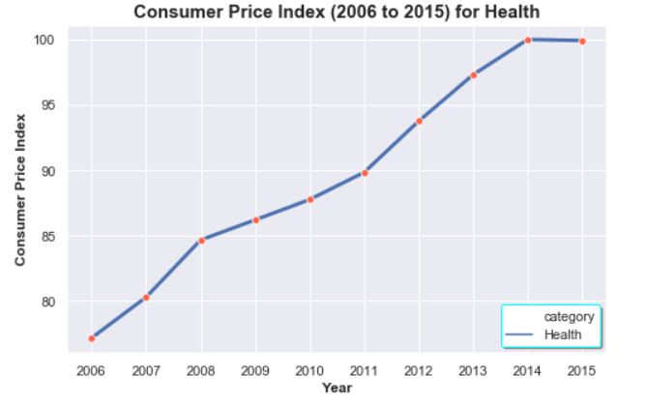
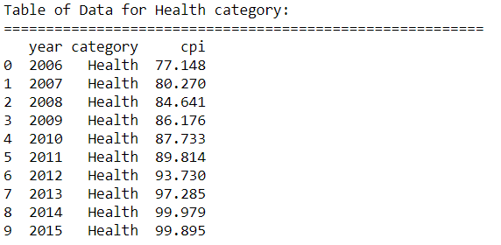
1) Cost of SG Healthcare
Based on the chart shown above, the Consumer Price Index has risen by about 15% from 2006 to 2014.
The rise in prices were rapidly initially from 2006 to 2008 and from 2011 to 2014 as seen in the steep rise in the graph during these periods.
However, there are optimistic signs that the healthcare costs are still under control by the government as the Consumer Price Index fell in 2015 from 2014.

Slide 5
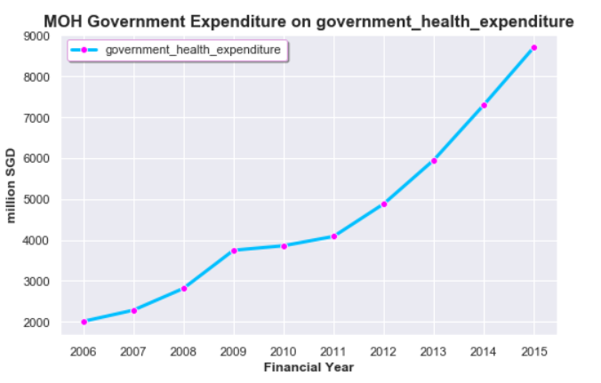
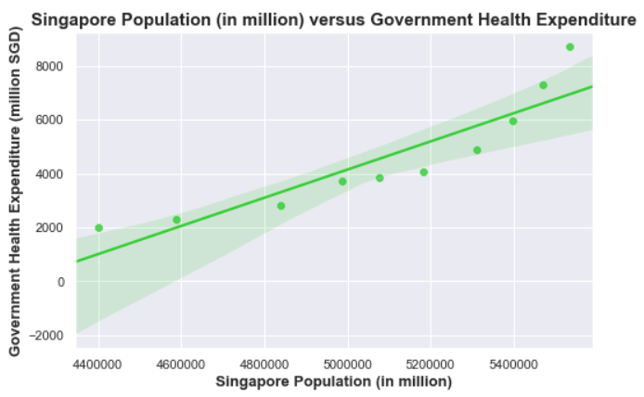
2) Government Expenditure
As a measure of the level of importance the government places on healthcare, we shall study the amount of resources (i.e. money) the government spends on healthcare.
As shown in the chart above (left), the government is spending more resources on healthcare., and the figures are rising exponentially in recent years.
This reflects the effort the government puts in on improving healthcare for Singaporeans.
Since the government has been put in great concern on Singapore’s healthcare, we will determine if the government health expenditure correlates with increasing Singapore Population over the years.

Slide 6
2) Government Expenditure
As shown in the chart above (right), we can see that there is a strong positive association between Singapore Population (in million) and Government Health Expenditure (in million SGD).
In additionally, we can also be proven that there is a strong positive linear correlation between Singapore Population (in million) and Government Health Expenditure(in million SGD) as r = 0.909170.
Next, we will determine if the greater emphasis placed on good healthcare indeed correlates with better health for Singaporeans.

Slide 7
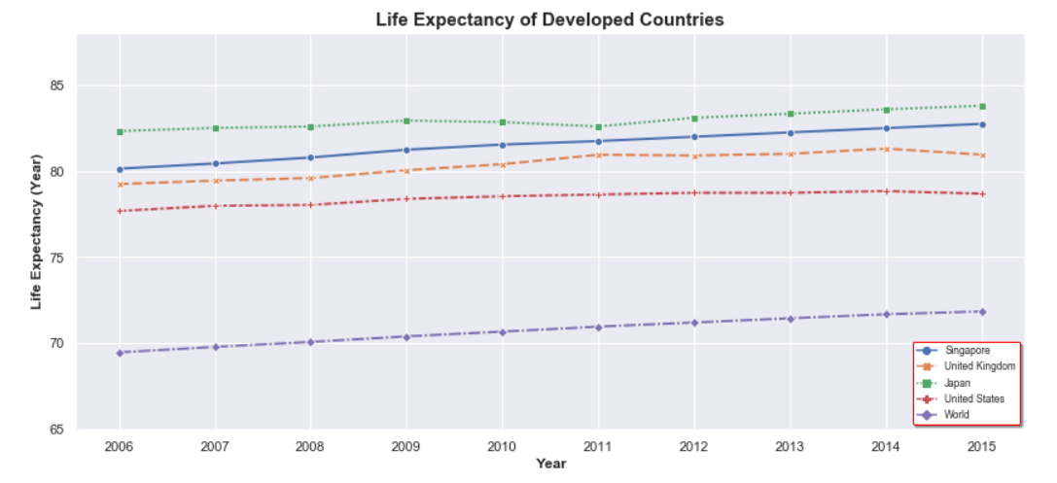
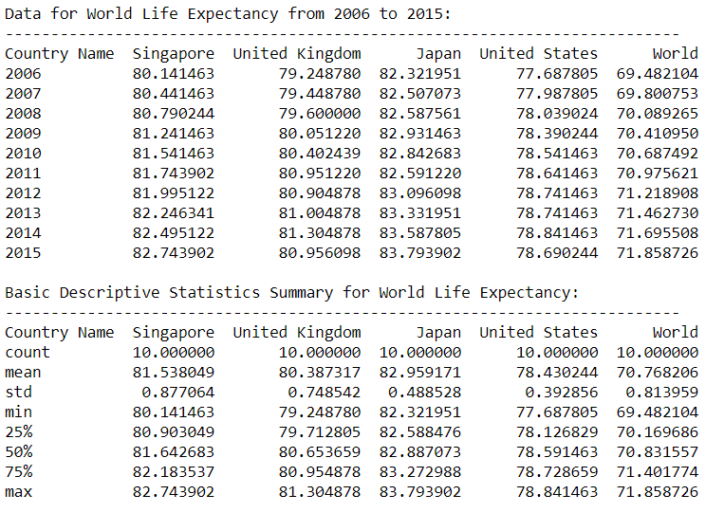
3) Quality of Health
To find out if healthcare is improving to help people in Singapore live a longer and better life, we will study the life expectancy rates and the mortality rates of people with different common chronic diseases.
We will also be comparing the life expectancy rates with common developed countries.

Slide 8
3) Quality of Health
From the graph above, an average Singapore evidently living longer than an average person around the world.
Singaporeans also have a comparable life, if not better, life expectancy than some developed countries.
However, living longer cannot be a definite statement for good quality of life and health. A person may be living longer, but plagued with chronic diseases.
On the other hand, it may be hint that there are advanced in modern medicine to increase the lives of these patients, hence allowing life expectancy to be a measure of better over healthcare.

Slide 9
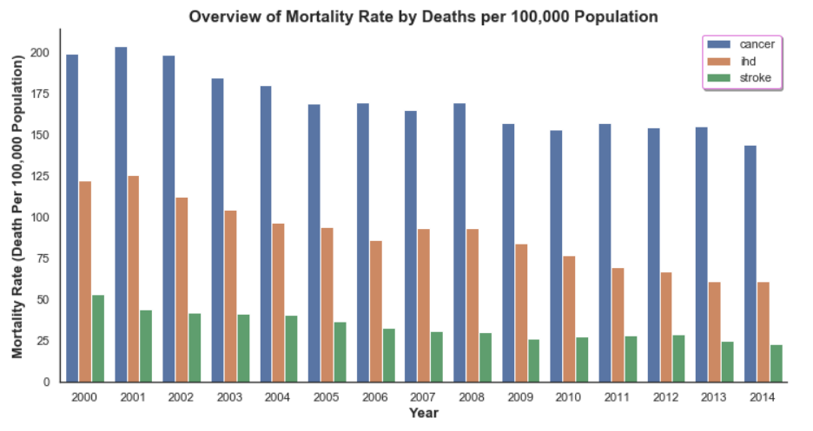
4) Mortality Rates due to Chronic Diseases
We shall now analyze the frequency of death caused by some common chronic diseases, as an indicator if there are better healthcare system in place to reduce the chances of people developing such diseases.

Slide 10
4) Mortality Rates due to Chronic Diseases
Over the recent years, there are less patients dying from the common chronic diseases per 100,000 population.
This could either mean that modern medicine is indeed effective in prolonging life, or simply because less people are developing these diseases due to better overall healthcare.
Next, we will see if it is proven that the rate of occurrence of respective chronic diseases declining over the years.

Slide 11
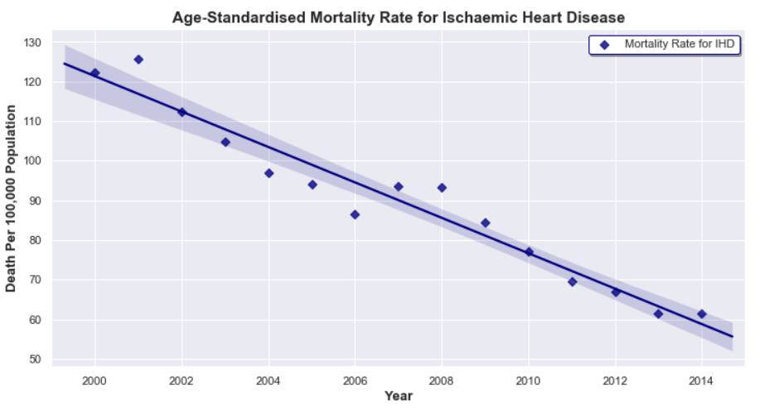

4) Mortality Rates due to Chronic Diseases
Ischaemic Heart Diseases
Based on the chart shown above, it shows a negative downward trend which also shows that less people are suffering from Ischaemic Heart Disease (IHD) over the years due to the advancement of healthcare and medicine over the years.
The relationship between two variables can be proven by the correlation coefficient, r = -0.972699, which means that there is a very strong negative linear relationship between the year and Death Per 100,000 Population.

Slide 12
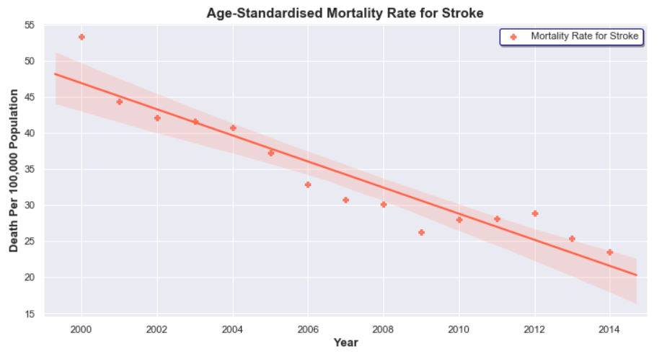

4) Mortality Rates due to Chronic Diseases
Stroke
Based on the chart shown above, it shows a negative downward trend which also shows that less people are suffering from Stroke over the years, which probably due to the advancement in the medicine and healthcare.
The relationship between two variables can be proven by the correlation coefficient, r = -0.942922, which means that there is a very strong negative linear relationship between the year and Death Per 100,000 Population.

Slide 13
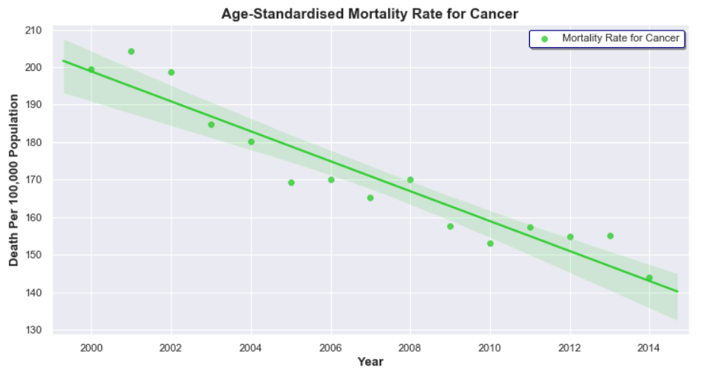

4) Mortality Rates due to Chronic Diseases
Cancer
Based on the chart shown above, it shows a negative downward trend which also shows that less people are suffering from Cancer over the years, which probably due to the advancement in the medicine and healthcare.
The relationship between two variables can be proven by the correlation coefficient, r = -0951277, which means that there is a very strong negative linear relationship between the year and Death Per 100,000 Population.

Slide 14
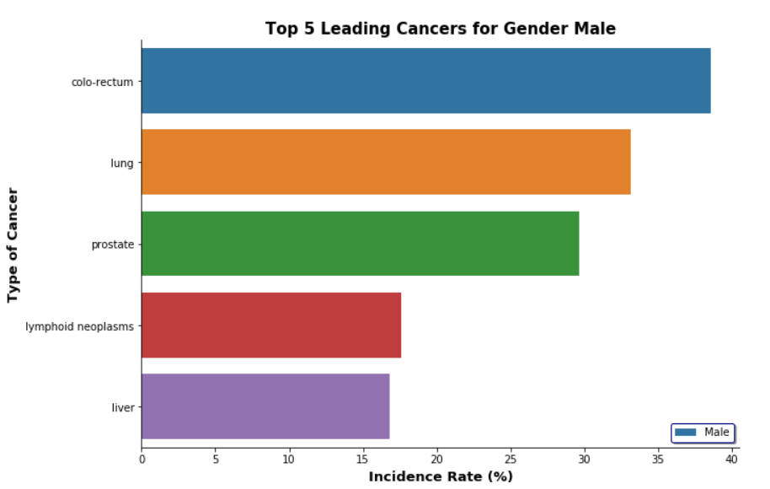
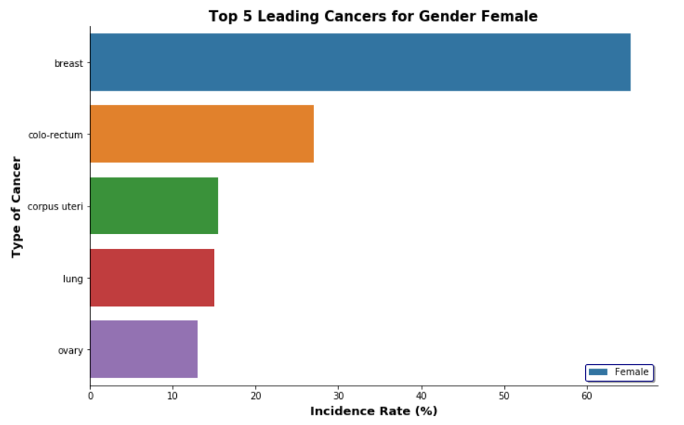
5) Top 5 Leading Cancers by Genders
In this study, we shall further analyze the trend of the top 5 deadliest cancer in Singapore by genders.
In this dataset, it provides the incidence rate of the top 5 cancers by gender in year 2015.

Slide 15

5) Top 5 Leading Cancers by Genders
From the chart above, colorectal, lung, and prostate were the top ranked cancers among the male resident population. The majority of cancer cases are sporadic, i.e. the disease is not inherited.
By pure chance, many cases of “common” cancers such as colon and lung cancers can appear to run in a family.
Personal risk depends on factors such as your age, family history of cancer and your tendency to inherit cancer genes. These are beyond your cancer.

Slide 16
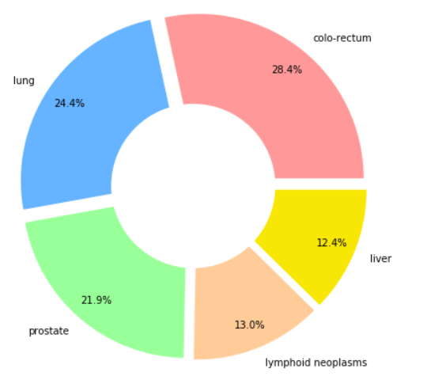
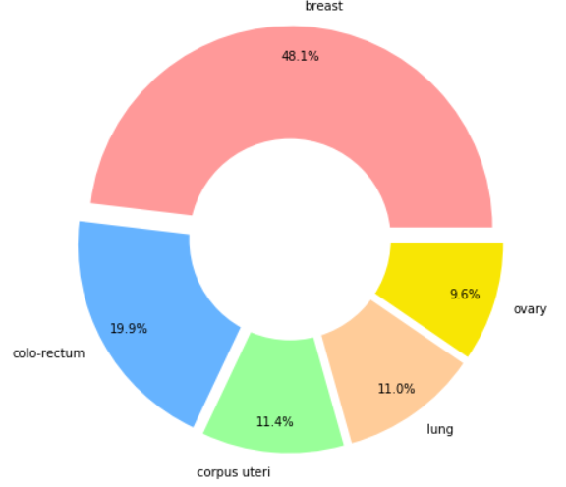
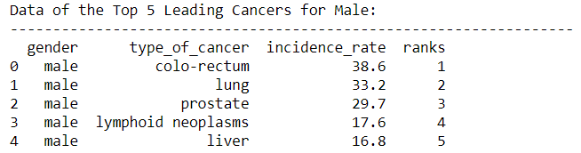
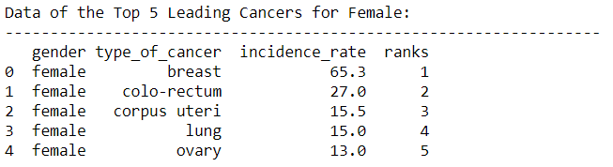
5) Top 5 Leading Cancers by Genders
Other risk factors that are within our control are not genetic. These include our lifestyle, diet, smoking and environmental exposure.
I believe Singapore healthcare government has been working hard by introducing campaigns activities on improving our healthy lifestyle on regular basis. Aside from government, it is also part of our job as a patient to reduce or prevent these risk factors at minimal level.

Slide 17
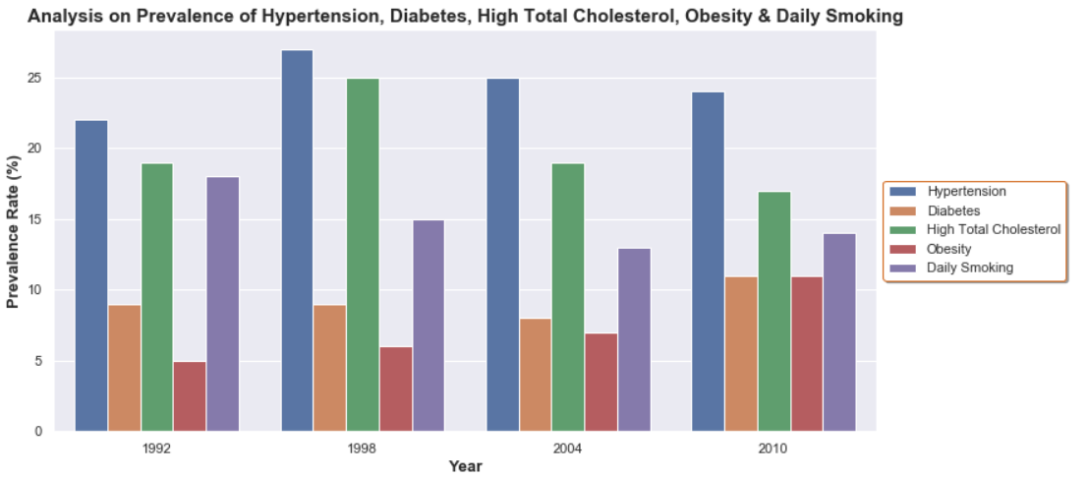
6) Prevalence of Hypertension, Diabetes, High Total Cholesterol, Obesity & Daily Smoking
In general, we can observe a fall in the prevalence of the hypertension, high total cholesterol and daily smoking over the years. However, we can also observe a rise in the prevalence of obesity and diabetes, which is interrelated with each other.
We can make the following inferences that campaigns and measures to discourage smoking (I quit campaign, tobacco taxes) have been effective in fulling its purpose; future campaigns to encourage healthy lifestyle to bring down diabetes and obesity rates can draw inspiration from the anti-smoking campaigns to try and recreate the success it enjoyed.

Slide 18
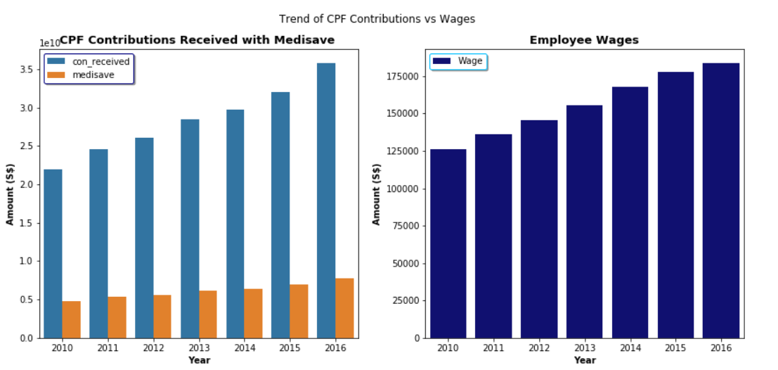
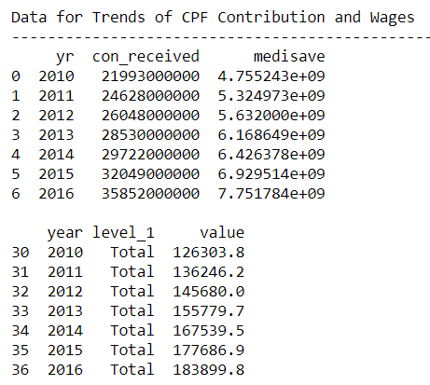
7) CPF Contribution with Medisave & Wages
In this study, we will be try to find out how employee wages contribute to their own CPF contributions and further contribute to their own Medisave account.
As 8% of the wage of the employees is credited to Medisave, so I will be use that toe valuate the amount that is contributed to Medisave CPF Board.
Noted that the current CPF contribution for both employer and employees combined is 37% of the total wage. The breakdown of the CPF contribution is 21% of the total wage will go to the Ordinary Account OA), 7% of the total wage will go to the Special Account (SA) and the remaining 8% of the total wage will be credited into the Medisave Account.

Slide 19
7) CPF Contribution with Medisave & Wages
From the chart above, the increase in wages in Singapore has caused the CPF contribution to increase throughout the years, which ultimately caused an increase in the contribution towards the Medisave.
As medisave can be used to fund the monthly premiums for Medishield/ Medishield life, most Singaporeans will use their medisave to sustain their Medishield plans as well as to pay their medical fees on chronic diseases such as Diabetes, Hypertension and Cancer.
In addition, the Singapore government provided various subsidies to lower the cost for the Medishield plans.
Hence, it can be inferred that most Singaporeans do not need to pay out of their pocket (in cash) to support their medishield plans.

Slide 20
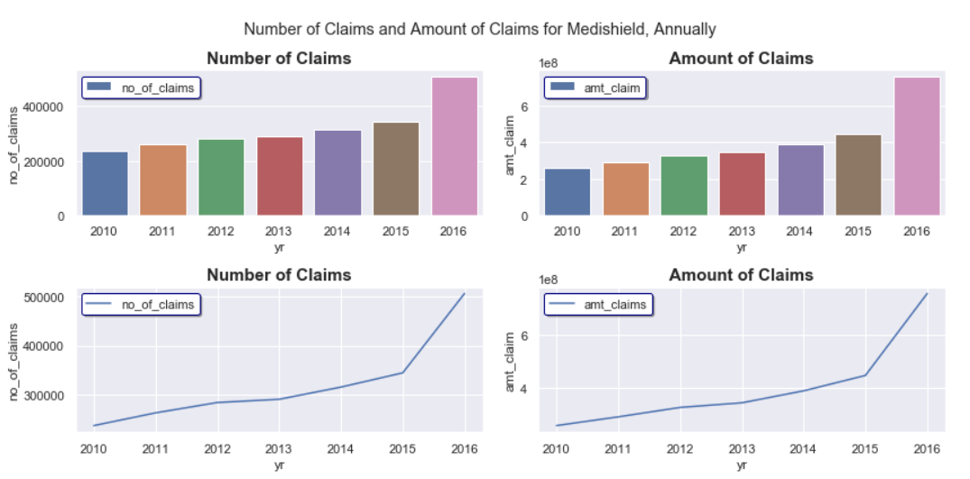
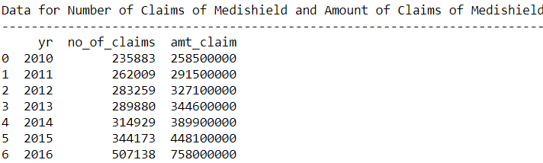
8) Number of Claims and Amount of Claims for Medishield
From the chart above, the number of claims and amount of claims made to medishield plans increase from 2010 to 2016.
The increase in the number of claims made may be due to the fact that Singapore is facing in an ageing population and there are more people from the baby boomer generation (Born between 1946 and 1964) that requires healthcare and medical services.
Another explanation could be the government has made it easier for the people to make claims under the medishield plans and this encourages the people to use their medishield benefits to cover their healthcare cost, which makes the overall healthcare more affordable.

Slide 21
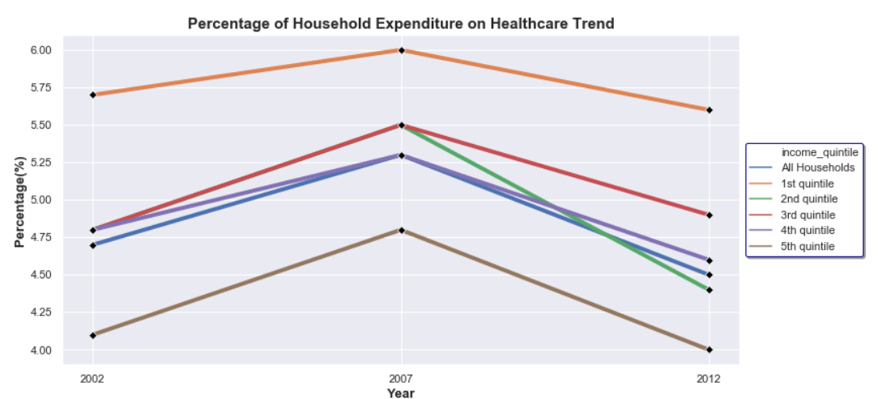
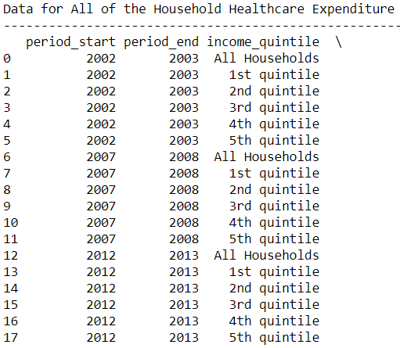
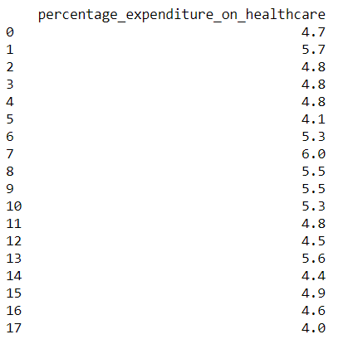
9) Household Expenditure on Healthcare
From the chart above, we can see the different percentages of healthcare expenditure by households of different levels.
Overall, the household expenditure on healthcare in Singapore has decreased from 2008 to 2012 (blue graph).
However, upon close inspection, we can see that the households in the 1st quintile have an higher expenditure one healthcare compared to the other quintiles.
One explanation of this could be that these households are in a lower income level and hence, they have a lower take home after CPF contribution.
As such, the lower level of income will contribute to a higher percentage of spending in healthcare.

Slide 22
9) Household Expenditure on Healthcare
On the other hand, the households on the 5th quintile has the smallest expenditure.
The CPF contributions of these household are capped at the first SGD6000 of the wages (Only the first 6k is subjected to the CPF contribution –e.g. if your salary is SGD6700 per month, only the first SGD6000 contributes to the CPF).
This will result in a higher take home income in the households of the 5th quintile and it creates a small percentage of the healthcare expenditure (in brown graph)

Slide 23
Limitations
Age of the Population
As the premiums of the medishield plan increases with age (the older the person is, the more likely he or she will fall sick, and the insurer will have to bearer more risk).
It might increase the healthcare expenditure for the people who do not have enough money in their medisave account as they are required to pay the outstanding balance out of the pocket.
Insufficient data points from healthcare dataset
As the data points of the most dataset ends at year 2012, it is very difficult to argument the trends of healthcare in the recent years (From 2013 to 2019). As such, using the trendline that is being shown might not be completely accurate because there will be distortion that could change the way the data looks.
Outpatient Treatment
As outpatient treatments at a general practitioner or SingHealth Polyclinic are not taken into consideration in this research, introducing this factor might change the healthcare spending of the household.
Preference of Healthcare Providers
This research did not take into account the preference of healthcare of the households. As some household might prefer private healthcare providers compared to government restructured hospitals. This preference will also affect the healthcare spending on the different housheolds.

Slide 24
Conclusion
From the data analysis shown from Part 1) to 9), we can make the following conclusions about Singapore healthcare system:
Singapore’s healthcare scene is improving overall as compared to the past, with better cost management from the government, greater emphasis placed on healthcare, and possible better quality of case which translates to less frequent chronic diseases.
Nonetheless, there is still room for improvement as Singapore is still behind some countries like Japan in metrics like life expectancy.

Slide 25
Checklist on Chart Type & SQL
Part | SQL | Matplotlib & Seaborn
 |  | Line Graph | Bar Chart | Scatter Plot | Pie Chart | Histogram | BoxPlot
1 | √ | √ | - | - | √ | - | -
2 | √ | √ | - | √ | - | - | -
3 | - | √ | - | - | - | - | -
4 | √ | - | √ | √ | - | - | -
5 | √ | - | √ | - | √ | - | -
6 | √ | - | √ | - | - | - | -
7 | - | - | √ | - | - | - | -
8 | - | √ | √ | - | - | - | -
9 | √ | √ | - | - | - | - | -
Histogram & Boxplot are not used in this analysis due to the limitation on data points provided by Data.gov.sg

Slide 26
Reference Links
Part | Reference Links
1 | https://data.gov.sg/dataset/consumer-price-indices-general-and-healthcare
2 | https://data.gov.sg/dataset/government-health-expenditure
3 | https://data.worldbank.org/indicator/SP.DYN.LE00.IN?locations=SG
4 | https://data.gov.sg/dataset/age-standardised-mortality-rate-for-ischaemic-heart-disease-stroke-and-cancer
5 | https://data.gov.sg/dataset/top-5-leading-cancers
6 | https://data.gov.sg/dataset/prevalence-of-hypertension-diabetes-high-total-cholesterol-obesity-and-daily-smoking
7 | https://data.gov.sg/dataset/cpf-contributions-received-net-amount-withdrawn-annual
8 | https://data.gov.sg/dataset/amount-of-claims-made-under-medishield-medishield-life-annual
9 | https://data.gov.sg/dataset/amount-of-claims-made-under-medishield-medishield-life-annual?resource_id=c2835545-c8b8-4624-ba39-6f1dcbb8f28e

Slide 27
Reference Links
https://www.bloomberg.com/news/articles/2018-09-19/u-s-near-bottom-of-health-index-hong-kong-and-singapore-at-top
https://en.wikipedia.org/wiki/World_Health_Organization_ranking_of_health_systems_in_2000

