Slide 1


Streamlit-Based-Diabetes-Risk-Classification-Using-Machine-Learning
Specialist Diploma in Applied Artificial Intelligence
Capstone Project 2021

Slide 2
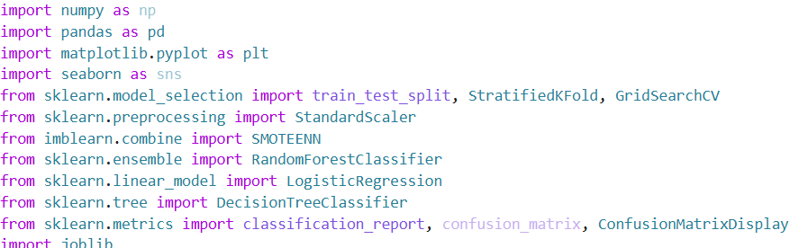
Imported Libraries
Imported Python libraries for data manipulation, visualization, preprocessing, resampling, model training, evaluation, and saving the trained model.

Slide 3
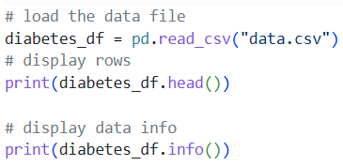
Load Data
Loaded the diabetes dataset from data.csv, displayed first few records, inspected the data information.

Slide 4
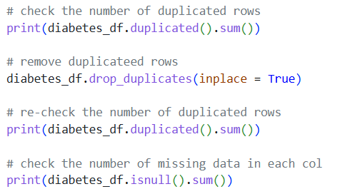
Inspect and Data Cleaning
Checked for duplicate and missing values. Removed duplicated rows from the dataset and rechecked that no duplicates remained. Missing values were also checked before modelling.

Slide 5
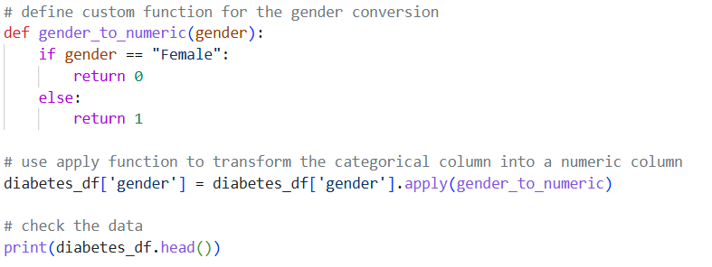
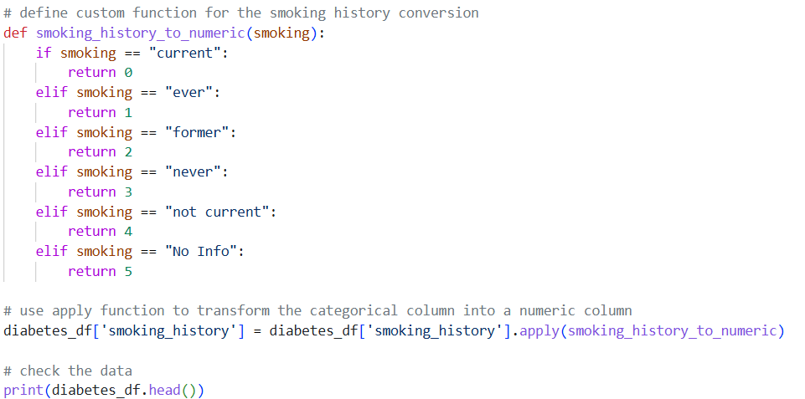
Categorical encoding
Converted categorical variables into numerical values so that machine-learning algorithms could process them. gender was converted to 0/1, while smoking_history was mapped to numerical categories from 0 to 5.

Slide 6
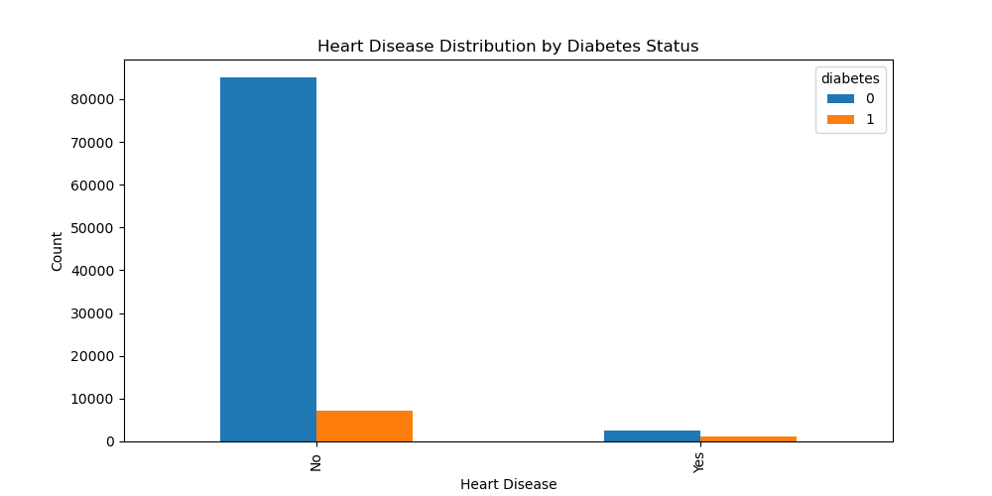
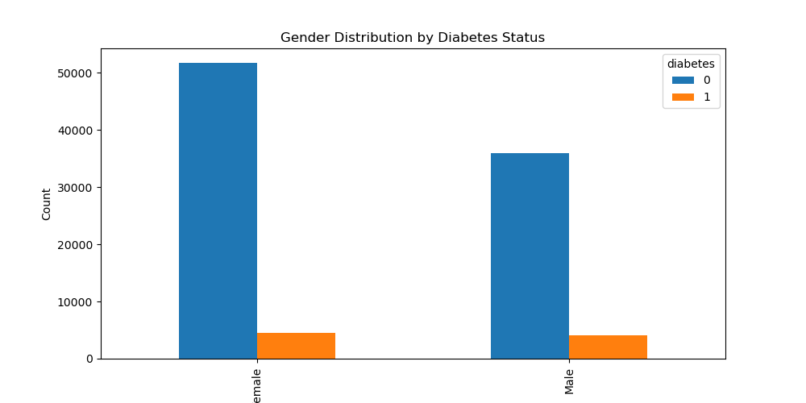
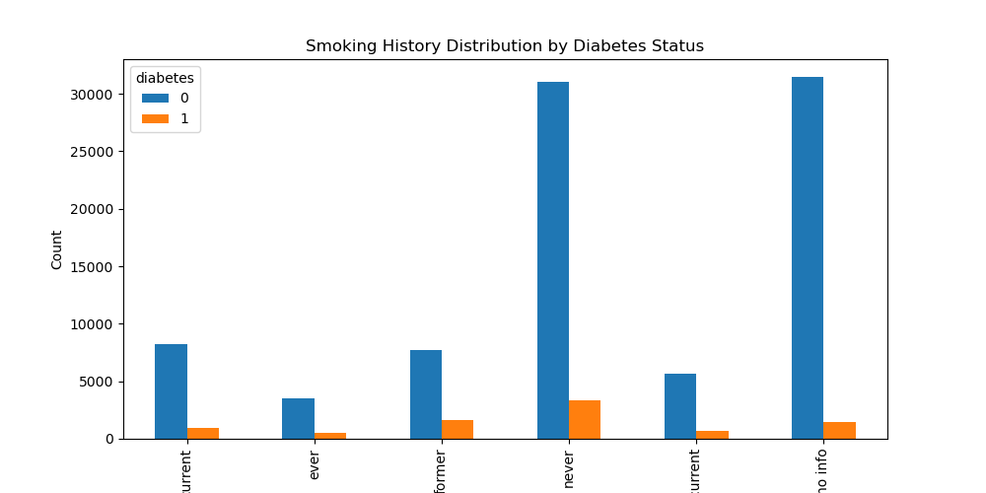
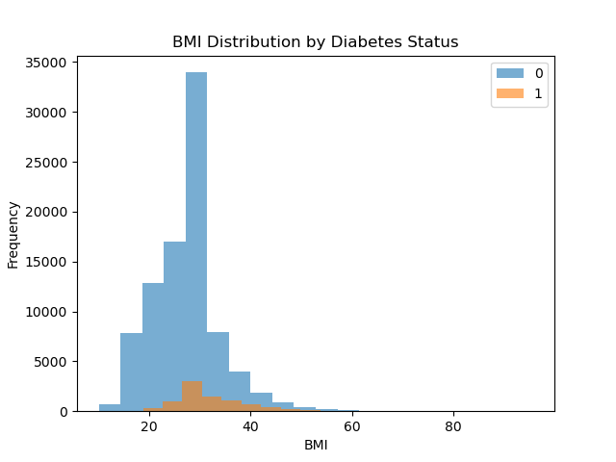
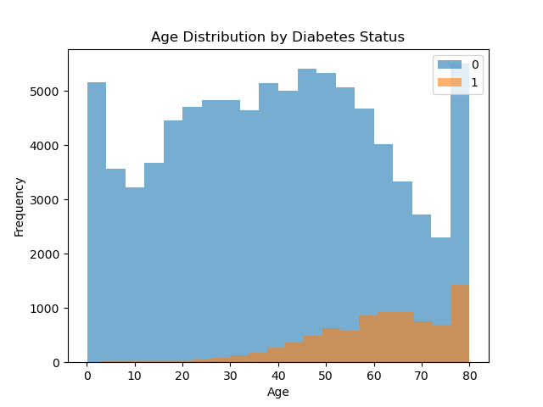
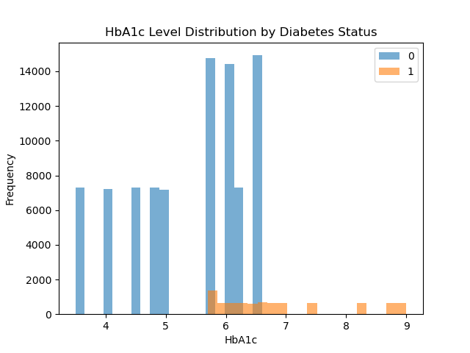
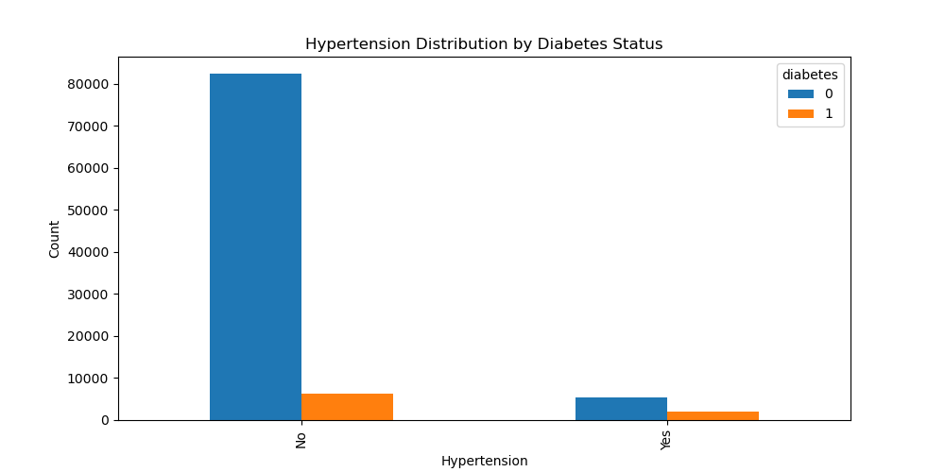
Exploratory Data analysis (EDA)

Slide 7
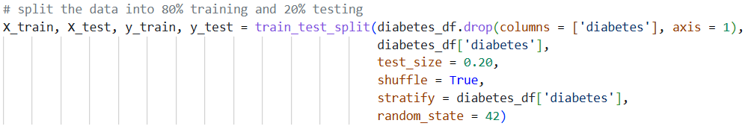
Train-Test Split
Divided the dataset into 80% training data and 20% testing data. Stratified sampling was used to maintain a similar diabetes class distribution in both datasets.

Slide 8
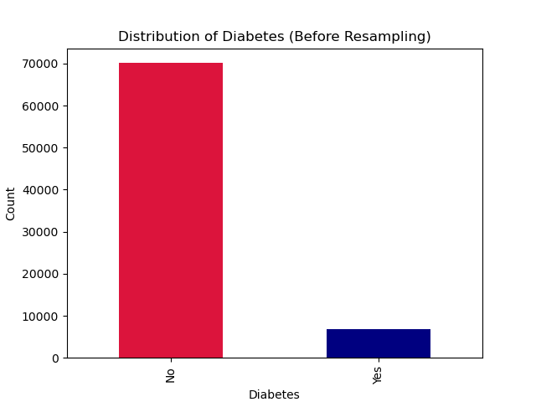
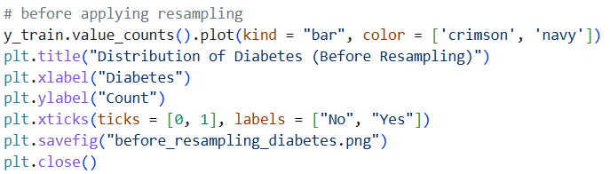
Class distribution analysis
Examined the distribution of diabetes classes in the training data before resampling to identify class imbalanced.

Slide 9
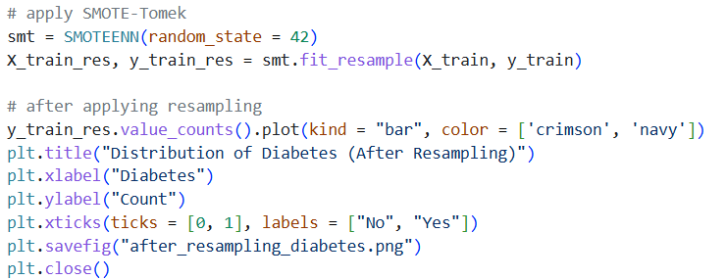
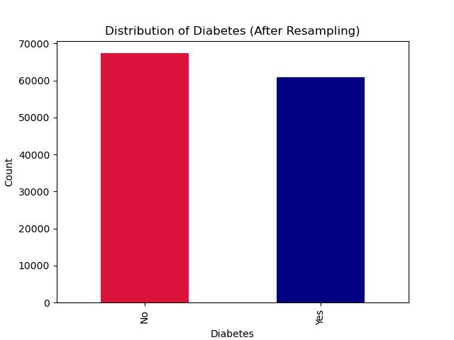
Class imbalance handling
Applied SMOTEENN to the training data. This combines synthetic oversampling with cleaning of potentially noisy or ambiguous observations to produce a more balanced training dataset.

Slide 10
Feature standardization
Applied StandardScaler to numerical variables – age, BMI, HbA1c level, and blood glucose level. The scaler was fitted only on the resampled training data and then applied to the test data.

Slide 11
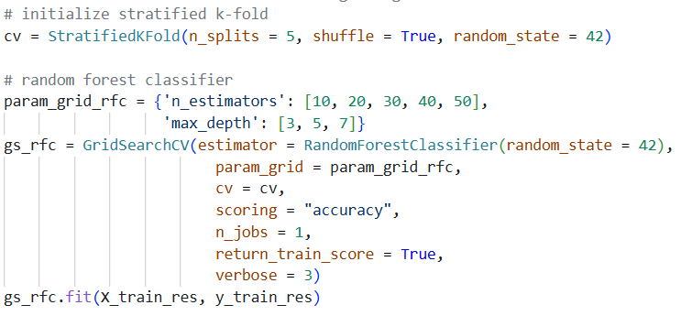
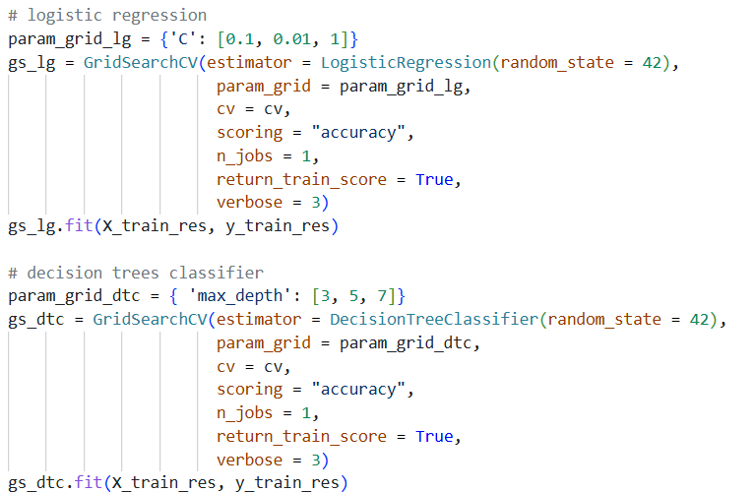
Model Training & Hyperparameter Tuning
Trained three classification models: Random Forest, Logistic Regression, and Decision Tree. GridSearchCV with 5-fold Stratified Cross-Validation was used to test different hyperparameter combinations and select the best-performing configuration based on accuracy.

Slide 12
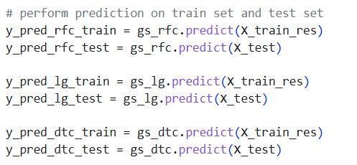
Model prediction
Used each optimized model to generate predictions for both the training data and the unseen test data. This allowed comparison of model performance on data used for training versus unseen data.

Slide 13
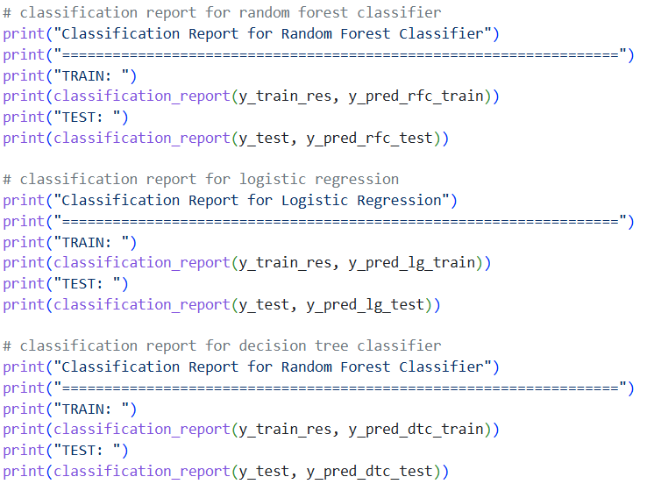
Model Evaluation
Evaluated the three classifiers using classification reports, including precision, recall, F1-score, and accuracy. Both training and test performance were examined to assess predictive performance and possible overfitting.

Slide 14
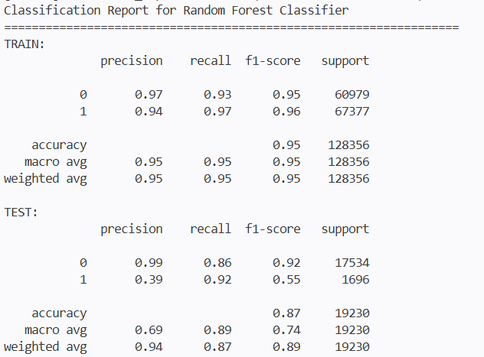
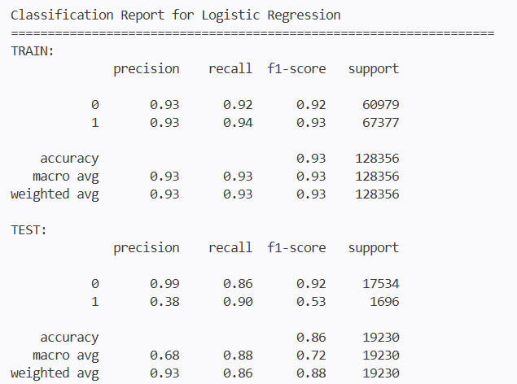
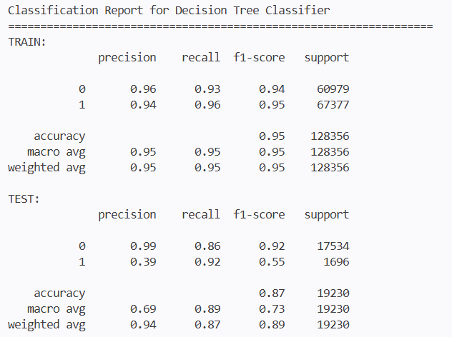
Model Evaluation

Slide 15
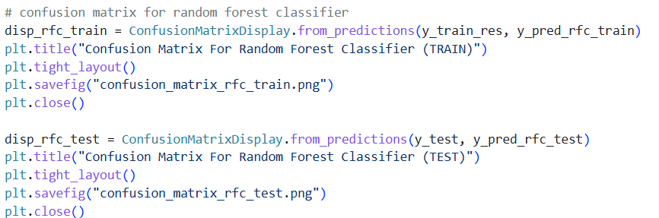
Confusion matrix analysis
Generated confusion matrices for Random Forest, Logistic Regression, and Decision Tree on both training and test datasets to examine correct and incorrect diabetes classifications.

Slide 16
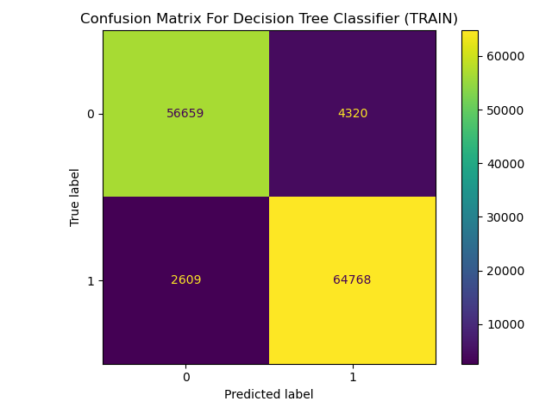
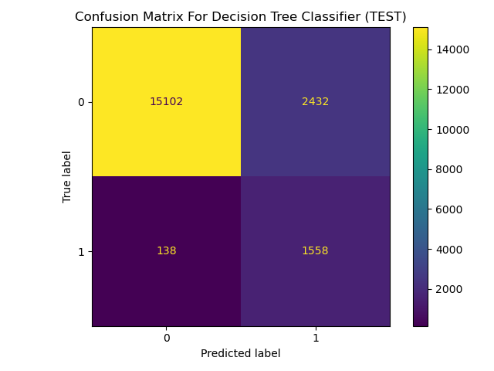
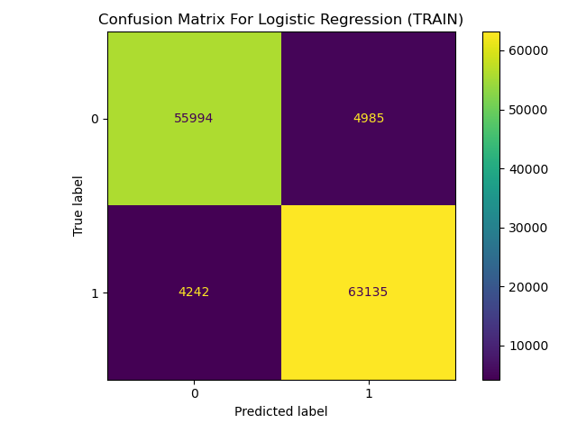



Confusion Matrix Analysis

Slide 17
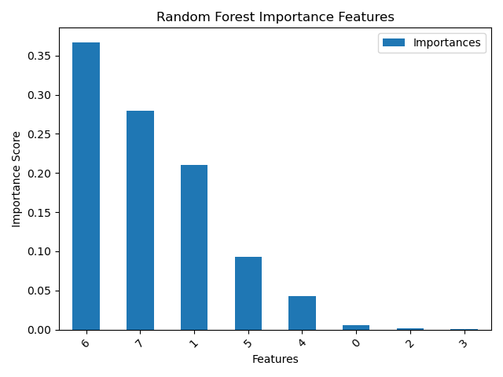
Feature Importances of Best Model

Slide 18

Model deployment preparation
Saved the best Random Forest estimator from the grid search as random_forest_model.joblib and saved the fitted scaler as scaler.joblib. These files can later be loaded by an application/ API to make predictions on new data.

Slide 19
Demo working implementation

