Slide 1
BT2102
Assignment 1
Group 67
Zhou Leyang A0234327J
Ke Jiayi A0241155N
Terence Lim Yong Sheng A0238035J
Jefferson Yeo Wee Shen A0230112H

Slide 2
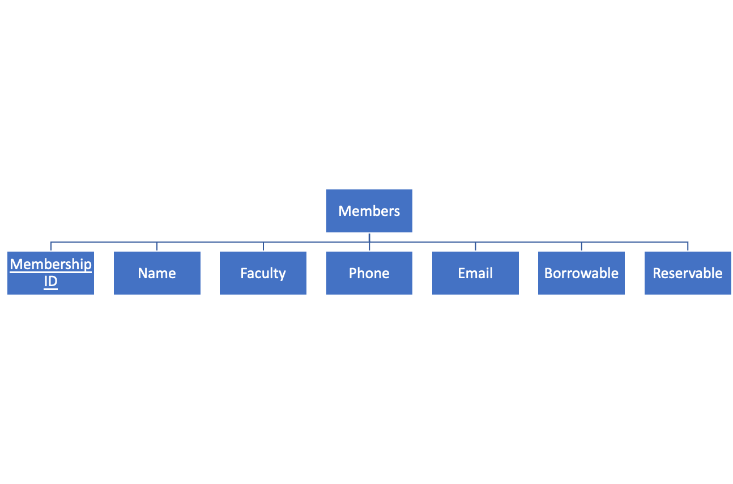
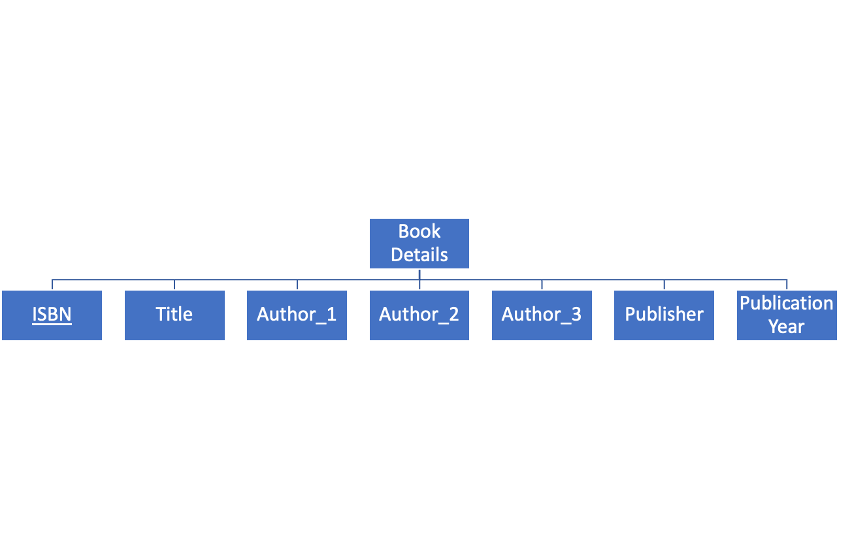
The Final Entities and Attributes
(Members, Book Details)

Slide 3
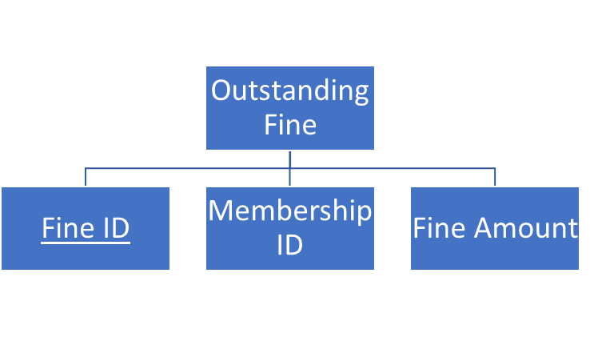
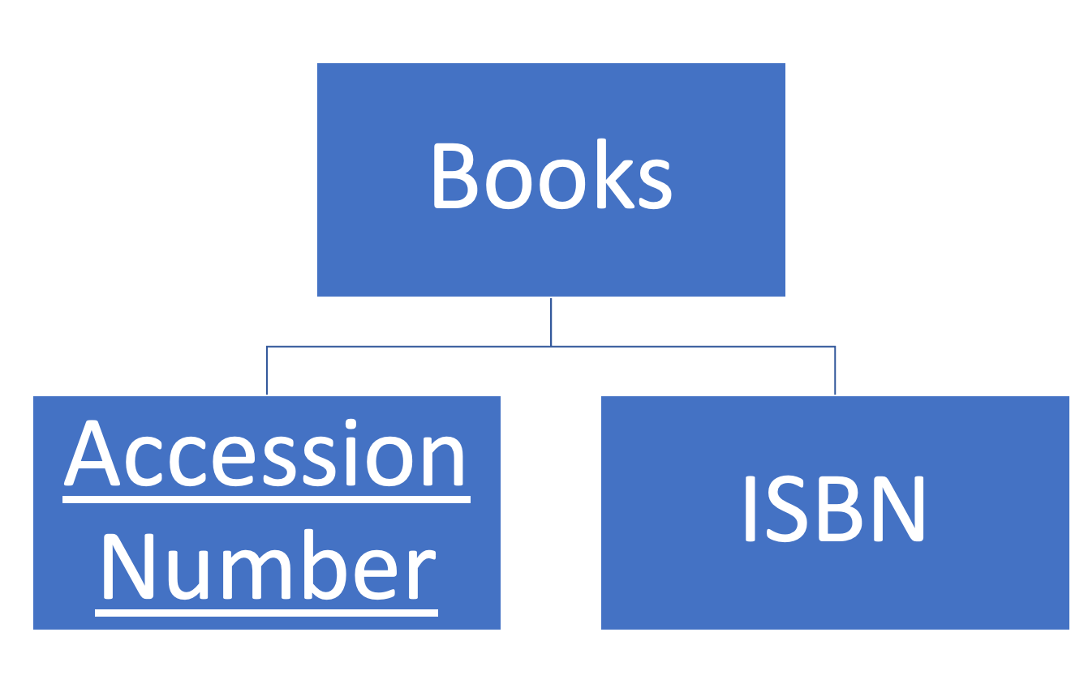
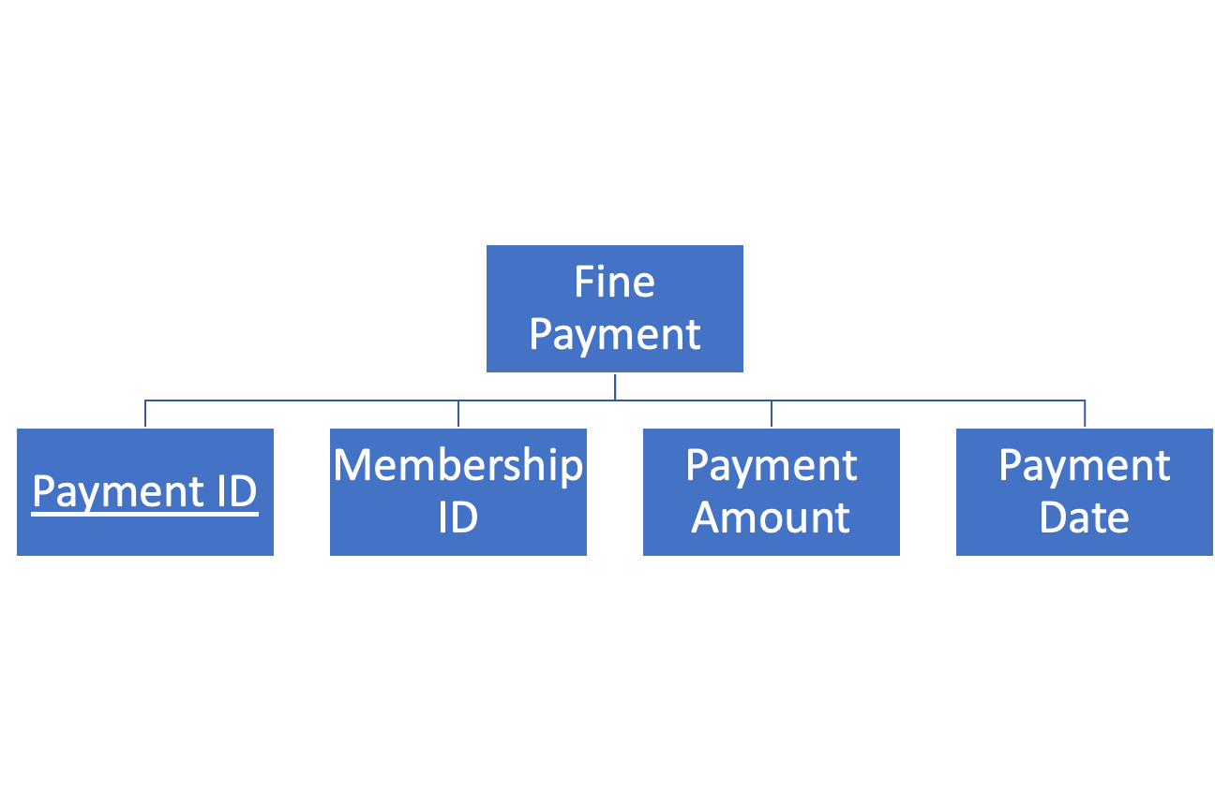
The Final Entities and Attributes
(Fine Payment, Outstanding Fine, Books)

Slide 4
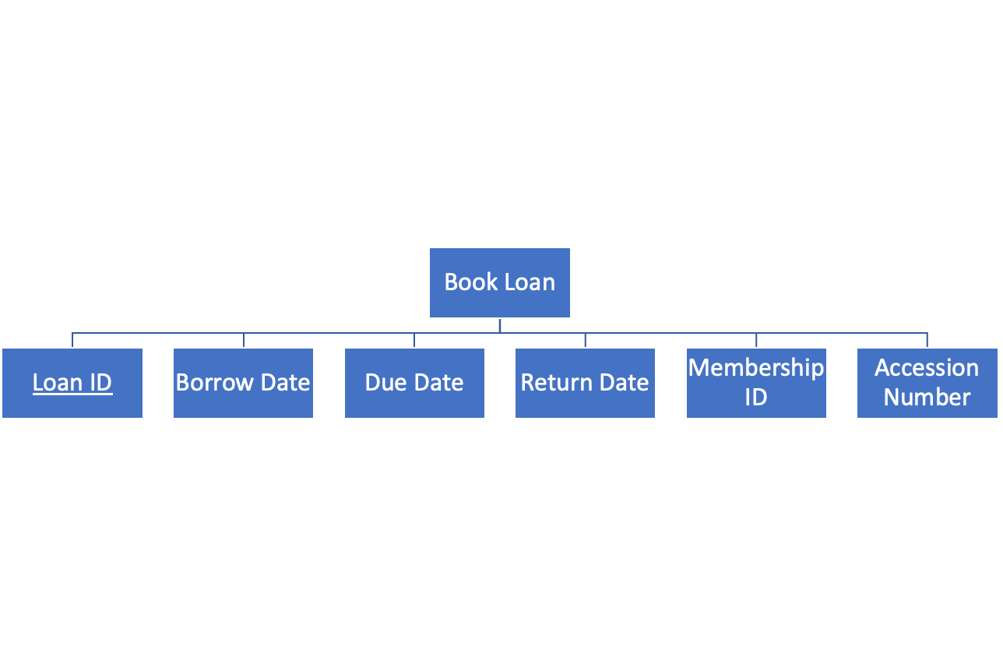
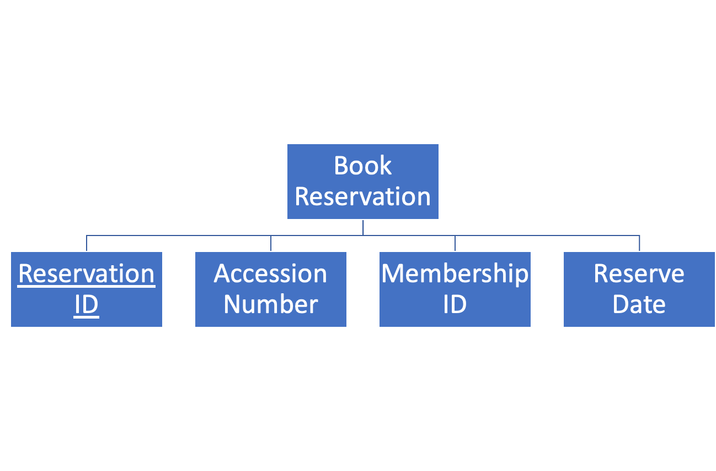
The Final Entities and Attributes
(Book Reservation, Book Loan)

Slide 5
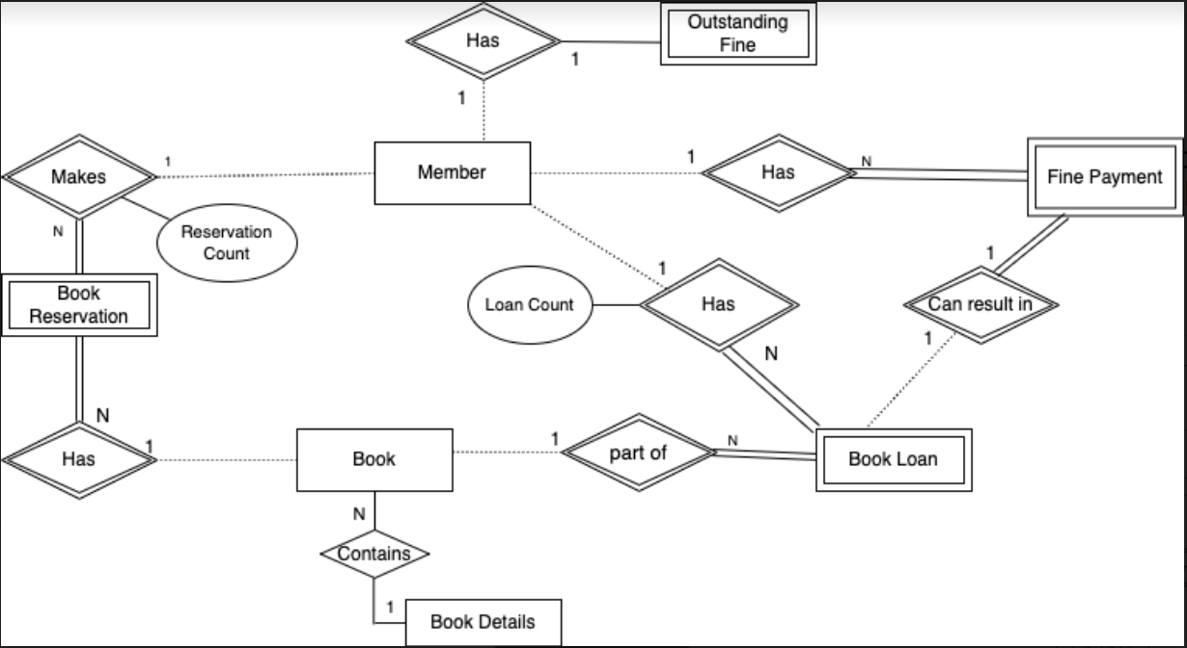
The Final Conceptual Data Model

Slide 6
The Final Logical Schema
Members (Membership ID, Name, Faculty, Phone Number, Email Address, Borrowable, Reservable)
Book Details (ISBN, Title, Author_1, Author_2, Author_3, Publisher, Publication Year)
Outstanding Fine (Fine ID, Fine amount, Membership ID)
Books (Accession number, ISBN)
Book Loan (Loan ID, Borrow Date, Due Date, Return Date, Accession Number, Membership ID)
Book Reservation (Reservation ID, Reserve Date, Accession Number, Membership ID)
Fine Payment (Payment ID, Payment Date, Payment Amount, Membership ID)

Slide 7
The Final Logical Data Model
Member (Membership ID, Name, Faculty, Phone Number, Email Address, Borrowable, Reservable) Primary Key Membership ID
Book Details (ISBN, Title, Author_1, Author_2, Author_3, Publisher, Publication Year) Primary Key ISBN | Books (Accession number, ISBN) Primary Key Accession number Foreign Key ISBN references Book Details (ISBN)
Book Loan (Loan ID, Borrow Date, Due Date, Return Date, Membership ID, Accession Number) Primary Key Loan ID Foreign Key Membership ID references Member (Membership ID) Foreign Key Accession Number references Book (Accession Number) | Book Reservation (Reservation ID, Reserve Date, Membership ID, Accession Number) Primary Key Reservation ID Foreign Key Membership ID references Member (Membership ID) Foreign Key Accession Number references Book (Accession number)
Outstanding Fine (Fine ID, Membership ID, Fine Amount) Primary Key Fine ID Foreign Key Membership ID references Member (Membership ID) | Fine Payment (Payment ID, Membership ID, Payment Date, Payment Amount) Primary Key Payment ID Foreign Key Membership ID references Member (Membership ID)

