Slide 2

Javascript Unit Testing &
Build Integration
Wouter Groeneveld
Agile software developer at Cegeka
wouter.groeneveld@gmail.com
Twitter: @cegeka

Slide 3
Wouter Groeneveld
Who am I?
Agile software developer @ Cegeka for 5 years;
a.k.a. dynamic languages fanboy
a.k.a. (alas...) Javascript guru (taught various JS & engineering courses, I used to be just the “expert”)
Likes to inspire others and improve himself.
<number>

Slide 4
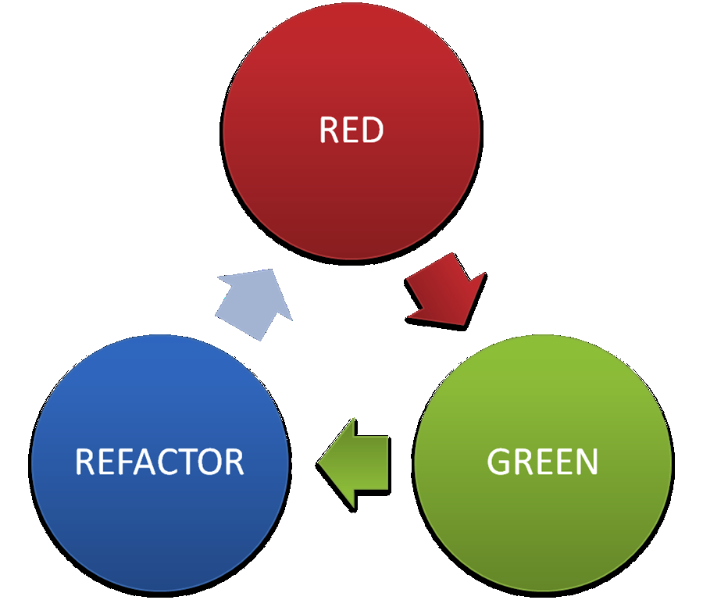
Working with JavaScript
<number>

Slide 5
Why isn't this popular? JS <> Java
// whoops?
var doIfYes = function() {
this.myvar = 10; // whoops
return true;
}
var result = Messagebox.show(“stuff”, doIfYes, doIfNo()); // whoops
<number>

Slide 6
JS <> Java
JS is a dynamic language
JS has functions as first-class citizens
JS' callback mechanics works different
JS does not have block level scoping
JS does not have class hierarchies (prototypal inheritance)
...
<number>

Slide 7



JS <> Java
Something NEW that we're AFRAID of?
<number>

Slide 8
JS <> Java
Things that make it even harder to test properly:
Lack of standard (browser quirks, “the one” testing/DOM/... API, ...)
Lack of integration with usual build cycle
How do I... @Test in JS? mvn clean install? ...
<number>

Slide 9

So “doing JS” equals...
“let's get it over with”?
Nasty, completely untestable code
UI & Domain interleaved
All voilating separation of concerns?
<number>

Slide 10

JavaScript, the ugly parts
(open doen main_ugly.html)
<number>

Slide 11
Zombies (very ugly)
$(function() {
// what's this counters?
var zombie = 3;
var plant = 0;
function updateHealth() {
$("#health").html(zombie);
// domain logic alert
if(zombie <= 0) {
$("#zombie").hide("slow");
}
}
...
<number>

Slide 12
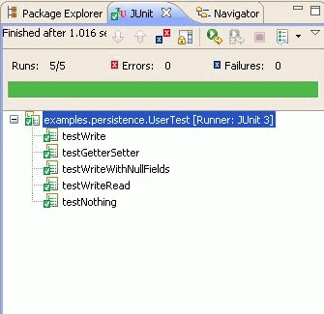
JS In need of the TDD cycle
How can we improve upon this?
Dynamic langs even need more tests! (no comiple-time errors)
Forces us to think about design & separation when implementing
We already have the skill & apply it to Java (or lang. x) everyday?!
<number>

Slide 13
Improving zombies (1)
var Zombies = (function() {
var Zombie = {
getHit: function(damage) {
this.health -= damage;
},
…
}
return {
Create: function() { return Object.create(Zombie); }
}
})();
<number>

Slide 14

Improving zombies (1)
What happened?
Create a Module to test separately
Include the module in the HTML file
Encapsulate logic, as we would in Java
So now I can test “module.js” as a separate unit.
<number>

Slide 15

Improving zombies (1)
What's a “module”? What are closures? Aaarghhh ??!!?!!1 /bail
https://github.com/jefklak/javascript-courses
<number>

Slide 16


But... how? Use instead of
public class MyTest {
@Before
public void setUp() { … }
@Test
public void plantShouldGrow() {
Plant plant = new Plant();
Plant.water();
Assert.assertEquals(1, plant.size);
}
}
describe(“my test suite”, function() {
beforeEach(function() { … });
it(“should grow when watered” function(){
var plant = Object.create(Plant);
plant.water();
expect(plant.size).toEqual(1);
});
});
<number>

Slide 17
But... how?
…
// you can crete your own matchers
expect(expression).matcher(arguments);
// you can nest tests all the way you want
describe(“module 1”, function() {
it(“should this or that”, …);
describe(“submodule from 1”, function() {
it(“should do that or whatever”, …);
});
});
<number>

Slide 18
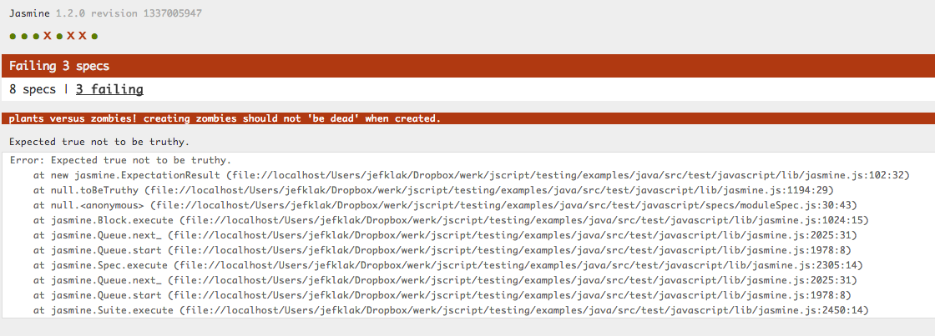
Output results
<number>

Slide 19

So... what should I test?
What do you think?
?
Everything of course!
Logic & related behaviour
UI & related behaviour
<number>

Slide 20
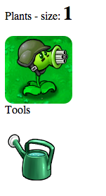

Okay, how do I test UI stuff?
Also with
Use custom matchers (for jQuery)
Use fixtures
What about ?
Too slow, too cumbersome, not specific enough
<number>

Slide 21
Improving zombies (2)
What happened?
Create a UI Module to test separately
Include the module in the HTML file (we now have 2)
Test as an “integration” test by using fixtures
<number>

Slide 22
Improving zombies (2)
it(“should kill the zombie after shooting it like hell”, function() {
$(“#can”).click(); // give the plant some power
$(“#plant”).click().click().click(); // shoot 3 times
expect($(“#zombie”)).not.toExist();
});
<number>

Slide 23


Back to our integration problem
Running JS tests in-browser using SpecRunner.html is cumbersome
Generates different output: no JUnit XML Reports
“one command to test them all”: mvn test
<number>

Slide 24
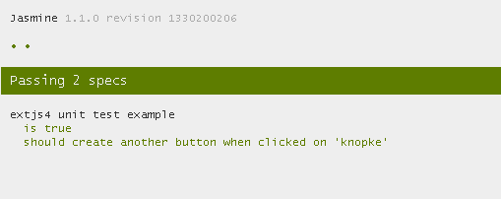
option #1: headful
Run SpecRunner.html in a real browser
= slooooow & in need of parsing results (?)
<number>

Slide 25
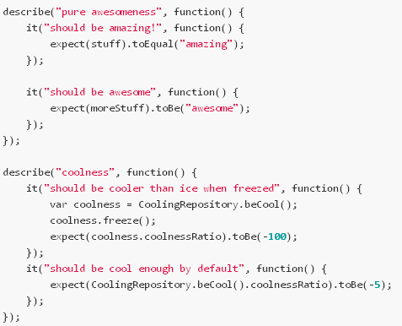
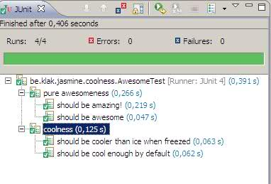
option #2: headless – Jasmine JS Runner
Run JS specs in JVM & convert results to JUnit equivalent
https://github.com/jefklak/jasmine-junit-runner
<number>

Slide 26

Option #2 – how does this work?
Use Env.js to emulate DOM (window) in JS
Use Rhino to evaluate JS in JVM context
Parse Jasmine results using a custom reporter
Convert to JUnit's Runner objects; auto-integrates in your IDE
<number>

Slide 27
Option #2 – the Java test eq.
@RunWith(JasmineTestRunner.class)
@JasmineSuite(sources = { "module.js" }, sourcesRootDir = "src/main/javascript")
public class ModuleTest {
}
<number>

Slide 28
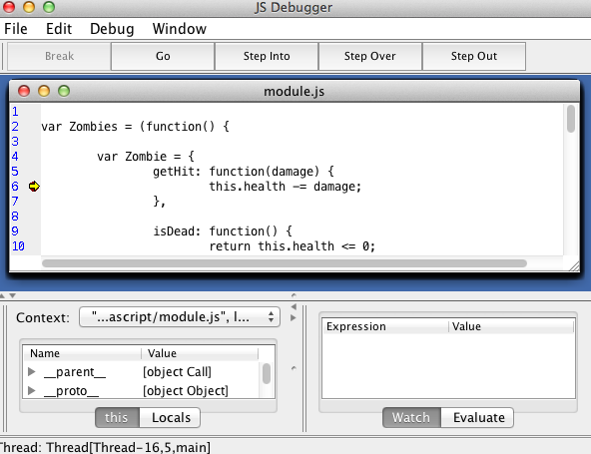
Option #2 – “severe” disadvantages
bad browser behaviour emulation
Requires a Java file for every spec file (for now)
Debugging? @JasmineSuite( debug = true)
Still slow
<number>

Slide 29


Option #3 – a “real” headless browser
Run SpecRunners in
Use a custom reporter to rewrite Jasmine results into JUnit XML structure
Integrate in maven with exec-maven-plugin
<number>

Slide 30
Option #3 – starting jasmine in phantom
page.open(specrunner, function(status) {
if (status === "success") {
utils.core.waitfor(function() { // wait for this to be true
return page.evaluate(function() {
return typeof(jasmine.phantomjsXMLReporterPassed) !== "undefined";
});
}, function() { // once done...
// Retrieve the result of the tests
<number>

Slide 31
Option #3 – “severe” disadvantages
JS runs in sandbox mode within phantom; no (easy) way to access objects from scope
Therefor not usable within JVM or JUnit directly (IDE)
Debugging? Possibly worse...
Browser quirks can only be tested with
<number>

Slide 32
Conclusion
How should I test JS:
Like you're used to: test-first with (instead of JUnit)
What should I test:
Domain logic – use modules!
UI logic – use jQuery & custom matchers
Browser specific quirks: with acceptance tests!
<number>

Slide 33

Conclusion
How should I integrate the whole thing:
Use a headless browser which produces JUnit XML Reports
Non-UI tests can also be integrated in IDE with the jasmine junit runner
<number>

Slide 34

The “no excuses” slide
These are no valid excuses for not testing your JS stuff:
I don't know how or what (you do now)
“But it's only a small event handler” - yeah, so?
“But my JS has been covered by Selenium already!” - really?
Browser specific quirks: with acceptance tests!
But it was late and we had pizza and...
<number>

