Slide 1

JavaScript
Unit testing &
Build integration
Wouter Groeneveld

Slide 2
Why JS Testing
isn’t very popular

Slide 3
javaScript != Java
function doIfYes() {
this.myvar = 10; // whoops
return true;
}
var result = Messagebox.show(“stuff”, doIfYes, doIfNo()); // whoops
doMoreThings(); // whoops
// result should be true if he pressed “YES”, right?

Slide 4
javaScript = HARD
Provided you don’t know
functions are objects
things can be async
scoping details (this)
prototypal inheritance
...

Slide 5
javaScript = EASY
Provided you don’t know
functions are objects
things can be async
scoping details (this)
prototypal inheritance
...

Slide 6
javaScript = EASY
Flexibility of a language
=
Complexity
With great power...

Slide 7
Why JS Testing
isn’t very popular
separation of concerns ☹
(UI/Domain, and how to test)

Slide 8
Why JS Testing
isn’t very popular
lack of any standard ☹
Browser quirks
ES5: .each() <= for(blah in ...)
1548 APIs, none do exactly what you need
One unit testing framework to rule them all?

Slide 9
Why JS Testing
isn’t very popular
lack of integration ☹
How do I…
run my JS tests together with Java @Tests?

Slide 10
How to unit test
And what to unit test

Slide 11
How to unit test
Use the test-first approach!
Apply your knowledge of any other language:
separate logic
write modules
keep methods (& names) small & clear

Slide 12
How to unit test
Write modules
var Module.W = (function() {
return {
publicA: a
};
})();
Makes testing easier...

Slide 13

How to unit test
Use as your Junit replacement
describe(“my calc”, function() {
it(“should be able to add two numbers”, function() {
expect(calc.add(2, 2)).toEqual(4);
});
});
= The “one ring”

Slide 14
What to unit test
Use - also for UI tests (jQuery)
it(“should be visible when clicked”, function() {
$(“#button”).click();
expect($(“#container”)).toBeVisible();
});
custom matchers - https://github.com/velesin/jasmine-jquery:
toBeHidden()
toBeChecked()
toContain()
toHaveCSS()
...

Slide 15


Slide 16
What to unit test
Use - also for UI tests (ExtJS 4)
it(“bla", function() {
var panel = Ext.create('WizardPanelWithComboboxen');
panel.down(“component”).setRawValue(“stuff”);
expect(panel.getValues()).toEqual([1, 2, 3]);
});
=> Proper setup of your Ext.application needed!

Slide 17
What to unit test
Use - also for async tests (callbacks)
it(“should be true when ajax call done”, function() {
var done = false;
doCall(function() {
done = true;
});
waitsFor(function() { return done; });
runs(function() {
expect(yourStuff).toBeCool();
});
});

Slide 19
What to unit test
Use - also for async tests (callbacks)
https://github.com/jefklak/jasmine-sync-flow
it("should be awesome", function() {
when(function() {
myRepository.saveStuff(this);
},function() {
doMoreAsyncStuff(this);
}).then(function() {
expect(more).toEqual(otherStuff);
});
});

Slide 20

so...
What to unit test?
Everything, duh!

Slide 21
How NOT to JS test
Using acceptance tests to cover everything
(webdriver, selenium, ...)

Slide 22
How to integrate JS tests
with your build

Slide 23
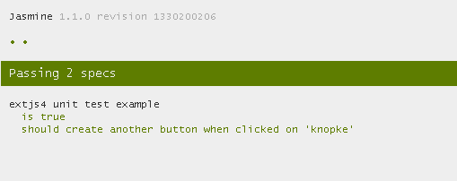
integration
headful:
suite.html

Slide 24
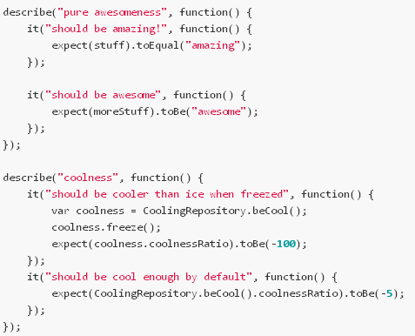
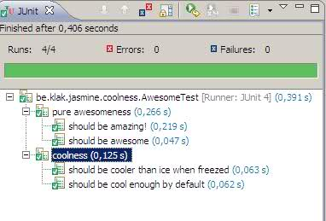
integration
headless:
Jasmine Junit Runner
https://github.com/jefklak/jasmine-junit-runner

Slide 25
Jasmine Junit Runner
Create a Java Test class which runs your jasmine spec:
@RunWith(JasmineTestRunner.class)
@JasmineSuite(sources = {
'jQuery.js', 'myAwesomeCode.js' } )
public class MyAwesomeTest { }
Requires Java files for every x spec file
Does integrate with your IDE
Creates a Junit XML report like any other Junit test
Runs headless within Rhino context, using env.js as DOM emulator
No suite html files required
Debugging with Rhino is possible but not optimal

Slide 27

integration
headless:
http://phantomjs.org/
Full browser stack (Webkit running in Qt frame) -> no hacks required
headless & fast(er) (no Rhino interpreter required)
Browses & evaluates to your suite html files
Not in JVM so not possible to integrate with IDE
Use in combination with jasmine Junit XML Reporter plugins for your CI

Slide 28

integration
...
<execution>
<id>jsunit</id>
<phase>test</phase>
<goals>
<goal>exec</goal>
</goals>
</execution>
</executions>
<configuration>
<executable>phantomjs.exe</executable> <workingDirectory>lib</workingDirectory>
<arguments>
<argument>run-jasmine.js</argument> <argument>./../suite.html</argument> <argument>surefire-reports</argument>
</arguments>
</configuration>
...

Slide 30

Biggest differences
Using Rhino to evaluate JS:
JS Scope & context control within the JVM!
Using Phantom to evaluate JS:
No access to sandbox world - need to write to files in JS space

Slide 31
So…
Lack of integration -> phantom + maven or embedded Java tests
Lack of standard -> jasmine as a base (extensible)
Separation of concerns -> split up logic like you’re used to & test behaviour!
Browser quirks
stick to ES5 + one UI lib (jQuery)
Test headless in a real browser: Phantom
Test quirks with webdriver in separate browsers

Slide 32


