Slide 2

Javascript Unit Testing &
Build Integration
Wouter Groeneveld
Agile software developer at Cegeka
wouter.groeneveld@gmail.com
Twitter: @cegeka

Slide 3
Wouter Groeneveld
Who am I?
Agile software developer @ Cegeka for 5 years;
a.k.a. dynamic languages fanboy
a.k.a. (alas...) Javascript guru
(taught various JS & engineering courses, I used to be just the “expert”)
Likes to inspire others and improve himself.

Slide 4
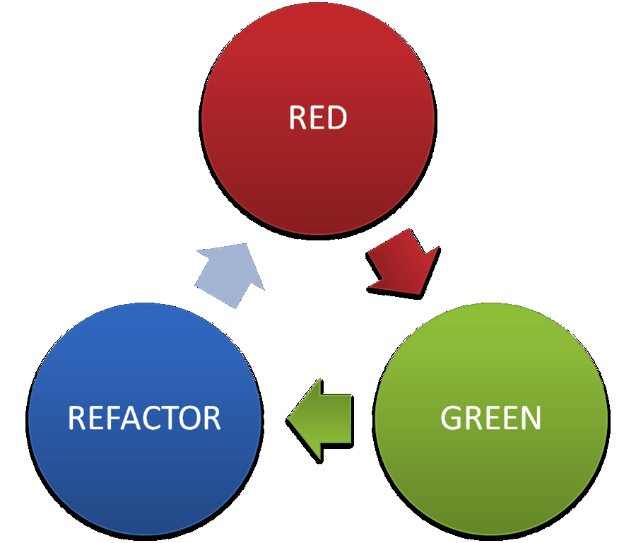
Working with JavaScript

Slide 5
JS <> Java
JS is a dynamic language
JS has functions as first-class citizens
JS' callback mechanics works different
JS does not have block level scoping
JS does not have classes (prototypal inheritance)
...

Slide 6



JS <> Java
Something NEW that we're AFRAID of?

Slide 7
JS <> Java
Things that make it even harder to test properly:
Lack of standard (browser quirks, “the one” testing/DOM/... API, ...)
Lack of integration with usual build cycle
How do I... @Test in JS? mvn clean install? ...

Slide 8

So “doing JS” equals...
“let's get it over with”?
Nasty, completely untestable code
UI & Domain interleaved
All violating separation of concerns?

Slide 9

JavaScript, the ugly parts
(open doen main_ugly.html)

Slide 10
Zombies (very ugly)
$(function() {
// what's this counters?
var zombie = 3;
var plant = 0;
function updateHealth() {
$("#health").html(zombie);
// domain logic alert
if(zombie <= 0) {
$("#zombie").hide("slow");
}
}
...

Slide 11
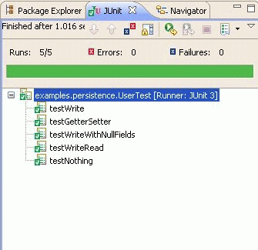
JS In need of the TDD cycle
How can we improve upon this?
Dynamic langs even need more tests!
(no compile-time errors)
Forces us to think about design
& separation when implementing
We already have the skill
& apply it to Java (or lang. x) everyday?!

Slide 12
Improving zombies (1)
var Zombies = (function() {
var Zombie = {
getHit: function(damage) {
this.health -= damage;
},
…
}
return {
Create: function() { return Object.create(Zombie); }
}
})();

Slide 13

Improving zombies (1)
What happened?
Create a Module to test separately
Include the module in the HTML file
Encapsulate logic, as we would in Java
So now I can test “module.js” as a separate unit.

Slide 14

Improving zombies (1)
What's a “module”? What are closures? Aaarghhh ??!!?!!1 /bail
https://github.com/jefklak/javascript-courses

Slide 15


But... how? Use instead of
public class MyTest {
@Before
public void setUp() { … }
@Test
public void plantShouldGrow() {
Plant myPlant = new Plant();
myPlant.water();
Assert.assertEquals(1, myPlant.size);
}
}
describe(“my test suite”, function() {
beforeEach(function() { … });
it(“should grow when watered”,function(){
var myPlant = Object.create(Plant);
myPlant.water();
expect(myPlant.size).toEqual(1);
});
});

Slide 16
But... how?
…
// you can create your own matchers
expect(expression).matcher(arguments);
// you can nest tests all the way you want
describe(“module 1”, function() {
it(“should this or that”, …);
describe(“submodule from 1”, function() {
it(“should do that or whatever”, …);
});
});

Slide 17
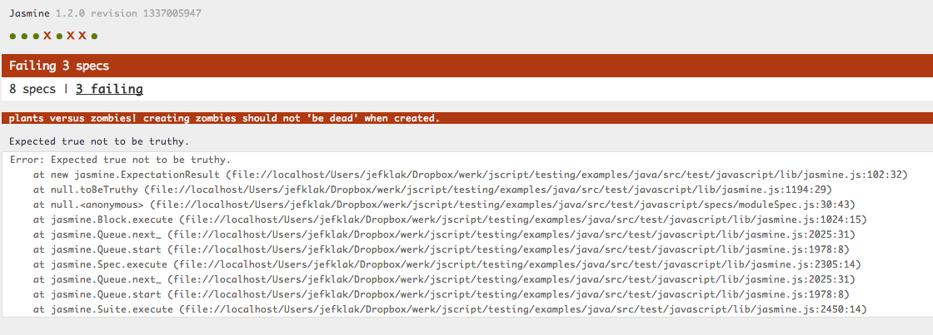
Output results

Slide 18

So... what should I test?
What do you think?
?
Everything of course!
Logic & related behavior
UI & related behavior

Slide 19
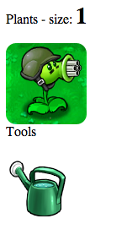

Okay, how do I test UI stuff?
Also with
Use custom matchers (for jQuery)
https://github.com/velesin/jasmine-jquery
Use fixtures
(If needed, use mocks and spies)
What about ?
Too slow, too cumbersome, not specific enough

Slide 20
Improving zombies (2)
What happened?
Create a UI Module to test separately
Include the module in the HTML file (we now have 2)
Test as an “integration” test by using fixtures

Slide 21
Improving zombies (2)
it(“should kill the zombie after shooting it like hell”, function() {
$(“#can”).click(); // give the plant some power
$(“#plant”).click().click().click(); // shoot 3 times
expect($(“#zombie”)).not.toExist();
});

Slide 22


Back to our integration problem
Running JS tests in-browser using SpecRunner.html is cumbersome
Generates different output: no JUnit XML Reports
“one command to test them all”: mvn test

Slide 23
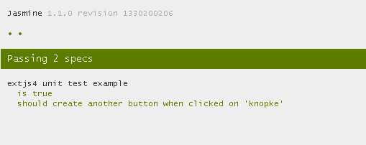
option #1: headful
Run SpecRunner.html in a real browser
= slooooow & in need of parsing results (?)

Slide 24
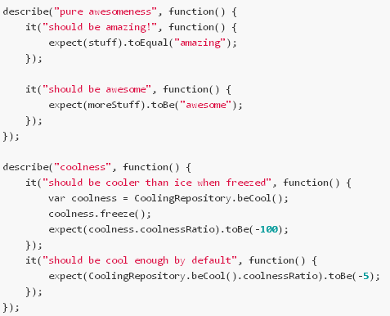
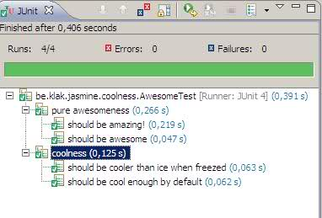
option #2: headless – Jasmine JS Runner
Run JS specs in JVM & convert results to JUnit equivalent
https://github.com/jefklak/jasmine-junit-runner

Slide 25

Option #2 – how does this work?
Use Env.js to emulate DOM (window) in JS
Use Rhino to evaluate JS in JVM context
Parse Jasmine results using a custom reporter
Convert to JUnit's Runner objects; auto-integrates in your IDE

Slide 26
Option #2 – the Java test eq.
@RunWith(JasmineTestRunner.class)
@JasmineSuite(sources = { "module.js" }, sourcesRootDir = "src/main/javascript")
public class ModuleTest {
}

Slide 27
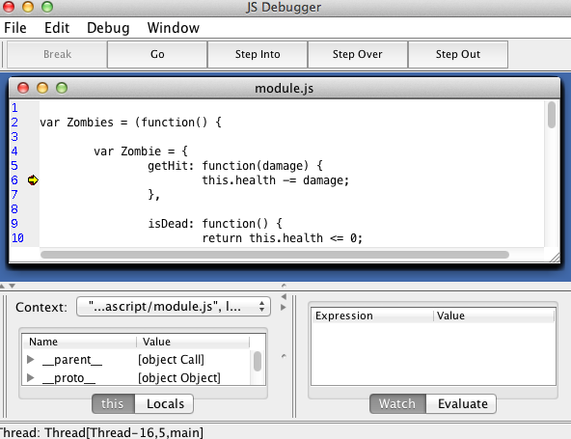
Option #2 – “severe” disadvantages
bad browser behavior
emulation
Requires a Java file
for every spec file (for now)
Debugging?
@JasmineSuite(
debug = true)
Still slow

Slide 28


Option #3 – a “real” headless browser
Run SpecRunners in
Use a custom reporter to rewrite Jasmine
results into JUnit XML structure
Integrate in maven with
exec-maven-plugin

Slide 29
Option #3 – starting jasmine in phantom
page.open(specrunner, function(status) {
if (status === "success") {
utils.core.waitfor(function() { // wait for this to be true
return page.evaluate(function() {
return typeof(jasmine.phantomjsXMLReporterPassed) !== "undefined";
});
}, function() { // once done...
// Retrieve the result of the tests

Slide 30
Option #3 – “severe” disadvantages
JS runs in sandbox mode within phantom;
no (easy) way to access objects from scope
so not usable within JVM or JUnit directly (IDE)
Debugging? Possibly worse...
Browser quirks can only be tested with

Slide 31
Conclusion
How should I test JS:
Like you're used to: test-first with (instead of JUnit)
What should I test:
Domain logic – use modules!
UI logic – use jQuery & custom matchers
Browser specific quirks: with acceptance tests!

Slide 32
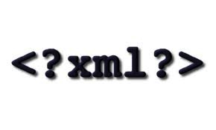
Conclusion
How should I integrate the whole thing:
Use a headless browser which produces JUnit XML Reports
Non-UI tests can also be integrated in IDE with the jasmine JUnit runner

Slide 33
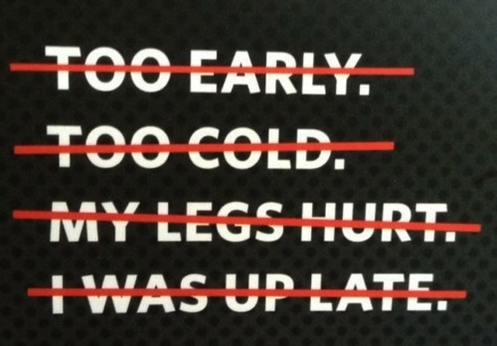
The “no excuses” slide
These are no valid excuses for not testing your JS stuff:
I don't know how or what (you do now)
“But it's only a small event handler” - yeah, so?
“But my JS has been covered
by Selenium already!” - really?
Browser specific quirks: with acceptance tests!
But it was late and we had pizza and...

