Slide 1
SBI Hotel Management System
Course Project for CSCI 352
Jeffrey Jordan and Kevin Patel

Slide 2
Background
A day to day hotel management system that handles checking in and checking out only.
We started this project to aid a team member’s family’s business.
How to run a hotel. Room information must be already known as well.
Future work will be done: save feature, future reservation.

Slide 3
Approach
This is a GUI project built with C# inside Visual Studio’s framework.
No extra libraries than the start-up libraries of VS.
Decorator and Observer.

Slide 4
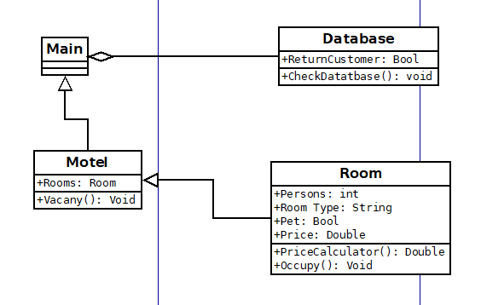
Class Diagrams

