Slide 1
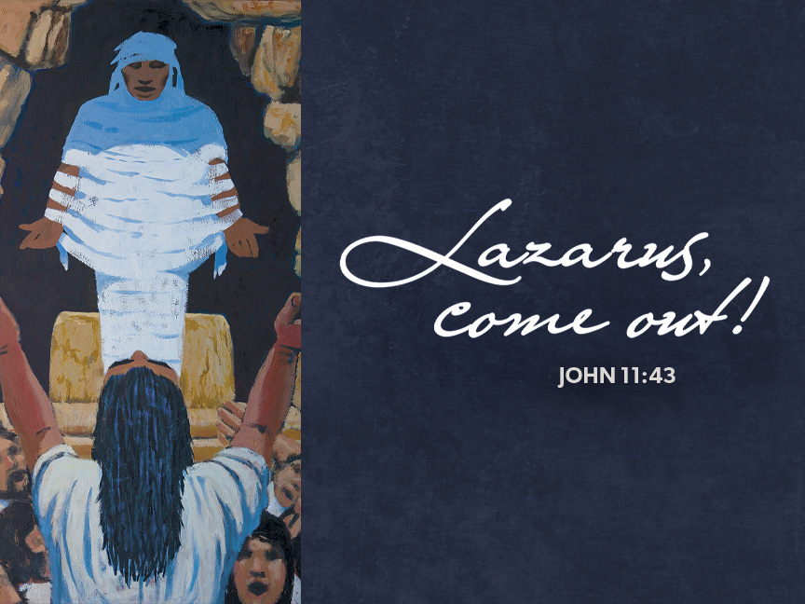

Slide 2
Confession and Forgiveness
P: Blessed be the holy Trinity, one God, who journeys with us these forty days, and sustains us with the gift of grace. C: Amen.

Slide 3
Confession and Forgiveness
P: Let us acknowledge before God and one another our need for repentance and God’s mercy. Holy God, C: we confess to you our faults and failings. Too often we neglect and do not trust your holy word; we take for ourselves instead of giving to others; we spoil rather than steward your creation; we cause hurt though you call us to heal; we choose fear over compassion.

Slide 4
Confession and Forgiveness
Forgive us, renew us, and lead us, as we seek to follow in your way of life. Amen.

Slide 5
Confession and Forgiveness
P: Hear the good news: God so loved the world that God gave the only Son, so that all may receive life. This promise is for you! God embraces you with divine mercy, God forgives you in Christ’s name, and revives you in the Spirit’s power. C: Amen.

Slide 6
O For a Thousand Tongues to Sing ELW 886

Slide 7
Greeting
P: The grace of our Lord Jesus Christ, the love of God, and the communion of the Holy Spirit be with you all. C: And also with you.

Slide 8
Kyrie
Have mercy on us, Lord, and hear our solemn prayer. We come to hear your living word; it saves us from despair. Have mercy on us, Christ, and wash away our sin. Pour out your grace and make us whole that new life may begin.

Slide 9
Kyrie
Have mercy on us, Lord, make sin and shame depart. Renew us with your saving pow’r; create in us new hearts!

Slide 10
Prayer of the Day
Almighty God, your Son came into the world to free us all from sin and death. Breathe upon us the power of your Spirit, that we may be raised to new life in Christ and serve you in righteousness all our days, through Jesus Christ, our Savior and Lord, who lives and reigns with you and the Holy Spirit, one God, now and forever. Amen.

Slide 11
Ezekiel 37:1-14

Slide 12
First Reading
¹The hand of the Lord came upon me, and he brought me out by the spirit of the Lord and set me down in the middle of a valley; it was full of bones. ²He led me all around them; there were very many lying in the valley, and they were very dry.³He said to me, “Mortal, can these bones live?” I answered, “O Lord God, you know.”⁴Then he said to me, “Prophesy to these bones, and say to them: O dry bones, hear the word of the Lord.⁵Thus says the Lord God to these bones: I will cause breath to enter you, and you shall live.⁶I will lay sinews on you, and

Slide 13
First Reading
will cause flesh to come upon you, and cover you with skin, and put breath in you, and you shall live; and you shall know that I am the Lord.”⁷So I prophesied as I had been commanded; and as I prophesied, suddenly there was a noise, a rattling, and the bones came together, bone to its bone.⁸I looked, and there were sinews on them, and flesh had come upon them, and skin had covered them; but there was no breath in them.⁹Then he said to me, “Prophesy to the breath, prophesy, mortal, and say to the breath: Thus says the Lord God: Come

Slide 14
First Reading
from the four winds, O breath, and breathe upon these slain, that they may live.”¹⁰I prophesied as he commanded me, and the breath came into them, and they lived, and stood on their feet, a vast multitude.¹¹Then he said to me, “Mortal, these bones are the whole house of Israel. They say, ‘Our bones are dried up, and our hope is lost; we are cut off completely.’¹²Therefore prophesy, and say to them, Thus says the Lord God: I am going to open your graves, and bring you up from your graves, O my people; and I will bring you back to the land of

Slide 15
First Reading
Israel.¹³And you shall know that I am the Lord, when I open your graves, and bring you up from your graves, O my people.¹⁴I will put my spirit within you, and you shall live, and I will place you on your own soil; then you shall know that I, the Lord, have spoken and will act, says the Lord.” The word of the Lord, Thanks be to God.

Slide 16
Psalm 130

Slide 17
Psalm 130
¹Out of the depths I cry to you, O Lord; ²O Lord, hear my voice! Let your ears be attentive to the voice of my supplication. ³If you were to keep watch over sins, O Lord, who could stand? ⁴Yet with you is forgiveness, in order that you may be feared. ⁵I wait for you, O Lord; my soul waits; in your word is my hope. ⁶My soul waits for the Lord more than those who keep watch for the morning, more than

Slide 18
Psalm 130
those who keep watch for the morning. ⁷O Israel, wait for the Lord, for with the Lord there is steadfast love; with the Lord there is plenteous redemption. ⁸For the Lord shall redeem Israel from all their sins.

Slide 19
Romans 8:6-11

Slide 20
Second Reading
⁶To set the mind on the flesh is death, but to set the mind on the Spirit is life and peace.⁷For this reason the mind that is set on the flesh is hostile to God; it does not submit to God’s law—indeed it cannot,⁸and those who are in the flesh cannot please God.⁹But you are not in the flesh; you are in the Spirit, since the Spirit of God dwells in you. Anyone who does not have the Spirit of Christ does not belong to him.¹⁰But if Christ is in you, though the body is dead because of sin, the Spirit is life because of righteousness.¹¹If the Spirit of him who

Slide 21
Second Reading
raised Jesus from the dead dwells in you, he who raised Christ from the dead will give life to your mortal bodies also through his Spirit that dwells in you. The word of the Lord, Thanks be to God.

Slide 22
Gospel Acclamation
We are turning, Lord, to hear you; you are merciful and kind— slow to anger, rich in blessing, and with love to us inclined.

Slide 23
The holy gospel according to John. Glory to you, O Lord.

Slide 24
Gospel
¹Now a certain man was ill, Lazarus of Bethany, the village of Mary and her sister Martha.²Mary was the one who anointed the Lord with perfume and wiped his feet with her hair; her brother Lazarus was ill.³So the sisters sent a message to Jesus, “Lord, he whom you love is ill.”⁴But when Jesus heard it, he said, “This illness does not lead to death; rather it is for God’s glory, so that the Son of God may be glorified through it.”⁵Accordingly, though Jesus loved Martha and her sister and Lazarus,⁶after having heard that Lazarus was ill, he stayed two days longer

Slide 25
Gospel
in the place where he was.⁷Then after this he said to the disciples, “Let us go to Judea again.”⁸The disciples said to him, “Rabbi, the Jews were just now trying to stone you, and are you going there again?” ⁹Jesus answered, “Are there not twelve hours of daylight? Those who walk during the day do not stumble, because they see the light of this world. ¹⁰But those who walk at night stumble, because the light is not in them.”¹¹After saying this, he told them, “Our friend Lazarus has fallen asleep, but I am going there to awaken him.”¹²The disciples said to

Slide 26
Gospel
him, “Lord, if he has fallen asleep, he will be all right.”¹³Jesus, however, had been speaking about his death, but they thought that he was referring merely to sleep.¹⁴Then Jesus told them plainly, “Lazarus is dead.¹⁵For your sake I am glad I was not there, so that you may believe. But let us go to him.” ¹⁶Thomas, who was called the Twin, said to his fellow disciples, “Let us also go, that we may die with him.”¹⁷When Jesus arrived, he found that Lazarus had already been in the tomb four days.¹⁸Now Bethany was near Jerusalem, some two miles away,

Slide 27
Gospel
¹⁹and many of the Jews had come to Martha and Mary to console them about their brother.²⁰When Martha heard that Jesus was coming, she went and met him, while Mary stayed at home.²¹Martha said to Jesus, “Lord, if you had been here, my brother would not have died.²²But even now I know that God will give you whatever you ask of him.”²³Jesus said to her, “Your brother will rise again.”²⁴Martha said to him, “I know that he will rise again in the resurrection on the last day.”²⁵Jesus said to her, “I am the resurrection and the life. Those who believe

Slide 28
Gospel
in me, even though they die, will live,²⁶and everyone who lives and believes in me will never die. Do you believe this?”²⁷She said to him, “Yes, Lord, I believe that you are the Messiah, the Son of God, the one coming into the world.”²⁸When she had said this, she went back and called her sister Mary, and told her privately, “The Teacher is here and is calling for you.”²⁹And when she heard it, she got up quickly and went to him.³⁰Now Jesus had not yet come to the village, but was still at the place where Martha had met him.³¹The Jews who were

Slide 29
Gospel
with her in the house, consoling her, saw Mary get up quickly and go out. They followed her because they thought that she was going to the tomb to weep there.³²When Mary came where Jesus was and saw him, she knelt at his feet and said to him, “Lord, if you had been here, my brother would not have died.”³³When Jesus saw her weeping, and the Jews who came with her also weeping, he was greatly disturbed in spirit and deeply moved.³⁴He said, “Where have you laid him?” They said to him, “Lord, come and see.”³⁵Jesus began to weep. 36So“Lord, come and see.” 35Jesus began to weep.³⁶So

Slide 30
Gospel
the Jews said, “See how he loved him!”³⁷But some of them said, “Could not he who opened the eyes of the blind man have kept this man from dying?” ³⁸Then Jesus, again greatly disturbed, came to the tomb. It was a cave, and a stone was lying against it. ³⁹Jesus said, “Take away the stone.” Martha, the sister of the dead man, said to him, “Lord, already there is a stench because he has been dead four days.”⁴⁰Jesus said to her, “Did I not tell you that if you believed, you would see the glory of God?” ⁴¹So they took away the stone. And Jesus looked

Slide 31
Gospel
upward and said, “Father, I thank you for having heard me.⁴²I knew that you always hear me, but I have said this for the sake of the crowd standing here, so that they may believe that you sent me.” ⁴³When he had said this, he cried with a loud voice, “Lazarus, come out!”⁴⁴The dead man came out, his hands and feet bound with strips of cloth, and his face wrapped in a cloth. Jesus said to them, “Unbind him, and let him go.”⁴⁵Many of the Jews therefore, who had come with Mary and had seen what Jesus did, believed in him.

Slide 32
Gospel
The gospel of the Lord, Praise to you, O Christ.

Slide 33
Sermon

Slide 34
My Faith Looks Up to Thee ELW 759

Slide 35
Apostle's Creed
I believe in God, the Father almighty, creator of heaven and earth. I believe in Jesus Christ, God’s only Son, our Lord, who was conceived by the Holy Spirit, born of the virgin Mary, suffered under Pontius Pilate, was crucified, died, and was buried; he descended to the dead. On the third day he rose again; he ascended into heaven,

Slide 36
Apostle's Creed
he is seated at the right hand of the Father, and he will come to judge the living and the dead. I believe in the Holy Spirit, the holy catholic church, the communion of saints, the forgiveness of sins, the resurrection of the body, and the life everlasting. Amen.

Slide 37
Prayers of Intercession
Each petition ends: Merciful God, receive our prayer.

Slide 38
Dialogue
The Lord be with you. And also with you. Lift up your hearts. We lift them to the Lord. Let us give thanks to the Lord our God. It is right to give our thanks and praise.

Slide 39
Holy, holy, holy
Holy, holy, holy Lord, God of power and might, heav’n and earth are full of your glory. Hosanna in the highest. Blessed is he who comes in the name of the Lord. Hosanna in the highest, hosanna in the highest.

Slide 40
Communion Dialogue
...Pour out upon us the Spirit of your love, O Lord, and unite the wills of all who share this heavenly food, the body and blood of Jesus Christ, our Lord; to whom, with you and the Holy Spirit, be all honor and glory, now and forever. Amen.

Slide 41
Lord's Prayer
Our Father, who art in heaven, hallowed be thy name, thy kingdom come, thy will be done, on earth as it is in heaven. Give us this day our daily bread; and forgive us our trespasses, as we forgive those who trespass against us; and lead us not into temptation, but deliver us from evil.

Slide 42
Lord's Prayer
For thine is the kingdom, and the power, and the glory, forever and ever. Amen.

Slide 43
Communion

Slide 44
Communion Hymn
O Lamb of God, you bear the sin of all the world away; You suffered death our lives to save: have mercy now, we pray. O Lamb of God, you bear the sin of all the world away; You set us free from guilt and grave: have mercy now, we pray.

Slide 45
Communion Hymn
O Lamb of God, you bear the sin of all the world away; Eternal peace with God you made: give us your peace, we pray.

Slide 46
Prayer after Communion
Embodied God, At your table, we have tasted the goodness of Jesus. With the eyes of our hearts open to your promise, empower us to hear the needs of our neighbors and touch the world with your love. Amen

Slide 47
Benediction
God, the giver of life Christ the resurrection and the life And the Holy Spirit of rebirth, Bless you in the Lenten journey. Amen.

Slide 48
What Wonderous Love is This ELW 666

Slide 49
Dismissal
Go in peace. Serve in love. Thanks be to God.

