Slide 1
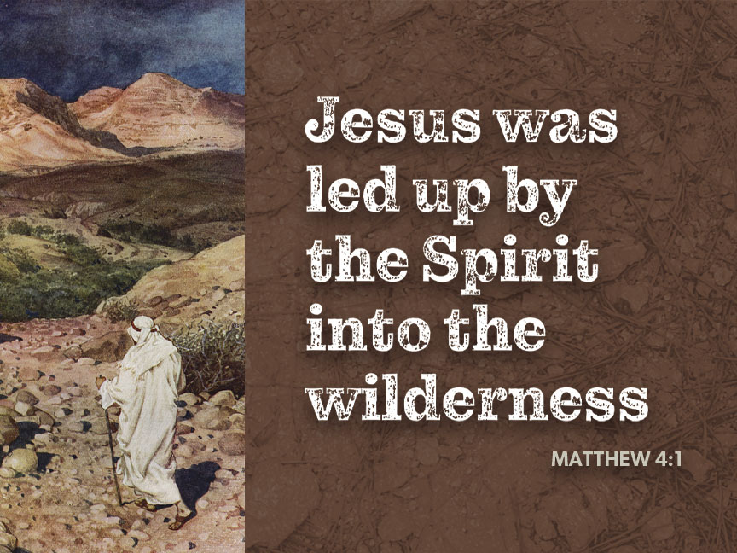
Notes:
Image: Figure in desert. Copyright © Lebrecht Music & Arts/Alamy Stock Photo. Used by permission.

