Slide 1
ZeroGrad: Costless conscious remedies for catastrophic overfitting in the FGSM adversarial training
Nikan Vasei,
Sero Hartounian,
Erfan Jafari,
Seyed Mohammadreza Khosravian

Slide 2
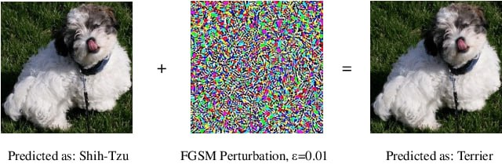
Introduction
Despite deep neural networks impressive success in many real-world problems, their instability under test-time adversarial noises is the major issue against their use in the safety critical applications.
Adversarial refers to a type of scenario or attack where the input data is intentionally manipulated in a subtle way to deceive the model into making incorrect predictions or classifications. These manipulated inputs are known as adversarial noises.

Slide 3
Types of Adversarial Attacks
Projected Gradient Descent (PGD):
A multi-step, iterative method that applies small perturbations over several steps to maximize the model's prediction error.
Makes crafting the adversarial perturbations very slow, and sometimes infeasible in case of large datasets and models
Fast Gradient Sign Method (FGSM):
A single-step method where small perturbations are added to the input in the direction that increases the model's prediction error.
results in a poor model generalization under the stronger test-time multi-step PGD attack.

Slide 4
Improving FGSM (1)
FGSMRS:
Adding uniform noise to training data
Still a large gap of accuracy between PGD and this method
Mysterious phenomenon called Catastrophic Overfitting
Drastic drop of accuracy under a strong attack
Many methods have been suggested for “catastrophic overfitting" like early stopping but none has been optimal.

Slide 5
Improving FGSM (2)
GradAlign:
Regularizes the model weights during training to make the input gradients more aligned with each other within the set of allowed perturbed inputs
Best when the loss behaves linearly as a function of the input
The computational cost of the regularization step is considerable
ZeroGrad:
Proposed in this paper
Achieves significantly better adversarial accuracy in the CIFAR-10 dataset

Slide 6
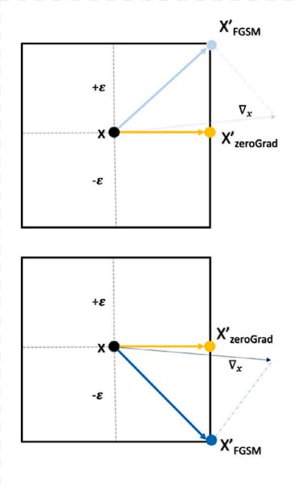
ZeroGrad
Zeroing out the input gradient elements whose absolute values are below a certain threshold
If sign of this small component (ΔX) of the input gradient changes in two consecutive epochs then X_{FGSM} is not consistent but X_{ZeroGrad} is consistent.
Such simple remedies prevent catastrophic overfitting.
In summary, we hypothesize that tiny fragile input gradients play a key role in catastrophic overfitting. Our intuition is that due to the discontinuity of the “sign” function in FGSM, elements of the input gradient that are close to zero could cause unexpected drastic change in the attack and result in large weight updates in two consecutive epochs

Slide 7
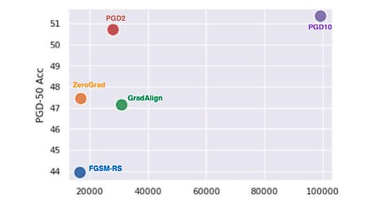
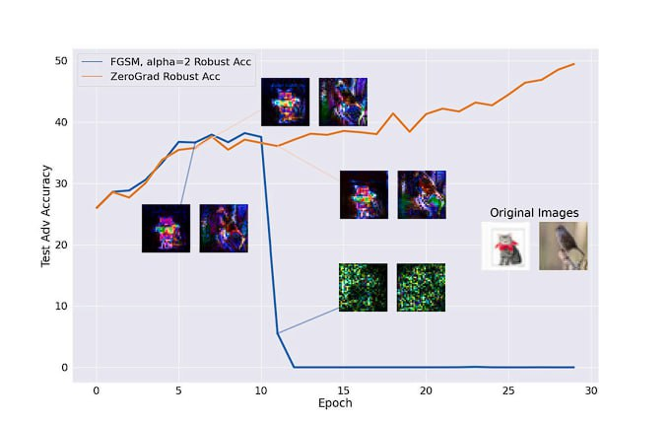
What ZeroGrad Offers
Proposing a computationally inexpensive method to avoid catastrophic overfitting
A more comprehensive explanation of catastrophic overfitting through associating the weight update with the input gradient magnitude.
Competitive adversarial accuracy on various datasets under no significant train-time overhead

Slide 8
Diving deeper into ZeroGrad
Combining FGSM adversarial training with random initialization can result in a simple method that is just effective as the PGD-based adversarial training with a low training cost.
Identification of the catastrophic overfitting as a failure mode.
Comprehensive understanding of this failure mode, and developing new methods that could solve this issue.

Slide 9
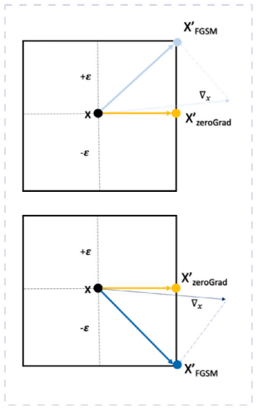
Basic Idea
Certain elements in the input gradient, whose magnitudes are susceptible to change their sign.
This susceptibility could for example stem from such elements being close to zero.
We call these critical elements, tiny fragile gradients.
Discontinuity of the “sign” function that is part of the FGSM.
Large weight updates in a training iteration.
Solution?
Zeroing out tiny fragile gradients
How to avoid?
Avoid occurrence of catastrophic overfitting by explicitly zeroing these tiny gradients.

Slide 10
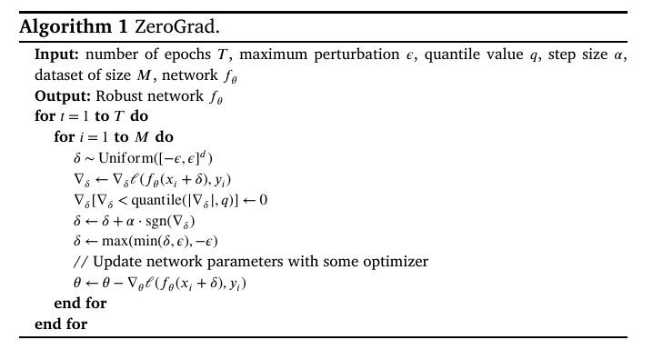
How ZeroGrad works?

Slide 11
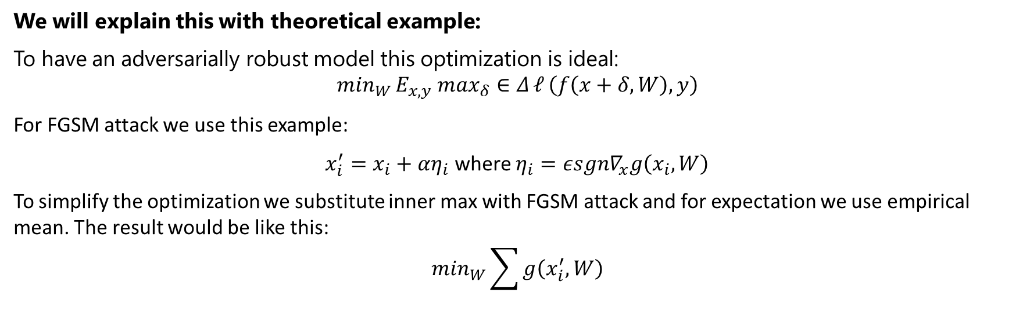
Causes of catastrophic overfitting (1)
We will explain this with theoretical example:
To have an adversarially robust model this optimization is ideal:
$$m{in}_{W }E_{x,y} max_{δ}∈Δ{𝓁}\left(f\left(x+δ,W\right),y\right)$$
For FGSM attack we use this example:
$x_{i}^{′}=x_{i}+αη_{i}$ where $η_{i}=εsgn∇_{x}g\left(x_{i},W\right)$
To simplify the optimization we substitute inner max with FGSM attack and for expectation we use empirical mean. The result would be like this:
$$min_{W}\sum{g\left(x_{i}^{′},W\right)}$$

Slide 12
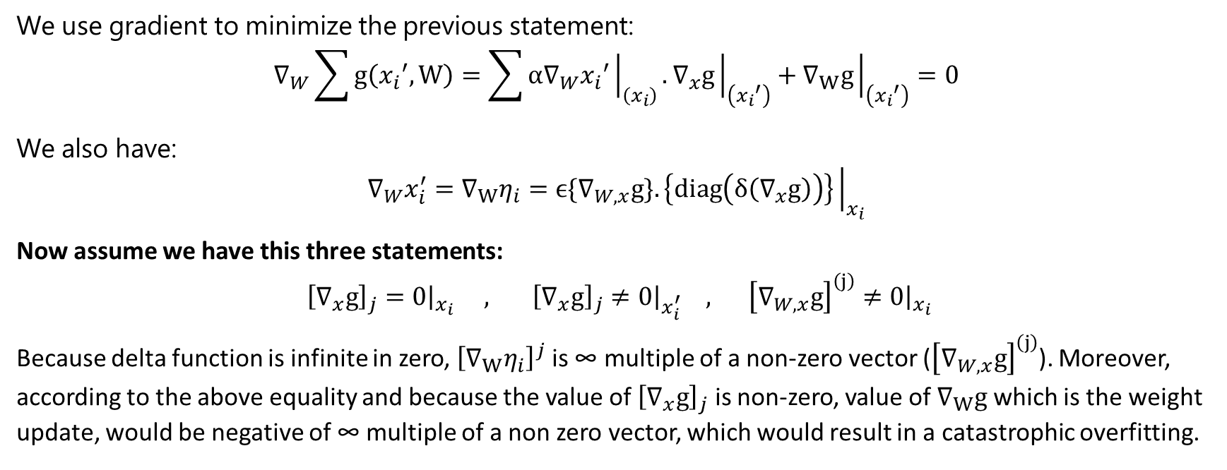
Causes of catastrophic overfitting (2)
We use gradient to minimize the previous statement:
$$∇_{W}\sum{g\left({x_{i}}^{′},W\right)}=\sum{α∇_{W}{x_{i}}^{′}{\left.​\right|}_{\left(x_{i}\right)}}.∇_{x}g{\left.​\right|}_{\left({x_{i}}^{′}\right)}+∇_{W}g{\left.​\right|}_{\left({x_{i}}^{′}\right)}=0$$
We also have:
$$∇_{W}x_{i}^{′}=∇_{W}η_{i}=ϵ{\{∇}_{W,x}g\}.\left\{diag\left(δ\left(∇_{x}g\right)\right)\right\}{\left.​\right|}_{x_{i}}$$
Now assume we have this three statements:
${\left[∇_{x}g\right]}_{j}=0{\left.​\right|}_{x_{i}} , {\left[∇_{x}g\right]}_{j}≠0{\left.​\right|}_{x_{i}^{′}} , {\left[∇_{W,x}g\right]}^{\left(j\right)}≠0{\left.​\right|}_{x_{i}}$
Because delta function is infinite in zero, ${\left[∇_{W}η_{i}\right]}^{j}$ is ∞ multiple of a non-zero vector (${\left[∇_{W,x}g\right]}^{\left(j\right)}$). Moreover, according to the above equality and because the value of ${\left[∇_{x}g\right]}_{j}$ is non-zero, value of $∇_{W}g$ which is the weight update, would be negative of ∞ multiple of a non zero vector, which would result in a catastrophic overfitting.

Slide 13
Causes of catastrophic overfitting (3)
In GradAlign method, we solve this problem by smoothly changing input gradients but it will increase the training time.
In ZeroGrad method, we zero out the tiny input gradients so that the training would not encounter large weight updates close to the local optima.

Slide 14
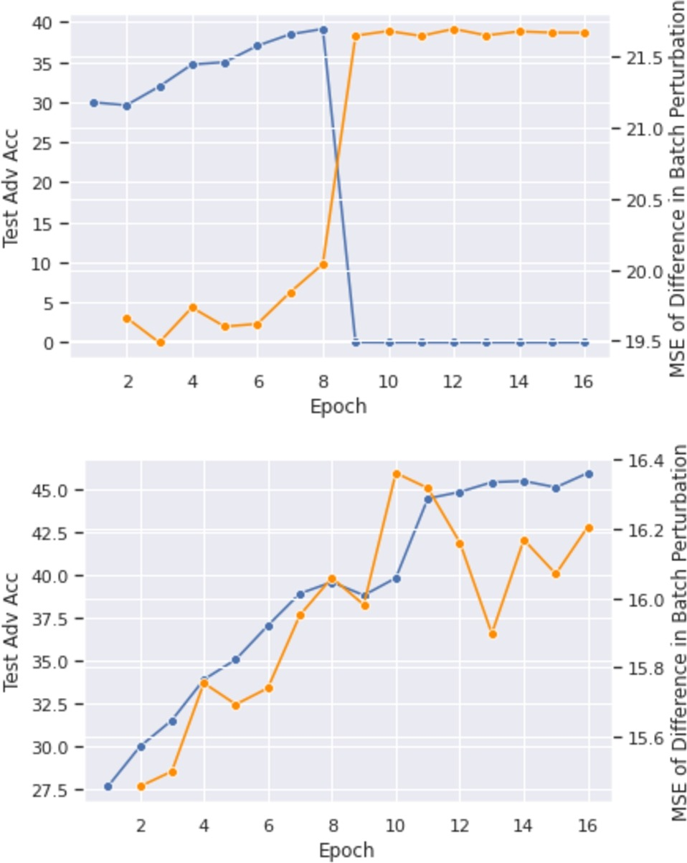
Numerical results
In first graph, we used FGSM-RS and we can see in epoch 9, a catastrophic overfitting has happened and test adversarial accuracy of the model has dropped.
In second graph, we used ZeroGrad and zeroed out 35 percent quantile of the absolute input gradients to zero and we prevented the drastic change of perturbations.

Slide 15
Experimental Evaluation of ZeroGrad
Effectiveness on CIFAR-10, CIFAR-100, and SVHN will be demonstrated using:
Proposed Method (ZeroGrad)
FGSM-RS (with tuned step size)
GradAlign
Test-time Attacks and models, Learning rate schedules and Some setup for the proposed method have been considered also.

Slide 16
CIFAR-10, CIFAR-100, SVHN and ImageNet
CIFAR-10: Model can be trained for higher epochs without encountering catastrophic overfitting, with some appropriate settings, such as piecewise learning rate schedule.
CIFAR-100: ZeroGrad outperfroms other models that are using single-step AT. Main contribution of ZeroGrad is that is provides simplicity, speed, and high robust accuracy.
SVHN: Slightly different results, due to nature of this dataset; Large portion of image is without any information, may cause appearance of fragile gradients.
ImageNet: Using Resnet-50, 15 epochs of training divided into three phase. In this dataset, catastrophic overfitting won’t happen to ZeroGrad.

Slide 17
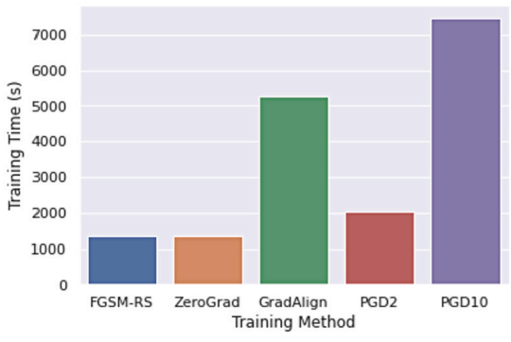
AutoAttack and Training Time
Robustness of models is tested by AutoAttack, which is an ensemble of different attack. These attack combined with each other, can identify defenses that give wrong impression of robustness. It is used to show that, training with method does not cause gradient masking.
Since FGSM-based methods are meant to be fast, here is training time of different methods for 30 epochs, using half precision on CIFAR-10.

Slide 18
Hyperparameter Selection and Adjustment
ZeroGrad has one single hyperparameter, that holds threshold for zeroing the gradients.
Suitable choice of q: related to given problem/dataset.
This appears to be related what percentage of pixels have no/little information about predicting the output.
The dataset can give us some hints about the percentage of pixels that are informative.
In addition to the initial estimation of hyperparameter, it is possible to adjust them using rolling back approach. One of the main consequences of catastrophic overfitting is stopping the training procedure prematurely, i.e. before achieving the best possible performance using that setting. Using our approach, we can prolong training until we get the best results.

Slide 19
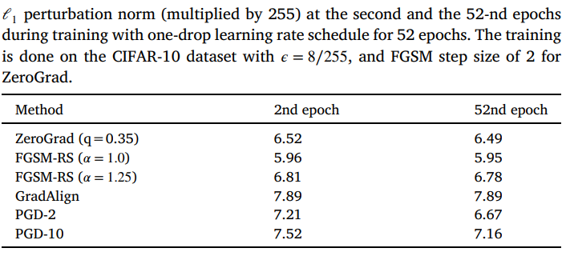
Mean perturbation size
Lowering the perturbation norm is not an ideal solution to avoid catastrophic overfitting, as it may harm the robust accuracy. Here is comparison of proposed techniques with simply reducing the FGSM step size 𝛼 to decrease the perturbation size during training on the CIFAR-10 dataset, and other methods as shown.
All different methods either have a fixed perturbation size during the training, or their perturbation size decreases as the model gets more robust to the adversarial attacks.
Overall, FGSM-RS cannot reach a test robust accuracy close to our methods with any value of the FGSM step size 𝛼. So the mechanism by which our method is avoiding catastrophic overfitting is not simply through shrinkage of the adversarial perturbation.

Slide 20
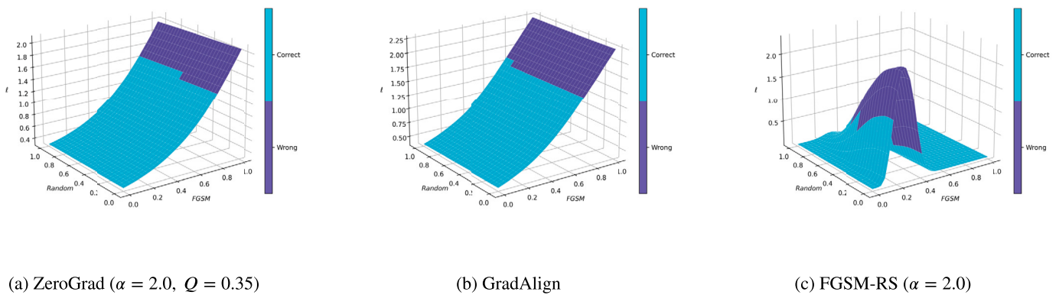
Decision Boundary Distortion
One possible sign of catastrophic overfitting in a model: distortion in decision boundary (Why?)
In the case of distortion, the loss surface of the overfitted model is curved and non-linear in the 𝜖-ball around the inputs.
Result: Highly robust accuracy against single-step attacks that target the borders of the decision boundary, and a low robust accuracy against multi-step attacks

Slide 21
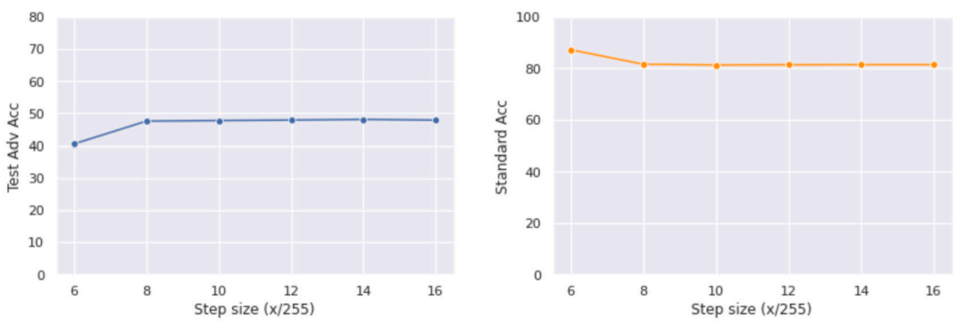
FGSM step size
FGSM-RS can help to slightly mitigate CO for small enough epsilons by adding an initial random noise.
However, this only holds when the step size (𝛼) is limited.
FGSM-RS is vulnerable to the large values of step size, and faces CO.
Here is report of the performance of ZeroGrad with different values for FGSM step size.

Slide 22
Conclusion
The goal here was to understand FGSM and FGSM-RS adversarial training, its unknown phenomenon, “catastrophic overfit” and also suggest solutions to prevent its occurrence
Hypothesis mentioned in this presentation, highlights the role of tiny and fragile input gradients in the training with the fast gradient sign method. Based on this intuition, it proposed an affordable effective method.

Slide 23
Questions & answers

Slide 24
Resources
Golgooni, Zeinab, et al. "Zerograd: Costless conscious remedies for catastrophic overfitting in the fgsm adversarial training." Intelligent Systems with Applications 19 (2023): 200258.

