Slide 1







IBM Capstone Project
Jefte Ntekwa
03/05/2024

Slide 2



OUTLINE
Executive Summary
Introduction
Methodology
Results
Visualization – Charts
Dashboard
Discussion
Findings & Implications
Conclusion
Appendix

Slide 3

EXECUTIVE SUMMARY
I’m assisting with collecting data from various sources and identifying trends for this year’s report on emerging skills
Data I used was collected from various sources such as:
Job posting sites
Training Portals
Surveys

Slide 4

INTRODUCTION
Methodology: Descriptive and Predictive analysis to analyzed the data and identify insights and trends that may affect the results
Questions answered include:
What are the top computer language in demand
What are the top database skills in demand?
What are the most popular IDEs?

Slide 5

METHODOLOGY
Scrap Data from websites
Inspect and clean data using python’s Pandas and NumPy libraries.
Visualized the data using Panda’s Matplotlib, Seaborn, and Folium libraries.
IDE: Visual Studio Code
Dataset sources
Job Posting sites
Training Sites
Surveys

Slide 6
Results
The data collected were filtered as follows:
Top 10 of Programming languages
Top 10 of Database
Platform Worked
Top 10 Web frame
One of the first things you can see is that 3 programming languages tend to be in the top 5 positions, which are:
SQL
JavaScript
HTML/CSS
Most people use similar databases for these 3 programming languages such as:
PostgreSQL
MySQL
One of the most prevalent Platform Worked among these programming languages is Linux.

Slide 7
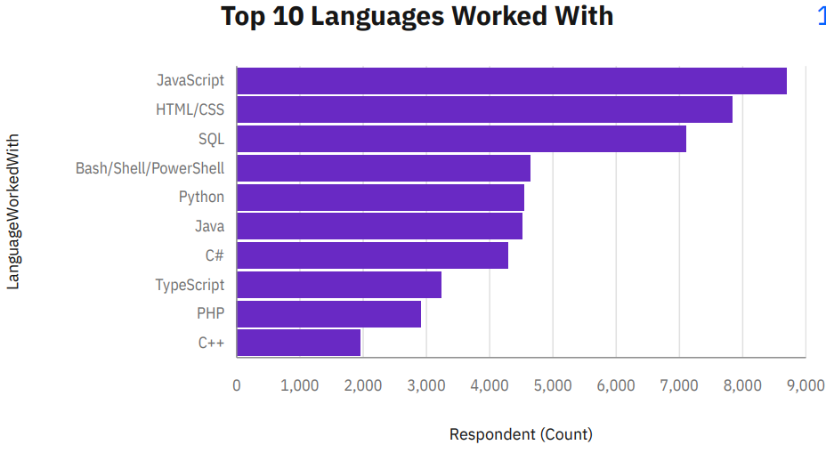
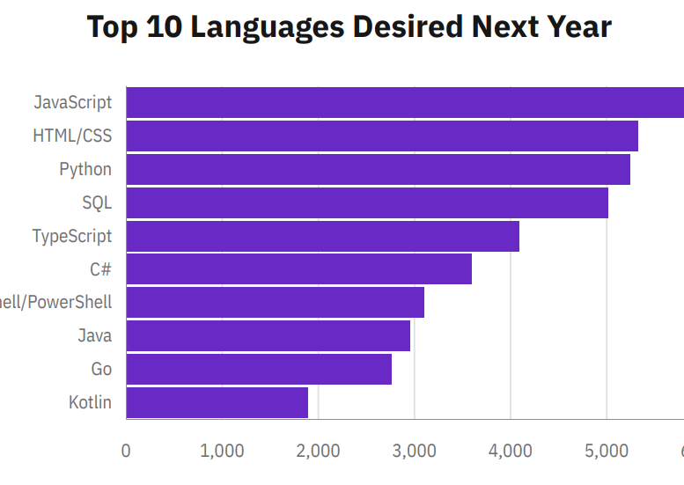
PROGRAMMING LANGUAGE TRENDS
2024
2025

Slide 8
PROGRAMMING LANGUAGE TRENDS - FINDINGS & IMPLICATIONS
Bases on the finding the top 3 most popular programming languages of the current year are:
JavaScript
HTML/CSS
SQL
For next year, the top 3 will be:
JavaScript, HTML/CSS and Python
Implications
JavaScript as one of the most convenient languages to use remains in the first positions
Python is one of the most consistent used languages.
People recognize that 3 of the languages postulated within the first 5 currently can be seen in the future as the most used, this is for the ease of use of these programming languages

Slide 9
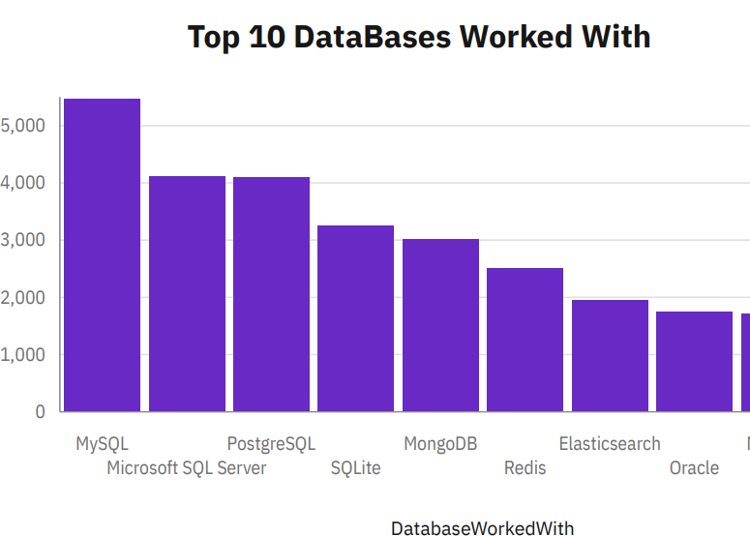
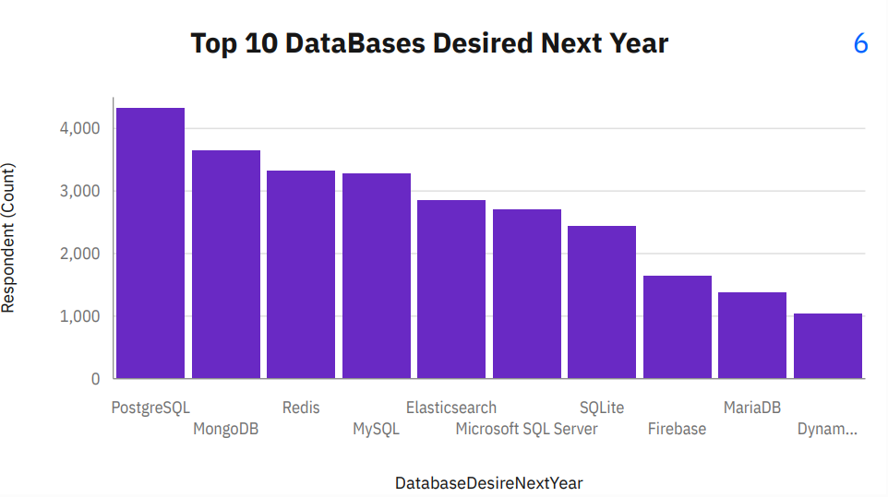
DATABASE TRENDS
2024
2025

Slide 10
DATABASE TRENDS - FINDINGS & IMPLICATIONS
Bases on the finding the top 3 most popular databases of the current year are:
MySQL
Microsoft SQL Server
PostgreSQL
Top 3 most desired languages next year are: PostgreSQL, MongoDB and Redis
Implications
PostgreSQL is slowly becoming the most used database in the US
The most databases are from Microsoft

Slide 11

DASHBOARD
Here is the link of the Dashboard
https://github.com/jeftentekwa/IBM-Data-Analyst-Capstone-Project/blob/main/New%20dashboard.pdf

Slide 12
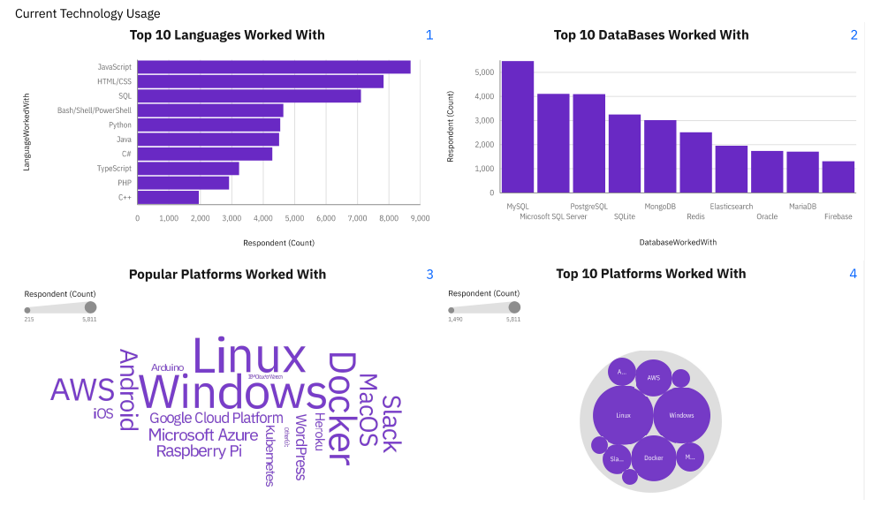
DASHBOARD TAB 1

Slide 13
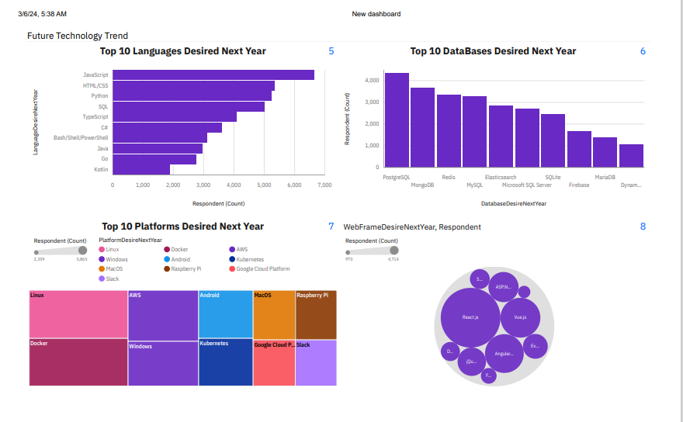
DASHBOARD TAB 2

Slide 14
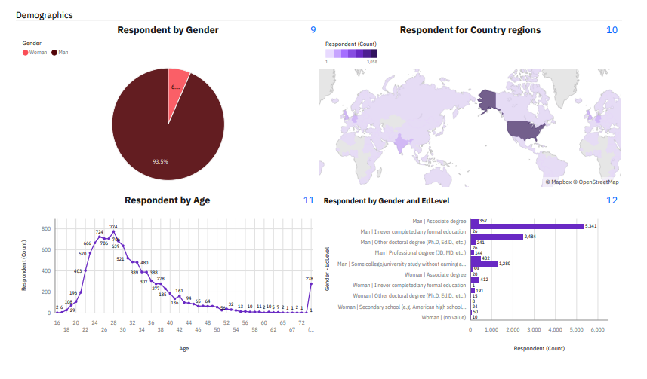
DASHBOARD TAB 3

Slide 15

CONCLUSION
I can conclude that programming languages usage is increasing gradually by years.
The most popular programming languages are web development languages such as JavaScript, HTML/CSS and SQL.
The data also shows that most people prefer using Microsoft platforms and databases to code. Additionally, AWS is also increasing in usage.

Slide 16

APPENDIX
Here the CVS file of the dataset

Slide 17
Popular Languages

