Slide 1
PurpleX
Phillip Kudryavtsev, Jonathan Gordon, Miguel Betances

Slide 2

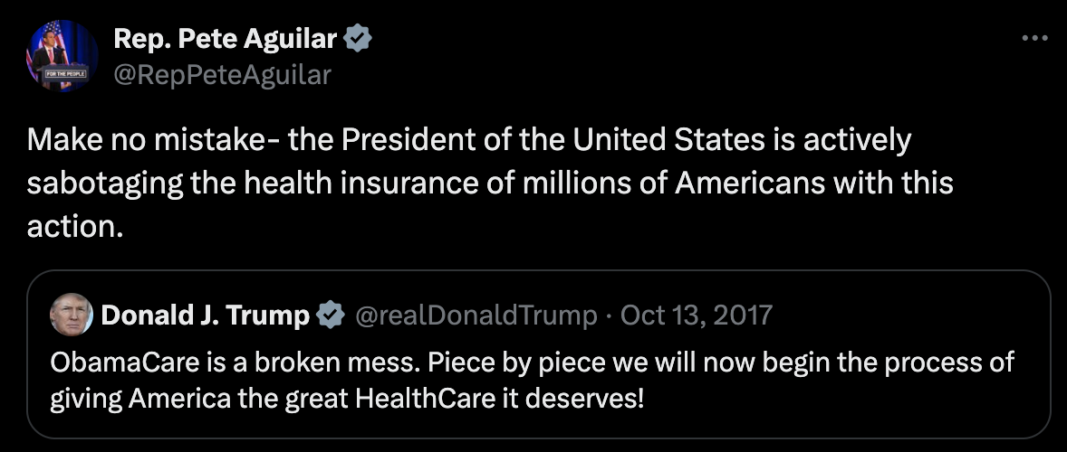
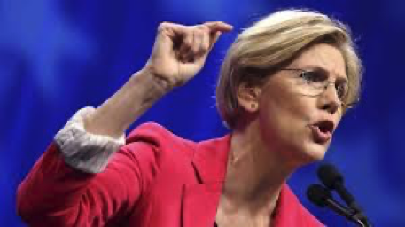
Transforming social media to foster understanding and meaningful discourse

Slide 3
AGENDA
Our Mission
Problem and Solution
Proof of Concept
Use of Machine Learning
Target Audience and Market Size
Costs

Slide 4
OUR MISSION
To bridge divides and foster understanding in a polarized world by reimagining the way we engage with social media. Utilize modern technology to empower users to explore diverse perspectives and sentiments on the most pressing topics of our time.

Slide 5
PROBLEM AND SOLUTION
The Problem
Polarization: 2020 study found that staying off Facebook for a month significantly reduced polarization on policy issues
Social Media Facilitates Division: Platforms like Facebook, YouTube and Twitter may not cause polarization but are key facilitators
Algorithmic Echo Chambers: 2021 study of over 17,000 Americans revealed that Facebook's algorithm limits exposure to diverse viewpoints
The Solution
Unified Social Media Feed: Integrate platforms like Twitter, Reddit and Threads into one app
Diverse Content Curation: Use topic modeling, sentiment analysis and clustering to create a balanced feed with varied opinions
Customizable Experience: Filter content by political leanings, sentiment or emotions for tailored engagement
Value Proposition: Our app curates diverse perspectives into a single feed, replacing echo chambers with meaningful discourse

Slide 6
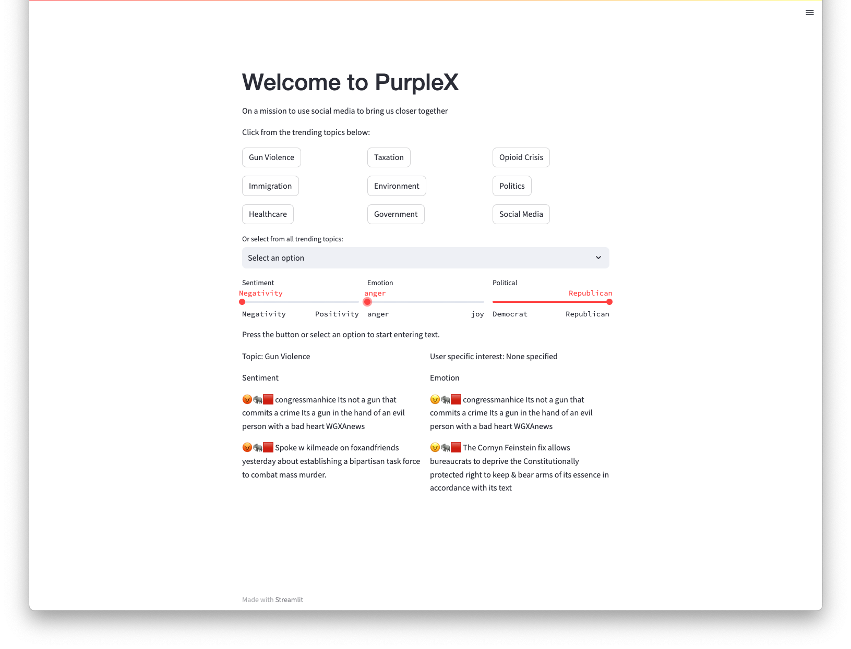
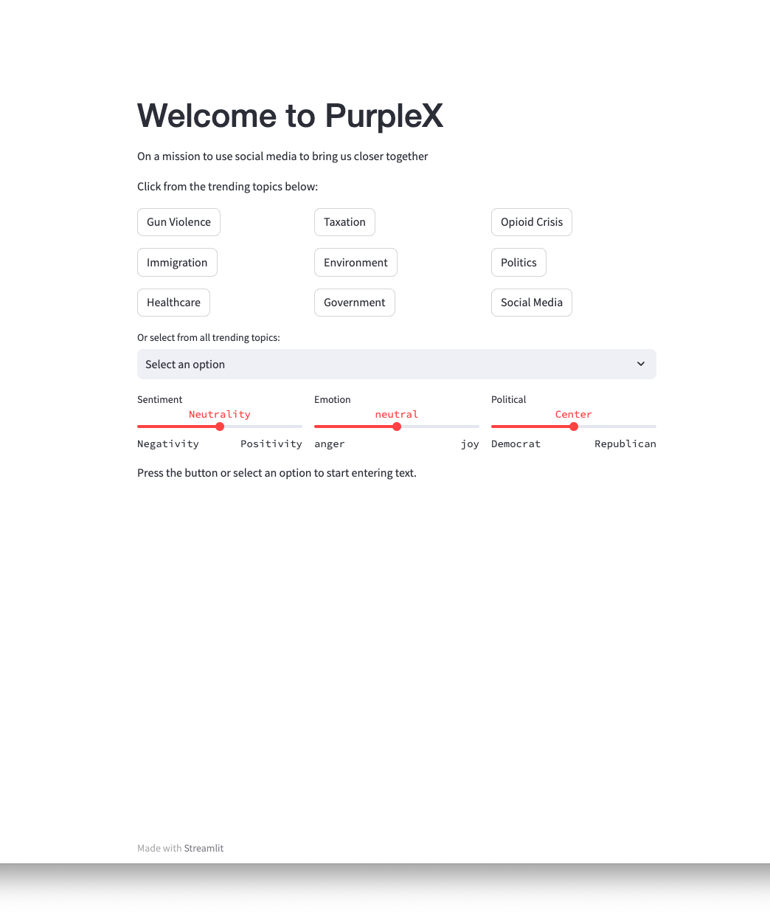
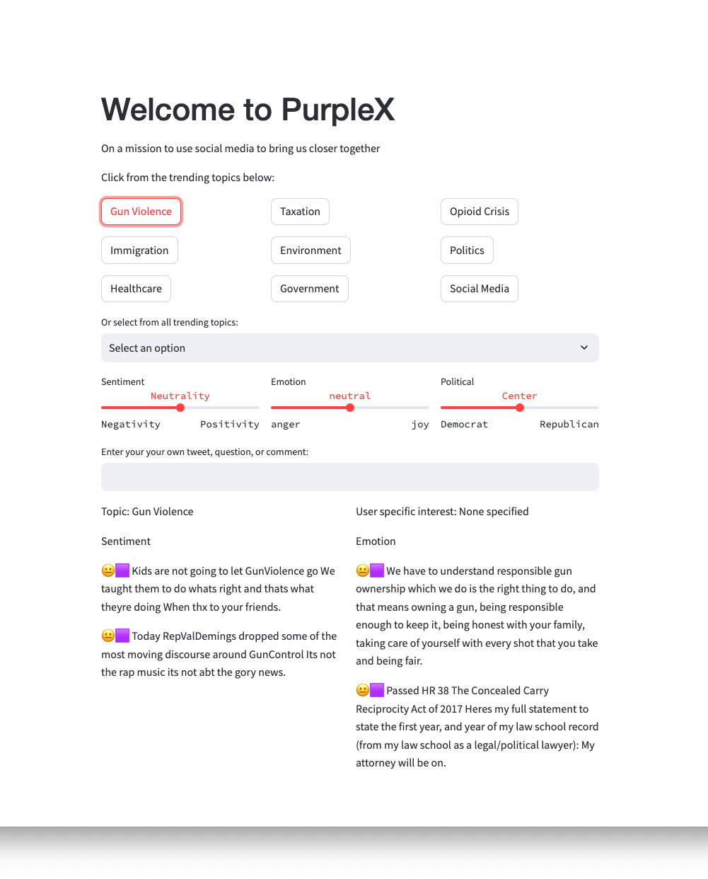
PROOF OF CONCEPT
Solving
Innovating
Affordability
Creative Finance

Slide 7

USE OF MACHINE LEARNING- Topic Modeling
Phase 1:
Extract dataset of tweets
Connect to collab GPU T4
Connect to hugging face API
Phase 2:
Prepare llama2 model for generating text and understanding the tweets through a custom system prompt
Embed tweets into numerical vectors using sentence transformer
Perform dimension reduction, as embedding on tweets creates 384 dimensions
Cluster embeddings to identify patterns.
Use llama2 LLM to label each cluster with descriptive words
Combine embeddings, clustering, and llama2 to generate relevant topic labels

Slide 8
USE OF MACHINE LEARNING- Sentiment, Emotion
Phase 1, Create the tweet database
Vector Embedding to Transform tweets to embedded vectors for later comparison with user input
Perform sentiment analysis on tweets (are they positive, neutral, negative)
Perform emotion analysis on tweets (anger, disgust, fear, joy, neutral, sadness, surprise)
Merge the tweets, topics (labels), sentiment, emotion, and embedded vector scores into one data frame
Phase 2, User experience
Create a User Interface to allow user to select or input topics, tweets, opinions
Use trained models from Phase 1, vectorize and analyze the user input
Find top 20 similar tweets
Select from most similar tweets according to user selected sentiment, emotion, political sliders
Output tweets, indicating their sentiment, emotion, political leaning

Slide 9
TARGET AUDIENCE OF MARKET SIZE
Total Social Media Users in USA
239M
Gen Z (24.9% of Users)
More likely to download new social media apps
Potential future leadership
More open minded to understanding new and/or opposing ideas
Millennials
72.4M
Gen-Z
Millennials (30.3% of Users)
59.5M

Slide 10
Financials
X API Access
Cloud Computing
Data Storage
Total
Fixed Cost
Variable Cost
Variable Cost
Variable Cost
$5,000 Monthly
$1,000-$3,000 Monthly
$100-$500 Monthly
$6,100 - $8,500 Monthly
Monetization
Freemium model with ad generated revenue
X made $3.14B in ad revenue in 2024 = $216.7M in monthly ad revenue
If we achieve 0.5% of X' monthly ad revenue, that would put as at $1.3M
As we partner with more platforms that have subscription, we would implement a subscription for users to gain access to those platforms in their feed

Slide 11
Summary
The Problem
America is polarized and social media is a key facilitator in creating echo chambers
The Solution
Utilize machine learning to create a universal feed of diverse content with the ability for users to customize and have control over their experience
Value Proposition
Our app curates diverse perspectives into a single feed, replacing echo chambers with meaningful discourse
Future Work
As we gather more data, we can:
Create more filters to create an even more customizable experience
Introduce more complex algorithms to enhance the diversified feed
Introduce more social media platforms

Slide 12
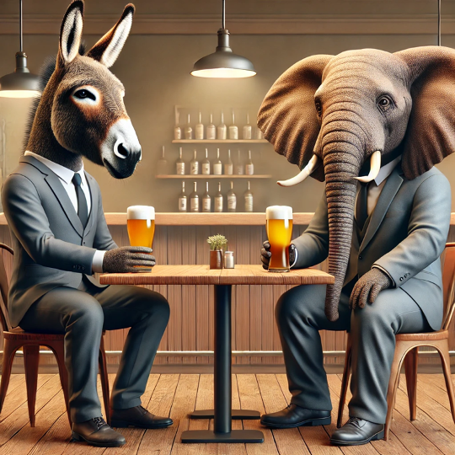
Thank you!
NEW BUSINESS OPPORTUNITY

Slide 13
Appendix

Slide 14
USE OF MACHINE LEARNING- Topic Modeling
Text Generation: Llama 2
Fine-tuned tokenizer and model via Hugging Face Transformers
Vector Embedding: SentenceTransformer
Model: bayesian generative embedding
Encodes tweets into vector space for clustering
Clustering Methods
UMAP: Reduces dimensions
HDBSCAN: Identifies clusters with noise handling
Representation Model
Llama 2: Generates detailed topic descriptions on clusters
Integration: BERTopic
Combines embedding, clustering, and representation models
Produces interpretable topics with 5 representative words
Notes:
also, here is a script for the ML slide in our presentation for 707:
Script for ML Slide:
- Text Generation with Llama 2:
- Prepares a model for generating text and understanding the tweets through a system prompt.
- Embedding Tweets:
- Convert tweets into numerical vectors using sentence transformer
- Dimension reduction:
- Embedding on tweets creates 384 dimensions, so we use UMAP for dimensionality reduction.
- Clustering:
- Use HDBScan for clustering on embeddings, to identify patterns.
- Topic Representation:
- Use llama2 to label each cluster with descriptive words
- BERTopic:
- Combines embeddings, clustering, and representation models to generate coherent and interpretable topic labels.

Slide 15
USE OF MACHINE LEARNING- Models Used
Phase 1, Create the tweet database
Vectorize tweets: paraphrase-MiniLM-L6-v2 (Hugging Face)
Perform sentiment analysis: Vader Analyzer
Perform emotion analysis: j-hartmann/emotion-english-distilroberta-base
Phase 2, User experience
Create a User Interface: streamlit
Use trained models from Phase 1:
Find top 20 similar tweets: pytorch_cos_sim
Select from most similar tweets according to user selected sentiment, emotion, political sliders
Output tweets, indicating their sentiment, emotion, political leaning

