Slide 1
Jegadeesh G
Final Project
3/21/2024 Annual Review

Slide 2
PROJECT TITLE
Natural language processing
Natural Language Processing, is a field of artificial intelligence (AI) and linguistics that focuses on enabling computers to understand, interpret, and generate human language in a way that is both meaningful and useful. NLP encompasses a broad range of tasks and techniques aimed at processing and analyzing natural language data, which includes text and speech.
3/21/2024 Annual Review

Slide 3


AGENDA
Load the Dataset: Read the dataset from a CSV file into a pandas DataFrame.
Tokenization: Tokenize the comments in the dataset using NLTK's word_tokenize function.
Sentiment Analysis: Perform sentiment analysis on the comments using NLTK's SentimentIntensityAnalyzer.
Visualization: Visualize the distribution of sentiment scores using matplotlib.
Display Results: Display the dataset with tokenized comments and sentiment scores.
3/21/2024 Annual Review

Slide 4

PROBLEM STATEMENT
Problem Statement:
The analysis and interpretation of customer feedback, especially in the context of reviews, can be a daunting task for businesses. Understanding sentiment expressed in these reviews is crucial for companies like Ryanair to enhance customer experience and make data-driven decisions.
3/21/2024 Annual Review

Slide 5

PROJECT OVERVIEW
Project Overview:
In this project, we aimed to analyze sentiment in customer reviews of Ryanair using natural language processing (NLP) techniques. We utilized the NLTK library in Python for tokenization and sentiment analysis. Our goal was to provide insights into the overall sentiment of the reviews.
3/21/2024 Annual Review

Slide 6

WHO ARE THE END USERS?
End Users:
Businesses: Companies like Ryanair can utilize this analysis to understand customer sentiment and make improvements to their services.
Data Analysts: Professionals in the field of data analysis can benefit from the techniques demonstrated in this project to derive insights from textual data.
3/21/2024 Annual Review

Slide 7

YOUR SOLUTION AND ITS VALUE PROPOSITION
Solution and Value Proposition:
Our solution involves:
Tokenizing customer comments: We used NLTK's word_tokenize function to break down comments into individual words.
Sentiment Analysis: Leveraging the Sentiment Intensity Analyzer from NLTK, we assigned sentiment scores to each comment.
Value Proposition:
Efficient Analysis: Our solution enables businesses to efficiently analyze large volumes of customer feedback.
3/21/2024 Annual Review

Slide 8

THE WOW IN YOUR SOLUTION
The Wow Factor in Our Solution:
The wow factor in our solution lies in its simplicity and effectiveness. By combining readily available tools and libraries in Python, we created a powerful analysis pipeline that can be easily adapted and scaled to analyze customer sentiment across various industries. Additionally, the visualizations provided offer a clear and intuitive representation of sentiment distribution.
3/21/2024 Annual Review
8

Slide 9
MODELLING
Teams cam add wireframes
The modelling phase involved:
Data Preparation: Loading the dataset and tokenizing comments for analysis.
Sentiment Analysis: Utilizing the Sentiment Intensity Analyzer to assign sentiment scores.
Visualization: Creating a histogram to visualize the distribution of sentiment scores.
3/21/2024 Annual Review
9

Slide 10
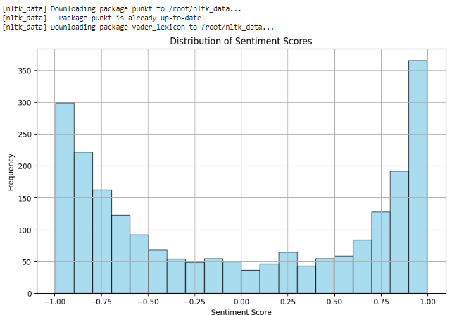
RESULTS
DEMO LINk - https://colab.research.google.com/drive/1-r38H5wu0hWhLpP0DcBGxdQJhWDu7hQL?usp=sharing
3/21/2024 Annual Review
10

