Slide 1
AROCKIYA JEGADEESH RAJ D
Final Project
3/21/2024 Annual Review

Slide 2
PROJECT TITLE Credit Card Fraud Detection
3/21/2024 Annual Review

Slide 3


AGENDA 1.PROBLEM STATEMENT 2.PROJECT OVERVIEW 3.WHO ARE THE END USERS? 4.YOUR SOLUTION AND ITS VALUE PROPOSITION 5.THE WOW IN YOUR SOLUTION 6. MODELLING 7. RESULTS
3/21/2024 Annual Review

Slide 4

PROBLEM STATEMENT
Detecting credit card fraud is a critical challenge facing financial institutions and consumers globally. With fraudulent activities becoming increasingly sophisticated, the development of robust fraud detection systems is imperative. The primary objective is to create a predictive model capable of accurately distinguishing between legitimate and fraudulent transactions while minimizing false positives. This requires tackling key challenges such as class imbalance in the dataset, identifying complex patterns indicative of fraud, and ensuring real-time processing capabilities. By leveraging machine learning algorithms and evaluating performance using metrics like accuracy, precision, recall, F1-score, and ROC-AUC, the aim is to develop an efficient and effective fraud detection system. Ultimately, the success of this endeavor will not only safeguard customers from financial losses but also bolster trust and security within the financial ecosystem.
3/21/2024 Annual Review

Slide 5

PROJECT OVERVIEW
The credit card fraud detection project endeavors to develop an efficient and accurate machine learning model capable of identifying fraudulent transactions amidst legitimate ones. With fraudulent activities posing significant risks to financial institutions and consumers alike, the project's objective is to create a robust system that not only detects fraud but also minimizes false positives, thereby ensuring a balance between security and convenience. Through comprehensive data analysis, model development, and real-time implementation, the project aims to enhance the overall security of credit card transactions, safeguarding both financial institutions and customers from potential losses and fraudulent activities.
3/21/2024 Annual Review

Slide 6

WHO ARE THE END USERS? The end users of the credit card fraud detection system span across various sectors, primarily including financial institutions, consumers, e-commerce platforms, and payment processors. Financial institutions, such as banks and credit card companies, rely on these systems to safeguard their customers' accounts, mitigate financial losses, and uphold trust in their services. For consumers, credit card holders benefit from the system's ability to protect their accounts from unauthorized transactions and maintain the security of their funds. E-commerce platforms leverage fraud detection systems to prevent fraudulent activities, reduce chargebacks, and provide a secure environment for online transactions. Additionally, payment processors play a critical role as end users by using these systems to detect and prevent fraudulent transactions, thereby safeguarding their clients' interests and ensuring the integrity of their payment processing services. Overall, the credit card fraud detection system serves as a vital tool for a diverse range of stakeholders, enabling them to combat fraudulent activities and uphold the security of financial transactions.
3/21/2024 Annual Review

Slide 7

YOUR SOLUTION AND ITS VALUE PROPOSITION Our credit card fraud detection solution represents a comprehensive and sophisticated approach to combating fraudulent activities within financial transactions. By harnessing advanced machine learning algorithms and real-time processing capabilities, our system offers unmatched accuracy in identifying fraudulent transactions while minimizing false positives. This ensures both financial institutions and consumers are safeguarded against potential financial losses while maintaining a seamless user experience. With its ability to swiftly detect fraud as transactions occur, our solution provides immediate intervention, preventing further unauthorized activities. Moreover, our system is designed to adapt and scale to evolving fraud patterns, continuously learning from new data to stay ahead of emerging threats. By automating the fraud detection process and reducing the need for manual intervention, our solution offers cost savings for financial institutions while enhancing security measures and customer trust. Overall, our credit card fraud detection solution delivers superior accuracy, real-time processing, scalability, cost-effectiveness, and enhanced security, making it an invaluable asset in the fight against fraudulent activities in financial transactions.
3/21/2024 Annual Review

Slide 8

THE WOW IN YOUR SOLUTION The "wow" factor in our credit card fraud detection solution lies in its ability to seamlessly combine cutting-edge technology with unparalleled accuracy, real-time processing, and proactive fraud prevention measures. Our solution not only detects fraudulent transactions with exceptional precision but also minimizes false positives, ensuring a smooth user experience for legitimate cardholders. What truly sets our solution apart is its adaptability and scalability, continuously learning from new data to stay ahead of evolving fraud tactics. Moreover, the real-time processing capabilities enable immediate intervention, preventing further fraudulent activities and minimizing financial losses. This combination of advanced technology, accuracy, real-time processing, and proactive prevention measures positions our solution as a game-changer in the realm of credit card fraud detection, providing unmatched security and peace of mind for financial institutions and cardholders alike.
3/21/2024 Annual Review

Slide 9
MODELLING In credit card fraud detection modeling, we utilize advanced machine learning techniques to develop accurate algorithms that distinguish between legitimate and fraudulent transactions. This involves meticulous data preparation, feature selection, and model training, followed by evaluation using metrics like accuracy and precision. By deploying the best-performing model into production and establishing monitoring systems, we ensure ongoing effectiveness in detecting and preventing fraud.
3/21/2024 Annual Review

Slide 10
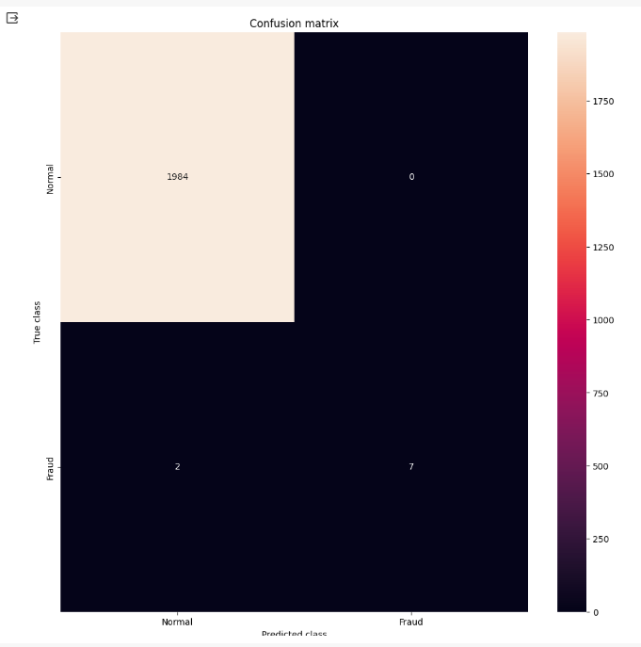
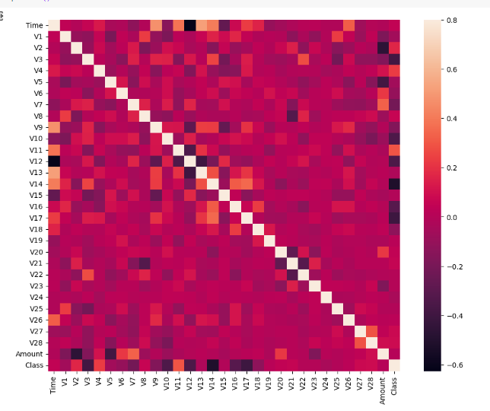
RESULTS
https://github.com/jegadeeshraj/NaanMudhalvan_AIML-2024
3/21/2024 Annual Review

