Slide 1
Jenkins
Jenkins is an open source continuous integration/continous delivery and deployment automation software Devops tool written in
Java programming language.
It is used to implement CI/CD workflows called pipelines.

Slide 2
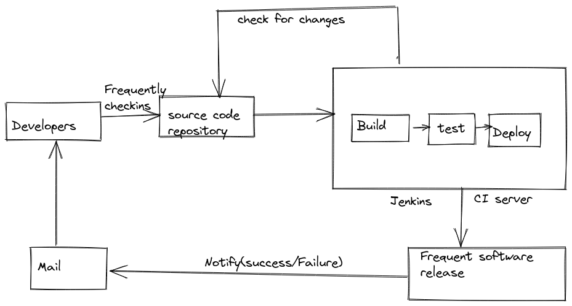
.

Slide 4
Benefits
Constant Feedback
Developers get constant feedback because of the automated build and test process
Bug fixing -costly
time taken to identify the cause of the bug is reduced drastically
Fast Software Delivery
The frequency of the software releases increases

