Slide 1


Slide 2
Chapter 4 : Functions
.

Slide 3
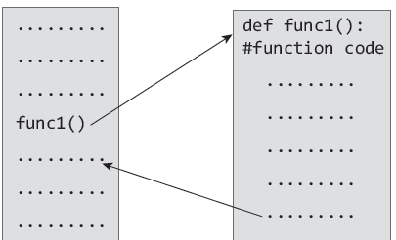
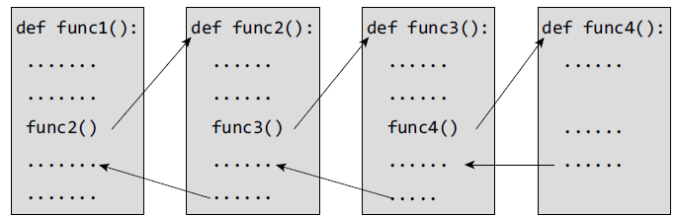
Functions
Python enables its programmers to break up a program into segments commonly known as functions, each of which can be written more or less independently of the others. Every function in the program is supposed to perform a well-defined task.

Slide 4
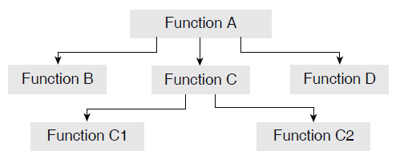
Need for Functions
Each function to be written and tested separately.
• Understanding, coding and testing multiple separate functions is far easier.
Without the use of any function, then there will be countless lines in the code and maintaining it will be a big mess.
• Programmers use functions without worrying about their code details. This speeds up program development, by allowing the programmer to concentrate only on the code that he has to write.
Different programmers working on that project can divide the workload by writing different functions.
• Like Python libraries, programmers can also make their functions and use them from different point in the main program or any other program that needs its functionalities.

Slide 5
Function Declaration and Definition
A function, f that uses another function g, is known as the calling function and g is known as the called function.
The inputs that the function takes are known as arguments/parameters.
When a called function returns some result back to the calling function, it is said to return that result.
The calling function may or may not pass parameters to the called function. If the called function accepts arguments, the calling function will pass parameters, else not.
Function declaration is a declaration statement that identifies a function with its name, a list of arguments that it accepts and the type of data it returns.
Function definition consists of a function header that identifies the function, followed by the body of the function containing the executable code for that function.

Slide 6
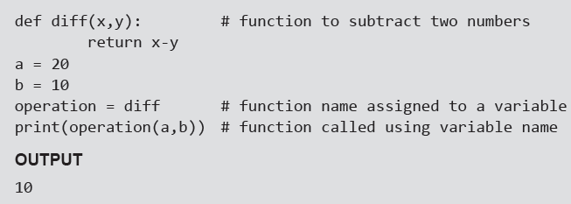
Function Definition
Function blocks starts with the keyword def.
The keyword is followed by the function name and parentheses (( )).
After the parentheses a colon (:) is placed.
Parameters or arguments that the function accept are placed within parentheses. Example
The first statement of a function can be an optional statement - the docstring describe what the function does.
The code block within the function is properly indented to form the block code.
A function may have a return[expression] statement. That is, the return statement is optional.
You can assign the function name to a variable. Doing this will allow you to call same function using the name of that variable.

Slide 7
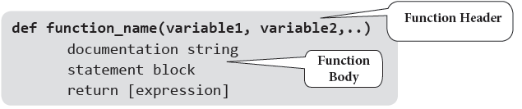
Function Call
The function call statement invokes the function. When a function is invoked the program control jumps to the called function to execute the statements that are a part of that function. Once the called function is executed, the program control passes back to the calling function.
Function Parameters
A function can take parameters which are nothing but some values that are passed to it so that the function can manipulate them to produce the desired result. These parameters are normal variables with a small difference that the values of these variables are defined (initialized) when we call the function and are then passed to the function.
Function name and the number and type of arguments in the function call must be same as that given in the function definition.
If the data type of the argument passed does not matches with that expected in function then an error is generated.
Example:

Slide 8
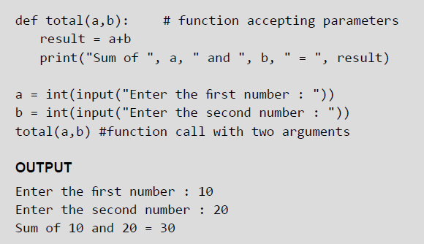
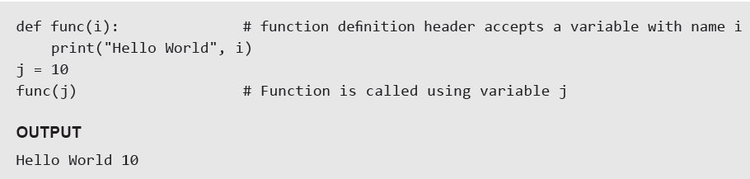
Examples

Slide 9
Local and Global Variables
A variable which is defined within a function is local to that function. A local variable can be accessed from the point of its definition until the end of the function in which it is defined. It exists as long as the function is executing. Function parameters behave like local variables in the function. Moreover, whenever we use the assignment operator (=) inside a function, a new local variable is created.
Global variables are those variables which are defined in the main body of the program file. They are visible throughout the program file. As a good programming habit, you must try to avoid the use of global variables because they may get altered by mistake and then result in erroneous output.

Slide 10
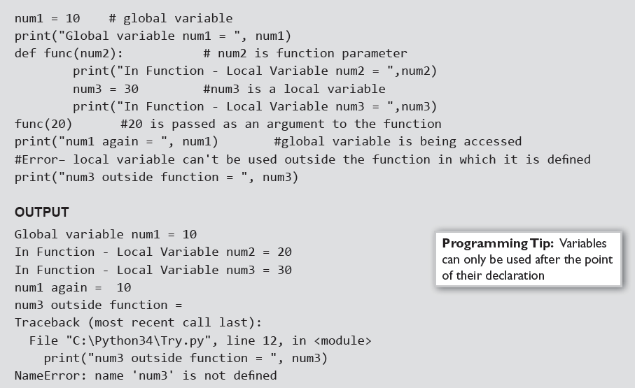
Local and Global Variables
Example:

Slide 11
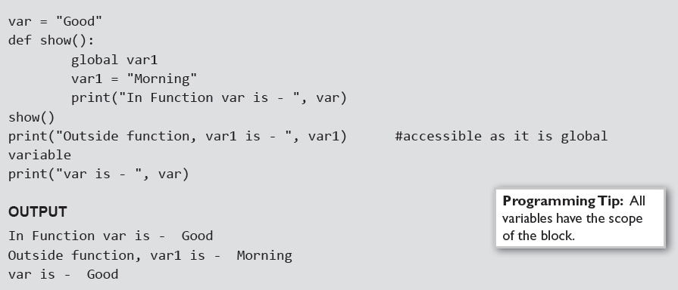
Using the Global Statement
To define a variable defined inside a function as global, you must use the global statement. This declares the local or the inner variable of the function to have module scope.
Example:

Slide 12
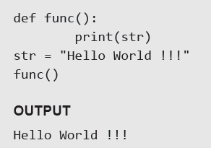
Resolution of Names
Scope defines the visibility of a name within a block. If a local variable is defined in a block, its scope is that particular block. If it is defined in a function, then its scope is all blocks within that function.
When a variable name is used in a code block, it is resolved using the nearest enclosing scope. If no variable of that name is found, then a NameError is raised. In the code given below, str is a global string because it has been defined before calling the function.
Example:

Slide 13
Fruitful Functions
A fruitful function is one in which there is a return statement with an expression. This means that a fruitful function returns a value that can be utilized by the calling function for further processing.

Slide 14
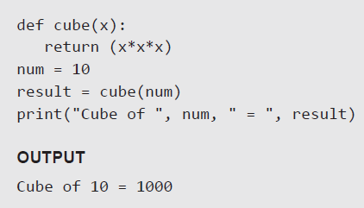
The return Statement
The syntax of return statement is,
return [expression]
The expression is written in brackets because it is optional. If the expression is present, it is evaluated and the resultant value is returned to the calling function. However, if no expression is specified then the function will return None.
The return statement is used for two things.
• Return a value to the caller
• To end and exit a function and go back to its caller
Example

Slide 15
Required Arguments
In the required arguments, the arguments are passed to a function in correct positional order. Also, the number of arguments in the function call should exactly match with the number of arguments specified in the function definition.
Example

Slide 16
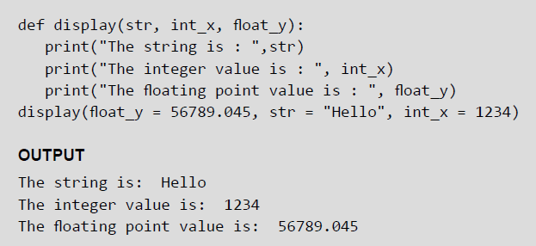
Keyword Arguments
When we call a function with some values, the values are assigned to the arguments based on their position. Python also allow functions to be called using keyword arguments in which the order (or position) of the arguments can be changed. The values are not assigned to arguments according to their position but based on their name (or keyword).
Keyword arguments are beneficial in two cases.
First, if you skip arguments.
Second, if in the function call you change the order of parameters.
Example:

Slide 17
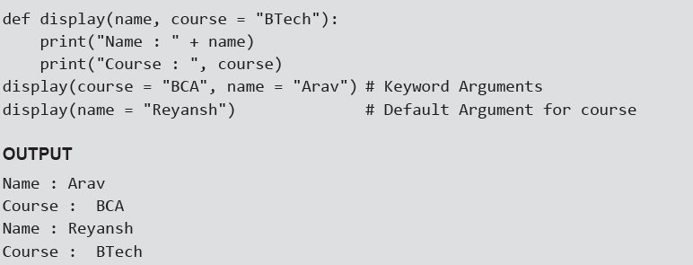
Default Arguments
Python allows users to specify function arguments that can have default values. This means that a function can be called with fewer arguments than it is defined to have. That is, if the function accepts three parameters, but function call provides only two arguments, then the third parameter will be assigned the default (already specified) value.
The default value to an argument is provided by using the assignment operator (=). Users can specify a default value for one or more arguments.
Example:

Slide 18

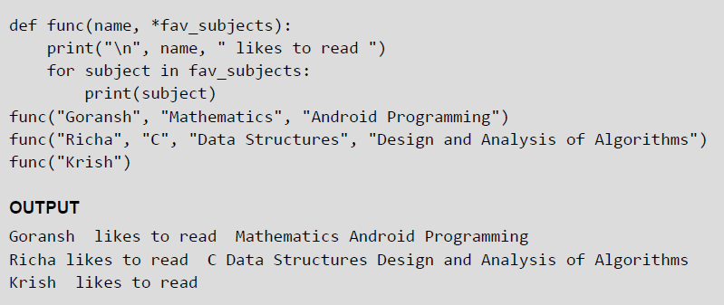
Variable-length Arguments
In some situations, it is not known in advance how many arguments will be passed to a function. In such cases, Python allows programmers to make function calls with arbitrary (or any) number of arguments.
When we use arbitrary arguments or variable length arguments, then the function definition use an asterisk (*) before the parameter name. The syntax for a function using variable arguments can be given as,
Example:

Slide 19
Lambda Functions or Anonymous Functions
Lambda or anonymous functions are so called because they are not declared as other functions using the def keyword. Rather, they are created using the lambda keyword. Lambda functions are throw-away functions, i.e. they are just needed where they have been created and can be used anywhere a function is required. The lambda feature was added to Python due to the demand from LISP programmers.
Lambda functions contain only a single line. Its syntax can be given as,
Example:

Slide 20
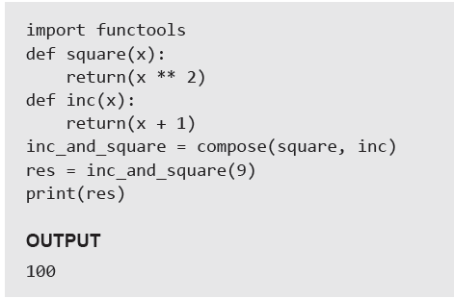
Function Composition in Python
Function composition combines two functions in such a way that the result of one function is passed as an argument to the other function. It can be denoted as f(g(x)) where, x is an argument to the function g() and the result of g(x) is an argument to the function f(). The result of function composition is finally given as the result of function f().
Example:

Slide 21
Documentation Strings
Docstrings (documentation strings) serve the same purpose as that of comments, as they are designed to explain code. However, they are more specific and have a proper syntax.
Example

Slide 22
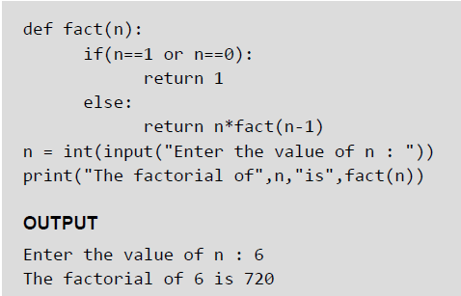
Recursive Functions
A recursive function is defined as a function that calls itself to solve a smaller version of its task until a final call is made which does not require a call to itself. Every recursive solution has two major cases, which are as follows:
base case, in which the problem is simple enough to be solved directly without making any further calls to the same function.
recursive case, in which first the problem at hand is divided into simpler sub parts.
Recursion utilized divide and conquer technique of problem solving.
Example:

