Slide 1
Human resources slide 1
AUTOMATIC MAIL CLASSIFIER AND ROUTER
A tool designed using UIPATH to make managing e-mails hassle free.

Slide 2
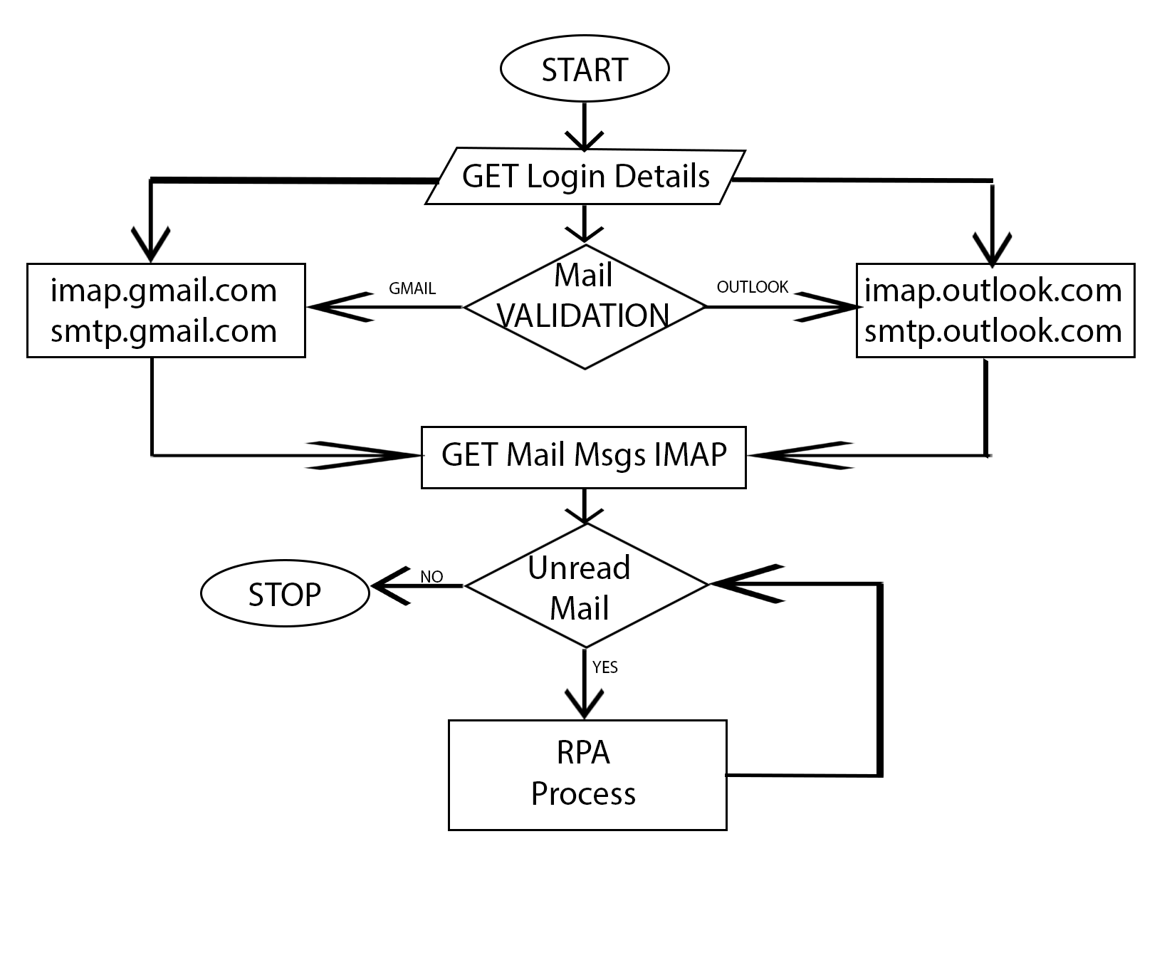

Slide 3
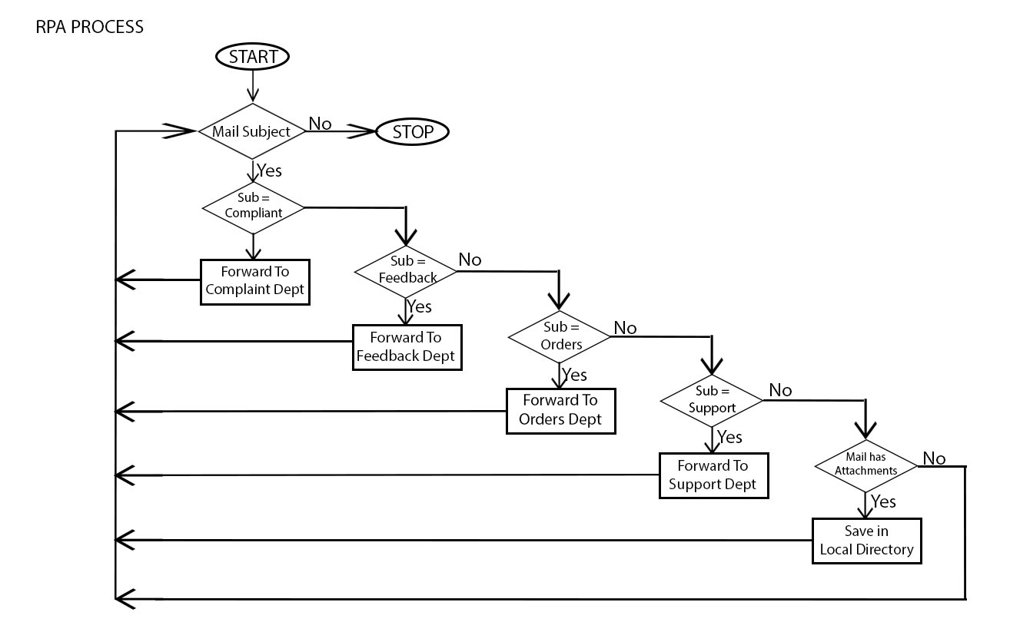

Slide 4

Human resources slide 3
SOME NOTABLE STATS:
SO WHAT’S THE SOLUTION?
This is where RPA comes into picture.Its an emerging Technology that aims to overcome these setbacks
IT departments also spend 30% of their time on low-level basic tasks
40%
30%
50% of companies spend $5 to $25 per manually-processed invoice.
WHAT IS RPA?
Abbreviated as Robotic Process Automation , that is based on notation of software robots and AI
workers
TIME SPENT DOING REPETETIVE
TASKS
50%
Nearly 60% workers feel that by automation the can focus on more complex jobs.
60%
WHATS THE SCOPE?
Businesses are missing about 50% of all automation opportunities on average
Statista believes that the RPA industry will be worth $3.1 billion by 2019 and $4.9 billion by 2020.
This rapid growth is due to the companies moving towards automation to reap its rewards
(per week per employee)
50%

Slide 5
Human resources slide 2
SOME TASKS THAT CAN BE AUTOMATED
Documenting and records management.
Claims, bookings and invoice management.
Customer relationship management.
Human resources & IT processes.

Slide 6
Human resources slide 4
Automating E-Mails
Some advantages include
STRATEGIC USE OF HUMAN RESOURCES:
REDUCED MANPOWER
BETTER CONSUMER SERVICE
REDUCE TIME
HUMAN RESOURCES

Slide 7
Human resources slide 10
Thank You

