Slide 1
Capstone Project - 2
Biodiversity for the national Parks
Jegan Velappanpillai

Slide 2
Source file – species.csv
This data file is a comma delimited file with 5825 records including the header
This file stores the Category, scientific name, common name and conservation status
Sample data
category,scientific_name,common_names,conservation_status
Mammal,Clethrionomys gapperi gapperi,Gapper's Red-Backed Vole,Mammal,Bos bison,"American Bison, Bison",
Mammal,Bos taurus,"Aurochs, Aurochs, Domestic Cattle (Feral), Domesticated Cattle",
Mammal,Ovis aries,"Domestic Sheep, Mouflon, Red Sheep, Sheep (Feral)",
Mammal,Cervus elaphus,Wapiti Or Elk,
Before start the analysis, we review the insights of the data
5541 Unique Specific Name
6 Species Types
5 Different conservation status, including Blank value

Slide 3
Data Processing
To proceed with analysis, we check the unique values and record counts of each data point
Since the conservation_status is having NULL values, do a data cleanup
Replace the NULL values in Conservation status with “No Intervention” for easy analysis.
Group the data based on Conservation_status, Scientific Name and review the numbers
Plot the details in a Bar chart with
Conservation Status in X axis
Number of Species in Y axis

Slide 4
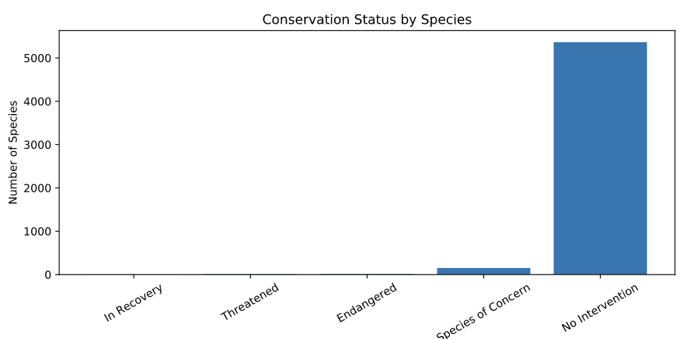
Plotting Conservation Status by Species

Slide 5
Investigating Endangered Species
To group the animal category to be Protected / Not Protected, we introduced a new column “is_protected” based on the Conservation Status
False if conservation status is “No Intervention”
True otherwise
Get the Percentage protected for further analysis
Percentage Protected = # of Protected / (# of Protected + # of not Protected)
Create a Pivot table with
Category as Index value
Count of Protected/Not Protected species based on Scientific name as Values
Calculate the Percentage Protected
Using Chi-Square Test, get the ”pval” to check endangered status
The null hypothesis, the difference was a result of chance
pval for mammal and Bird is ~0.6876, which is > 0.05, so it accepts null hypothesis
pval for Mammal and Reptile is 0.038, which is < 0.05, so null hypothesis is wrong

Slide 6
Sightings of different species (Goats)
The Observation data file is a comma delimited file with 23,297 records including the header
This file stores the Scientific Name, Park Name and # of Observations
Sample data
scientific_name,park_name,observations
Vicia benghalensis,Great Smoky Mountains National Park,68
Neovison vison,Great Smoky Mountains National Park,77
Prunus subcordata,Yosemite National Park,138
Abutilon theophrasti,Bryce National Park,84

Slide 7
Data Processing
To get the records related to “sheep” we add a new column with a True/False flag
In the Species_info dataset, add a column is_sheep
If the Common name is having the work “Sheep” in it, then we flag the Column as True
Since this filter also brings in Plants Category, we filter only the Mammals for our analysis
Get only the data where the animal category is Mammal and Common name is having “Sheep” in it
Now merge the dataset with the Observations dataset
Now get the sum of all observations for each park

Slide 8
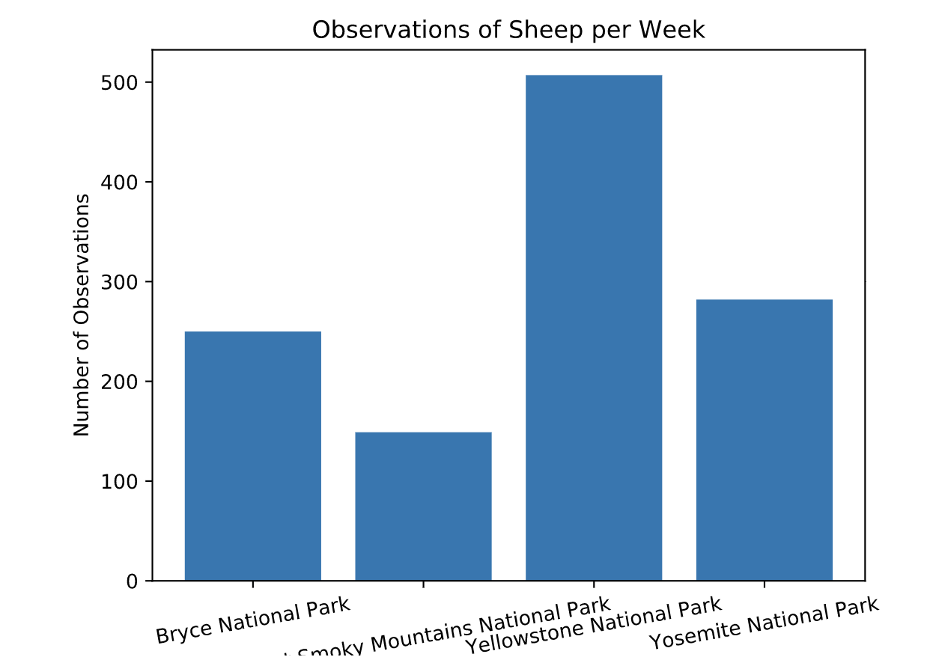
Bar chart on Observations of Sheep

