Slide 1
learning how to make music using trackers
a workshop by some guy

Slide 2
who am I?
just some guy who likes to make weird electronic music

Slide 3
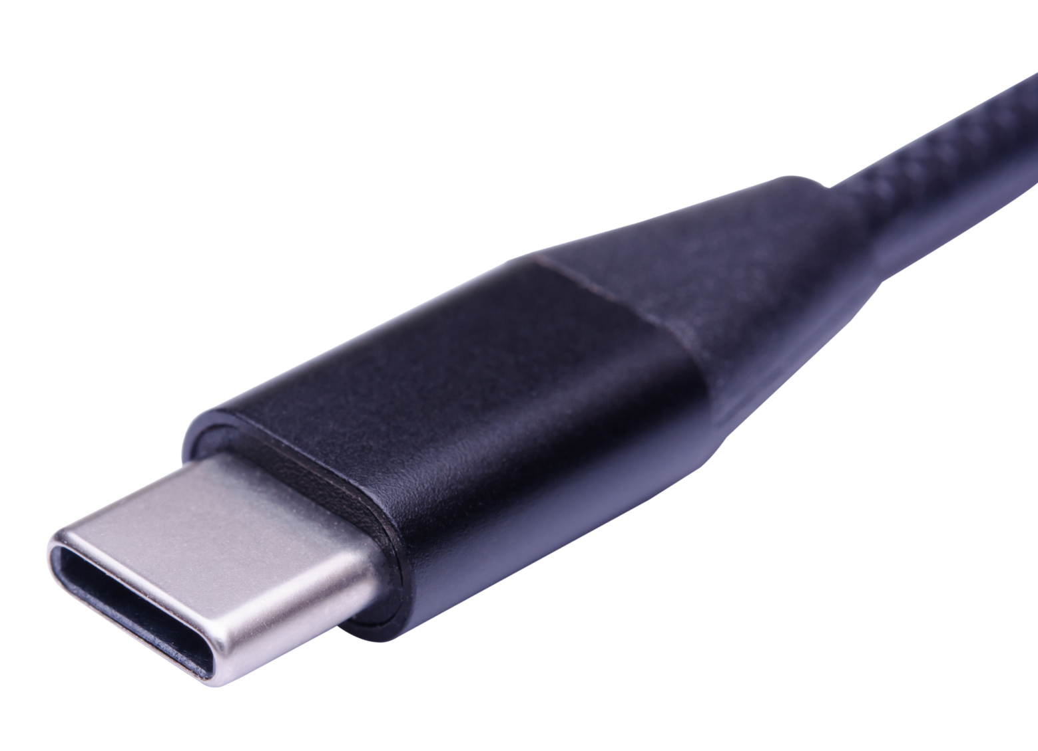
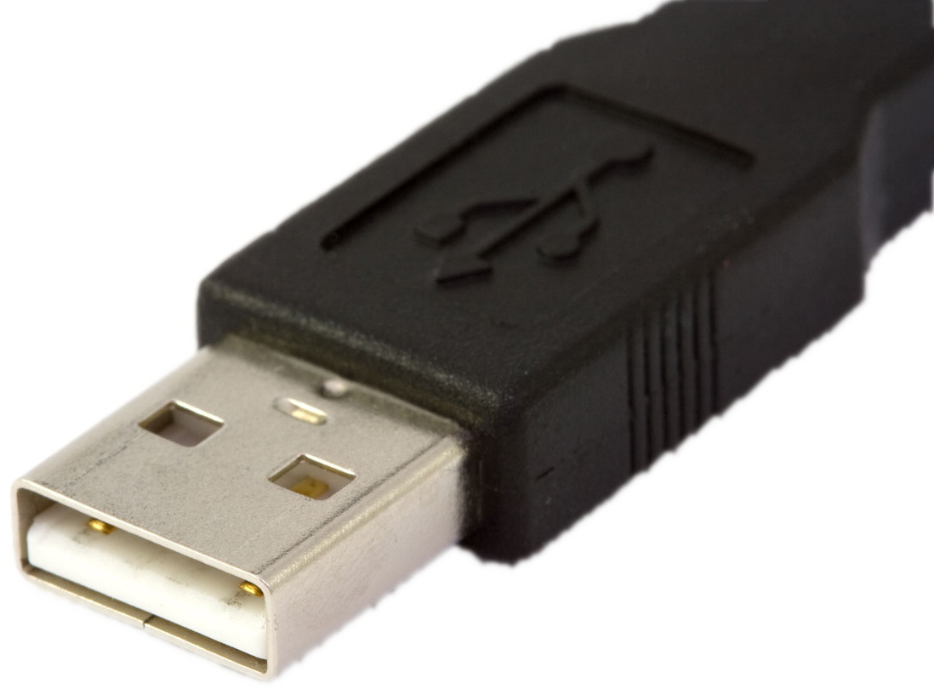
what are the requirements for this workshop?
headphones
a laptop with:
  wi-fi access
  chrome or edge browser installed
  a USB A or USB C port for the M8 headless unit
important note: the headphones and your laptop need to be compatible with each other.
also, if your headphones only have a USB connector, your laptop has to have enough ports for the headphone and the headless unit to connect simultaneously.

Slide 4
you will be handed a set of the following items
an M8 headless unit with a 64gb microSD card
a short microUSB-to-USB A cable
a small USB A-to-USB C adapter
a microSD card reader
PLEASE RETURN ALL OF THESE ITEMS AT THE END OF THE WORKSHOP

Slide 5
what are we going to cover?
basics
  connecting M8 headless to your computer
  controls and navigating screens
  the song-chain-phrase structure
sampler engine
two of the internal synth engines
  wavsynth
  macrosynth (aka Braids)
quick rendering pieces
rendering full song

Slide 6
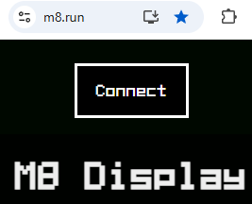
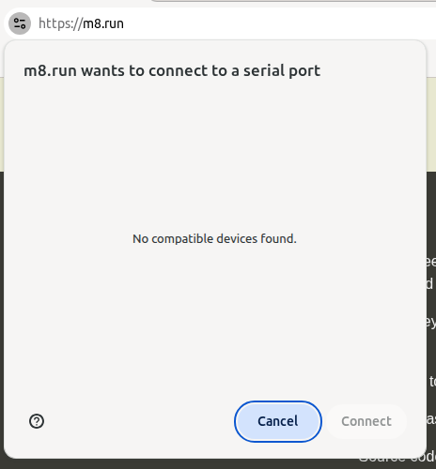
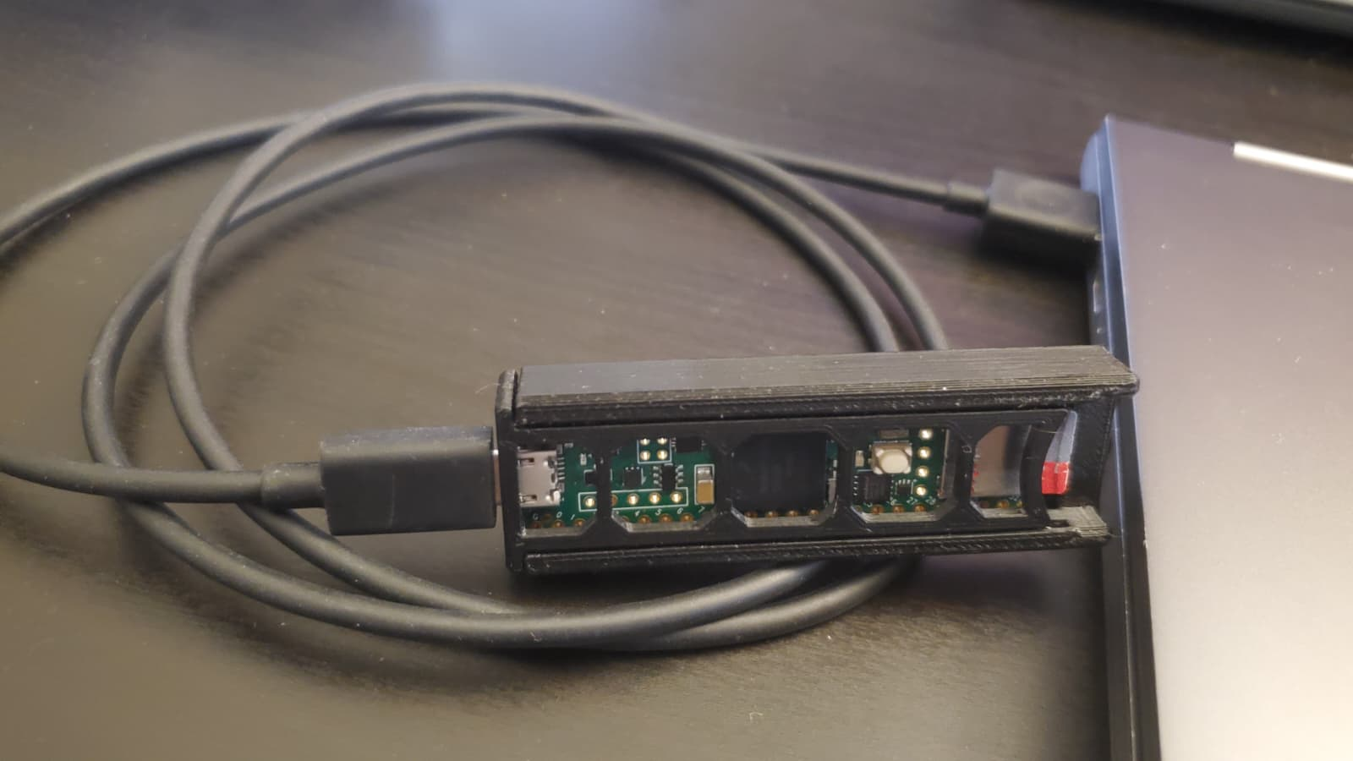
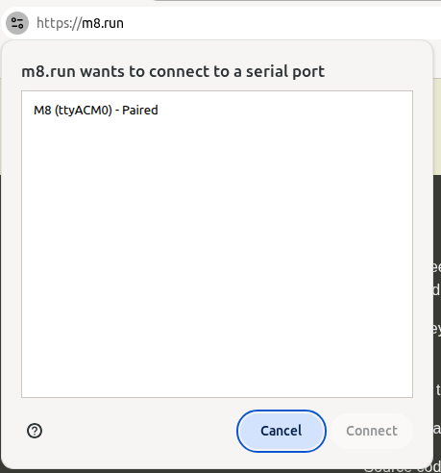
connecting M8 headless to your laptop
1. go to www.m8.run and click on “Connect”
3. plug your M8 headless unit into to your laptop via USB
4. select the M8 from the list and click on “Connect”
2. this window will pop up

Slide 7
linux stuff (in case it doesn’t work outright)
try these terminal commands then restart:
  sudo usermod -a -G dialout $USER
  sudo adduser $USER dialout
if it still doesn’t work, try this:
  create file /etc/udev/rules.d/50-myusb.rules
  populate it with:
    KERNEL=="ttyUSB[0-9]*",MODE="0666"
    KERNEL=="ttyACM[0-9]*",MODE="0666"

Slide 8
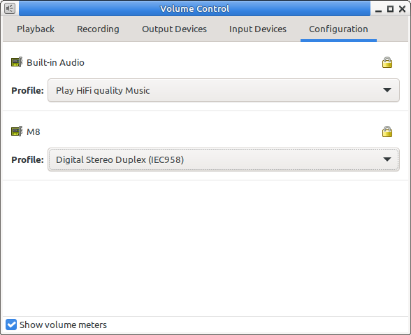
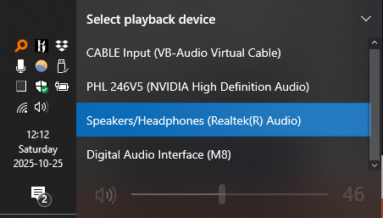
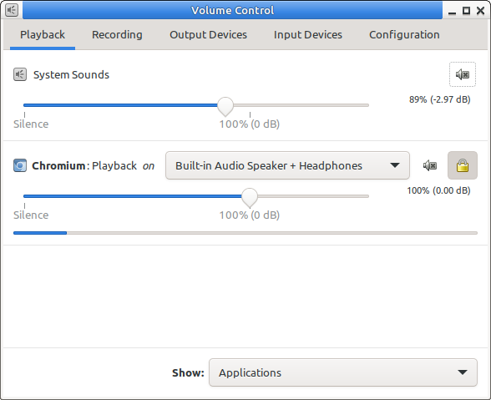
audio configuration
linux
windows

Slide 9
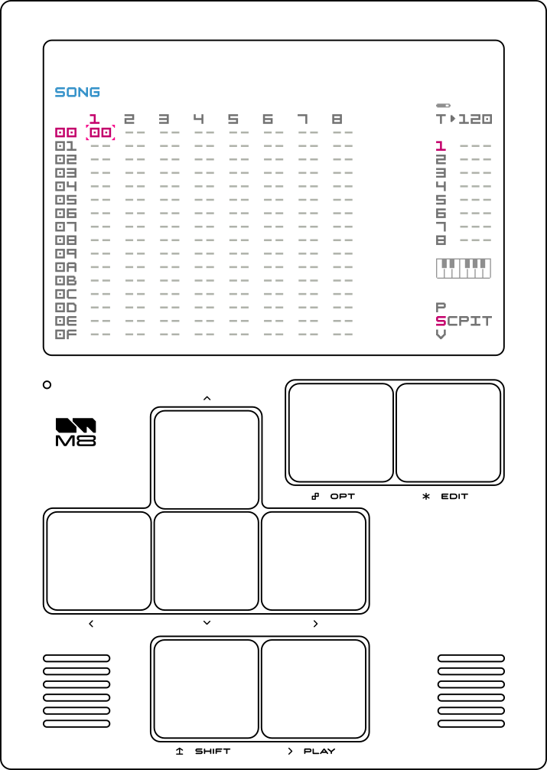
controls
option/z
edit/x
up/up arrow
down/down arrow
left/left arrow
right/right arrow
shift/shift
play/spacebar

Slide 10

navigation and mini-map
shift + arrow: change screens
(along mini-map)

Slide 11
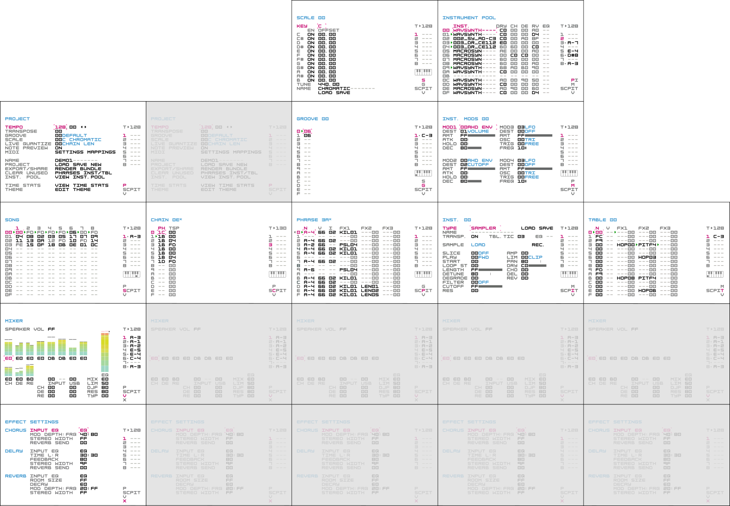

navigation and mini-map
song page

Slide 12
navigation and mini-map
mixer page

Slide 13
song-chain-phrase structure
song can contain many chains
chain can contain many phrases
phrase is split into 16 steps
the phrase is where you drop notes, sample triggers and add effects
song
chain
phrase

Slide 14
special note about volumes
headphone volume and mix volume
track volumes
instrument volumes (dry, amp, mfx, reverb, delay)
instrument mods set to volume
note velocity
of course, your laptop’s master volume

Slide 15
editing values
edit + right: typically increases value by 01
edit + left: typically decreases value by 01
edit + up: typically increases value by 10
edit + down: typically decreases value by 10

Slide 16
copy & paste
edit on non-blank chain, phrase or note:
  copies single values that can be placed in blank spaces
edit on blank chain, phrase or note:
  pastes single values that can be placed in blank spaces
shift + option: enter selection mode for “copy”
  press option once more to finalize selection
shift + edit: “paste” what you just copied

Slide 17
sampler

Slide 18
making simple four on the floor

Slide 19
wavsynth

Slide 20
macrosynth

Slide 21
quick render sections

Slide 22
empty chains
00 vs FE

Slide 23
render your creation to wav

Slide 24
useful resources
M8 manual: https://cdn.shopify.com/s/files/1/0455/0485/6229/files/m8_operation_manual_v20250501.pdf?v=1746136009
M8 tips and tricks doc: https://docs.google.com/document/d/1IpUeR2s9TpkwH9w2lfqfLLkUxLvXcQWipDR046DzOYk/edit?pli=1#heading=h.mbmpsjq0d8t9
Dirtywave Discord: https://discord.gg/vh3UVdjZCH
The M8 Companion: https://cs.uwaterloo.ca/~plragde/flane/TM8C/index.html
Red Means Recording videos:
  https://www.youtube.com/watch?v=jMxDGkXlb0k
  https://www.youtube.com/watch?v=QYeM4Dx2kGU
All My Friends Are Synths tutorial: https://www.youtube.com/watch?v=Xe0NnfjcJ_g

Slide 25
other hardware trackers
Dirtywave M8 Tracker: https://dirtywave.com/
picoTracker: https://xiphonics.com/
Polyend Tracker & Tracker Mini: https://polyend.com/
kinda hardware
LSDJ: https://www.littlesounddj.com/lsd/index.php
Little Piggy Tracker: https://littlepiggytracker.github.io/

Slide 26
software trackers
LSDJ: https://www.littlesounddj.com/lsd/index.php
Little Piggy Tracker: https://littlepiggytracker.github.io/
Renoise (DAW): https://www.renoise.com/
FamiTracker: https://github.com/Dn-Programming-Core-Management/Dn-FamiTracker/releases/tag/Dn0.5.0.1
DefleMask: https://www.deflemask.com/
MilkyTracker: https://milkytracker.org/

Slide 27
thank you!
contact details:
email: djegasus@gmail.com
discord: jegasus
youtube: www.youtube.com/@djegasus
you can find all of this content online at https://github.com/jegasus/m8-tracker-workshop

