Slide 1
Development and mechanical characterization of Jute Fiber reinforced flower powder particulate polymer composites
Guide:
Mr. T Prabhuram,
Assistant Professor,
Department of Mechanical Engineering,
St. Joseph’s Institute of Technology.
Team members:
Hari Haran K (312418114053)
Jegath Greeny E S (312418114053)

Slide 2
Abstract
To introduce a composite made out of a resin(epoxy), reinforcement(jute fiber) and filler material(flower particles). Then we test the mechanical properties of the fabricated composite. We have used thrown out rose petals and mary gold petals to make the filler material.

Slide 3
Motivation

Slide 4
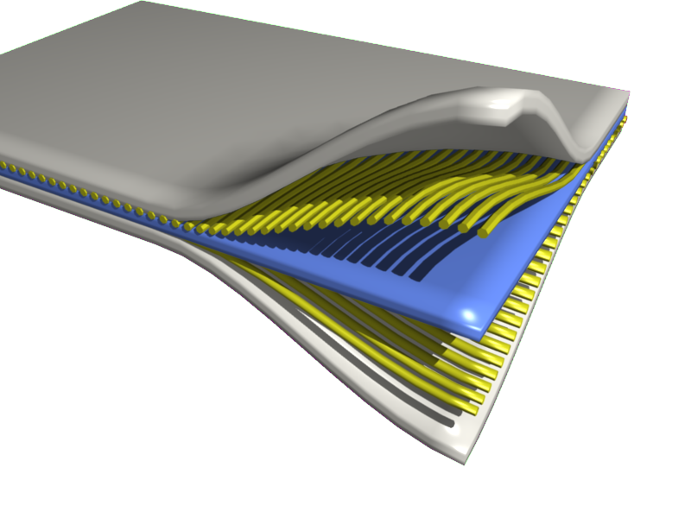
Composites
A composite material (also called a composition material or shortened to composite, which is the common name) is a material which is produced from two or more constituent materials. These constituent materials have notably dissimilar chemical or physical properties and are merged to create a material with properties unlike the individual elements.

Slide 5
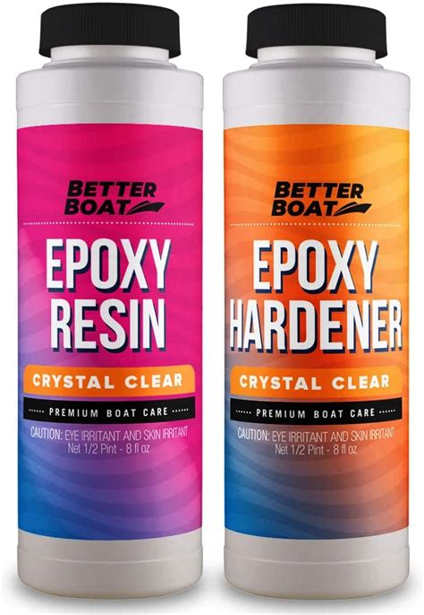
Epoxy
Epoxy is the family of basic components or cured end products of epoxy resins. Epoxy resins, also known as polyepoxides, are a class of reactive prepolymers and polymers which contain epoxide groups. The epoxide functional group is also collectively called epoxy. The IUPAC name for an epoxide group is an oxirane.

Slide 6
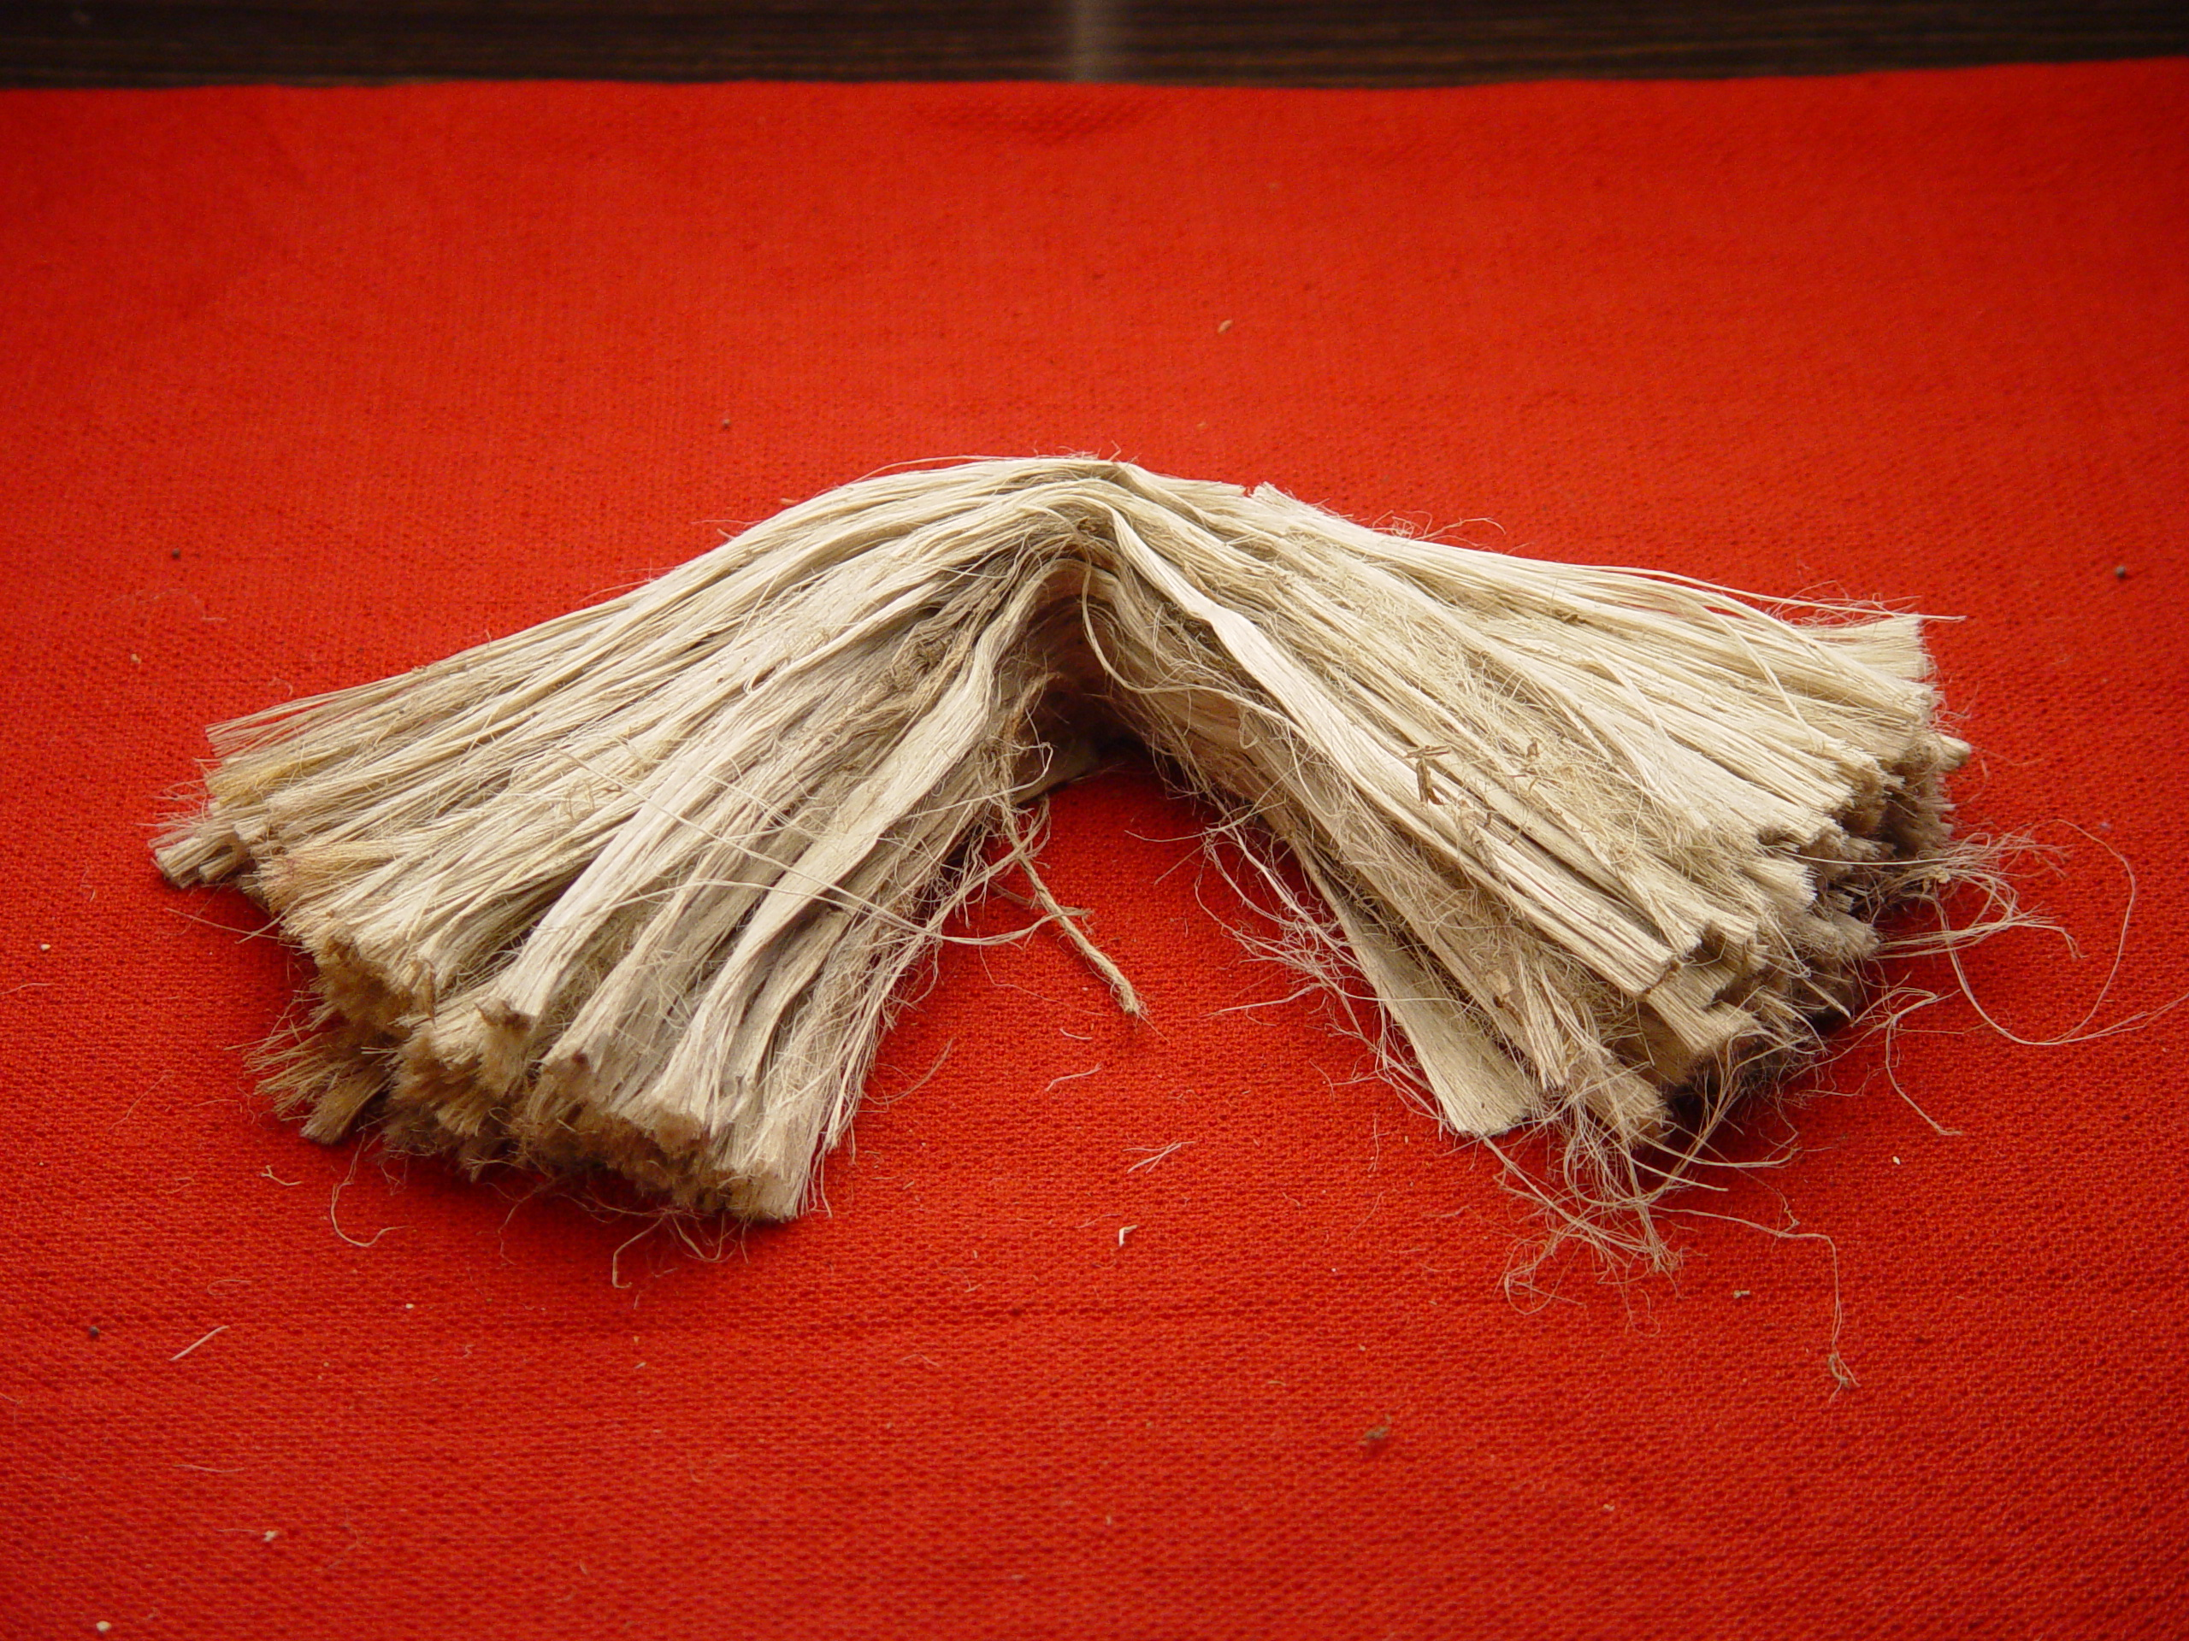
Jute Fiber
Jute is a long, soft, shiny bast fiber that can be spun into coarse, strong threads. It is produced from flowering plants in the genus Corchorus, which is in the mallow family Malvaceae. The primary source of the fiber is Corchorus olitorius, but such fiber is considered inferior to that derived from Corchorus capsularis."Jute" is the name of the plant or fiber used to make burlap, hessian or gunny cloth.

Slide 7
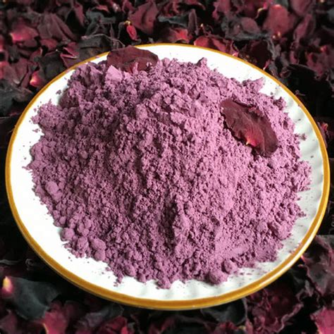
Rose petal particles
A rose is a woody perennial flowering plant of the genus Rosa, in the family Rosaceae, or the flower it bears. There are over three hundred species and tens of thousands of cultivars.
The powder was prepared from dried thrown out rose petals.

Slide 8
Mary Gold petals particles
Calendula is a genus of about 15–20 species of annual and perennial herbaceous plants in the daisy family Asteraceae that are often known as marigolds. They are native to southwestern Asia, western Europe, Macaronesia, and the Mediterranean. (Other plants also known as marigolds, are corn marigold, desert marigold, marsh marigold, and plants of the genus Tagetes)

Slide 9
Methodology
Then the composite is cut into appropriate shapes to be used in the tests.
Then different tests are carried out on the composites.
Tensile test
Penetration test
Hardness test
Impact test
Wear test
Then finally SEM analysis is carried out on the specimen.

Slide 10
Sample Preparation
Frist epoxy, jute fiber is set up for three layers then the filler material(flower particles) is filled in between them.
Then the composite is allowed to settle for a period of time.
This would take about two days
Then the composite is cut into appropriate shapes.

Slide 11
Project Plan
SERIAL NUMBER | ACTIVITY | DUE DATE
1 | Literature survey | On going
2 | Material selection | Completed
3 | Fabrication of composite material | 1st week of March
4 | Testing of composites | 3rd week of March
5 | Interpretation of results | 1st week of April
6 | Project report preparation | 4th week of April

Slide 12
Thank you

