Slide 1
Kinect + ROS =
Navigation
Dr. Rainer Hessmer
May 2011

Slide 2
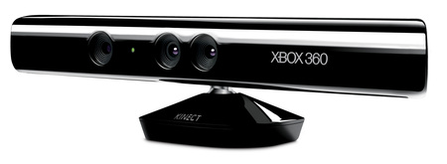
The Kinect Sensor
30 Hz, RGB 8-bit VGA
(640 x 480) video
30 Hz, 11 bit gray scale
depth video (2,048 levels)
Tracking range: 0.7–6 m (2.3–20 ft)
Angular field of view:
  57° horizontally
  43° vertically

Slide 3
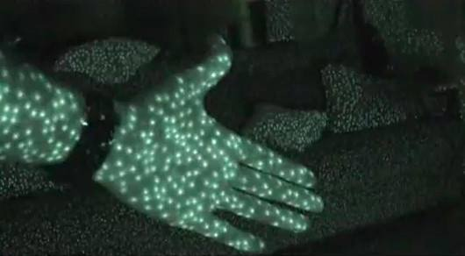
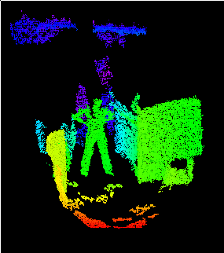
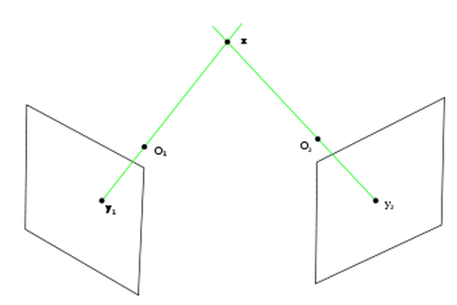
Depth from Structured Light
By Joseph L. Flatley

Slide 4
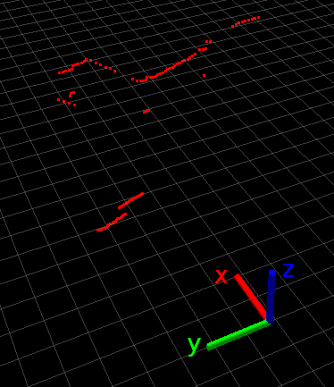
Faking a Laser Scanner
Cut a slice out of
the Kinect depth
image
Get closest value
in each column

Slide 5
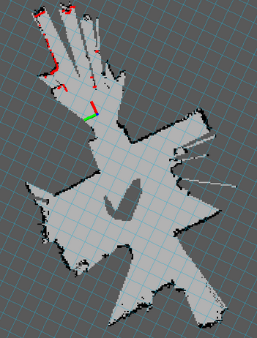
SLAM
(Simultaneous Localization and Mapping)
Odometry
Laser depth data
Extract features
Model probabilistically
Generate most likely map
http://www.youtube.com/watch?v=yQfvObAAxZA&feature=player_detailpage

Slide 6
Navigation
Map
Start pose, goal pose
Global plan
Monte Carlo Localization for pose estimation (where am I?)
  Odometry
  Laser scan data
Local plan → drive commands

Slide 7
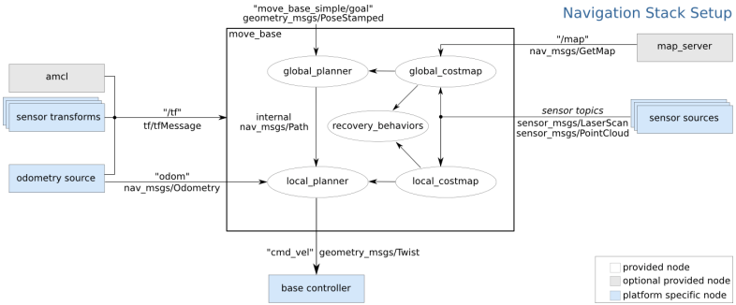
ROS Navigation Stack
from http://www.ros.org/wiki/navigation/Tutorials/RobotSetup

Slide 8
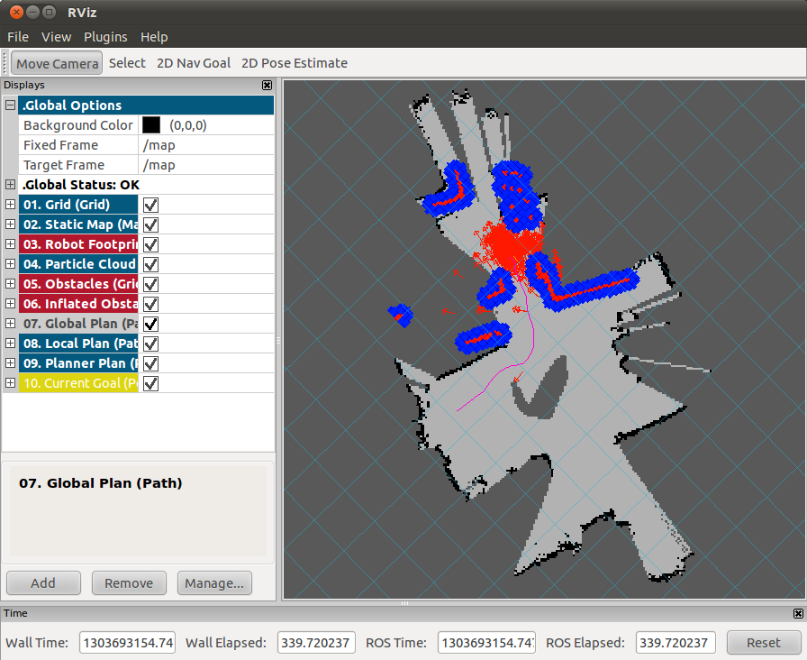
Navigation in Action
http://www.youtube.com/watch?v=j-5iaRHzZlM&feature=player_detailpage

Slide 9
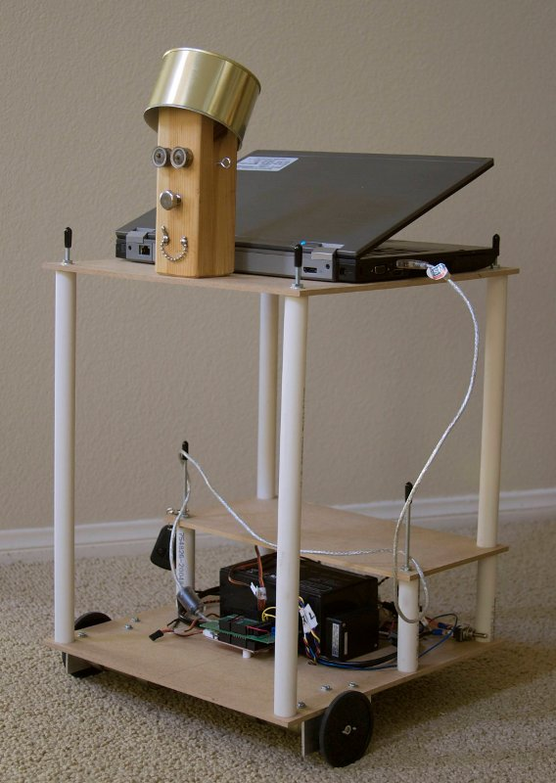
Questions?

