Slide 1
Navigation
Dr. Rainer Hessmer
June 2011

Slide 2
Navigation in a Nutshell
Map
Start pose, goal pose
Global plan
Monte Carlo Localization for pose estimation (where am I?)
  Odometry
  Laser scan data
Local plan → drive commands

Slide 3
Global Path Planning
Ingredients:
  Map
  Start pose, goal pose
  Robot footprint
  Path finding algorithm
    Dijkstra
    Best-First-Search
    A*

Slide 4
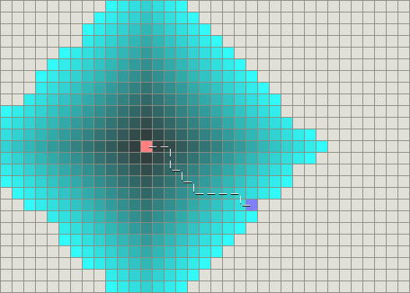
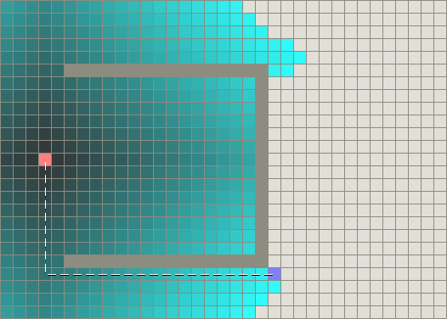
Dijkstra's Algorithm
Easy to understand
Finds a shortest path
Fairly inefficient
Images from http://theory.stanford.edu/~amitp/GameProgramming/AStarComparison.html

Slide 5
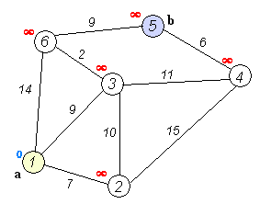
Dijkstra
Generalized distance = cost
http://en.wikipedia.org/wiki/Dijkstra%27s_algorithm
Setup
  Starting point = initial node
  Cost of node Y: Cost to get from initial node to Y
  Every node gets a cost value (e.g. distance): Initial node = 0; others infinity (∞)
  Mark all nodes as unvisited. Set initial node as current.
Lather, rinse, repeat
  For current node, iterate of unvisited neighbors and calculate tentative cost. If this distance is less than previously recorded cost, overwrite the cost.
  When all neighbors of the current node are considered, mark current node as visited. No need to check again. Recorded cost is final and minimal.
  If all nodes visited, finish. Otherwise, unvisited node with smallest distance becomes next current node. Repeat.

Slide 6
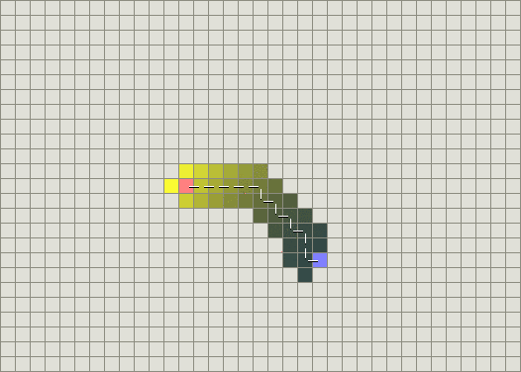
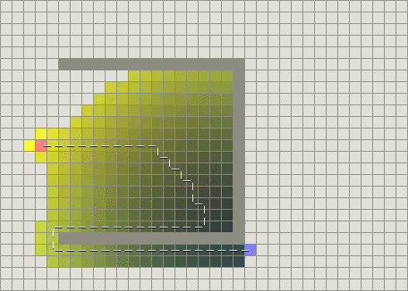
Greedy Best-First-Search
Uses estimate (heuristic) for how far from the goal a cell (vertex) is
Fast but does not guarantee shortest path
Images from http://theory.stanford.edu/~amitp/GameProgramming/AStarComparison.html

Slide 7
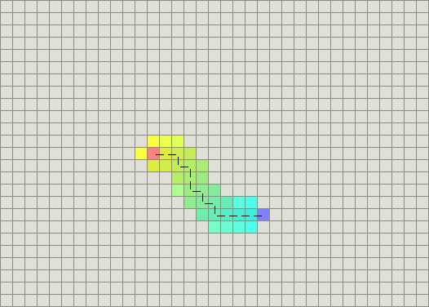
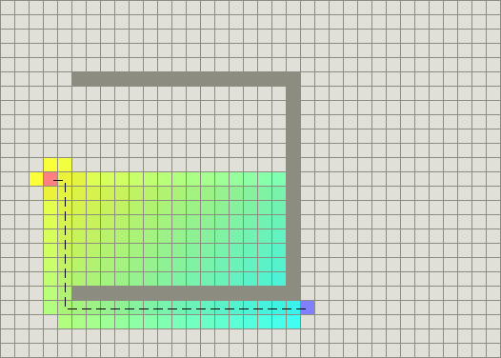
A* Algorithm
Combines Dijkstra with Best-First-Search
Finds a shortest path
Uses heuristic to perform directed search → much faster than Dijkstra
Uses vertex n that has the lowest
f(n) = g(n) + h(n)
  g(n): cost of the path from starting to vertex n
  h(n): optimistic heuristic for cost from vertex n to the goal.
Images from http://theory.stanford.edu/~amitp/GameProgramming/AStarComparison.html

Slide 8
ROS Global Path Planner
Generates a high level plan for the navigation stack to follow (Dijkstra's algorithm)
Create a series of waypoints for the local planner to achieve.
Grid-based, assumes circular robot.
Produces waypoints that are optimistic for the actual robot footprint → path may be infeasible to follow
Does not take robot dynamics into account → potentially dynamically infeasible path
Links:
  http://www.ros.org/wiki/navigation/GlobalPlanner
  http://www.ros.org/wiki/navfn

Slide 9
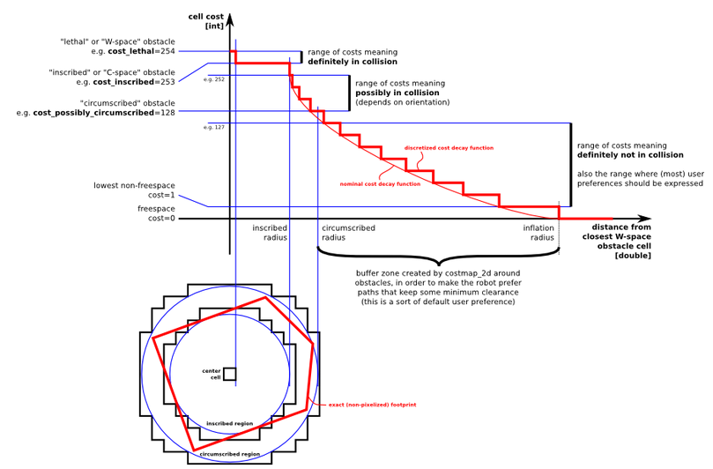
Cost Function
Obstacle locations have infinite cost
Expand obstacles with robot footprint envelope
Make vicinity of obstacles more expensive (inflation radius)
http://www.ros.org/wiki/costmap_2d

Slide 10
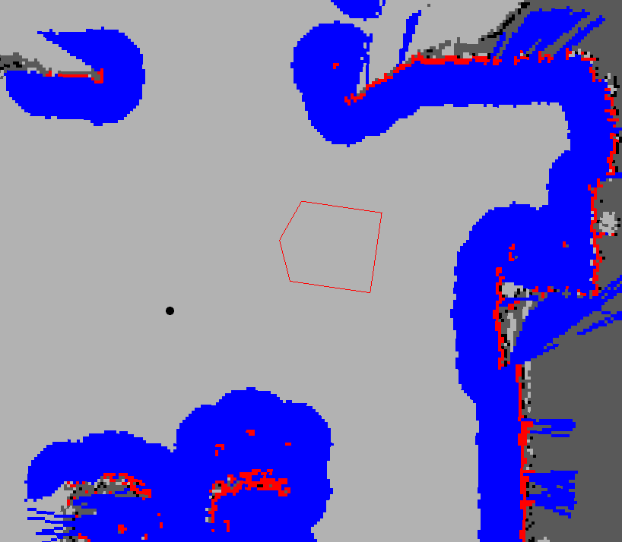
Cost Map Example
Red cells: Obstacles
Blue cells: Obstacles inflated by inscribed radius of the robot
Red polygon:
Robot footprint
http://www.ros.org/wiki/costmap_2d

Slide 11
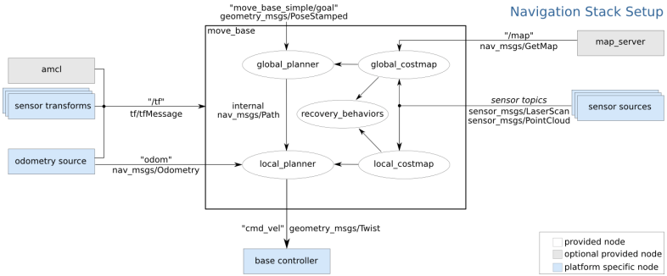
ROS Navigation Stack
from http://www.ros.org/wiki/navigation/Tutorials/RobotSetup

Slide 12
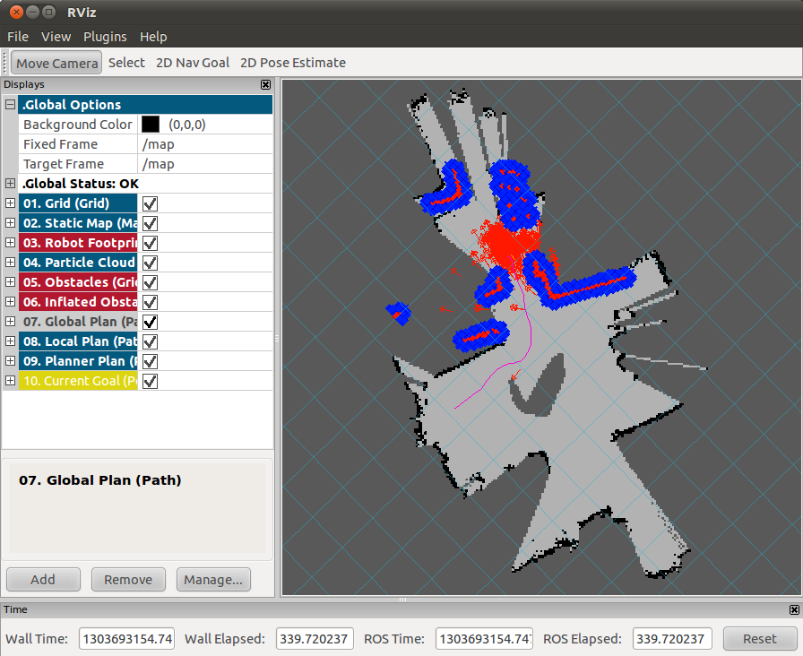
Navigation in Action
http://www.youtube.com/watch?v=j-5iaRHzZlM&feature=player_detailpage

Slide 13
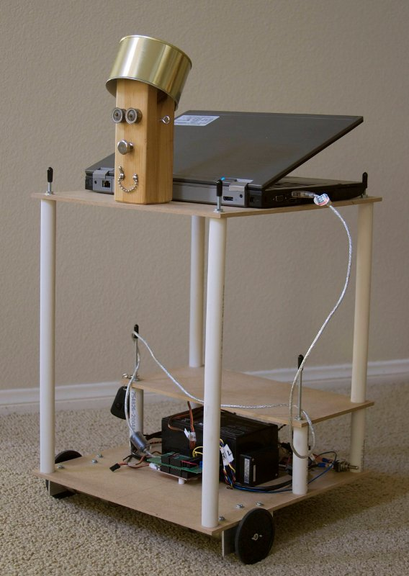
Questions?

