Slide 1
CMP 262 Final Project Presentation
Jared Egerer

Slide 2
Introduction
Purpose
How can we make better buying choices based on customer sentiment and demand?
Assist restaurant and bar procurement
Diversify tap offerings

Slide 3
Methodology
Statistics
Up to 50 Beers per Style
Over 110 Styles
Nearly 1,500 Breweries
Taste Profiles
Source: BeerAdvocate.com

Slide 4
Questions to Ask
When looking at the most highly rated styles of beer, what flavor profiles are most commonly associated?
Which breweries perform the best and worst overall?

Slide 5
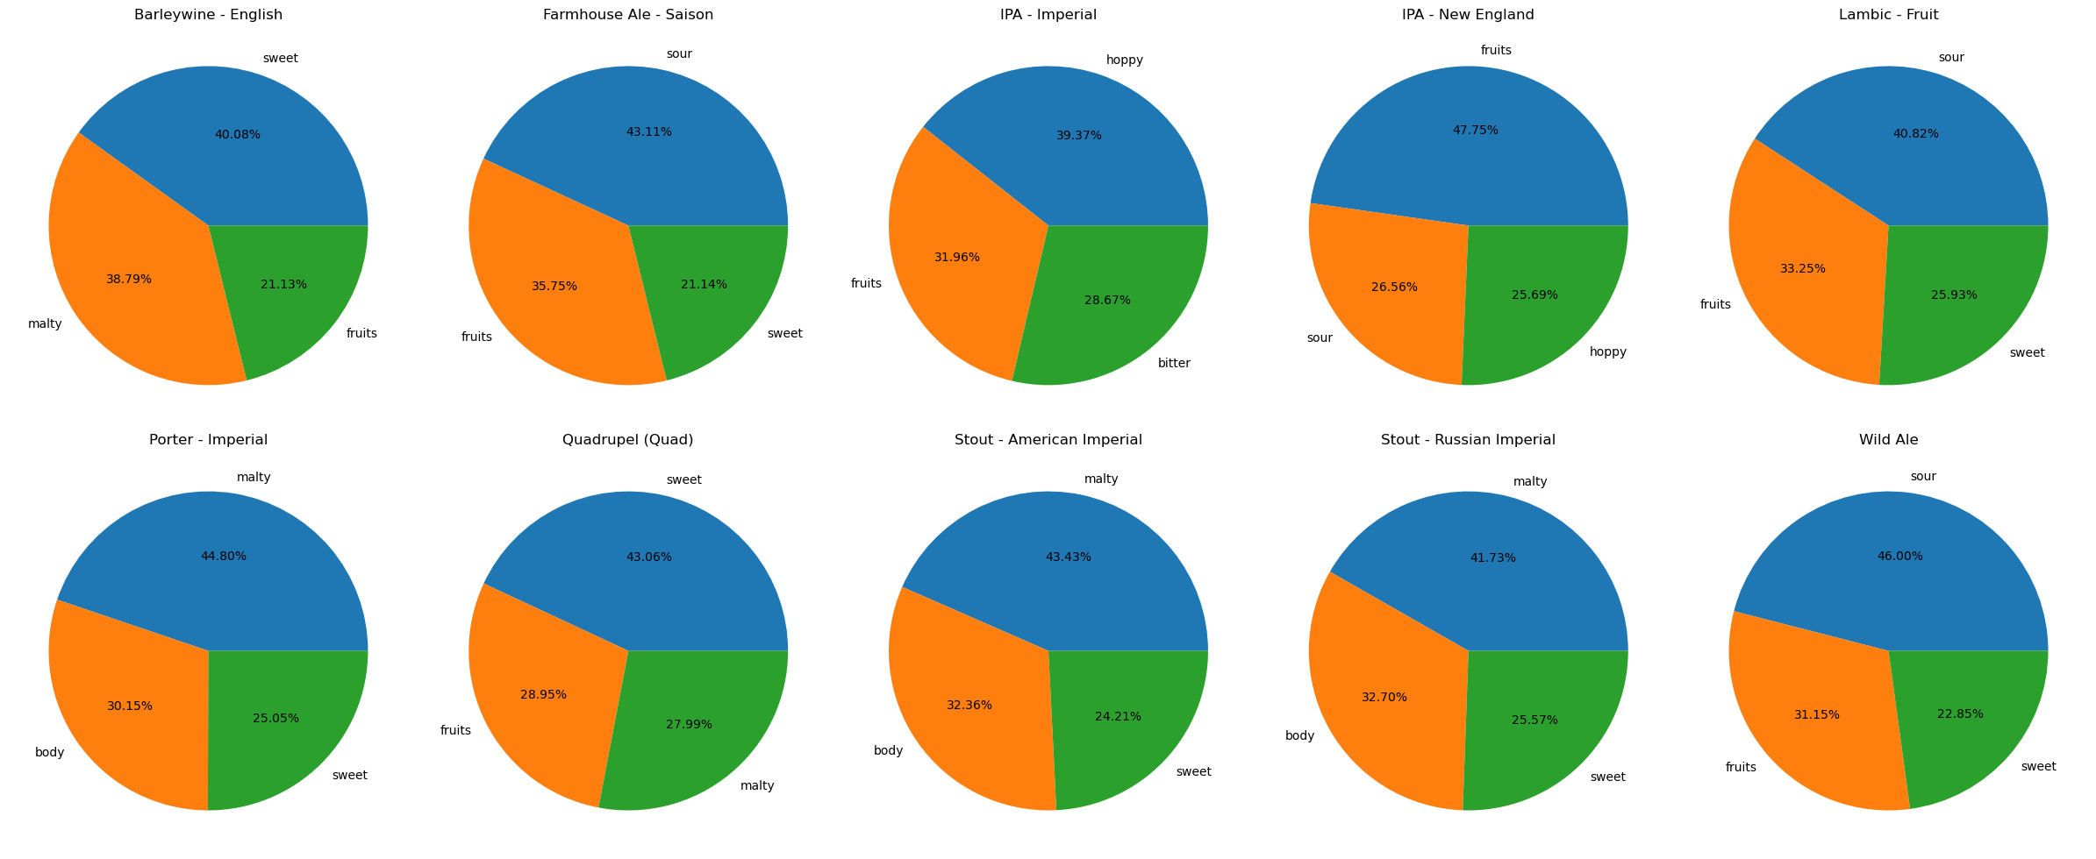
Beer Styles and Taste Profiles

Slide 6
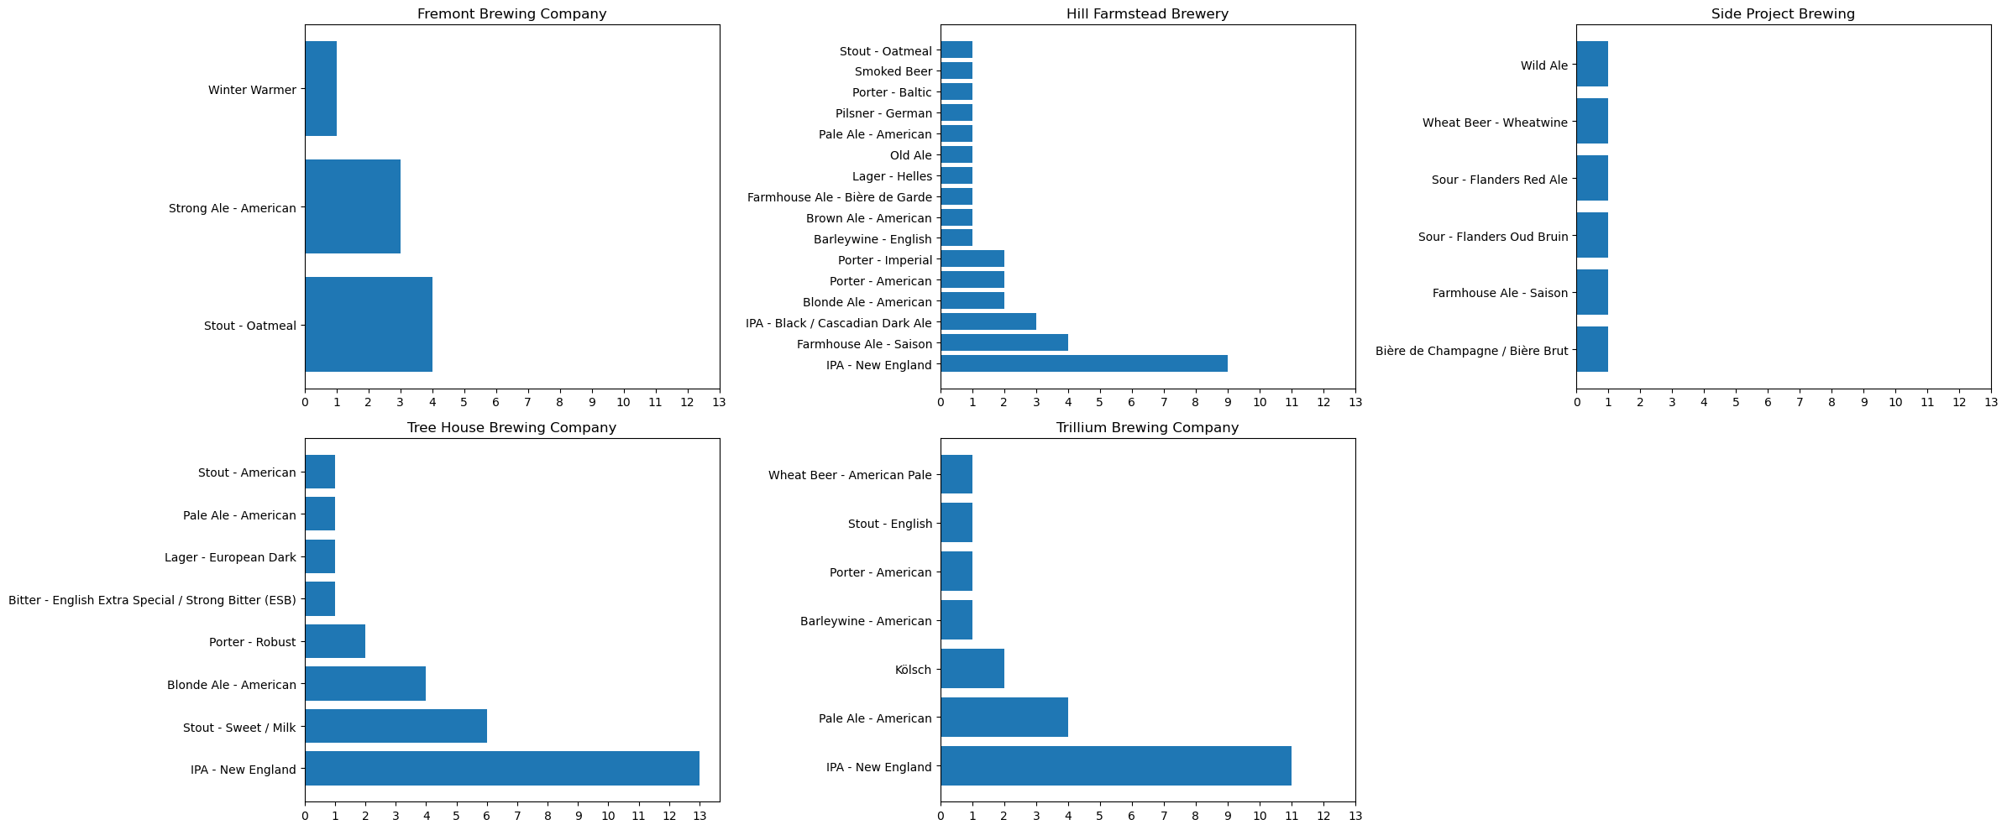
The Top 5 Breweries

Slide 7
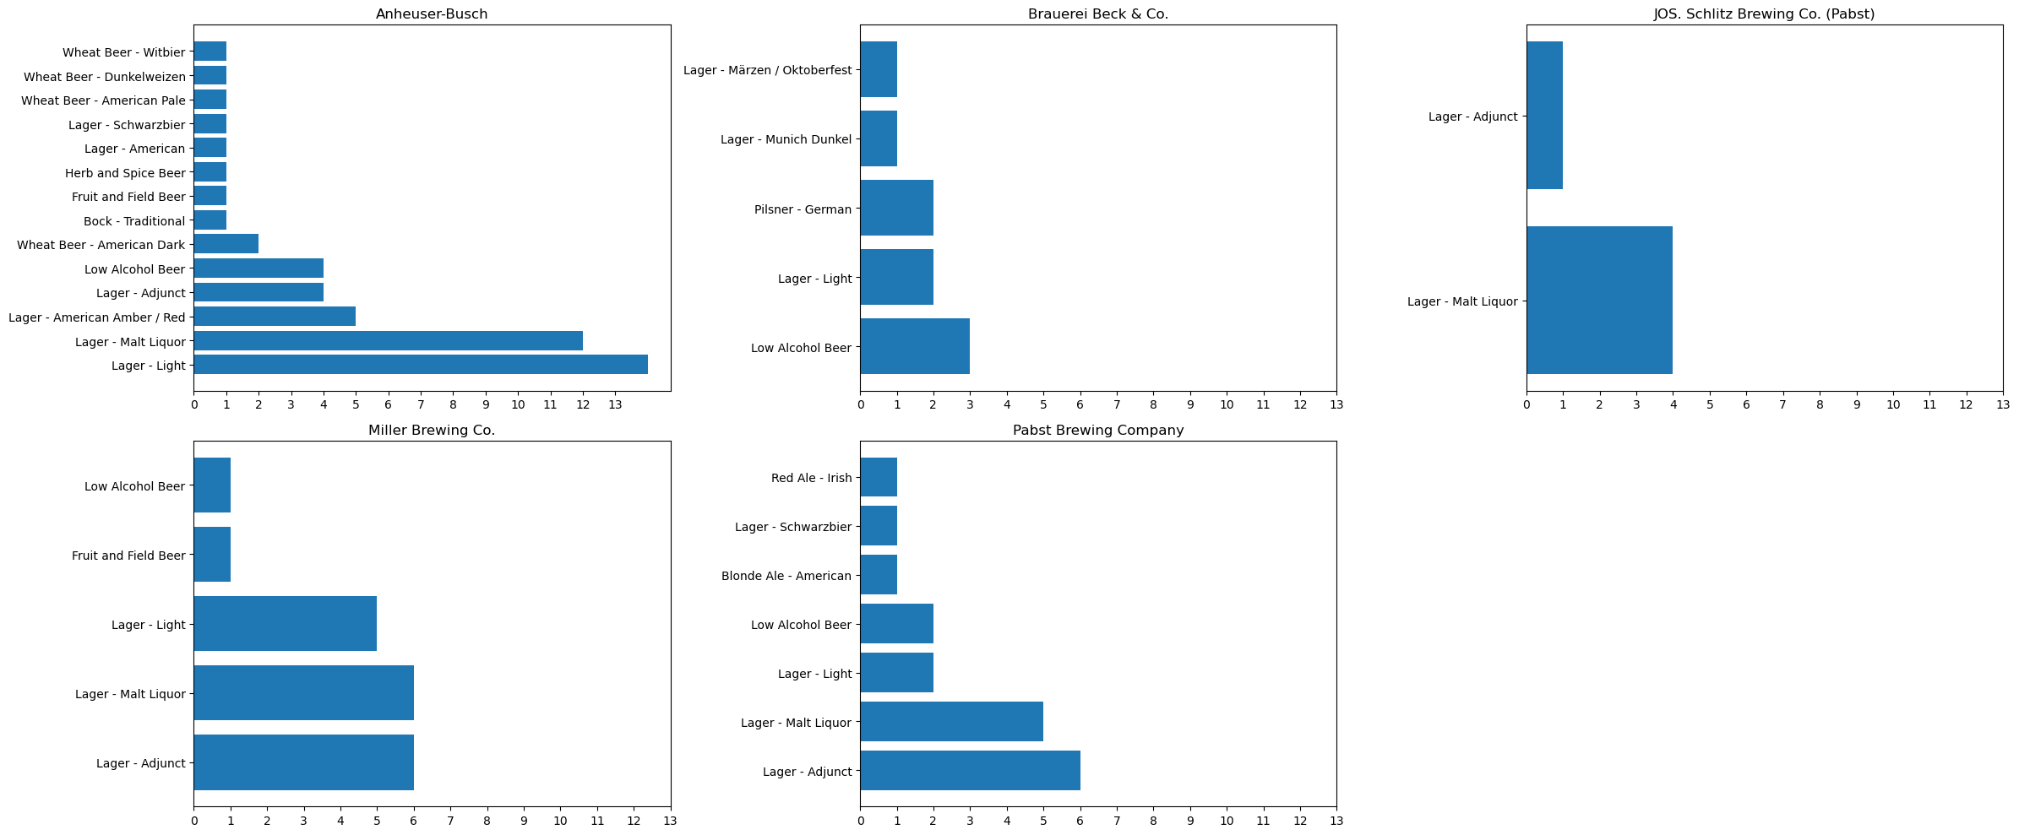
The Bottom 5 Breweries

Slide 8
What’s Next?
Regional brewery ratings and their beer styles
Deeper dive into taste profiles

