Slide 1
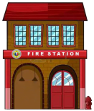
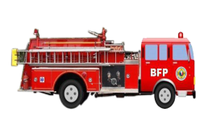
FIREFIGHTING CAPABILITY
As of APRIL 2017
1,213
355
(301+54)
✗
66
✗
144 Cities and 1,050 Municipalities
with fire station building
and with fire truck/s
Municipalities with
fire truck only
Municipalities without
fire truck
* All cities have fire trucks
54
✗
301
✗
367
(301+66)
✗
✗
Municipalities with
fire station building only
Municipalities
without fire station building
and without fire truck/s
Municipalities without
fire station building
* All cities have fire station buildings
1

Slide 2
FIREFIGHTING CAPABILITY
As of APRIL 2017
REGION | WITH FIRE STATION BUILDING AND FIRE TRUCK/S |  |  | MUNICIPALITIES WITH FIRE TRUCK ONLY | MUNICIPALITIES WITHOUT FIRE TRUCK | MUNICIPALITIES WITH FIRE STATION BLDG ONLY | MUNICIPALITIES WITHOUT FIRE STATION BLDG AND WITHOUT FIRE TRUCK | MUNICIPALITIES WITHOUT FIRE STATION BLDG | TOTAL NUMBER OF CITIES AND MUNICIPALITIES |  |  | NUMBER OF FIRE SUB-STATION BUILDINGS
 |  |  |  |  |  |  |  |  | CITY | MUNICIPALITY | TOTAL
 | CITY | MUNICIPALITY | SUB-TOTAL
1 | 9 | 78 | 87 | 17 | 21 | 0 | 21 | 38 | 9 | 116 | 125 | 1
2 | 4 | 72 | 76 | 1 | 16 | 4 | 12 | 13 | 4 | 89 | 93 | 2
3 | 14 | 105 | 119 | 7 | 4 | 2 | 2 | 9 | 14 | 116 | 130 | 19
4A | 19 | 107 | 126 | 5 | 11 | 3 | 8 | 13 | 19 | 123 | 142 | 15
4B | 2 | 42 | 44 | 13 | 16 | 0 | 16 | 29 | 2 | 71 | 73 | 1
5 | 7 | 84 | 91 | 1 | 22 | 3 | 19 | 20 | 7 | 107 | 114 | 4
6 | 3 | 82 | 85 | 0 | 16 | 0 | 16 | 16 | 3 | 98 | 101 | 9
7 | 10 | 70 | 80 | 1 | 26 | 1 | 25 | 26 | 10 | 97 | 107 | 21
8 | 7 | 108 | 115 | 1 | 27 | 1 | 26 | 27 | 7 | 136 | 143 | 5
9 | 5 | 35 | 40 | 8 | 24 | 1 | 23 | 31 | 5 | 67 | 72 | 19
10 | 9 | 51 | 60 | 9 | 24 | 0 | 24 | 33 | 9 | 84 | 93 | 24
11 | 6 | 41 | 47 | 0 | 2 | 0 | 2 | 2 | 6 | 43 | 49 | 16
12 | 5 | 43 | 48 | 0 | 2 | 0 | 2 | 2 | 5 | 45 | 50 | 3
ARMM | 2 | 15 | 17 | 0 | 101 | 34 | 67 | 67 | 2 | 116 | 118 | 2
CAR | 2 | 54 | 56 | 0 | 21 | 1 | 20 | 20 | 2 | 75 | 77 | 3
CARAGA | 6 | 51 | 57 | 3 | 13 | 2 | 11 | 14 | 6 | 67 | 73 | 5
NCR | 16 | 1 | 17 | 0 | 0 | 0 | 0 | 0 | 16 | 1 | 17 | 115
NIR | 19 | 29 | 48 | 0 | 9 | 2 | 7 | 7 | 19 | 38 | 57 | 6
TOTAL | 145 | 1068 | 1213 | 66 | 355 | 54 | 301 | 367 | 145 | 1489 | 1634 | 270

Slide 3
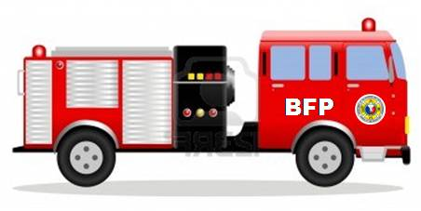
NUMBER OF FIRE TRUCKS*
PER AGE GROUP
(as of APRIL 2017)
NUMBER OF FIRE TRUCKS
PER STATUS
(as of APRIL 2017)
AGE (in years) | BFP OWNED | LGU OWNED | SUBTOTAL
Unidentified | 20 | 29 | 49
0-7 | 655 | 79 | 734
8-10 | 171 | 53 | 224
11-15 | 152 | 64 | 216
16-20 | 221 | 73 | 294
21-24 | 119 | 17 | 136
SUB-TOTAL (0-24) | 1,338 | 315 | 1653
25 | 46 | 12 | 58
26-30 | 217 | 77 | 294
31-35 | 201 | 4 | 205
36-40 | 299 | 23 | 322
41-45 | 76 | 4 | 80
46-50 | 22 | 0 | 22
Over 50 | 42 | 1 | 43
SUB-TOTAL (25 and above) | 903 | 121 | 1024
TOTAL | 2,241 | 436 | 2,677
STATUS | BFP OWNED | LGU OWNED | SUB TOTAL
Serviceable | 1,988 | 371 | 2,359
Unserviceable | 189 | 58 | 247
Under Repair | 64 | 7 | 71
TOTAL | 2,241 | 436 | 2,677
Serviceable, Unserviceable and Under Repair Fire Trucks only.
1029 Fire trucks are 25 Years old and older
8 Cities and 171 Municipalities have only one (1) Fire Truck age 25 years or older

Slide 4

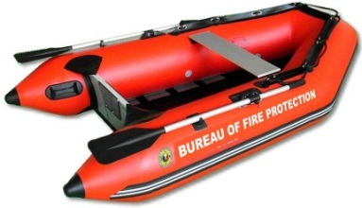
NUMBER OF FIRE VEHICLES AND EQUIPMENT
FIRE TRUCKS* |  | AMBULANCES* |  | RESCUE VANS* |  | FIRE BOATS*
BFP-owned | LGU-owned | BFP-owned | LGU-owned | BFP-owned | LGU-owned | BFP-owned | LGU-owned
2,241 | 436 | 94 | 15 | 33 | 10 | 45 | 12
2,677 |  | 109 |  | 43 |  | 57
* Serviceable, unserviceable and under repair vehicles and equipment.
NUMBER OF FIRE TRUCKS* PER AGE GROUP
(as of APRIL 2017)
AGE (in years) | BFP-OWNED | LGU-OWNED | SUB-TOTAL | % SHARE
0 - 24 | 1,338 | 315 | 1,653 | 62%
25 and older | 903 | 121 | 1024 | 38%
TOTAL | 2,241 | 436 | 2,677 | 100%
* Serviceable, Unserviceable and Under Repair FIRE TRUCKS only.

Slide 5
PERSONNEL STRENGTH
(as of MARCH 2017)

