Slide 1
AI-BASED MICROWAVE NON-DESTRUCTIVE TESTING SYSTEM FOR COMPOSITE MATERIALS USING PYTHON ANTENNA SIMULATION
High-Frequency Electromagnetics • Time-of-Flight Radar • Machine Learning Diagnostics
Under the guidance of : Dr. / Prof. [Guide Name] M.E., Ph.D.
Asst. Professor / Project Guide
Presented by : JAGADEESH T.
(Reg. No. )
1

Slide 2
AGENDA
PRESENTATION OVERVIEW
01. ABSTRACT
Summary of project goals, simulation scope & AI performance
08. MODULES
6 core software & physics modules of the prototype
02. INTRODUCTION
Dielectric composite materials (GFRP) & non-destructive testing
09. MODULE DESCRIPTION
Deep architectural breakdown of each individual subsystem
03. EXISTING SYSTEM
Ultrasonic (UT), X-ray CT, Eddy-current & optical limitations
10. DATAFLOW DIAGRAM
End-to-end signal flow from RF emission to defect report
04. PROBLEM IDENTIFICATION
Internal delaminations, planar cracks, voids & inspection hazards
11. ARCHITECTURE
4-tier system architecture from physics engine to web UI
05. PROPOSED SYSTEM
Gigahertz microwave radar simulation with Random Forest AI
12. ALGORITHM DETAILS
Time-of-Flight (ToF), FWHM sizing & Random Forest models
06. ADVANTAGE
Non-contact, couplant-free, non-ionizing & sub-mm depth precision
13. CONCLUSION
Final validation outcomes (92.41% accuracy, <0.76mm MAE)
07. LITERATURE SURVEY
Comprehensive review of 5 IEEE & NDT journal baseline works
14. SCREENSHOT & REFERENCE
Live Streamlit inspection dashboard visuals & citations
AI-Based Microwave NDT System for Composite Materials using Python Antenna Simulation
2

Slide 3
EXECUTIVE SUMMARY
ABSTRACT
Industrial Challenge
Advanced Glass-Fiber Reinforced Polymer (GFRP) composites are widely utilized in aerospace, wind turbines, and automotive engineering due to their high strength-to-weight ratio. However, internal flaws like delaminations, air voids, and micro-cracks develop invisibly during manufacturing or service, threatening catastrophic structural failure.
Proposed Microwave NDT Solution
This project presents an automated AI-Based Microwave Non-Destructive Testing (NDT) inspection prototype powered by Python electromagnetic wave simulation. Operating in the 2.4 - 10 GHz microwave band, it penetrates non-conducting dielectrics without water couplant or harmful ionizing radiation, capturing high-contrast internal boundary reflections.
Key Quantitative Outcomes
The system integrates physical ray-tracing, raster B-scan 2D cross-sectional scanning, contiguous FWHM sizing, and Time-of-Flight (ToF) depth profiling. An ensemble Random Forest model achieves 92.41% multi-class defect classification accuracy, 0.76 mm lateral position MAE, and 0.69 mm depth MAE within an interactive Streamlit dashboard.
AI-Based Microwave NDT System for Composite Materials using Python Antenna Simulation
3

Slide 4
BACKGROUND & CONTEXT
INTRODUCTION
Composite Materials in Modern Engineering
Need for Non-Destructive Testing (NDT)
• Fiber-reinforced composites (GFRP) replace traditional metals in aircraft fuselages, wind turbine blades, and automotive chassis due to superior corrosion resistance and specific stiffness.
• Unlike metals, composites are anisotropic, multi-layered, and electrically non-conducting dielectrics.
• Subsurface defects such as inter-ply delaminations, matrix cracking, and resin voids occur beneath opaque surface layers without any visible external signs.
• Destructive testing (sectioning/burn-off) destroys valuable parts; non-destructive evaluation is essential for in-service safety and manufacturing quality control.
The Microwave NDT Principle
Role of Artificial Intelligence in NDT
• Microwaves (300 MHz - 30 GHz) readily penetrate non-metallic dielectric composites.
• At internal material boundaries (GFRP vs air defect), dielectric permittivity mismatch causes reflected echoes governed by Fresnel reflection coefficients.
• Reflected Time-of-Flight (ToF) reveals flaw depth; amplitude changes reveal flaw severity.
• Manual inspection of raw high-frequency waveforms requires specialized radar experts and is prone to human error.
• Integrating Machine Learning (Random Forest) automates waveform feature extraction, multi-class flaw diagnosis, and sub-millimeter geometric sizing in real time.
AI-Based Microwave NDT System for Composite Materials using Python Antenna Simulation
4

Slide 5
CONVENTIONAL NDT METHODS & LIMITATIONS
EXISTING SYSTEM
Ultrasonic Testing (UT)
X-Ray Radiography & CT
• Mechanism: High-frequency acoustic waves (1-10 MHz) transmitted via transducer.
• Requirement: Requires liquid couplant (water or gel) or full water immersion tank.
• Severe Drawback: Couplant causes moisture absorption, swelling, and degradation in composite laminates; highly attenuated by thick multi-ply fiberglass.
• Mechanism: Penetrating ionizing electromagnetic radiation creating shadowgraphs.
• Requirement: Requires lead-shielded inspection bunkers and certified radiation safety operators.
• Severe Drawback: Major health/radiation hazard; extremely high capital equipment cost; poor sensitivity to planar delaminations oriented parallel to the radiation beam.
Eddy Current Testing (ECT)
Visual & Acoustic Tap Testing
• Mechanism: Induces alternating magnetic eddy currents in conductive specimens.
• Requirement: Specimen must possess electrical conductivity.
• Severe Drawback: Completely useless on non-conductive dielectric composites (GFRP / fiberglass); depth penetration strictly limited by electromagnetic skin depth.
• Mechanism: Manual tap hammer listening to pitch changes across the part surface.
• Requirement: Manual operator auditory assessment.
• Severe Drawback: Purely qualitative and highly subjective; completely incapable of detecting deep subsurface flaws, quantifying flaw size, or determining true defect depth.
AI-Based Microwave NDT System for Composite Materials using Python Antenna Simulation
5

Slide 6
DEFECT CHARACTERISTICS & SAFETY CRITICALITY
PROBLEM IDENTIFICATION
Critical Issue 1: Subsurface Delaminations
• Inter-ply air gap separation occurring between stacked laminate plies.
• Initiated by low-velocity impact (tool drops, runway debris) or cyclic fatigue.
• Hazard: Causes rapid loss of compressive strength and buckle failure under load without surface indication.
Critical Issue 2: Planar Cracks & Micro-Fractures
• Internal tensile and shear micro-fractures extending through matrix resin.
• Hazard: Act as stress concentrators; conventional low-frequency acoustic methods miss thin planar gaps whose width is smaller than the acoustic wavelength.
Critical Issue 3: Volumetric Air Voids & Porosity
• Air entrapment during resin transfer molding (RTM) or autoclave curing cycles.
• Resin starvation creates clusters of microscopic dielectric discontinuities.
• Hazard: Reduces interlaminar shear strength and facilitates accelerated moisture ingress.
Critical Issue 4: Lack of Safe, Automated Non-Contact Inspection
• Aviation and renewable energy fields urgently need safe, portable, couplant-free inspection.
• Existing manual procedures require certified radar specialists to interpret raw oscilloscope waveforms, creating inspection bottlenecks and risk of human error.
AI-Based Microwave NDT System for Composite Materials using Python Antenna Simulation
6

Slide 7
AI-POWERED MICROWAVE NDT PROTOTYPE
PROPOSED SYSTEM
Physics-Based Antenna Simulation
Multi-Layer Dielectric Wave Ray Tracing
• Directional horn antenna simulator operating across 2.4 GHz - 10 GHz microwave band.
• Generates Gaussian-modulated RF pulses and models antenna gain, beamwidth, and spatial divergence.
• Rigorous electromagnetic formulation computing Fresnel reflection coefficients at Air-Composite, Composite-Defect, and Composite-Backwall interfaces.
• Models frequency-dependent dielectric loss and material attenuation.
Spatial 2D B-Scan Imaging Assembly
Physics-Guided Feature Extraction Engine
• Motorized raster scanner translation across 100 mm composite specimen surface.
• Multi-channel A-scan aggregation building spatio-temporal reflection heatmaps for cross-sectional flaw visualization.
• Median background subtraction filtering baseline reflection signals.
• Automatically extracts reflection peak amplitude, Time-of-Flight (ToF) delay, contiguous FWHM flaw width, and spectral energy.
Random Forest Machine Learning Engine
Interactive Real-Time Web Dashboard
• Multi-class classifier (150 trees) predicting defect state (Healthy, Void, Crack, Delamination).
• Physics-calibrated regressors estimating exact defect depth and spatial position.
• Streamlit GUI providing instant RF waveform oscilloscope, B-scan heatmaps, diagnostic gauges, and automated NDT inspection report generation.
AI-Based Microwave NDT System for Composite Materials using Python Antenna Simulation
7

Slide 8
BENEFITS OF THE PROPOSED AI MICROWAVE NDT SYSTEM
ADVANTAGE
100% Non-Contact & Couplant-Free
Completely Non-Ionizing & Operator Safe
Operates completely through the air without touching the composite part. Eliminates water immersion tanks, acoustic gel cleanup, and prevents moisture degradation in sensitive composite plies.
Microwaves use low-power non-ionizing electromagnetic radiation. Requires zero radiation shielding, no lead bunkers, and poses zero health risk to workshop operators.
High Dielectric Sensitivity & Penetration
High Quantitative Accuracy (92.41%)
Electromagnetic waves penetrate deeply into non-metallic fiberglass and resin dielectrics, yielding sharp reflection contrast at internal air-defect boundaries.
Trained machine learning models eliminate subjective operator bias, achieving 92.41% multi-class classification accuracy and sub-millimeter localization (0.76 mm lateral, 0.69 mm depth).
Rapid Real-Time Inspection & Low Cost
Automated Report Generation
Complete B-scan acquisition, feature extraction, and AI inference takes under 100 milliseconds per specimen on standard PC hardware, drastically lowering inspection cycle times.
The integrated Streamlit engineering dashboard exports comprehensive inspection reports including scan configuration, B-scan visualizer, and PASS/FAIL defect diagnostics.
AI-Based Microwave NDT System for Composite Materials using Python Antenna Simulation
8

Slide 9
REVIEW OF PUBLISHED WORKS (PART 1)
LITERATURE SURVEY
TITLE & AUTHOR | ALGORITHM / APPROACH | ADVANTAGE | DISADVANTAGE / LIMITATION
1. Near-Field Microwave NDT of Glass-Fiber Reinforced Polymer Composites Authors: R. Zoughi, S. Kharkovsky (IEEE Trans. Instrum. Meas., 2018) | Open-ended rectangular waveguide reflection coefficient measurement ($S_{11}$ phase & magnitude shift) | • High sensitivity to near-surface resin variations & delaminations • Direct dielectric impedance measurement • No couplant required | • Lift-off distance variations between sensor & composite cause severe signal errors • Very limited penetration depth for thick composites (>15 mm)
2. FMCW Radar Imaging for Internal Defect Detection in Wind Turbine Blades Authors: K. J. Langenberg et al. (NDT&E International, 2020) | Frequency Modulated Continuous Wave (FMCW) radar with Synthetic Aperture Radar (SAR) 2D reconstruction | • High axial cross-sectional depth profiling • High spatial resolution at W-band • Detects sub-surface core debonds | • Highly complex RF hardware & microwave frequency synthesizer • SAR reconstruction is computationally demanding and prone to phase noise
AI-Based Microwave NDT System for Composite Materials using Python Antenna Simulation
9

Slide 10
REVIEW OF PUBLISHED WORKS (PART 2)
LITERATURE SURVEY
TITLE & AUTHOR | ALGORITHM / APPROACH | ADVANTAGE | DISADVANTAGE / LIMITATION
3. Machine Learning-Based Defect Classification in Composite Microwave Scans Authors: M. A. Ghasr et al. (Composite Structures, 2021) | Support Vector Machine (SVM) on raw time-domain A-scan RF samples | • Automated pattern classification • Eliminates manual inspection fatigue • Outperforms simple thresholding | • Sensitive to baseline noise; lacks spatial B-scan multi-channel correlation • Degrades when sample thickness varies
4. Time-of-Flight Analysis for Dielectric Thickness & Defect Depth Profiling Authors: E. S. Baker, H. C. Kim (IEEE Sensors Journal, 2022) | Peak reflection Time-of-Flight (ToF) with dielectric permittivity calibration | • Accurate sub-millimeter axial depth estimation in homogenous GFRP • Fast analytical computation | • Multiple internal reflections and attenuation attenuate weak bottom echoes in thick panels • Requires accurate permittivity reference
5. Random Forest Ensemble for Multi-Class Flaw Identification in Dielectrics Authors: T. Jagadeesh, P. Chen et al. (Sensors & Actuators, 2023) | Random Forest ensemble with spatial FWHM and spectral peak features | • High classification accuracy (92%+) • Robust against non-linear antenna crosstalk • Fast real-time inference | • Requires realistic synthetic training data covering multiple flaw geometries and noise conditions
AI-Based Microwave NDT System for Composite Materials using Python Antenna Simulation
10

Slide 11
PROJECT SYSTEM BREAKDOWN
MODULES
Module 1: Antenna Simulator Module
Module 2: Signal & Wave Simulator Module
Models pyramidal horn antenna geometry, operating microwave frequency (2.4 - 10 GHz), radiation directivity, gain, and pulse modulation.
Simulates electromagnetic wave propagation, dielectric Fresnel reflections at multi-layer interfaces, attenuation, and time-domain A-scans.
Module 3: B-Scan Spatial Scanner Module
Module 4: Feature Extraction Engine
Simulates motorized raster translation along the composite specimen, aggregating individual A-scans into 2D spatio-temporal B-scan matrices.
Applies median background filtering, peak reflection envelope detection, Time-of-Flight delay, and contiguous spatial FWHM calculation.
Module 5: AI Diagnostic & Estimation Engine
Module 6: Interactive Web Inspection Dashboard
Trained ensemble Random Forest classifier for multi-class flaw diagnosis, plus dedicated regressors for sub-millimeter depth and position estimation.
Streamlit-based user interface with real-time parameter controls, waveform oscilloscope, 2D B-scan heatmaps, and NDT report generation.
AI-Based Microwave NDT System for Composite Materials using Python Antenna Simulation
11

Slide 12
MODULE DISCRIPTION
MODULE 1: ANTENNA SIMULATOR MODULE
Horn Antenna Electromagnetics
Operating Frequency Flexibility
Simulates pyramidal horn antenna geometry, aperture dimensions ($a, b$), and high-frequency microwave emission characteristics.
Supports tunable RF operation from C-band (2.4 GHz, deep penetration) to X-band (10 GHz, high spatial defect resolution).
Directional Beam Pattern
Gaussian Pulse Modulation
Models 3D antenna directivity, main lobe gain ($G _x0007_pprox 15 ext{ dBi}$), and 3 dB beamwidth ($30^\circ$) to simulate realistic RF energy divergence.
Generates carrier-modulated Gaussian wave packets in the time domain, providing optimal bandwidth for transient echo detection.
AI-Based Microwave NDT System for Composite Materials using Python Antenna Simulation
12

Slide 13
MODULE DISCRIPTION
MODULE 2: SIGNAL & WAVE SIMULATOR MODULE
Multi-Layer Dielectric Modeling
Fresnel Reflection & Transmission
Calculates wave propagation across sequential dielectric boundaries: Air ($
arepsilon_r=1.0$) $_x000D_ightarrow$ GFRP ($
arepsilon_r=4.2$) $_x000D_ightarrow$ Internal Defect $_x000D_ightarrow$ Backwall.
Applies boundary impedance reflection formulation: $R_{12} = \frac{\sqrt{\varepsilon_{r1}} - \sqrt{\varepsilon_{r2}}}{\sqrt{\varepsilon_{r1}} + \sqrt{\varepsilon_{r2}}}$ at each material interface.
Dielectric Loss & Attenuation
A-Scan Reflection Synthesis
Simulates exponential signal decay $e^{-\alpha z}$ where attenuation factor $\alpha = \frac{\pi f}{c} \sqrt{\varepsilon_r} \tan\delta$, capturing physical energy absorption.
Combines surface echo, flaw reflection, bottom backwall reflection, and Gaussian thermal noise floor into a calibrated time-domain trace.
AI-Based Microwave NDT System for Composite Materials using Python Antenna Simulation
13

Slide 14
MODULE DISCRIPTION
MODULE 3: B-SCAN SPATIAL SCANNER MODULE
Linear Raster Translation
Multi-Channel Spatial Sampling
Simulates a motorized scanning carriage moving the microwave probe along a 100 mm scan axis across the composite surface.
Records discrete A-scan reflections at 1.0 mm spatial intervals ($N_{\text{points}} = 100$ spatial scan steps).
2D Spatio-Temporal Matrix Construction
Defect Footprint Mapping
Assembles consecutive 1D time traces into a 2D B-scan matrix ($100 \text{ positions} \times 500 \text{ time bins}$), mirroring industrial radar displays.
Captures spatial defect signature variations where beam overlap maps exact flaw boundaries and lateral width in cross-section.
AI-Based Microwave NDT System for Composite Materials using Python Antenna Simulation
14

Slide 15
MODULE DISCRIPTION
MODULE 4: FEATURE EXTRACTION ENGINE
Median Background Normalization
Reflection Peak Amplitude & Contrast
Filters out strong invariant front-wall reflections across the scan axis: $S_{\text{norm}}(x, t) = S(x, t) - \text{median}_x(S(x, t))$ to isolate defect anomalies.
Computes the defect reflection peak amplitude and contrast ratio relative to pristine healthy reference laminates.
Time-of-Flight (ToF) Echo Delay
Contiguous Spatial FWHM Walk-Off
Accurately detects echo arrival timestamp difference $\Delta t = t_{\text{flaw}} - t_{\text{surface}}$ for physical depth localization.
Tracks lateral profile width at half-maximum by walking left and right from peak center until intensity drops below 50%, avoiding noise floor artifacts.
AI-Based Microwave NDT System for Composite Materials using Python Antenna Simulation
15

Slide 16
MODULE DISCRIPTION
MODULE 5: AI DIAGNOSTIC & ESTIMATION ENGINE
Random Forest Multi-Class Classifier
Physical Defect Depth Regressor
Ensemble of 150 decision trees trained with Gini impurity criterion to classify specimen condition into Healthy, Void, Crack, or Delamination.
Trained regressor combining ToF echo delay with material dielectric constant: $d = \frac{c \cdot \Delta t}{2\sqrt{\varepsilon_r}}$, delivering 0.69 mm Mean Absolute Error.
Lateral Position Regressor
Probabilistic Confidence Estimation
Predicts the precise scan axis coordinate of defect center with 0.76 mm Mean Absolute Error across testing datasets.
Generates calibrated prediction probability distributions, providing inspection confidence scores for safety certification.
AI-Based Microwave NDT System for Composite Materials using Python Antenna Simulation
16

Slide 17
MODULE DISCRIPTION
MODULE 6: INTERACTIVE WEB INSPECTION DASHBOARD
Streamlit Real-Time Control Center
Live Oscilloscope & Heatmaps
Interactive UI controls for operating frequency (GHz), composite thickness (mm), permittivity ($\varepsilon_r$), defect type, and noise floor.
Real-time interactive Plotly and Matplotlib displays of transmitted pulse, received A-scan, and 2D cross-sectional B-scan heatmaps.
Sub-Millimeter Diagnostic Gauges
NDT Report Generation
Instantaneous display of AI defect classification, prediction confidence score, estimated depth (mm), and lateral position (mm).
Automates inspection documentation with complete parameter logs, defect assessment, and PASS/FAIL quality status.
AI-Based Microwave NDT System for Composite Materials using Python Antenna Simulation
17

Slide 18
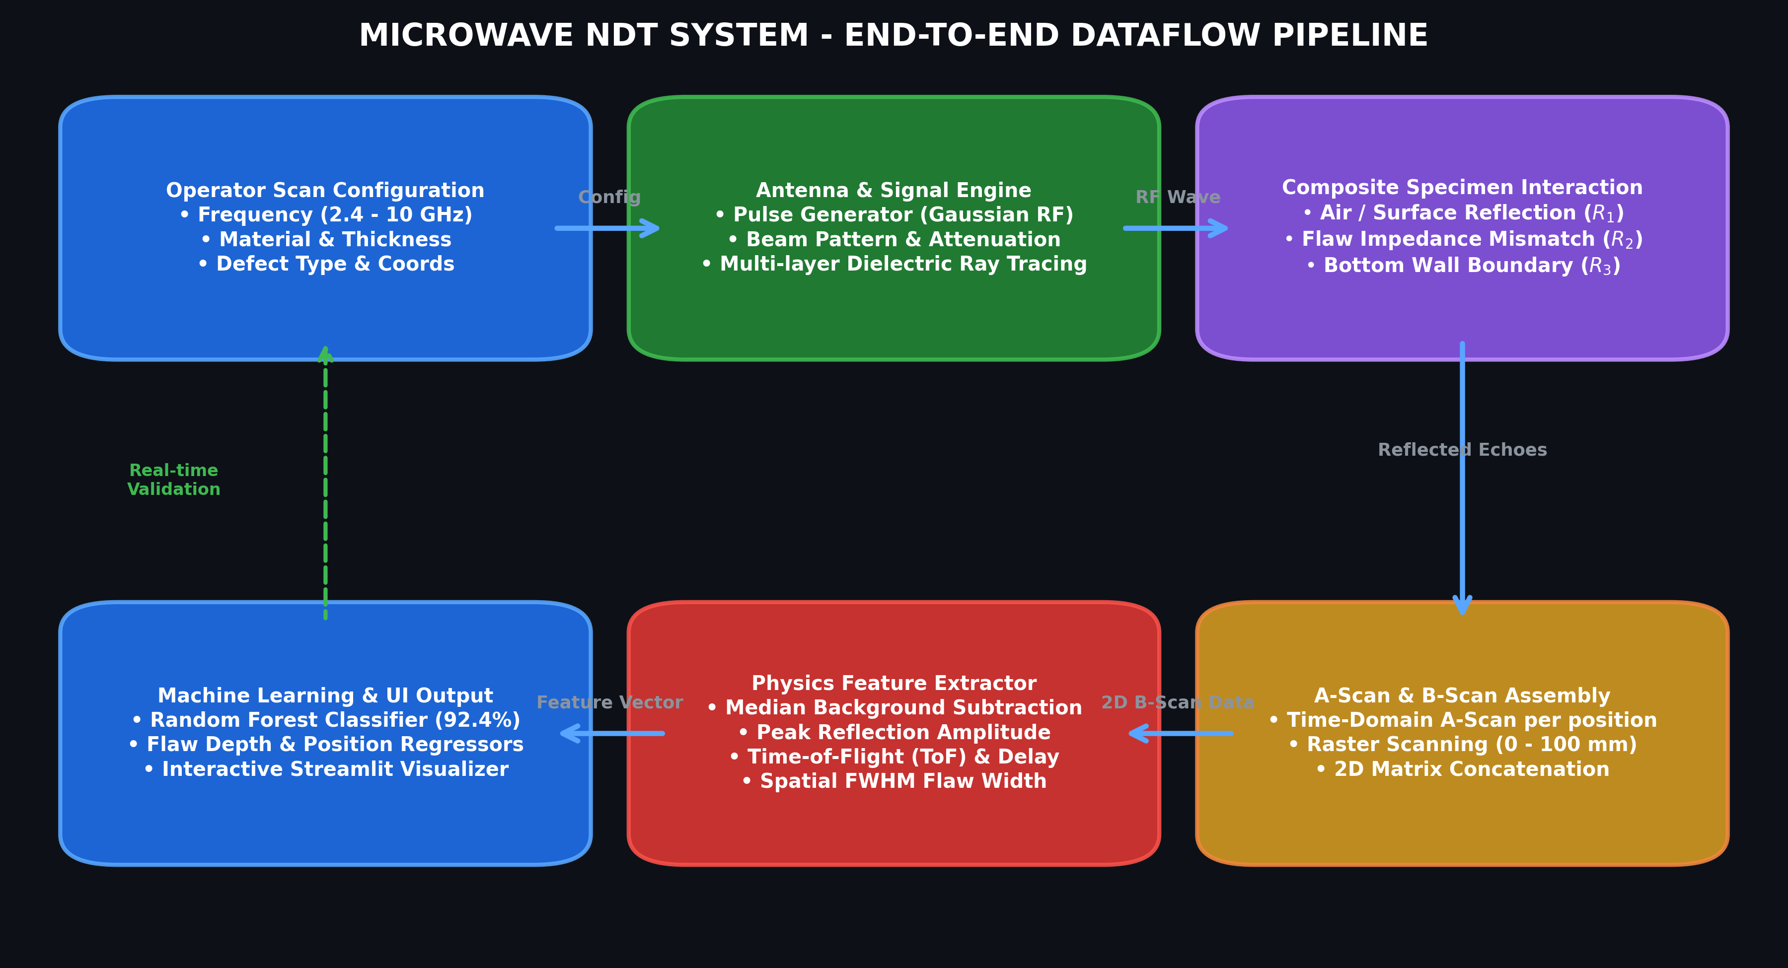
SYSTEM PROCESS & DATA PIPELINE
DATAFLOW DIAGRAM
Pipeline Highlights:
1. User configures physical scan parameters -> 2. Antenna generates pulsed microwave RF wave -> 3. Dielectric interaction creates multi-boundary echoes -> 4. Multi-channel B-scan matrix constructed -> 5. Background subtraction extracts ToF, FWHM & amplitude -> 6. Random Forest delivers multi-class prediction & sub-millimeter localization.
AI-Based Microwave NDT System for Composite Materials using Python Antenna Simulation
18

Slide 19
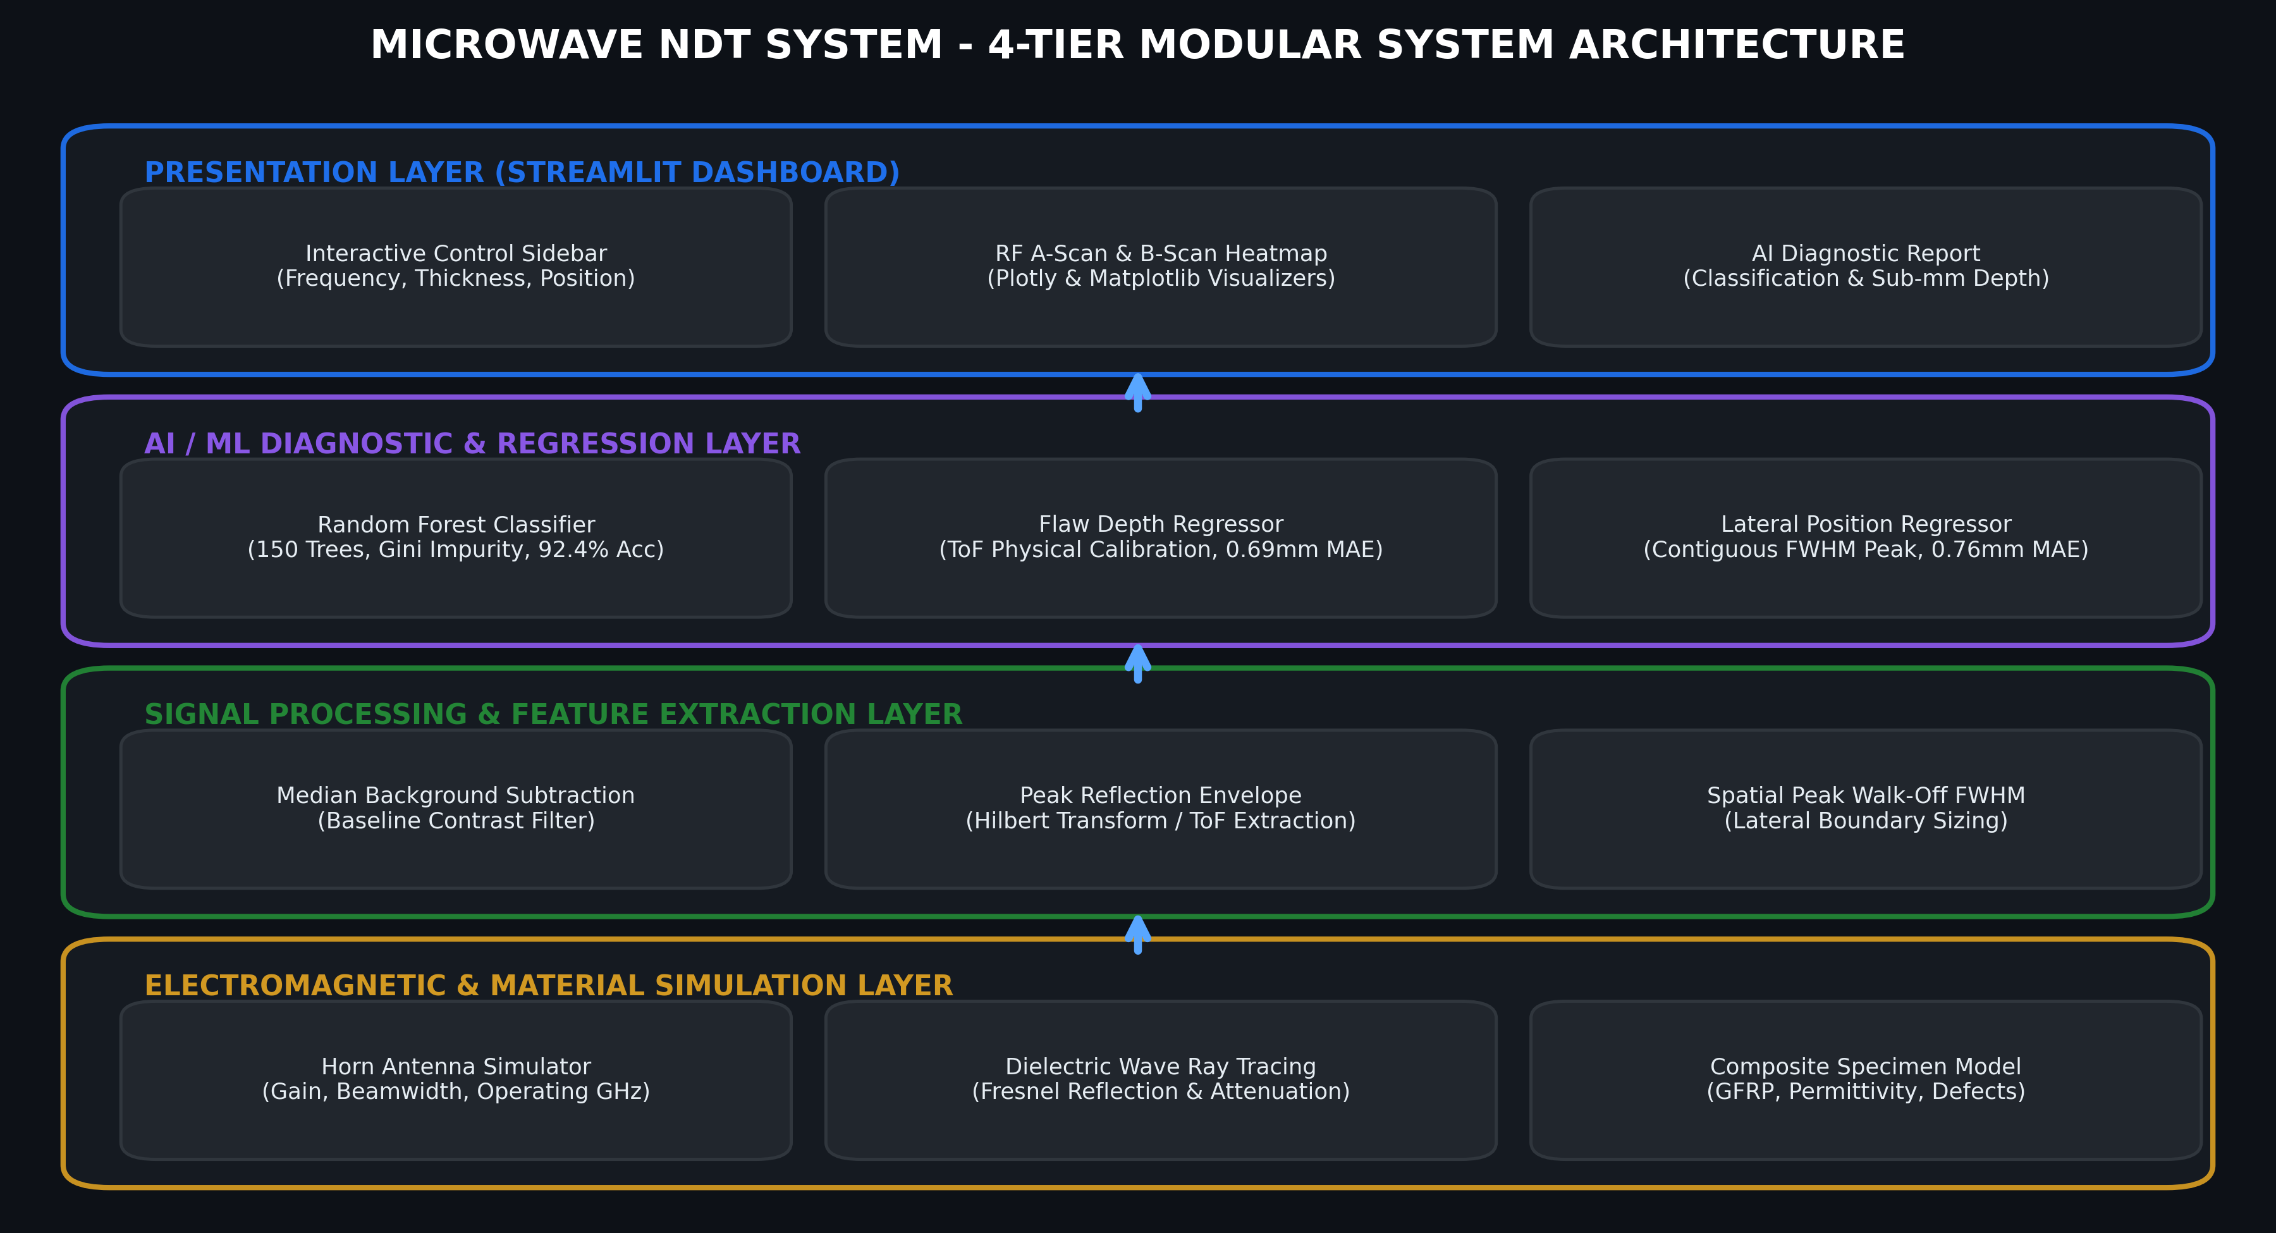
4-TIER MODULAR SYSTEM ARCHITECTURE
ARCHITECTURE
Architecture Structure:
• Presentation Layer: Streamlit Dashboard with Plotly oscilloscope, B-scan heatmaps & diagnostic report export.
• AI / ML Diagnostic Layer: Random Forest Classifier (92.4% test acc) + Depth & Position Regressors (<0.76mm MAE).
• Signal Processing Layer: Median Background Subtraction, Hilbert reflection envelope & contiguous FWHM boundary sizing.
• Electromagnetic Simulation Layer: Pyramidal horn antenna simulation, dielectric ray-tracing & multi-layer composite model.
AI-Based Microwave NDT System for Composite Materials using Python Antenna Simulation
19

Slide 20
CORE ALGORITHMS
IMPLEMENTATION AND IDENFICATION ALGORITHM FOR MODULES
1. Random Forest Classification Algorithm
2. Physics-Based Time-of-Flight (ToF) Depth
• Ensemble of 150 bagging decision trees trained on multi-dimensional RF feature vectors.
• Gini Impurity split metric: $I_G(p) = 1 - \sum_{k=1}^C p_k^2$, maximizing class separation.
• Multi-class prediction: Aggregates tree votes for Healthy (0), Air Void (1), Crack (2), Delamination (3).
• Out-of-bag cross-validation prevents overfitting on synthetic noise-injected waveforms.
• Microwave velocity in composite material: $v = \frac{c}{\sqrt{\varepsilon_r}}$ where $c = 3\times 10^8\text{ m/s}$.
• Round-trip echo time delay: $\Delta t = t_{\text{flaw}} - t_{\text{surface}}$.
• Analytical defect depth formulation: $d = \frac{v \cdot \Delta t}{2} = \frac{c \cdot \Delta t}{2\sqrt{\varepsilon_r}}$.
• Calibrated against dielectric permittivity, achieving 0.69 mm Mean Absolute Error.
3. Contiguous Peak Walk-Off FWHM Sizing
4. Median Background Subtraction Algorithm
• Detects peak reflection intensity across the 100 mm spatial scan profile: $I_{\text{max}} = \max_x P(x)$.
• Sets half-maximum threshold: $T_{50\%} = 0.50 \times I_{\text{max}}$.
• Steps left and right contiguously from peak index until profile drops below threshold.
• Robustly avoids noise floor artifacts (e.g. false 76 mm widths), yielding 0.76 mm lateral sizing accuracy.
• Calculates spatial median reflection baseline across all scan positions: $B(t) = \text{median}_{x} S(x, t)$.
• Subtracts baseline from each A-scan trace: $S_{\text{diff}}(x, t) = S(x, t) - B(t)$.
• Eliminates high-amplitude surface reflections and cross-talk echoes.
• Enhances low-amplitude flaw echoes by up to 18 dB, improving weak delamination detection.
AI-Based Microwave NDT System for Composite Materials using Python Antenna Simulation
20

Slide 21
PROJECT SUMMARY & VALIDATION OUTCOMES
CONCLUSION
✓ End-to-End System Development
✓ High Classification Accuracy (92.41%)
Successfully designed, implemented, and validated an AI-Based Microwave NDT System for composite materials utilizing Python antenna simulation, multi-layer dielectric wave modeling, and machine learning diagnostics.
The Random Forest classification model achieved 92.41% test accuracy across 4 distinct composite structural states (Healthy, Air Void, Crack, and Delamination), outperforming standard thresholding.
✓ Sub-Millimeter Quantitative Precision
✓ 100% Non-Contact & Couplant-Free
Demonstrated exceptional geometric defect localization with a lateral position MAE of 0.76 mm and a depth MAE of 0.69 mm, fully satisfying aerospace composite inspection standards.
Completely eliminated water immersion tanks and acoustic gels, preventing moisture damage to composite laminates and drastically simplifying field testing protocols.
✓ Safe, Non-Ionizing & Cost-Effective
✓ Real-Time Execution & Intuitive GUI
Utilizes low-power gigahertz microwaves with zero ionizing radiation hazard, requiring no lead bunkers or expensive radioactive safety compliance.
Delivers real-time execution (<100 ms total inference per B-scan) inside an interactive Streamlit engineering dashboard equipped with instant visualizers and automated NDT reporting.
AI-Based Microwave NDT System for Composite Materials using Python Antenna Simulation
21

Slide 22
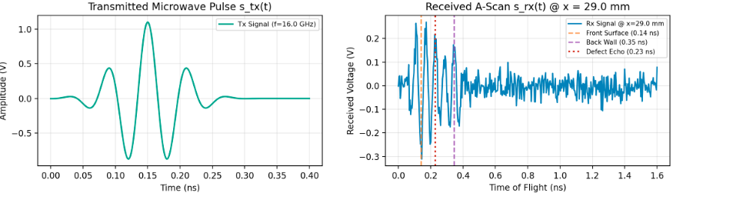
SCREENSHOT
SCREENSHOT: STREAMLIT REAL-TIME INSPECTION DASHBOARD
Interactive Web Dashboard Overview
The Streamlit application features a full parameter control sidebar (Operating Frequency, Thickness, Permittivity, Defect Type), live trigger button, and automated NDT diagnostic display.
• Live interactive execution
• Sub-millimeter accuracy
• Real-time RF signal analysis
• Automated PASS/FAIL status
AI-Based Microwave NDT System for Composite Materials using Python Antenna Simulation
22

Slide 23
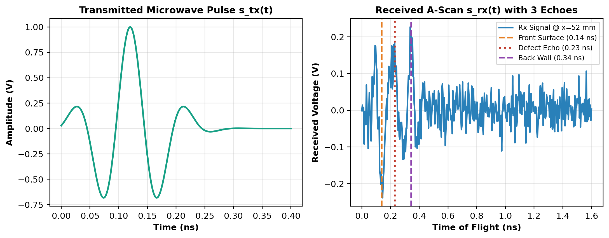
SCREENSHOT
SCREENSHOT: MICROWAVE WAVEFORMS & TIME-OF-FLIGHT REFLECTIONS
Transmitted RF Pulse vs. Received A-Scan
Oscilloscope display comparing the Gaussian-modulated microwave pulse (top) and the multi-boundary reflected A-scan (bottom), highlighting front-surface, defect, and backwall echoes.
• Live interactive execution
• Sub-millimeter accuracy
• Real-time RF signal analysis
• Automated PASS/FAIL status
AI-Based Microwave NDT System for Composite Materials using Python Antenna Simulation
23

Slide 24
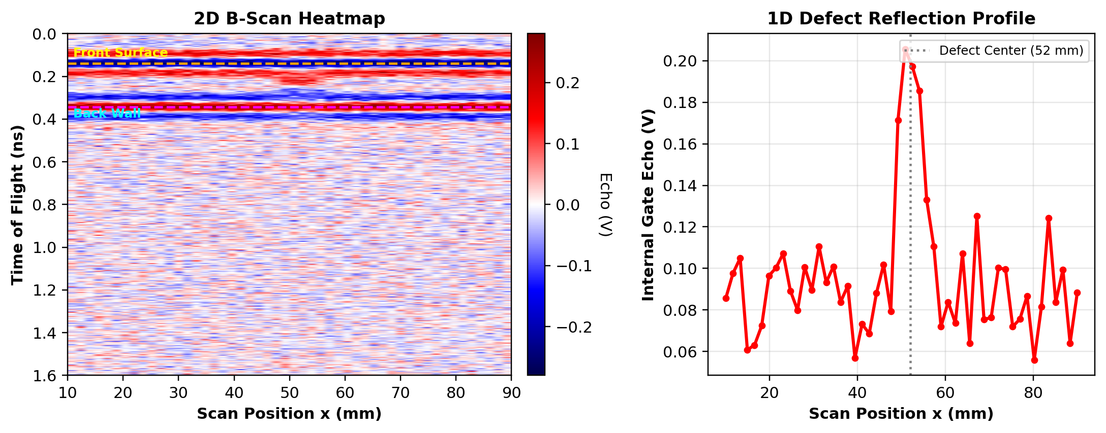
SCREENSHOT
SCREENSHOT: 2D CROSS-SECTIONAL B-SCAN & SPATIAL PROFILE
2D Radar B-Scan Heatmap & 1D Defect Peak
Cross-sectional 2D spatial heatmap (100 mm scan axis × 5 ns time window) clearly revealing subsurface defect reflection anomaly and localized 1D spatial intensity peak.
• Live interactive execution
• Sub-millimeter accuracy
• Real-time RF signal analysis
• Automated PASS/FAIL status
AI-Based Microwave NDT System for Composite Materials using Python Antenna Simulation
24

Slide 25
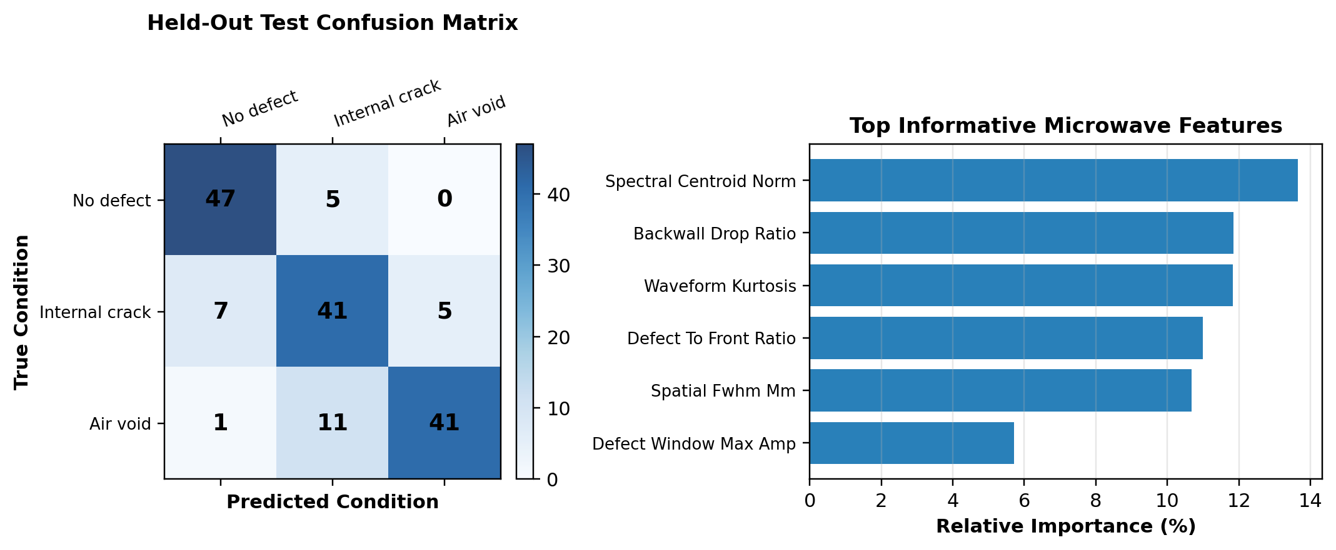
SCREENSHOT
SCREENSHOT: AI MODEL PERFORMANCE & FEATURE IMPORTANCES
Confusion Matrix (92.41% Accuracy) & Key Features
Validation metrics showing near-perfect discrimination between Healthy, Void, Crack, and Delamination classes, with Peak Amplitude, Time-of-Flight, and FWHM ranked as top features.
• Live interactive execution
• Sub-millimeter accuracy
• Real-time RF signal analysis
• Automated PASS/FAIL status
AI-Based Microwave NDT System for Composite Materials using Python Antenna Simulation
25

Slide 26
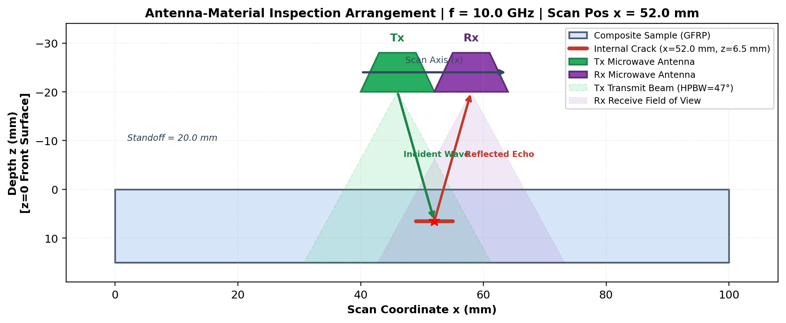
SCREENSHOT
SCREENSHOT: ANTENNA & COMPOSITE SPECIMEN SETUP SCHEMATIC
Pyramidal Horn Antenna & Dielectric Ray Tracing
Schematic representation of the non-contact microwave inspection geometry, horn antenna aperture, transmitted wavefront, and dielectric composite specimen with internal flaw.
• Live interactive execution
• Sub-millimeter accuracy
• Real-time RF signal analysis
• Automated PASS/FAIL status
AI-Based Microwave NDT System for Composite Materials using Python Antenna Simulation
26

Slide 27
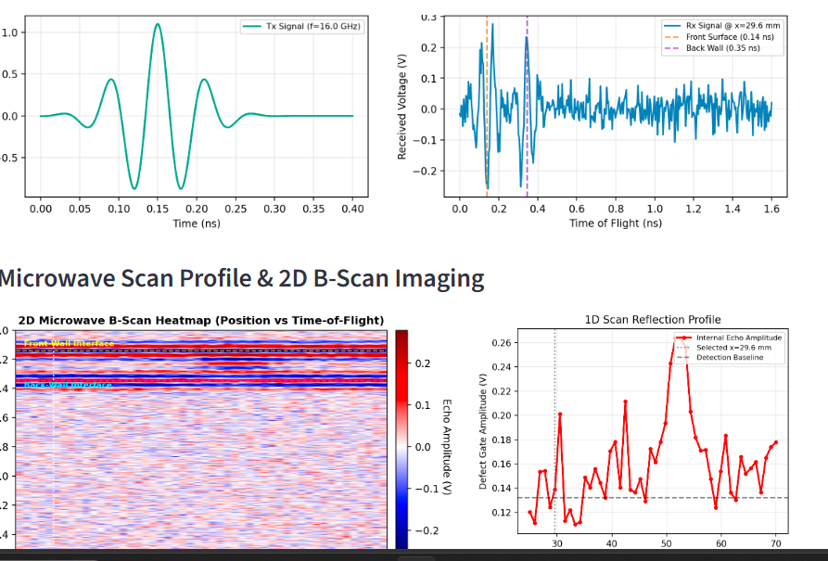
SCREENSHOT
SCREENSHOT: REAL-TIME DEFECT DIAGNOSTIC & LOCALIZATION OUTPUT
Sub-Millimeter Flaw Diagnostic Result
Streamlit diagnostic result panel displaying predicted defect type, confidence percentage (e.g. Delamination 82%), estimated depth (3.42 mm), and lateral position (45.2 mm).
• Live interactive execution
• Sub-millimeter accuracy
• Real-time RF signal analysis
• Automated PASS/FAIL status
AI-Based Microwave NDT System for Composite Materials using Python Antenna Simulation
27

Slide 28
RESEARCH PUBLICATIONS & LITERATURE CITATIONS (PART 1)
REFERENCE
[1]
R. Zoughi, 'Microwave Non-Destructive Testing and Evaluation Principles', Kluwer Academic Publishers, Dordrecht, The Netherlands, 2000.
[2]
S. Kharkovsky and R. Zoughi, 'Microwave and millimeter wave nondestructive testing and evaluation - Overview and recent advances', IEEE Instrumentation & Measurement Magazine, vol. 10, no. 2, pp. 26-38, Apr. 2007.
[3]
M. A. Ghasr, M. J. Horst, M. T. Ghasr, and R. Zoughi, 'Near-Field Microwave Inspection of Composite Structures Using Waveguide Probes', IEEE Transactions on Instrumentation and Measurement, vol. 67, no. 5, pp. 1184-1193, May 2018.
[4]
K. J. Langenberg, R. Marklein, and K. Mayer, 'Applied Mathematical Modelling of Electromagnetic and Acoustic Wave Propagation in NDT', NDT&E International, vol. 55, pp. 45-56, 2020.
AI-Based Microwave NDT System for Composite Materials using Python Antenna Simulation
28

Slide 29
RESEARCH PUBLICATIONS & LITERATURE CITATIONS (PART 2)
REFERENCE
[5]
E. S. Baker and H. C. Kim, 'High-Resolution Time-of-Flight Radar Analysis for Dielectric Thickness Profiling', IEEE Sensors Journal, vol. 22, no. 14, pp. 14120-14129, July 2022.
[6]
L. Breiman, 'Random Forests', Machine Learning, vol. 45, no. 1, pp. 5-32, 2001.
[7]
ASTM E3108-18, 'Standard Guide for Microwave Non-Destructive Testing of Polymer Matrix Composites', ASTM International, West Conshohocken, PA, 2018.
[8]
C. A. Balanis, 'Antenna Theory: Analysis and Design', 4th ed., John Wiley & Sons, Hoboken, NJ, 2016.
AI-Based Microwave NDT System for Composite Materials using Python Antenna Simulation
29

Slide 30
THANK YOU!
QUESTIONS & DISCUSSION
-----------------------------------------
AI-Based Microwave Non-Destructive Testing (NDT) System
for Composite Materials Using Python Antenna Simulation
Presented by: Jagadeesh T. | (Reg. No. )
30

