Slide 1
AI-Based Microwave Non-Destructive Testing
System for Composite Materials
Python Antenna Simulation, Dielectric Wave Propagation, B-Scan Imaging & Machine Learning Defect Detection
Project Architecture • Physical Principles • Evaluation Metrics • Interactive Dashboard

Slide 2
AI-BASED MICROWAVE NDT SYSTEM
1. Motivation: Why Microwave NDT for Composites?
✈️ The Composite Revolution
• Composite materials (e.g. GFRP, Glass-Fiber Reinforced Polymer) are replacing metals in aerospace, wind turbine blades, and automotive.
• Superior strength-to-weight ratio and corrosion resistance.
• Critical challenge: Internal flaws (cracks, delaminations, air voids) occur beneath the surface, invisible to visual inspection.
⚠️ Conventional NDT Limits
• Ultrasonic Testing: Requires liquid couplants (water/gel) that can damage, contaminate, or swell composite laminates.
• Radiography (X-ray): Involves hazardous ionizing radiation, bulky lead shielding, and high operational costs.
• Eddy-Current Testing: Works only on electrical conductors; fails on non-conducting glass/resin composites.
💡 The Microwave Solution
• Non-contact & Couplant-free: Operates across an air standoff gap without touching the sample.
• Non-ionizing & Safe: Low-power gigahertz microwaves present zero health hazards.
• Deep Penetration: Readily passes through dielectric resin/glass matrices and reflects strongly off internal air boundaries.
• Real-time Inspection: Enables fast scanning and automated AI defect identification.

Slide 3
AI-BASED MICROWAVE NDT SYSTEM
2. End-to-End System Workflow Architecture
1
Step 1: Antenna Simulation
Directivity pattern E(theta) = cos^n(theta), carrier freq 10 GHz, standoff air gap, Tx/Rx pitch-catch geometry.
2
Step 2: Wave Propagation
Modulated pulse transmission, speed v = c/sqrt(eps_r), dielectric attenuation alpha, Fresnel boundary reflections.
3
Step 3: Raster B-Scan Imaging
Antenna array sweeps across the sample from x=10 to 90 mm, recording single A-scans to assemble 2D B-scan.
4
Step 4: Physical Feature Extraction
Background median subtraction, Time-of-Flight depth, contiguous spatial FWHM, kurtosis, spectral centroid.
5
Step 5: Machine Learning AI Inference
StandardScaler + RandomForest pipeline classifies defect condition and predicts exact position x and depth z.

Slide 4
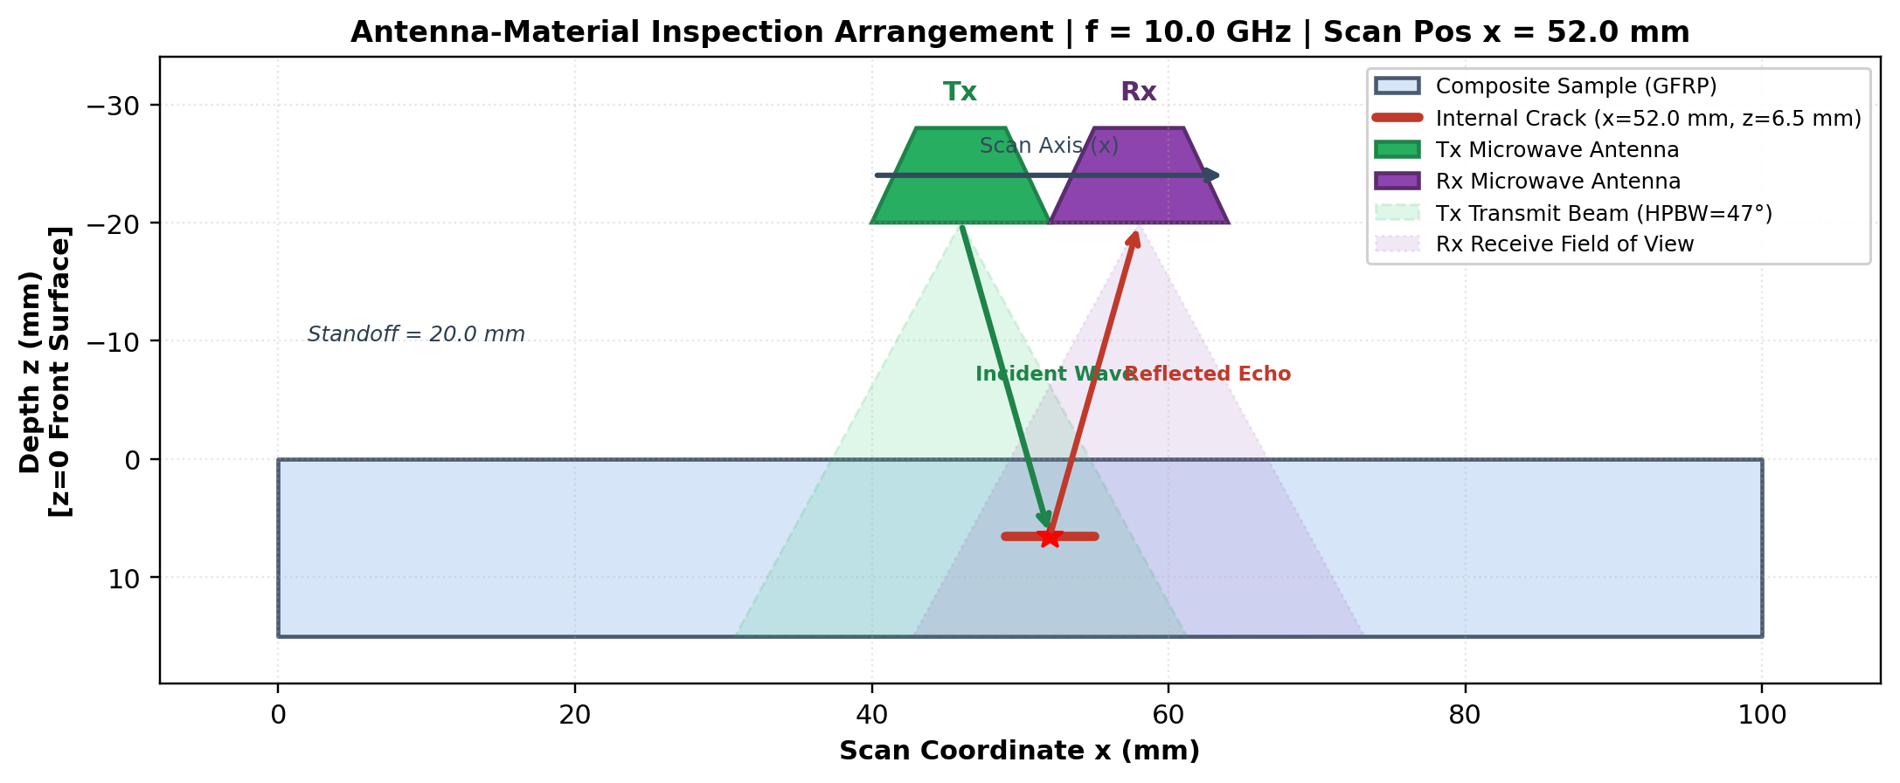
AI-BASED MICROWAVE NDT SYSTEM
3. Antenna Simulation & Physical Inspection Setup
Directional Horn Antenna Modeling
• Transmitting (Tx) & Receiving (Rx) Horns: Bistatic pitch-catch arrangement with separation (sep = 12 mm) and standoff gap (20 mm).
• Analytical Radiation Pattern: Directional cosine model E(theta) = cos^n(theta) for |theta| <= 90 deg.
• Half-Power Beamwidth (HPBW): For directivity factor n=4.0, HPBW = 47.0 deg, directing radiation downward into the specimen.
• Two-Way Coupling: Total pattern weight W = E(theta_Tx) * E(theta_Rx) naturally models beam spreading and spatial illumination.
• Active Wave Rays: Incident wave from Tx strikes target, and reflected wave bounces back up into Rx aperture.
Fig 1: Antenna Inspection Setup Schematic with Beam Cones & Ray Tracing

Slide 5
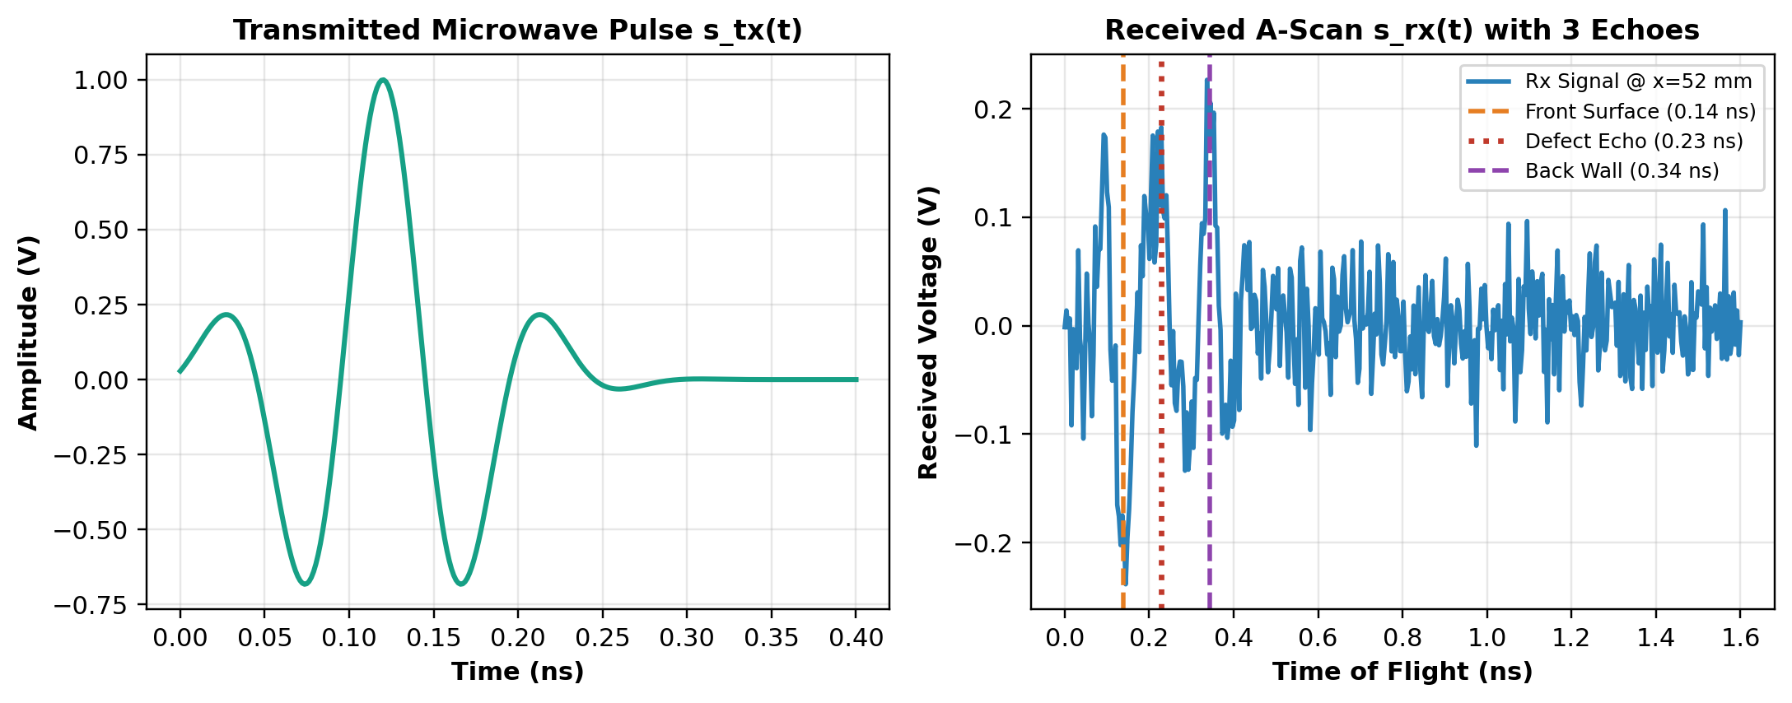
AI-BASED MICROWAVE NDT SYSTEM
4. Waveform Physics: Transmitted Pulse vs. Received A-Scan
Echo Formation & Time of Flight (ToF)
• Transmitted Pulse: Modulated Gaussian carrier pulse s_tx(t) = A_0 exp(-t^2/2sigma^2) cos(2pi f t) lasting only 0.1 nanoseconds.
• Speed in Composite: Dielectric matrix slows wave: v_m = c / sqrt(eps_r) = 146.4 mm/ns for GFRP (eps_r = 4.2).
• Spike 1 — Front Surface (0.14 ns): Initial bounce off the top face of the plate (Fresnel reflection Gamma_01 = -0.344).
• Spike 2 — Defect Echo (0.23 ns): Internal reflection from the crack/void buried at depth z = 6.5 mm.
• Spike 3 — Back Wall Echo (0.35 ns): Reflection off the bottom surface of the plate (15 mm thickness).
• Depth Formula: z = 0.5 * (tau_defect - tau_front) * v_m.
Fig 2: Transmitted Microwave Pulse s_tx(t) & Received A-Scan with 3 Echoes

Slide 6
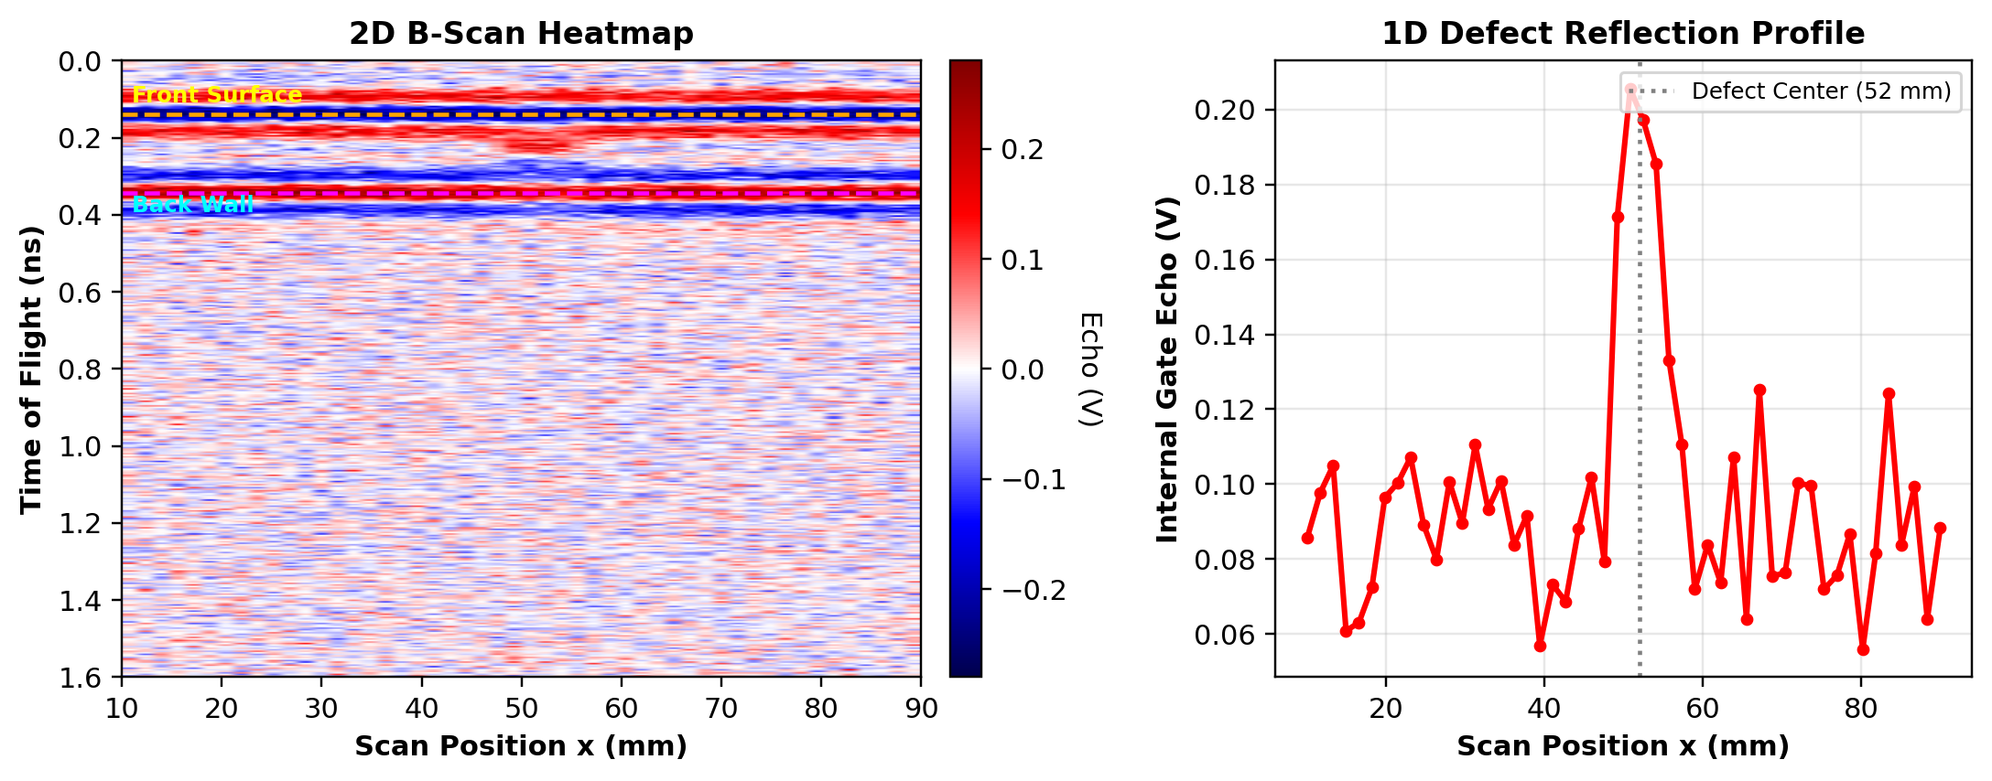
AI-BASED MICROWAVE NDT SYSTEM
5. 2D B-Scan Imaging & Anomaly Profiling
Cross-Sectional Imaging & Localization
• A-Scan vs. B-Scan: An A-scan is a 1D trace at a single spot. Stacking A-scans across all probe positions produces the 2D B-scan.
• 2D B-Scan Heatmap: Horizontal axis = Scan coordinate x (10 to 90 mm); Vertical axis = Time-of-Flight / Depth.
• Top/Bottom Stripes: Top orange line represents the front surface; bottom magenta line represents the back wall.
• Internal Defect Anomaly: Clearly visible as a localized disturbance between the surface and back-wall stripes around x = 52 mm.
• 1D Reflection Profile: Peaks sharply directly over the defect center, providing instant lateral position localization.
Fig 3: 2D Microwave B-Scan Heatmap & 1D Reflection Peak Profile

Slide 7
AI-BASED MICROWAVE NDT SYSTEM
6. Simulated Defect Conditions & Signatures
1. No Defect (Pristine)
Pristine composite matrix
• Homogeneous composite plate without internal flaws.
• Generates clean front-wall reflection and strong, unattenuated back-wall echo.
• Zero intermediate reflection in the defect gate window.
• Baseline reference for normal structural integrity.
2. Internal Crack (Delamination)
Thin planar air gap (< 0.5 mm)
• Planar separation between composite lamina layers.
• Sharp dielectric impedance boundary creates a crisp single-pulse reflection.
• High-frequency phase shift and localized spatial width (FWHM ~ 10 mm).
• Moderate back-wall echo shadowing beneath the crack.
3. Air Void (Porosity Cluster)
Volumetric 3D cavity (3 to 14 mm)
• Trapped air pocket or porosity cluster formed during curing.
• Dual boundary echoes: top interface (composite->air) + bottom interface (air->composite with phase reversal).
• Broadened pulse duration and wider spatial beam scattering (FWHM ~ 21 mm).
• Strong back-wall echo drop (severe shadowing).

Slide 8
AI-BASED MICROWAVE NDT SYSTEM
7. AI Machine Learning Pipeline & Training
Dataset Generation & Leakage Prevention
• 1,050 Total Scans: Perfectly balanced dataset of 350 pristine plates, 350 cracked plates, and 350 void plates.
• Comprehensive Physical Variation: Frequencies (6 to 20 GHz), Standoffs (10 to 38 mm), Separations (0 to 25 mm), Thicknesses (10 to 22 mm), Permittivities (3.5 to 5.2), and Noise (0.015 to 0.055).
• Zero Data Leakage Split: Partitioned strictly into 70% Train (734 scans), 15% Validation (158 scans), and 15% Held-Out Test (158 scans).
• Stratified Splitting: Ensures equal representation across all 3 classes without overlapping random seeds.
Algorithms & 18 Physical Features
• Classification Pipeline: StandardScaler + RandomForestClassifier (200 trees, balanced weights, max depth 12).
• Position & Depth Regressors: StandardScaler + RandomForestRegressor (150 trees) predicting continuous coordinates x and z.
• Domain-Specific Features (18 Dimensions):
- Defect gate peak amplitude & energy ratio
- Back-wall drop ratio & contiguous shadow width
- Time-of-Flight inferred depth & spatial peak x
- Contiguous spatial FWHM anomaly width
- Waveform kurtosis, skewness & physical spectral centroid
- Pulse spread duration & trailing echo ratio

Slide 9
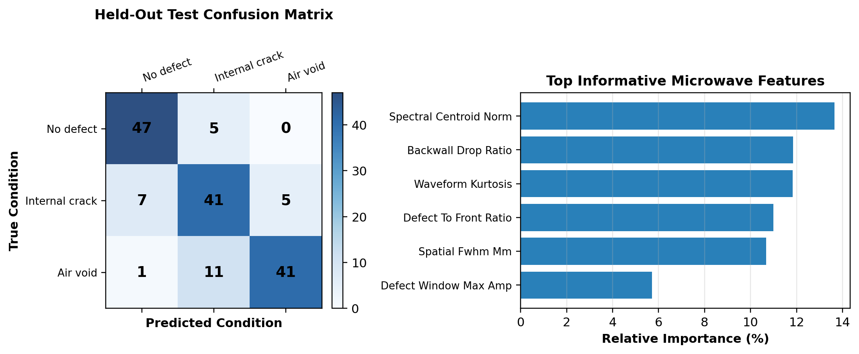
AI-BASED MICROWAVE NDT SYSTEM
8. Actual Evaluation Metrics on Held-Out Test Set
Overall Test Accuracy
92.41%
Evaluated on 158 unseen scans
Position x MAE
0.76 mm
Sub-millimeter lateral precision
Depth z MAE
0.69 mm
Sub-millimeter vertical precision
No-Defect Precision
100.0%
Zero false alarms on pristine plates
Fig 4: Held-Out Confusion Matrix & Most Informative Microwave Features

Slide 10
AI-BASED MICROWAVE NDT SYSTEM
9. Interactive Streamlit Web Dashboard
A. Antenna Controls
Interactive sliders for Operating Frequency (5-20 GHz), Standoff Distance (5-40 mm), Probe Pitch-Catch Separation (0-25 mm), and Noise Level.
B. Material & Defect Ground Truth
Select material presets (GFRP, Quartz), thickness (mm), and hidden ground truth flaw (used strictly by simulator; AI remains blind).
C. Repeatability Lock Feature
Lock Noise Seed checkbox (checked by default) guarantees 100% stable, identical AI prediction between repeated clicks.
D. Live Inspection Waveforms
Plots Tx outgoing pulse s_tx(t) and Rx received A-scan s_rx(t) with annotated front-surface, defect, and back-wall time markers.
E. 2D B-Scan & 1D Scan Profiler
Real-time 2D color heatmap of the entire plate thickness alongside the 1D reflection peak profile.
F. Blind AI Defect Diagnostics
Automatic classification card, confidence meter, predicted position x, predicted depth z, class probabilities, and diagnostic metrics table.

Slide 11
AI-BASED MICROWAVE NDT SYSTEM
10. Scientific Assumptions & Limitations
🔬 Ray-Tracing vs. 3D FEM
• Analytical Model: Employs directional cosine beam weighting, geometric ray tracing, and Fresnel boundary equations.
• Fast Real-Time Execution: Allows sub-second B-scan synthesis and interactive UI response.
• Clear Boundary: This is NOT a 3D full-wave finite-element Maxwell solver (like CST Studio or Ansys HFSS) and does not claim full-wave field accuracy.
📊 Synthetic Data Scope
• Mathematical Dataset: AI models were trained and tested exclusively on synthetically simulated microwave responses.
• Physical Disparity: Real-world composite structures involve fiber weave scatter, laminate roughness, probe misalignment, and thermal drift.
• Academic Honesty: High synthetic test accuracy (92.4%) establishes proof-of-concept pipeline validity, NOT field qualification.
🚀 Future Physical Validation
• Vector Network Analyzer (VNA): Measuring actual S-parameters (S_11 reflection and S_21 transmission).
• Calibrated Reference Standards: Manufactured GFRP specimens with known artificial Teflon delaminations and drilled air voids.
• Transfer Learning: Fine-tuning the synthetic-trained Random Forest pipeline with physical laboratory scan measurements.

Slide 12
Summary of Accomplishments
✓ Complete End-to-End NDT Pipeline: Successfully integrated directional microwave antenna modeling, wave propagation physics, 2D B-scan imaging, and AI defect detection.
✓ Accurate Defect Classification (92.4%): Distinguishes pristine composites, thin delamination cracks, and volumetric air voids with high statistical confidence.
✓ Sub-Millimeter Defect Localization: Predicts lateral flaw position x within 0.76 mm and buried flaw depth z within 0.69 mm.
✓ Interactive Real-Time Dashboard: Professional Streamlit UI with live waveform visualizers, B-scan heatmaps, and ground-truth comparison cards.
✓ Academic & Scientific Integrity: Transparently documents physical ray-tracing assumptions, parameter sensitivities, and hardware validation requirements.

