Slide 1

Customer Behavior Analytics and Recommendation Algorithms
Jehan

Slide 2
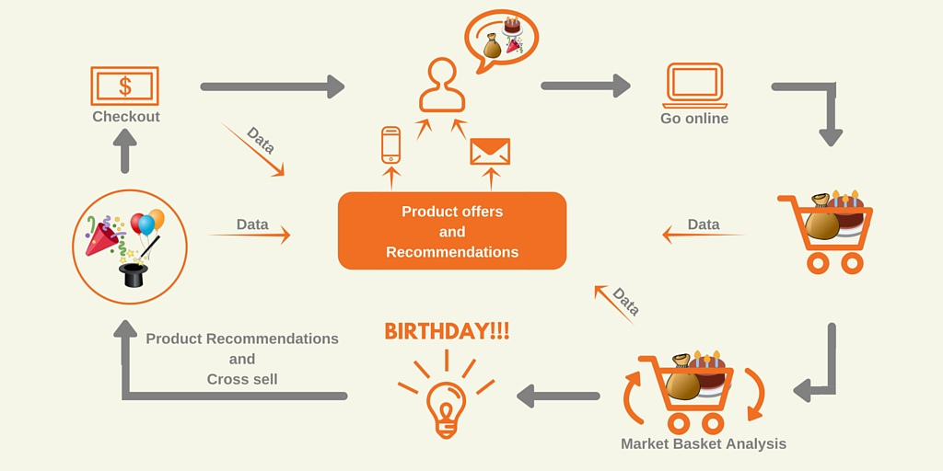
MBA and Applications

Slide 3
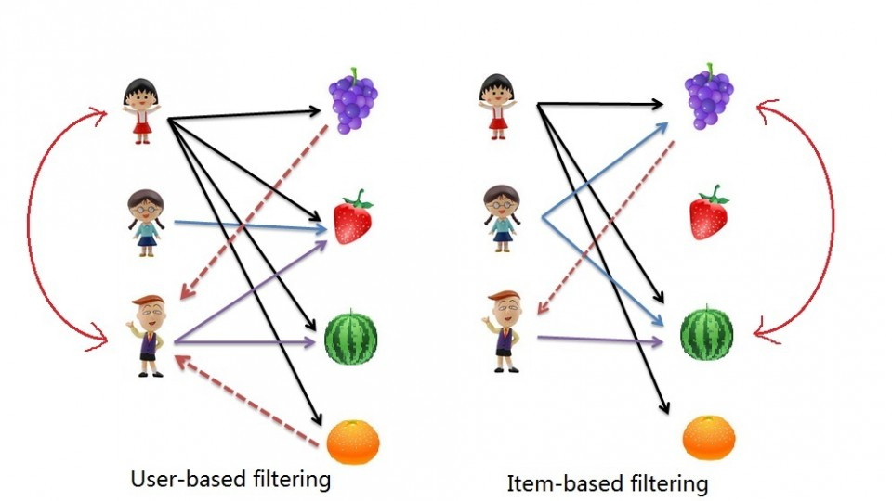
Recommendation Algorithms
User Based Collaborative Filtering
Item Based Collaborative Filtering

Slide 4

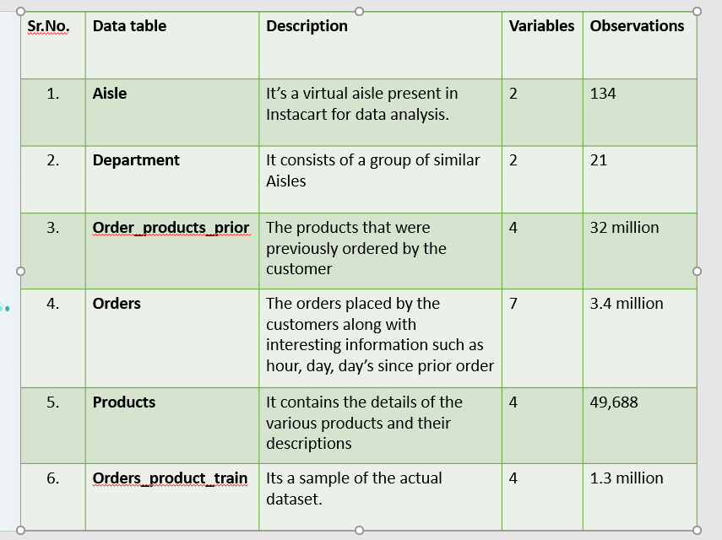
Instacart is an American company that operates as a same-day grocery delivery service.
Instacart provides these services from smart – phone applications as well as its website.
As of March 2017, Instacart services 36 markets, composed of 1,200 cities in 25 states.
New venture capital valued Instacart at approximately $3.4 billion.
Data used for project

Slide 5

Research Questions
Identifying the key factors used in analysis of the customer basket
Role of Predictive Analytics in Customer Behavior Analysis and Product Recommendations for Retail Industry

Slide 6

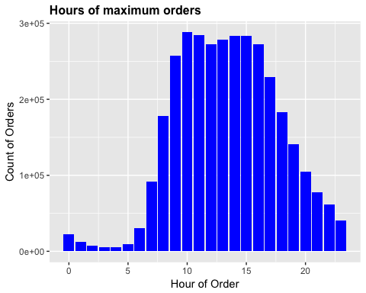
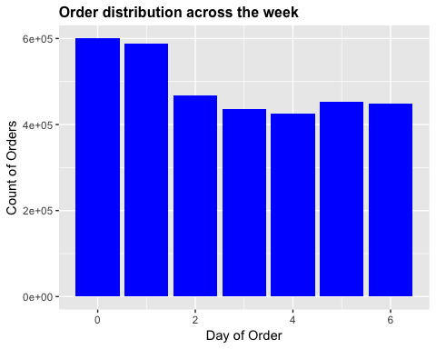
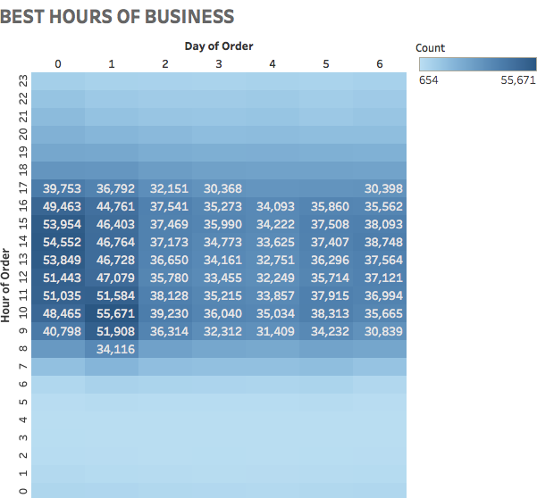
Key Factors

Slide 7

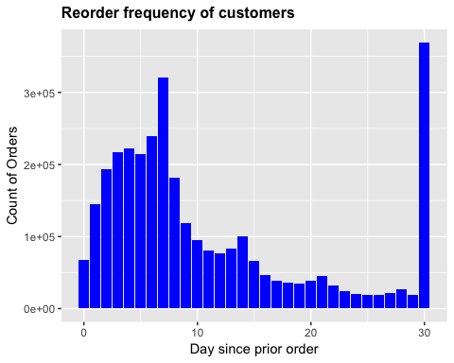
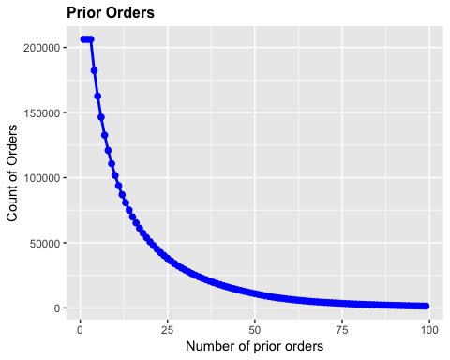
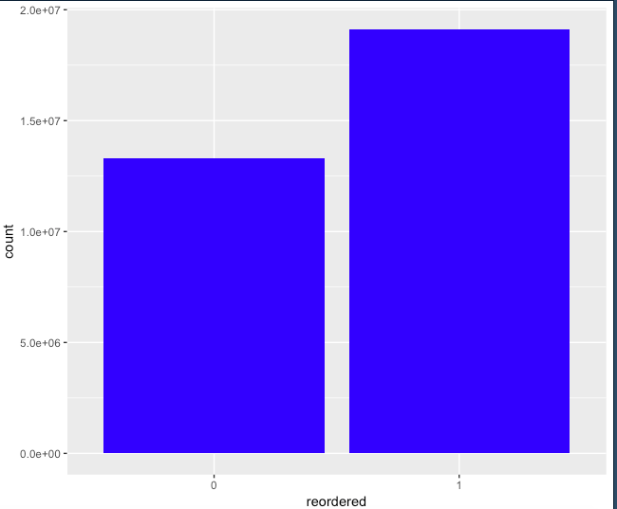
Key Factors

Slide 8


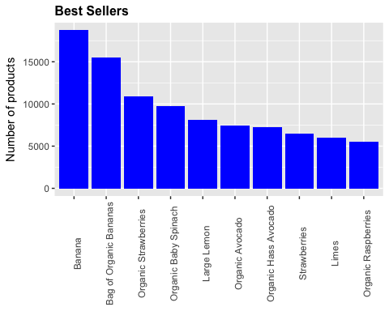
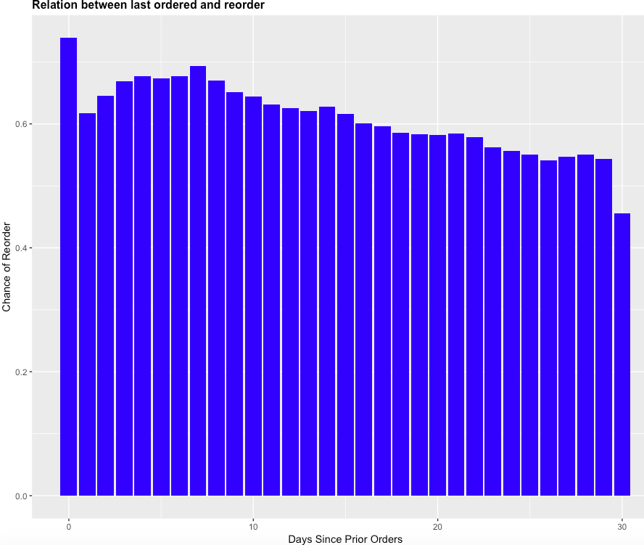
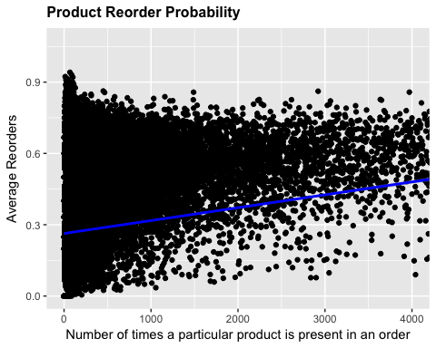

Slide 9

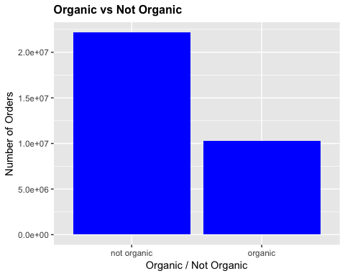
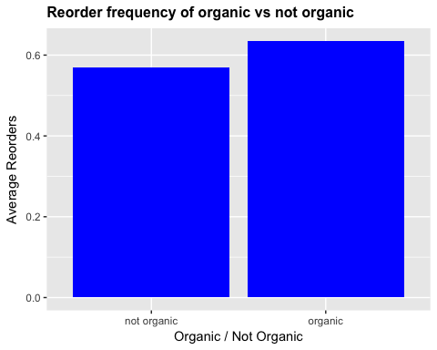

Slide 10
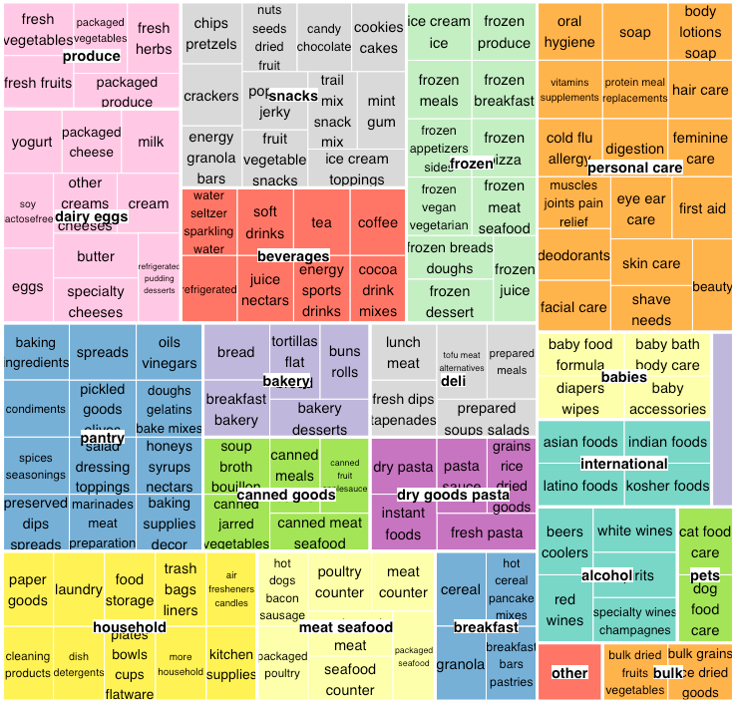
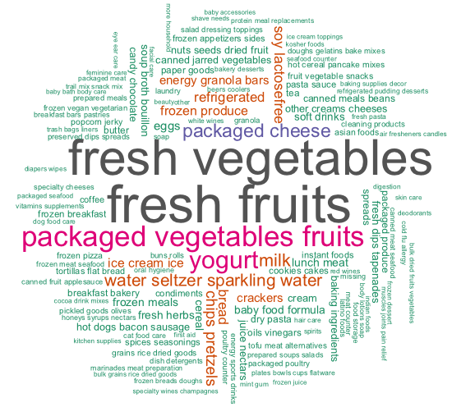
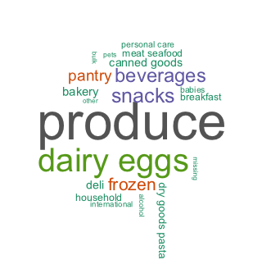

Slide 11
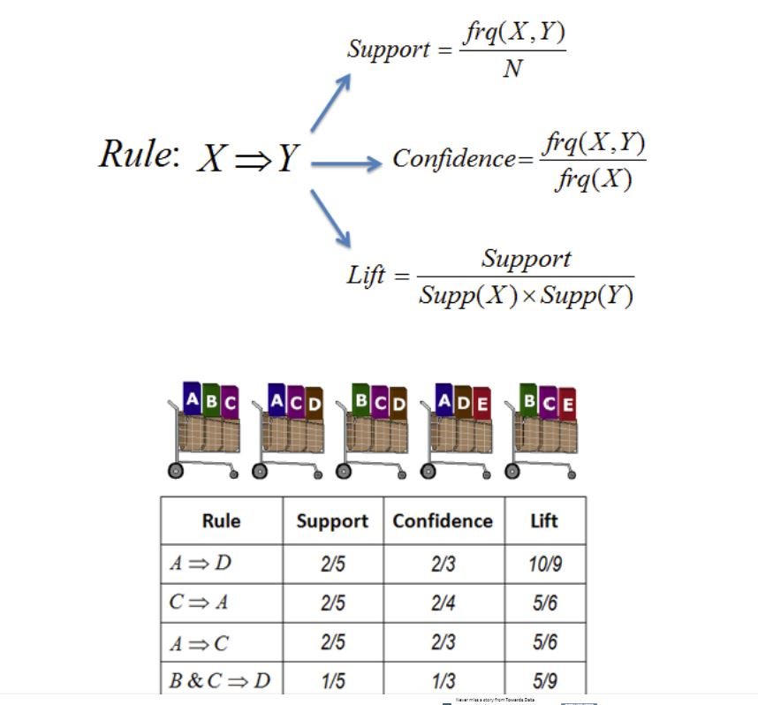
Association Rule Mining

Slide 12
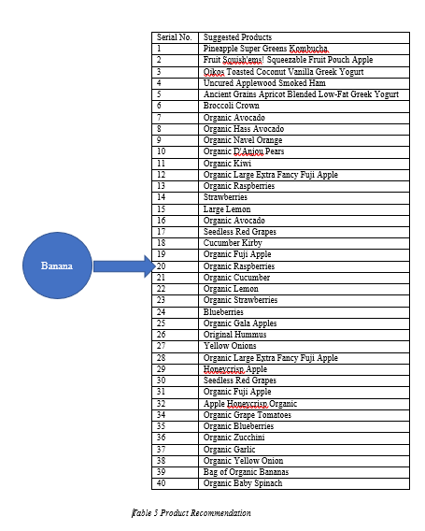
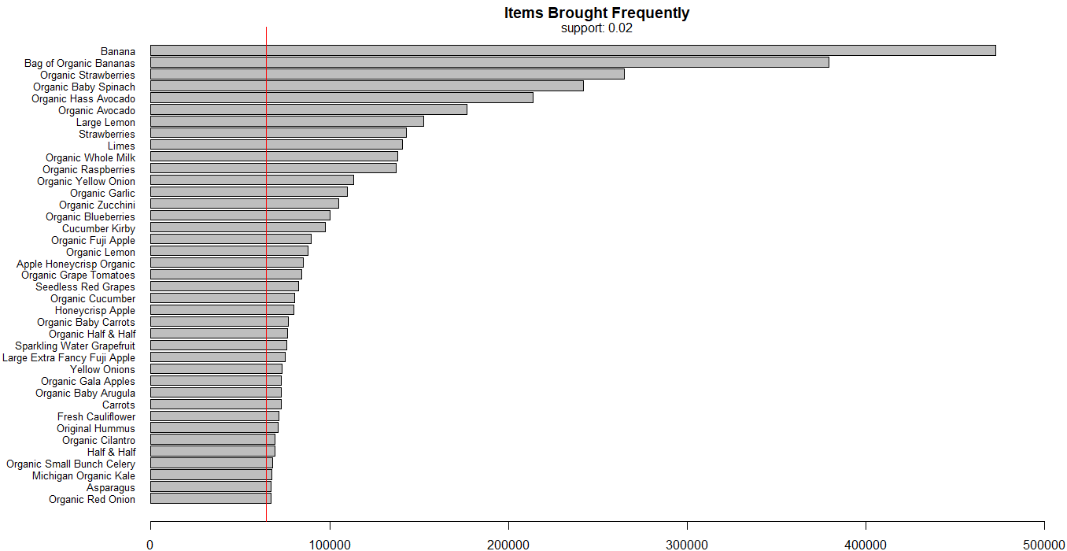

Slide 13

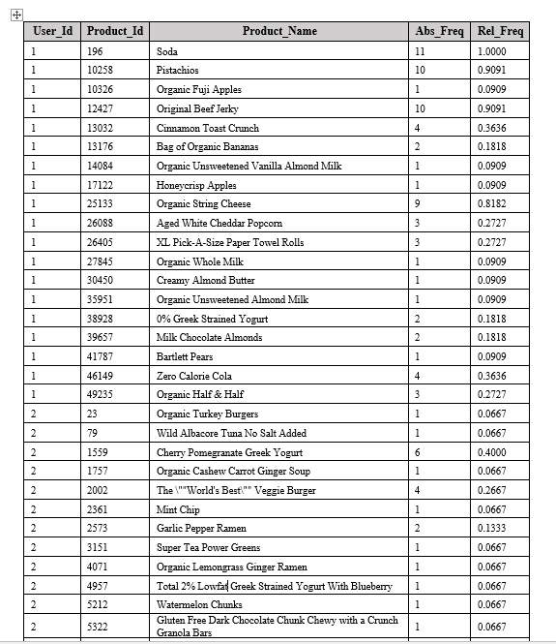
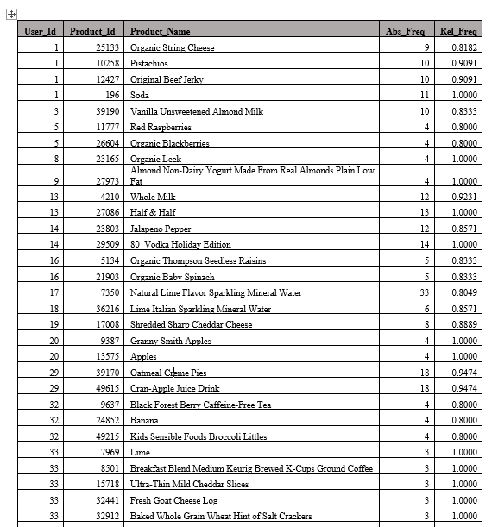
User Item Matrix

Slide 14
Limitations and Future Scope
Limitations:
Time and computational complexity.
Implementation of Recommender algorithm.
Future Scope:
Automate the recommendation system as per the User Item Matrix.
Implementing Big data technologies like Hadoop/ Spark.
Use cloud computational services like AWS.

Slide 15


