Slide 1
Exploratory Analysis on the Freddie Mac Dataset
and Modelling Mortgage Data to Predict Repurchase
Jehan Vakharia

Slide 2
2-Step Vision For This Project
Find Trends in DataSet, and explain why they are useful/interesting. (Sections 1 - 3)
Use the data to train a classifier for modelling whether the loan is repurchased or not. (Section 4)

Slide 3
Statement of Purpose
This dataset is useful (even as a sample of the original) because it can provide insights on the mortgage market on a wide scale.

Slide 4
Section 1 Outline
Insights: from the Origination File Trends: across multiple mortgages instead of within.
Found in areas Including:
Distribution of First Time Home-Buyers
Analysis of Highest Unpaid Principal Balance (Geographically)
Distribution of Channel of Origination
Analysis of Prepayment Penalty Mortgages (PPMs) by Year
Yearly Trend in Original Loan To Value (LTV) Ratios and Combined LTV Ratios

Slide 5
Section 2 Outline
Insights: from the Updates File Trends: within loans*, not across multiple.
Trends in Loan Age between 2014-2019
Distribution of Loan Age, Months to Maturity, Interest Rates for 2016
Distribution of Zero-Balance Loans by Type of Termination
Distribution of Credit Score of Refinanced Loans
Distribution of Debt-to-Income Ratio of Refinanced Loans
*Used interchangeably with “mortgage”

Slide 6
Section 3 Outline
Insights: Across Data Sets Trends: meaningful changes in updates file, using look-up data from originations file
Changes in Interest Rates for Repurchased vs Non-Repurchased loans.

Slide 7
Section 4 Outline
Insights: validity of modelling “repurchase” from data in both files
Model: Random Forest Classifier

Slide 8
Section 1
These insights will pertain to data from the originations file

Slide 9
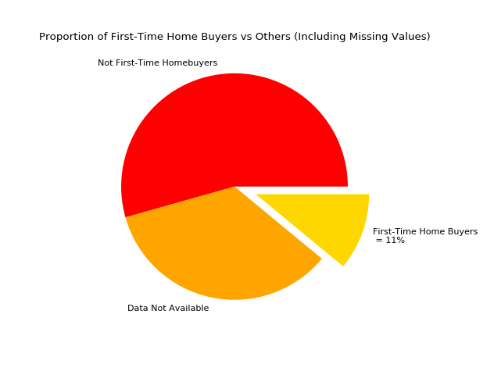
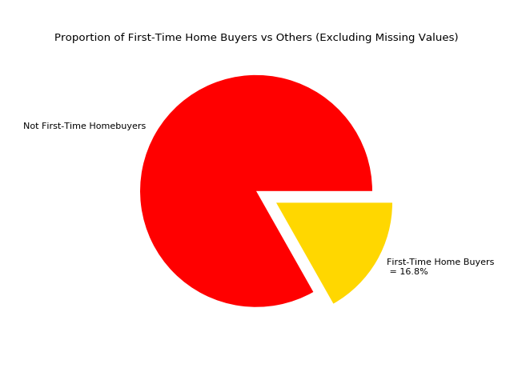
Percentage of First-Time Home Buyers
First-Time Home Buyers only consist of 11% of total mortgage data (including values for data not available)
However, out the data that is available, they comprise of 16.8% of total mortgages.

Slide 10
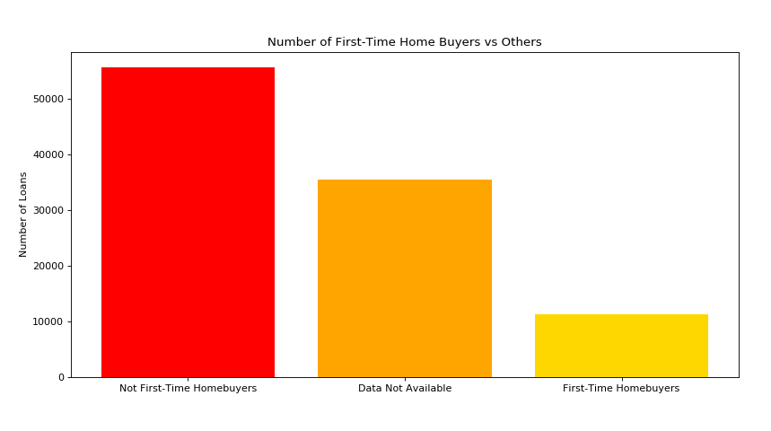
Number of First-Time Home Buyers
The number of first-time homebuyers is quite small, but what’s more concerning is the fact that there is so much missing data on this flag.
In general, First-Time Home Buyers are much less likely to refinance loans. This is because they’re likely to have a smaller upfront deposit - and therefore a very high Loan-To-Value ratio, making it harder for them to get mortgages approved.

Slide 11
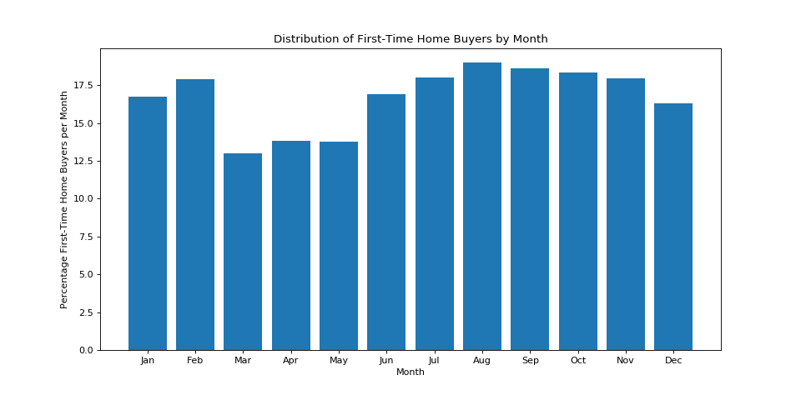
Seasonality of First-Time Home Buyers
Peak Months: August and February (Bi-modal)
Lowest Month: March
There is also a very sharp decrease between February and March.

Slide 12
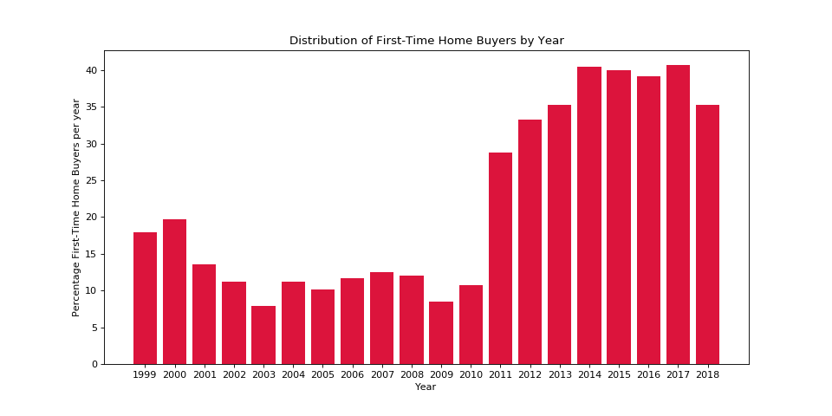
First Time Home-Buyers by Year
First-time homebuyer proportions seem to dip into an extreme low in 2008 and then start rising rapidly after 2010.

Slide 13
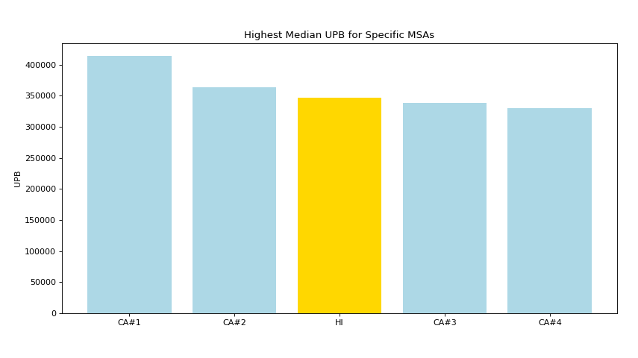
Top 5 MSA’s* with the Highest Median UPB**
The bars are sorted in descending order, with CA#1 having the highest UPB.
The labels starting in CA are all MSAs in California. The bar labelled HI is in Hawaii.
However, this data is slightly misleading for it doesn’t include any information on the number of mortgages made in these MSAs.
Hawaii
California
*MSA = Metropolitan State Area
**UPB =Unpaid Principal Balance

Slide 14
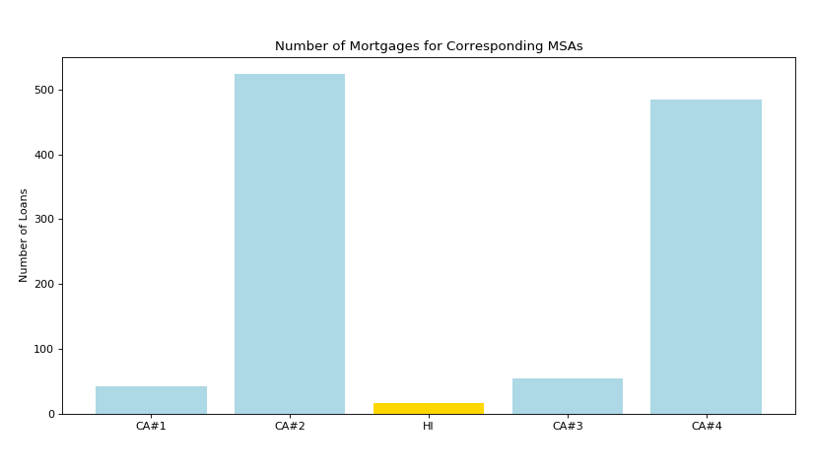
Number of Mortgages in each MSA
This chart shows how the different MSAs actually have vastly varying number of loans issued.
California seems to have a much higher number of mortgages than hawaii.
UPB is important to note, because it reveals where the biggest costs of delinquency are.
Hawaii
California

Slide 15
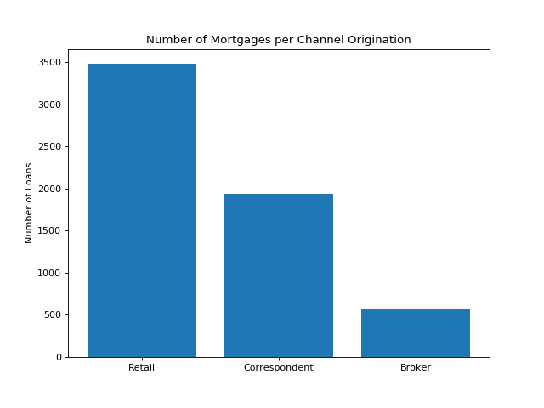
Distribution of Channel of Origination
Brokers seem to be the smallest proportion of loan origination channels. The highest being retail.
This is useful because brokers are most likely to seek out other (better) options when it comes time to renew the mortgage.

Slide 16
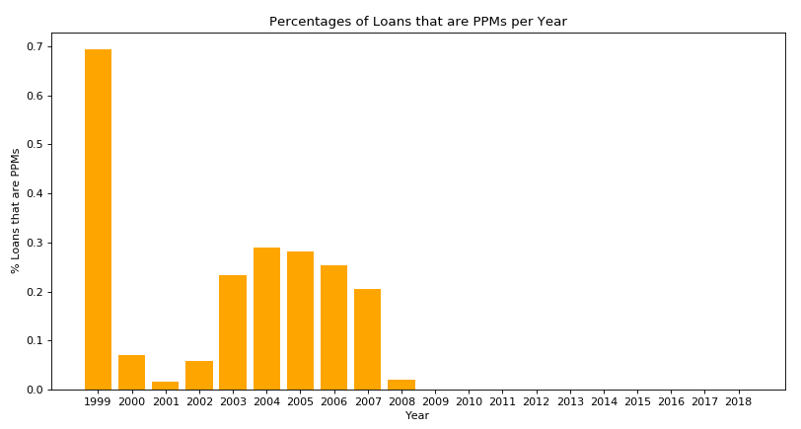
Prepayment Penalties by Year
This sudden drop in PPMs after 2008 was probably due to the Housing Market Collapse, with Freddie Mac being bailed out.

Slide 17
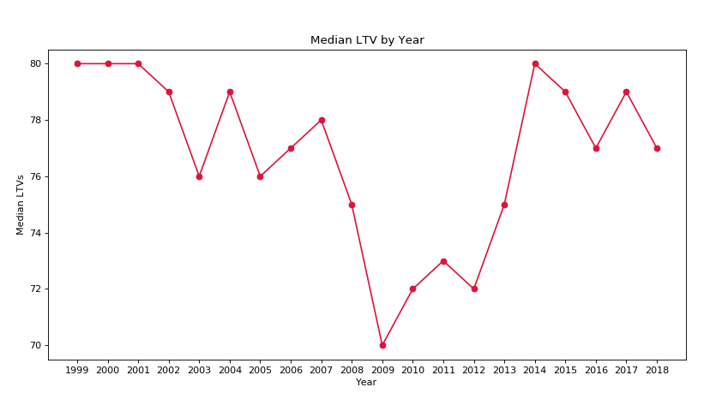
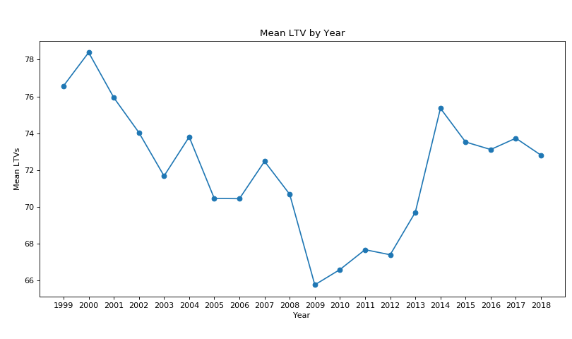
Trends in Original LTV Ratio by year
Distribution shows that LTV ratios have slowly been rising closer to pre-crisis levels since 2009.
Higher LTV ratios indicate higher risk to lenders (in the case of downward fluctuations in housing values) and are hence less likely to be approved for loans.

Slide 18
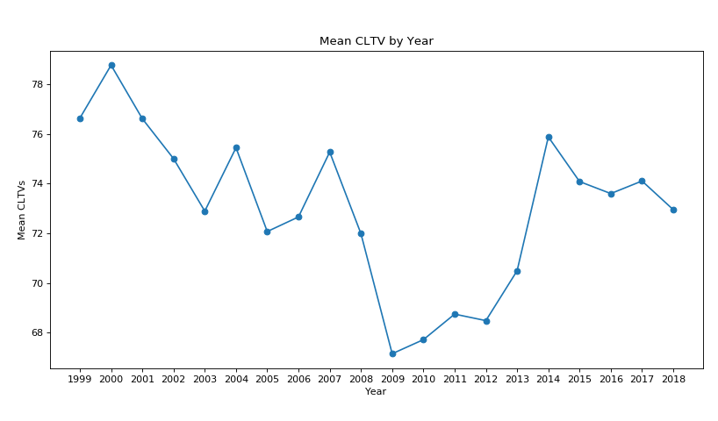
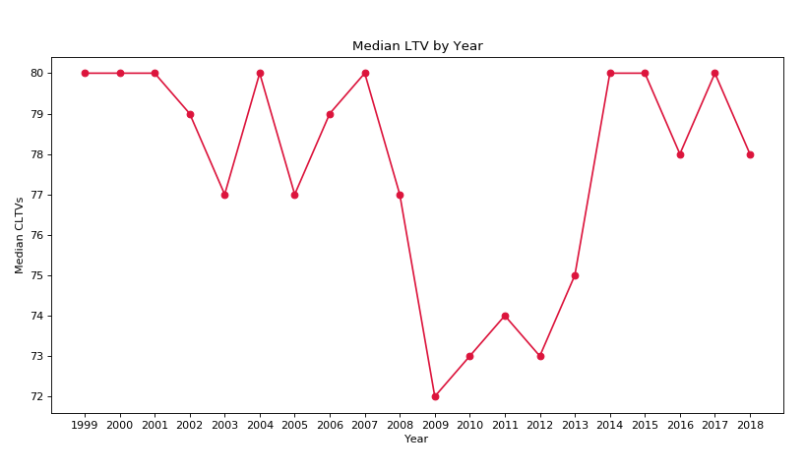
Trends in CTLV by Year
CLTV Ratios seem to be increasing back to their pre-crisis levels as well.
CLTV Ratio includes the combined loan values of the primary loan plus all secondary loans.

Slide 19
Section 2
These insights will pertain to data from the monthly progress file

Slide 20
Distribution of Loan Age: 2014-2019
 | Loan Age | Loan Age (Ongoing) | Loan Age (Terminated)
MIN | 1 month | 14 months | 1 months
FIRST QUARTILE | 20 months | 31 months | 28 months
MEDIAN | 41 months | 53 months | 56 months
THIRD QUARTILE | 74 months | 83 months | 91 months
MAX | 241 months | 241 months | 241 months
MEAN | 53.52 months | 65.44 months | 64.66 months
The first field is for Loan Ages of all the records in the dataset, including intermediate monthly progress records.
The second field is for Loan Ages of mortgages still open (March 2019).
The third field is for Loan Ages of only the zero-balance records since 2014.

Slide 21
Analysis of Terminated Loans: 2016
 | Loan Age | Months to Maturity | Interest Rate
MIN | 1 months | 0 months | 2.000 %
FIRST QUARTILE | 25 months | 206 months | 3.875 %
MEDIAN | 47 months | 292 months | 4.375 %
THIRD QUARTILE | 81 months | 331 months | 4.875 %
MAX | 212 months | 477 months | 8.500 %
MEAN | 65.44 months | 264.25 months | 4.492 %
Only prepaid and charged off loans have been considered here.

Slide 22
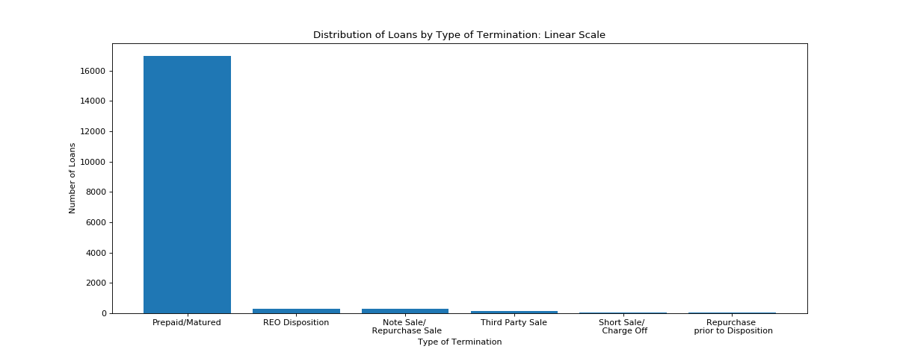
Distribution of Loans by Termination
The assumption here is that these are only the loans from 2014 onwards.
The vast majority seems to be Prepaid/Matured.

Slide 23
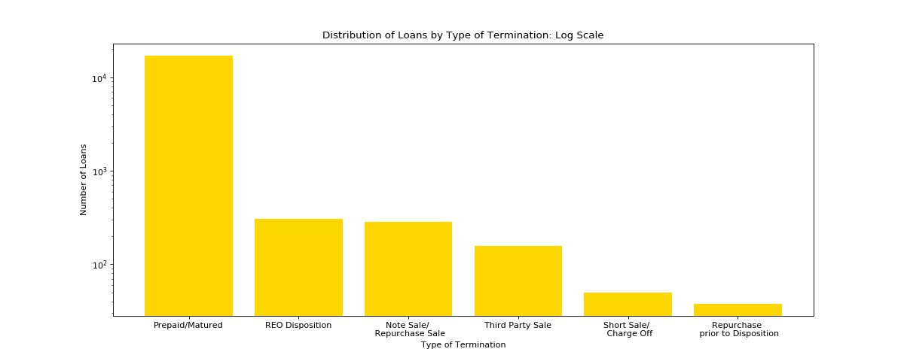
Distribution of Loans by Termination
The log scale here shows the distribution of the other types of termination more clearly.

Slide 24
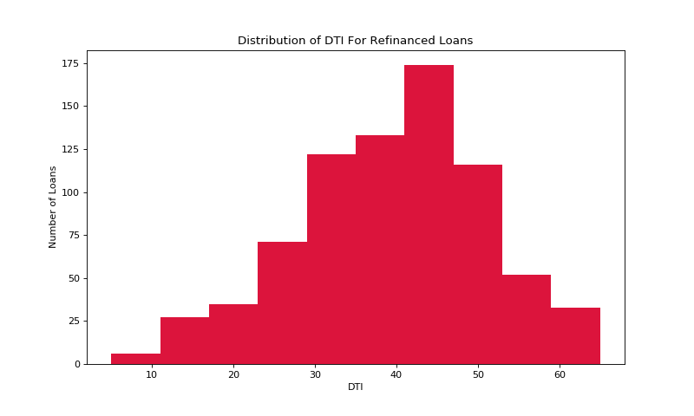
DTI of Repurchased Loans
The Debt-To-Income (DTI) ratio of borrowers that refinanced their loans seems to be 45%.

Slide 25
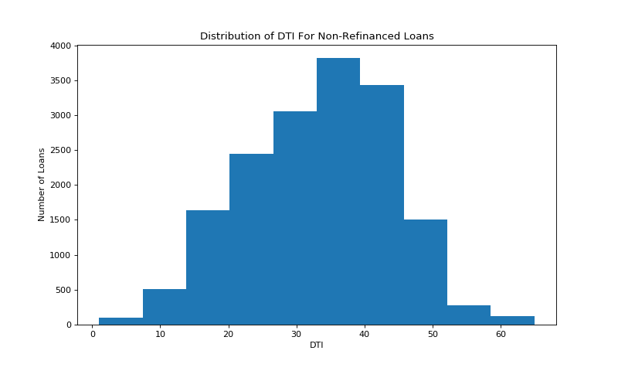
DTI of Non-Repurchased Loans
The Debt-To-Income (DTI) ratio of borrowers that didn’t refinance their loans seems to be 35%.
However, the overall difference isn’t staggering.
Realistically, borrowers with higher DTIs should be less likely to have mortgages approved - and hence less likely to refinance.

Slide 26
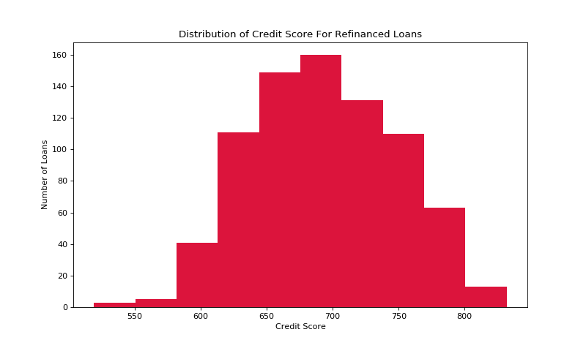
Credit Scores by Repurchased Loans
The credit scores of borrowers who refinanced their mortgages seem to peak at around 675.

Slide 27
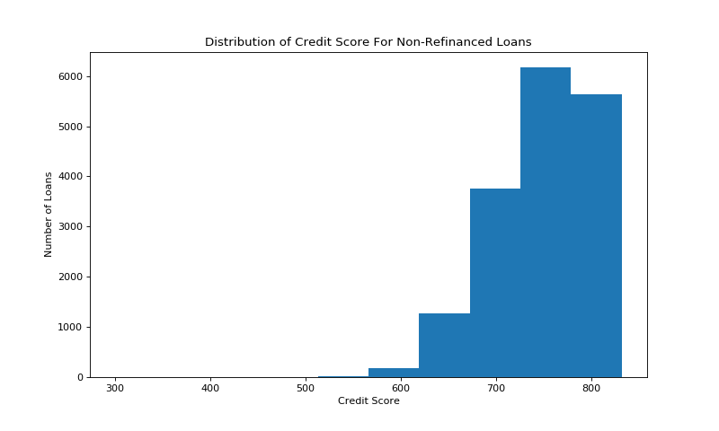
Credit Scores of Non-Repurchased Loans
The credit scores of borrowers who didn’t refinance their mortgages seem to peak at around 775.
Ideally, a financial institution wants to encourage the borrowers with better credit to stay with their institution - since those borrowers are less prone to default on the loan.
The institution will therefore offer better rates and deals on renewing the mortgage.
The credit scores of borrowers who refinanced their mortgages seems to peak at around 675.

Slide 28
Section 3
These insights will pertain to data from both the files, using “loan_sequence_number” as a lookup identification number for the originations file.

Slide 29
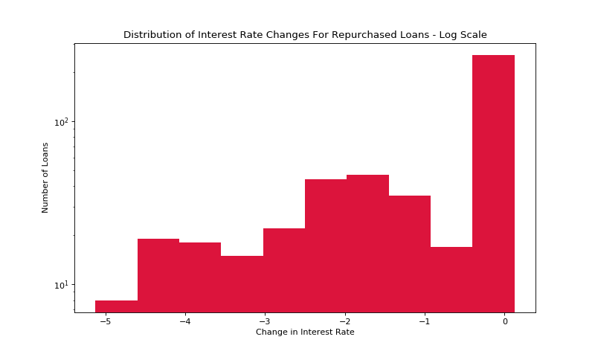
Distribution of Change in Interest Rates
The changes in interest rate for repurchased loans seem to peak at 0

Slide 30
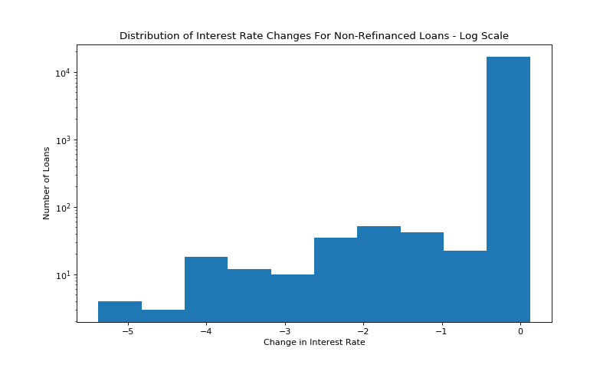
Distribution of Change in Interest Rates
The changes in interest rate for non-repurchased loans also seem to peak at 0
However, the distribution for loans that weren’t repurchased seems to show a sharper distribution.
Yet, the sample size for repurchased loans is much smaller so this difference in proportion of larger interest-rate changes might be attributed to bias.

Slide 31
Section 4
The Machine Learning model used to classify the Freddie Mac data into “repurchased” or “not repurchased” is a Random Forest Classifier.
A dataset of this size, especially after clearing up missing values, is small enough for shallow ML models to be just as effective as deep learning models.

Slide 32
The Feature Data
The following fields were used to predict “repurchase”:
Months to Maturity
Zero Balance Code
Interest Rate Change
Credit Score
First-Time Home Buyer Flag
DTI Ratio
Channel (Broken up using one-hot encoding)

Slide 33
The Label Data
The field: “repurchase_flag”
Values: either “Y” or “N”

Slide 34
Model specifications:
Random Forest Classifier, using 1000 decision trees
Accuracy measured using the following:
RMSE: 0.03319
Cross-Validation Accuracy Score (5-fold): 0.99889

Slide 35
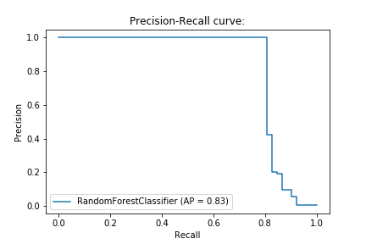
Additional Measure: Precision-Recall Curve
The distribution of “Y” to “N” in the label data was heavily imbalanced towards “N”.
This curve shows that even when taking that imbalance into account, the model still has an Average Precision Accuracy = 0.83

Slide 36
Summary
Most interesting features:
Proportion of Brokers as source of origination.
Proportion First-Time Home Buyers
Locations of highest Unpaid Principal Balance
Credit Scores of Borrowers
Effects of Housing Market Collapse on Loan-To-Value ratios and presence of Prepayment-Penalty loans.

Slide 37
Summary
The machine learning model was easy to train, and was accurate, proving that the dataset is fit for shallow modelling.
Average Precision accuracy might improve with additional grid-search for hyperparameter tuning.
Although, since Random Forest is already a very good classifier, that might not be necessary.
Additional training on the original (not sample) dataset would warrant switching to deep learning.

Slide 38
Summary
Discussion about the dataset as a whole:
Large amounts of missing values in “First-Time Home Buyer Flag” (as discussed before) But also in “Current Interest Rate” and “Months to Maturity” (mainly for loans with REO dispositions) This cut down the usable data for the model by a sizeable chunk.
Ambiguity in certain fields in the guide could have better explanations: Particularly the “zero-balance codes”, and the “channels” of origination.

Slide 39
Software Used
All data manipulations, extrapolations and plotting were done in Python, on Jupyter Notebooks and hosted on Google Colaboratory for most efficient runtime.
In the Jupyter notebook, the pandas and numpy libraries was used for all of the data manipulation, scikitlearn was used for modelling and matplotlib was used for plotting.
Microsoft Excel was used for inspecting data quickly, but not for manipulating data.

Slide 40
References
Mac, Freddie. "Single Family Loan-Level Dataset General User Guide." Freddie Mac. Available online: http://www. freddiemac. com/fmac-resources/research/pdf/user_guide. pdf (accessed on 3 February 2019) (2019).

Slide 41
Thank You

