Slide 1
School shooting 1999-2019

Slide 2
hypothesizes
Tuesday is more likely day for school shootings
January is the most likely month for school shootings
Teenage males are the most likely shooters
Urban areas by average have the most school shootings

Slide 3
Data
The Washington Post is compiling a database of school shootings in the United States since Columbine.

Slide 4
Difficulties with data
Finding the data set
Figuring out how to add the local data together
Formatting some Collums

Slide 5
Questions that Came up with the DATA
Was school shooting on the rise or was 2018 a bad year
Has all Mass shooting gone up over the years
What Month do most shootings tend to happen
When do gunmen plan to go for the attack

Slide 6
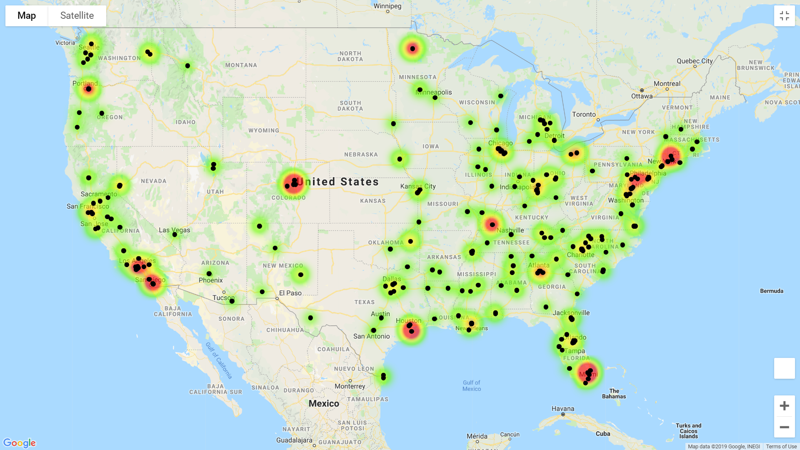

Slide 7
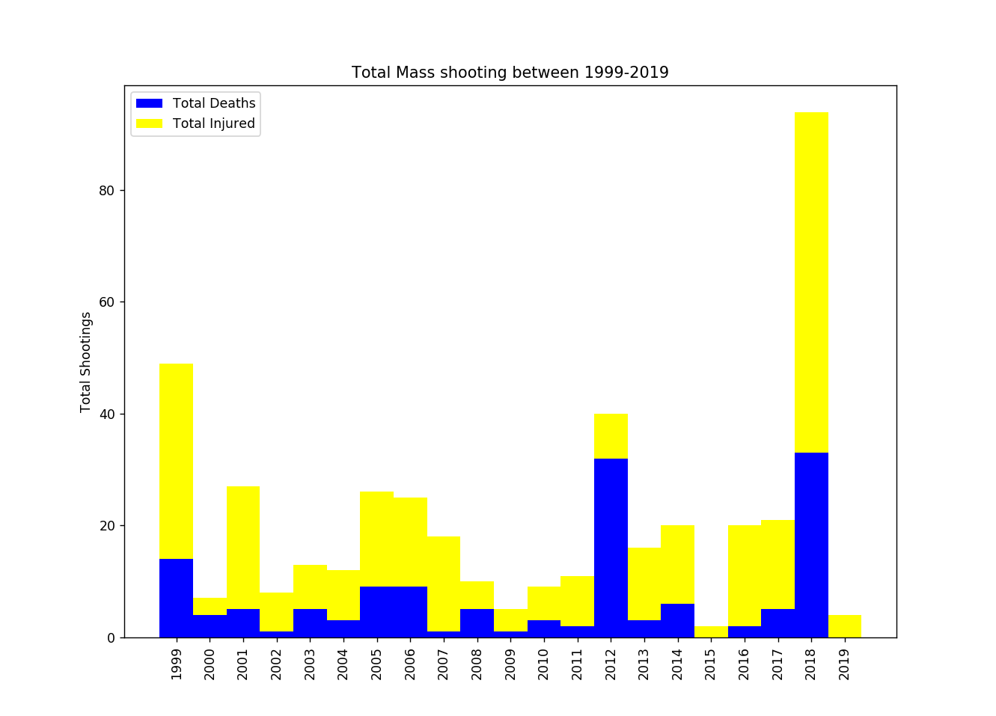

Slide 8
year | Total Shootings | Total Dead | Total Injured | Total Enrollment
1999 | 7 | 14 | 35 | 9345
2000 | 12 | 4 | 3 | 10093
2001 | 13 | 5 | 22 | 21379
2002 | 5 | 1 | 7 | 8110
2003 | 12 | 5 | 8 | 14028
2004 | 9 | 3 | 9 | 8338
2005 | 13 | 9 | 17 | 10751
2006 | 15 | 9 | 16 | 18215
2007 | 10 | 1 | 17 | 11023
2008 | 9 | 5 | 5 | 9969
2009 | 9 | 1 | 4 | 6445
2010 | 9 | 3 | 6 | 12327
2011 | 7 | 2 | 9 | 7852
2012 | 11 | 32 | 8 | 10600
2013 | 13 | 3 | 13 | 13325
2014 | 16 | 6 | 14 | 16274
2015 | 7 | 0 | 2 | 7176
2016 | 13 | 2 | 18 | 11345
2017 | 15 | 5 | 16 | 11767
2018 | 25 | 33 | 61 | 31295
2019 | 8 | 0 | 4 | 6921
The data shows that in 2018 was the deadliest year for shootings. The data does not show that shootings have ebbed and flowed through the years.

Slide 9
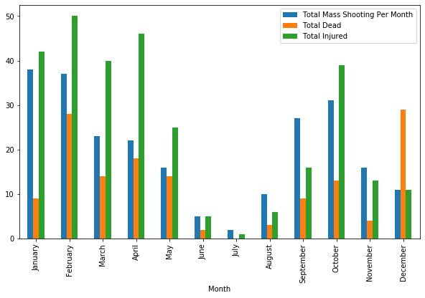
Monthly Distribution Of School Shootings from 1999_2019
January,38 | Dead 9 Injured 42
Febuary,37 | Dead 28 Injured 50
March,23 | Dead 14 Injured 40
April,22 | Dead 18 Injured 46
MAY,16 | Dead 14 Injured 25
June,5 | Dead 2 Injured 5
July,2 | Dead 0 Injured 1
August,10 | Dead 3 Injured 6
September,27 | Dead 9 Injured 16
October,31 | Dead 13 Injured 39
November,16 | Dead 4 Injured 13
December,11 | Dead 29 Injured 11
After winter break, returning to school for second semester most attacks tend to occur
With January and February taking place for most school shootings within the month. January taking the lead by 1
July is the least common month for School Shootings due to most states are out in summer Break

Slide 10
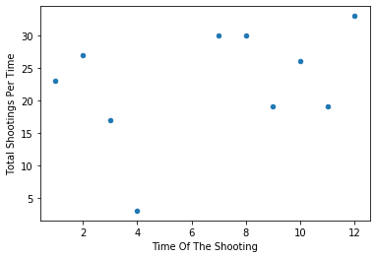
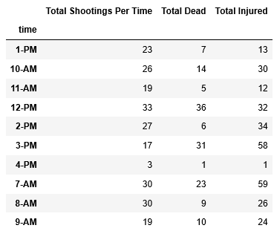
Shooters Time Preference
Most shootings Occur 12 pm
Second leading time 7 am and 8 am
Least school shooting occur around 4 pm
Conclusion
In most cases gunmen choose to commit act around lunch time when all students and staff members are gathered at the same place and time.
Most Shooters carry out the attack the first hours of the school day versus waiting to the end of the day

Slide 11
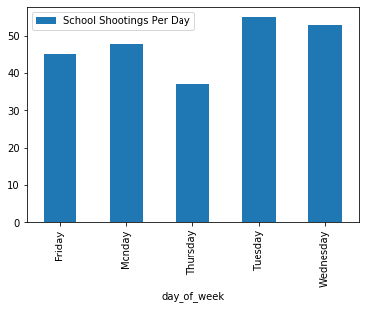
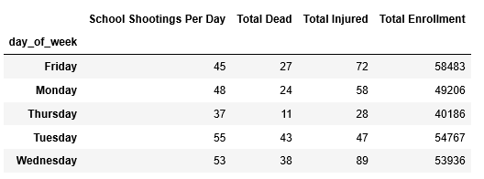
Weekday Distribution Of School Shootings 1999-2019
Tuesday is the primary day for school shootings with a total of 55 shootings
Thursday Is The least common day for school Shootings

Slide 12
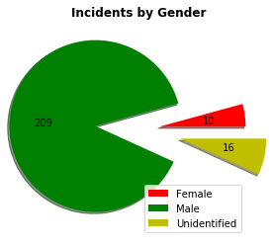
Gender | Incidents
Male | 209
Unidentified | 16
Female | 10
Distribution of school shootings by gender between 1999 and 2019
Male is the number one gender committing these crimes with 209 incidents followed by Female with 10 incidents over the sample period. There were 16 that were unidentified.
Age15 is the most common age committing these crimes with 32 incidents over the sample period, followed by age 16 with 28 incidents. Age 17 and 14 are tied with 27 incidents each.

Slide 13
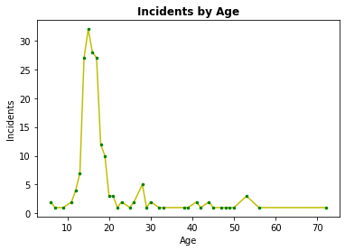
Age
Age | Incidents
15.0 | 32
16.0 | 28
14.0 | 27
17.0 | 27
18.0 | 12

Slide 14
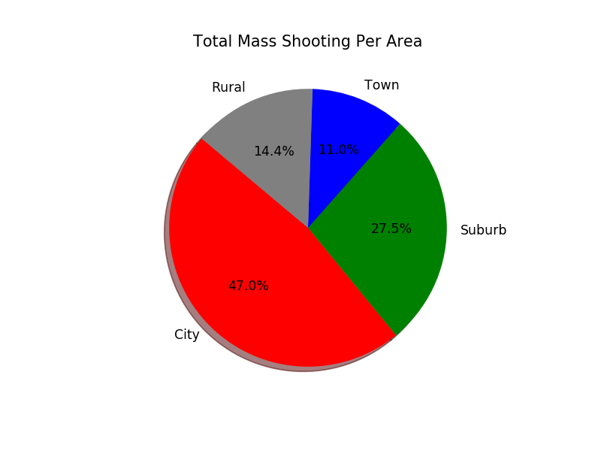
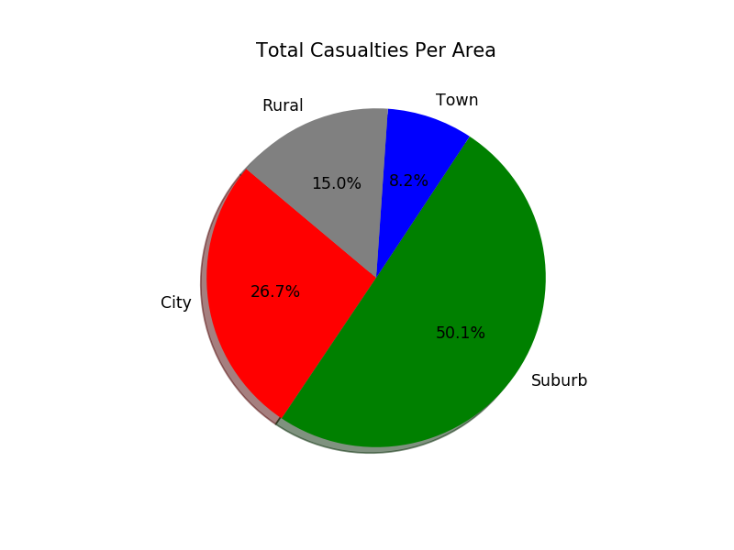
Total Shootings and Casualties per region based on the areas
given by the Department of Education

Slide 15
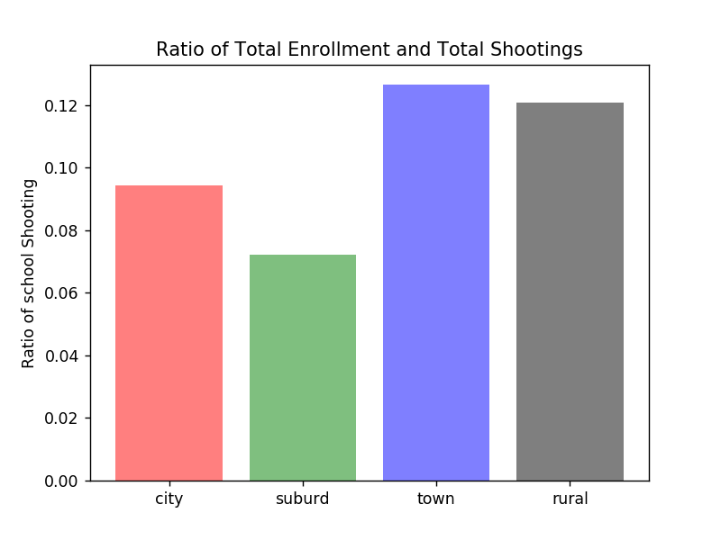
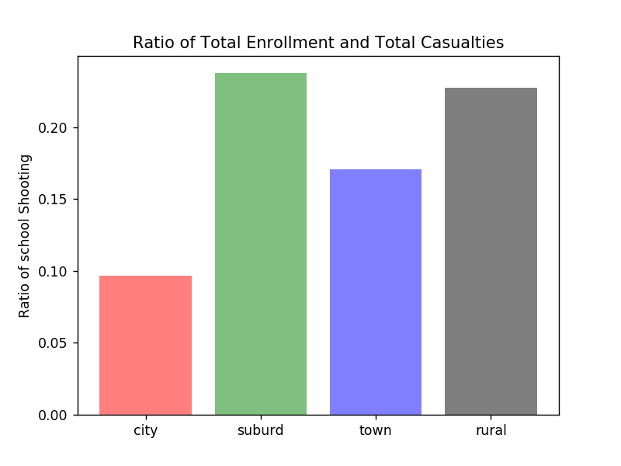
Ratios of Total Enrollment of all School Areas, Total Shootings,
and Total Casualties

Slide 16
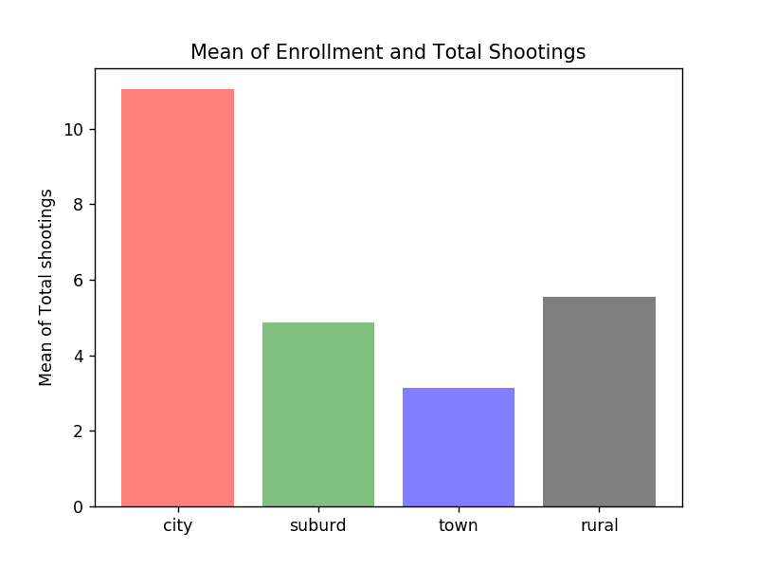
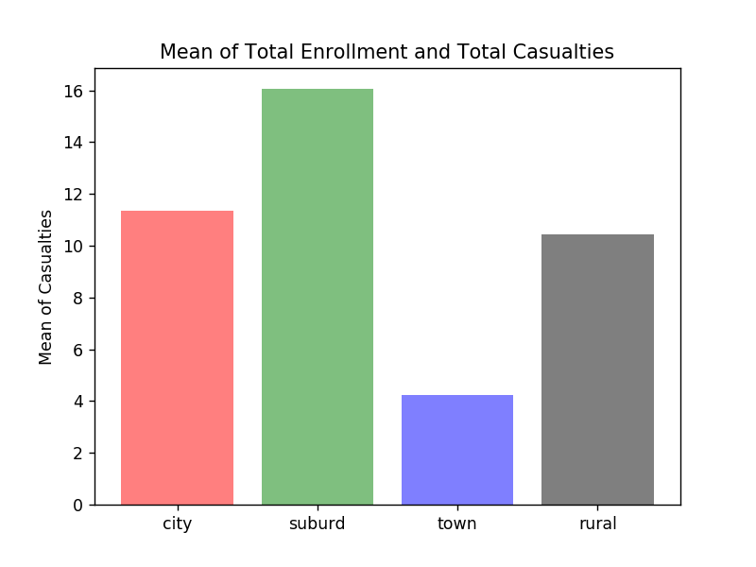
Mean of Total Enrollment of all School Areas, Total Shootings,
and Total Casualties

Slide 17
Urban areas by average have the most school shootings?
Areas | Total casualties | Total shootings | Total Enrollment | Average Enrollment | Shooting Enrollment ratio | Shooting Enrollment Mean | Shooting casualties ratio | Shooting casualties Mean
city | 114 | 111 | 117671 | 1005.0409 | 0.0943308 | 11.044327 | 0.0968803 | 11.342822
suburb | 214 | 65 | 90074 | 1332.3136 | 0.0721629 | 4.8787311 | 0.2375824 | 16.062284
town | 35 | 26 | 20541 | 828.08333 | 0.1265761 | 3.1397806 | 0.1703909 | 4.2266278
rural | 64 | 34 | 28166 | 612.80556 | 0.1207129 | 5.5482526 | 0.2272243 | 10.44377
City's have the most shooting
The Suburb's have the most casualties from shootings
Looking at the data the Suburb’s is the deadliest area or have the most casualties

Slide 18
Recap
January tends to be highest casualties for school shootings
Tuesdays are the deadliest day of the week
Lunch time is the leading time preference for the attack
There are more shootings in the cities but more casualties in the suburbs
Males age 15 are most prominent shooters

