Slide 1

Submitted by
Jeh Dadina
16010124038
Rishi Dadia
16010124037
Department of Computer Engineering
B.Tech, Third Year, Semester V
Mini Project: FSD (MERN Stack)
Find the card that actually fits you
A credit card recommendation platform for Indian spenders, built on MongoDB, Express, React and Node.
github.com/jehdadina-jpg/swiperight
Notes:
Jeh: Introduce the project in one breath. SwipeRight takes how you spend and tells you which of 64 Indian credit cards is worth the most to you. It is a MERN project: MongoDB, Express, React, Node. We will follow the same chapters as the report.

Slide 2
1 INTRODUCTION
Cards are sold on headlines, not on you
Sixty-plus popular cards, a dozen-plus issuers, each with its own rates, monthly caps, milestones and fee waivers.
What a card is worth depends on how you spend: fuel and groceries, or flights and dining.
Comparison sites rank by editorial order or sponsorship, not by your spending.
Doing the maths by hand for every card is why most people just pick the one a bank executive suggests.
64
real Indian cards
15
issuers
13
spending categories
SwipeRight | FSD Mini Project | MERN stack
2
Notes:
Jeh: Explain the background. A 12,000 rupee fee card is a bargain for a frequent flyer and a loss for someone who mostly buys fuel and groceries. Terms are scattered over a dozen issuer sites and nobody applies caps and fees by hand.

Slide 3
1 INTRODUCTION
From spending profile to five ranked cards
Problem
No quick, unbiased way for a buyer to learn which card suits their own spending.
Input
1
Statement (PDF/CSV), sliders, or logged expenses
Solution
Reduce any input to yearly spend per category, score every eligible card on net benefit, return the best five with reasons.
Engine
2
Rewards, caps, milestones, fees, weighted score
Result
3
Filters the user controls
Exclude banks, cap the annual fee, require lounge access, set income and CIBIL.
Top 5 with reasoning, chart and breakeven
Swipe
4
Left to pass, right to shortlist and compare
SwipeRight | FSD Mini Project | MERN stack
3
Notes:
Rishi: State the problem, then the solution. Three ways to describe your spending go in, one ranked, explained list of five cards comes out, and you swipe right to shortlist.

Slide 4
1 INTRODUCTION
Objectives and scope
Pure MERN
Spend to categories
Rank 64 cards
MongoDB, Express, React, Node with a clean client, API and database split
Statement, sliders or expenses become yearly spend across 13 categories
Net annual benefit with caps, milestones and fees applied correctly
Real CRUD
Preferences
Trustworthy
Expenses and shortlist behind JWT auth, ownership checked on every query
Exclude banks, fee cap, lounge, compare three cards, export card image
Validated input, clear errors, 30 automated tests
In scope
Web client, REST API, data model, PDF/CSV parsing, engine, tests
Out of scope
Scanned-PDF OCR, bank integrations, applications or payments, cloud deployment
SwipeRight | FSD Mini Project | MERN stack
4
Notes:
Rishi: Six objectives. Note what is out of scope: OCR for scanned statements, live bank integration, and cloud deployment.

Slide 5
2 REQUIREMENTS
What the system does
FR1
FR2
FR3
FR4
Accounts
Card directory
Statement analysis
Estimated spend
Register, sign in, JWT. Guests welcome.
Search, filter, sort 64 cards.
PDF/CSV up to 10 MB, 13 categories.
Sliders or a swipe quiz.
FR5
FR6
FR7
FR8
Expense tracker
Ranked top 5
Shortlist & compare
Catalogue admin
Add, view, edit, delete: full CRUD.
Net benefit, rate, breakeven, reasons.
Swipe deck, notes, compare three.
Admin-only create, update, soft delete.
Non-functional: responsive UI, bcrypt + JWT, helmet, rate limiting, in-memory uploads, zod validation, ownership checks, central error handling.
SwipeRight | FSD Mini Project | MERN stack
5
Notes:
Jeh: Eight functional requirements. Guests can do almost everything; signing in adds saved expenses and a shortlist that follows you across devices.

Slide 6
2 TECHNOLOGY STACK
MongoDB, Express, React, Node
M
E
R
N
MongoDB
Express.js
React 18
Node.js 18+
Mongoose ODM
REST API
Vite, JavaScript
Services
7 collections
Indexes on user, date, name
Unique (user, card)
Seeded with 64 cards
zod validation
JWT + bcrypt
helmet, cors, rate limit
multer in-memory uploads
react-router, Zustand
Tailwind, Framer Motion
Recharts, Axios
html-to-image export
Statement parser
Categoriser
Recommendation engine
node:test + supertest
SwipeRight | FSD Mini Project | MERN stack
6
Notes:
Rishi: One slide for the stack. Mongo stores everything, Express and Node host the API and the engine, React with Vite is the client. Tests run on an in-memory Mongo so they never touch real data.

Slide 7
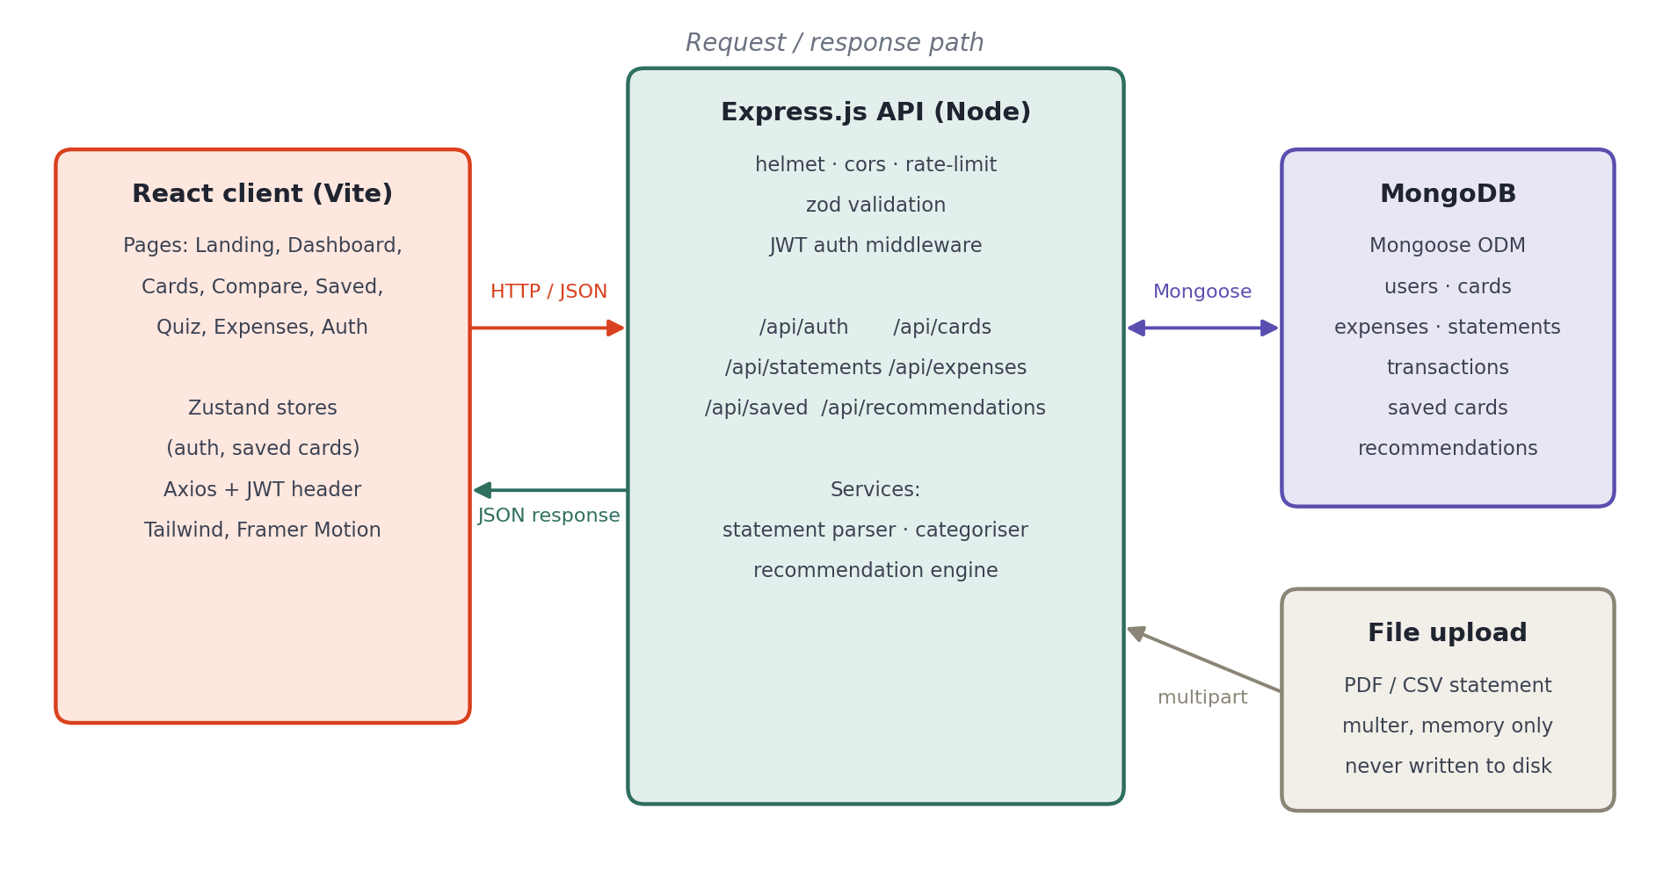
3 SYSTEM DESIGN
Three tiers, one request path
Dev proxy
Vite proxies /api to Express, so no CORS setup in development.
Privacy
Uploads live in memory only. Only the extracted transactions are stored.
Guests or users
Optional auth on upload and recommend; required auth on expenses and shortlist.
SwipeRight | FSD Mini Project | MERN stack
7
Notes:
Jeh: Walk the arrow. The client sends JSON to Express; Express validates, authenticates, and talks to Mongo through Mongoose. Statement files are parsed in memory and discarded.

Slide 8
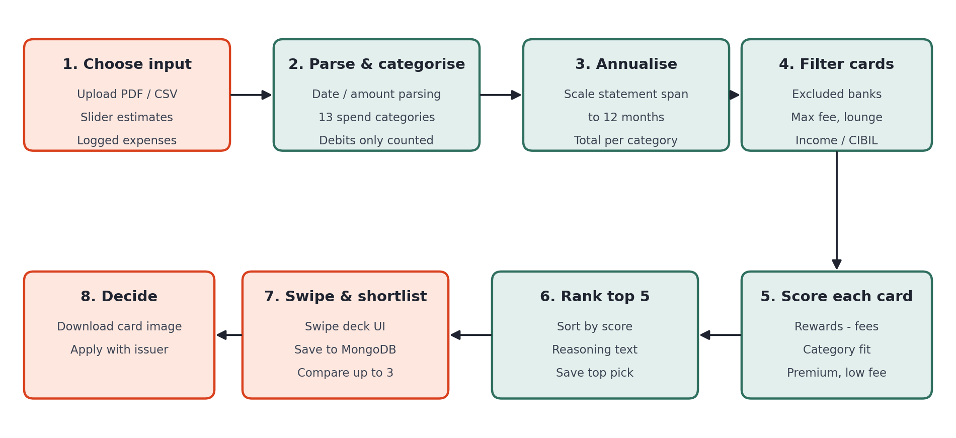
3 SYSTEM DESIGN
Workflow: input to decision
Statements are scaled to a 12-month figure from the span of their dates, so monthly statements and yearly slider estimates compare fairly.
SwipeRight | FSD Mini Project | MERN stack
8
Notes:
Rishi: Eight steps. Input, parse and categorise, annualise, filter, score, rank, swipe, decide. A one-month statement is scaled to twelve months before scoring.

Slide 9
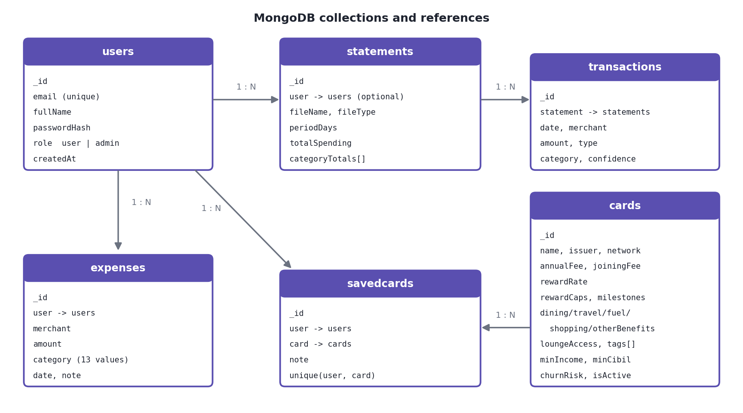
3 SYSTEM DESIGN
Seven collections, clear references
users
accounts and roles, hash never returned
cards
64-card catalogue the engine scores
statements + transactions
analysed uploads and their rows
expenses
manual spending, one owner
savedcards
shortlist, unique per user and card
recommendations
top pick of each run, as history
SwipeRight | FSD Mini Project | MERN stack
9
Notes:
Jeh: Users own expenses, statements and saved cards. Statements embed their category totals because they are read together; transactions are separate because there can be hundreds. Saved cards have a unique index so saving twice is harmless.

Slide 10
3 SYSTEM DESIGN
REST API under /api
Auth
POST /auth/register POST /auth/login GET /auth/me
public / user
Cards
GET /cards GET /cards/issuers GET /cards/:id
public
Cards (admin)
POST /cards PUT /cards/:id DELETE /cards/:id
admin
Statements
POST /statements GET /statements(/:id) DELETE /statements/:id
optional / user
Expenses
POST GET GET /summary PUT /:id DELETE /:id
user
Saved cards
POST GET PUT /:id (note) DELETE /:id
user
Recommend
POST /recommendations GET /recommendations/history
optional / user
SwipeRight | FSD Mini Project | MERN stack
10
Notes:
Rishi: Twenty-five routes. Public ones for cards and recommendations, authenticated ones for expenses and the shortlist, admin-only for the catalogue. Every error is a JSON object with an error message and a sensible status code.

Slide 11
4 IMPLEMENTATION
How a card is scored
1 Reward per category
Better of base rate and the card's multiplier or cashback, then capped: category cap, else monthly cap x 12, else Rs 2,000/month above base.
2 Honest assumptions
Ordinary spend earns at most 2%. Boosts tied to partner merchants apply to 25% of a category. Milestones count once.
3 Net benefit and score
Net = rewards minus annual fee, expressed as a percent of yearly spend so it shares the 0-100 scale of the other weights.
SwipeRight | FSD Mini Project | MERN stack
11
Notes:
Jeh: Two steps. First, rewards: take the better of the base rate and the category boost, then apply caps. Then the weighted score: forty percent net benefit, thirty category fit, twenty premium features, ten low fee. We fixed inflated numbers by enforcing caps, a two percent base ceiling and a partner share.

Slide 12
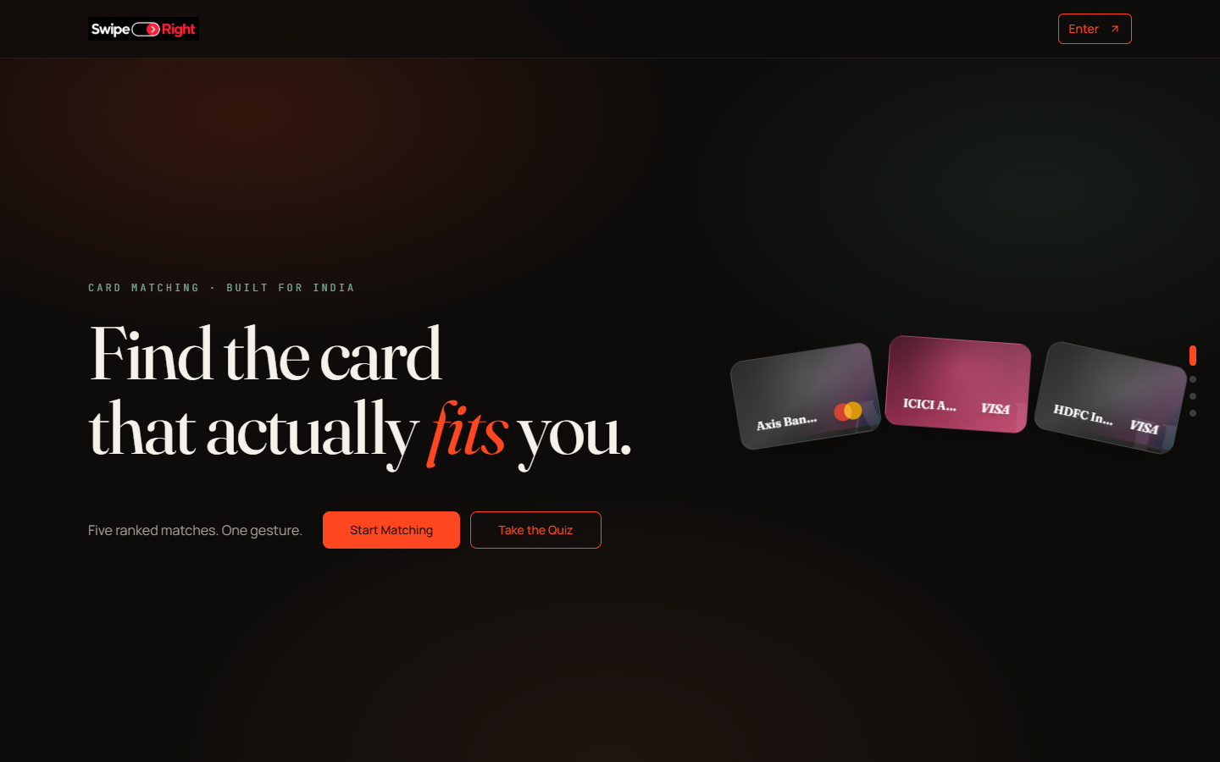
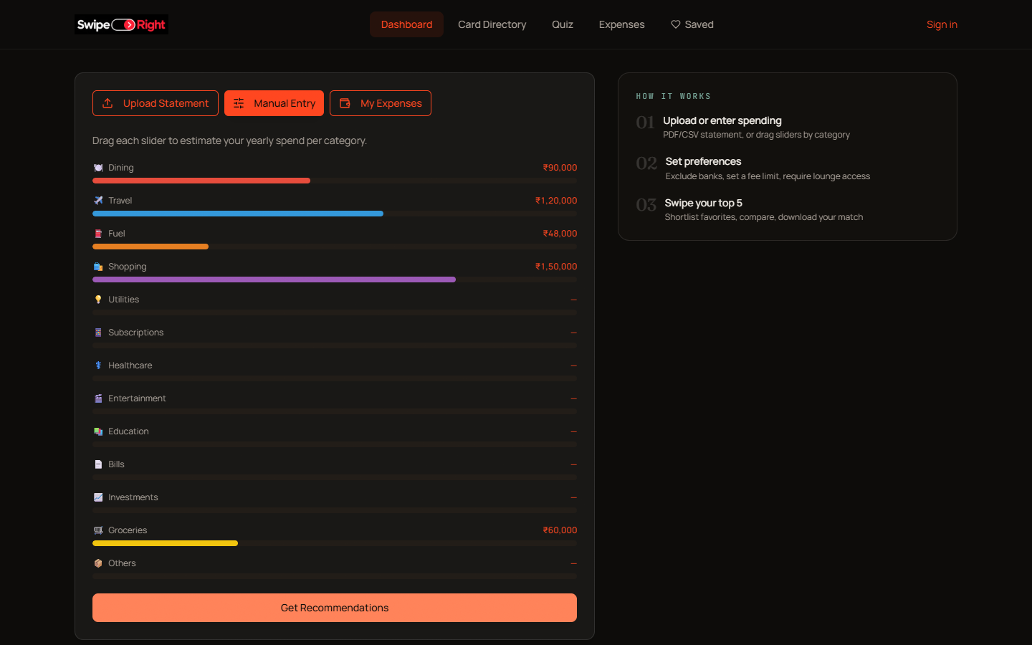
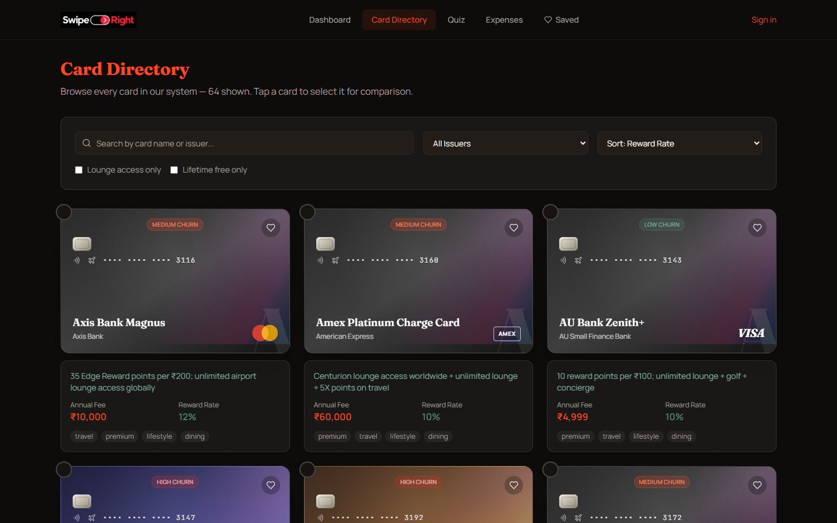
4 IMPLEMENTATION
Interface: landing, dashboard, directory
Landing
Dashboard
Card directory
React 18 + Vite, react-router, Zustand stores for auth and the shortlist, Tailwind and Framer Motion.
SwipeRight | FSD Mini Project | MERN stack
12
Notes:
Rishi: The product is dark with a single ember accent. Landing explains the name, the dashboard takes input and shows the ranked results, and the directory lets you search and filter every card.

Slide 13
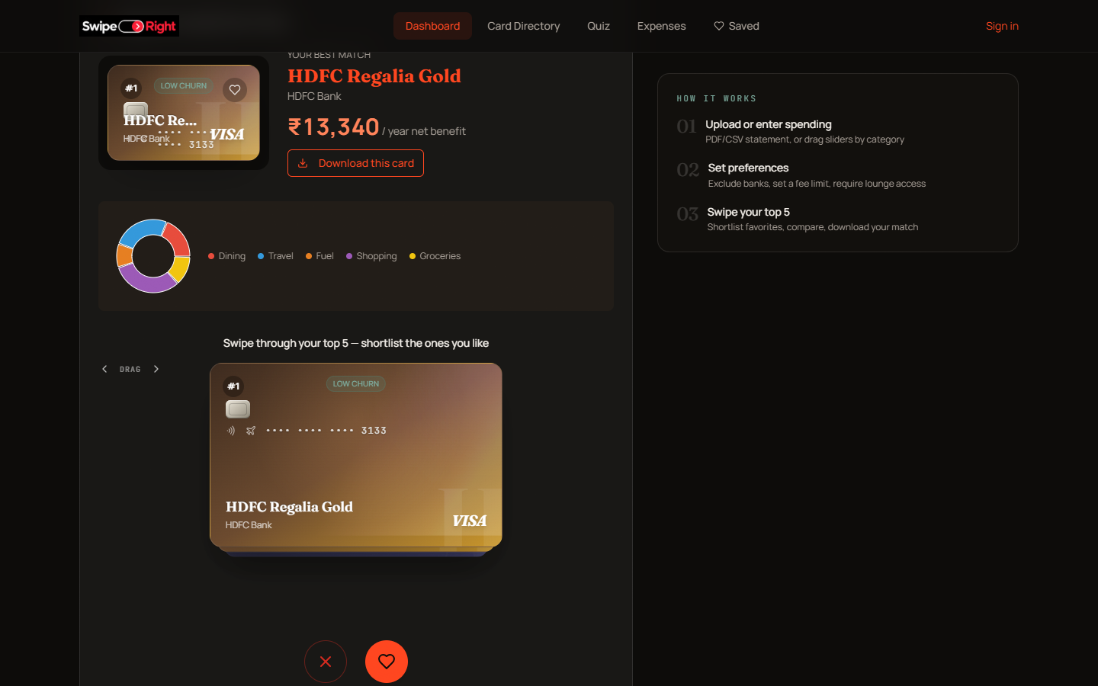
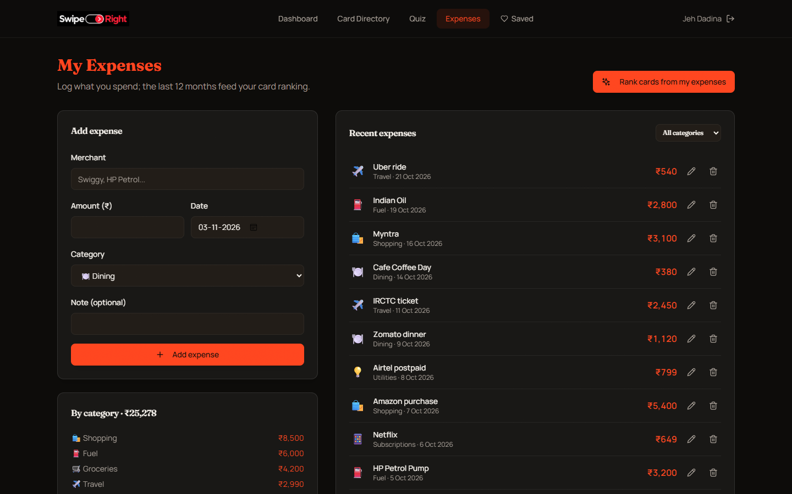
4 IMPLEMENTATION
Results, swipe deck and expense tracker
Best match and swipe deck
Expense tracker
Swipe right shortlists a card, left passes. The winning card can be downloaded as an image.
SwipeRight | FSD Mini Project | MERN stack
13
Notes:
Jeh: After a request you see the best match with its yearly net benefit, a spend chart and the swipe deck. Signed-in users also get an expense tracker whose last twelve months can be ranked directly.

Slide 14
4 IMPLEMENTATION
CRUD, validation and error handling
Add expense form
POST /expenses, zod, Expense.create
Errors the user sees
400 negative amount, bad input
401 wrong password, no token
404 another user's record
409 email already registered
413 file over 10 MB
422 statement with no transactions
Create
Read
List, filter, totals
GET /expenses, 12-month aggregation
Update
Edit row in form
PUT /expenses/:id, owner-filtered
Delete
Trash icon
DELETE /expenses/:id, 404 if not yours
The saved-card shortlist follows the same pattern: upsert, update note, delete.
SwipeRight | FSD Mini Project | MERN stack
14
Notes:
Rishi: The expense tracker is the main CRUD resource. Every query filters by the user from the JWT, so another user's id simply returns 404. Validation is layered: zod on the request, Mongoose on the document, and a central error handler.

Slide 15
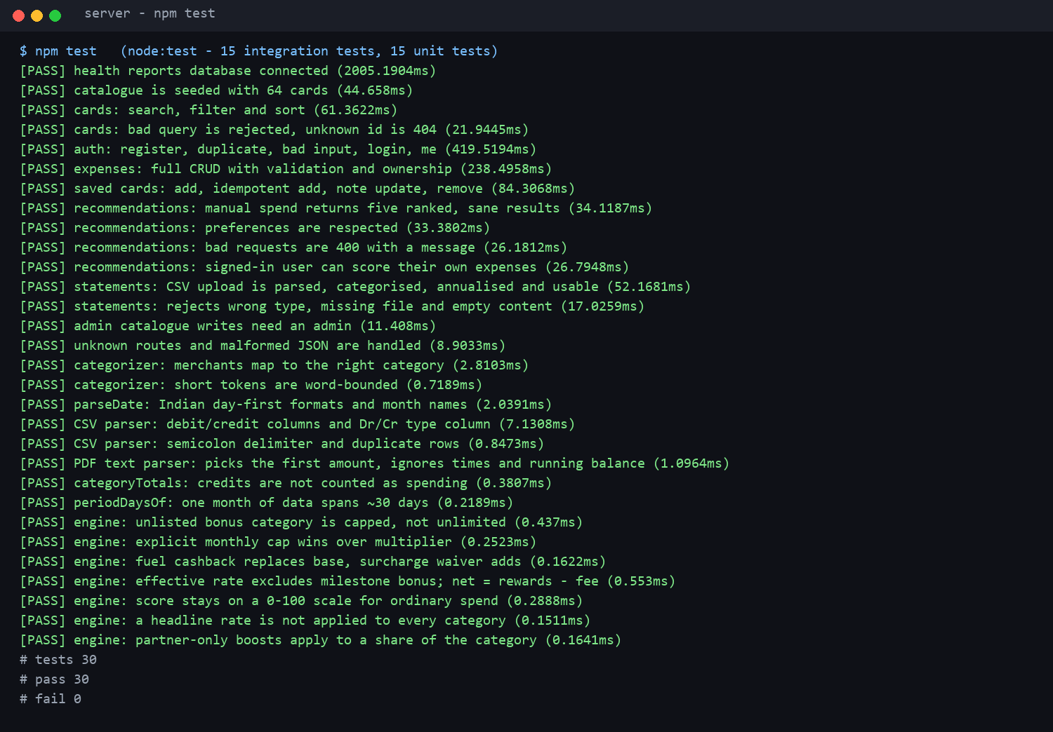
5 TESTING AND RESULTS
30 tests, 30 passing
30/30
tests pass
15
API and integration
15
unit tests
SwipeRight | FSD Mini Project | MERN stack
15
Notes:
Jeh: Fifteen integration tests run the real Express app against an in-memory MongoDB, and fifteen unit tests cover parsing and the reward maths. Finding a 16 percent effective rate in one of them is what led to the base-earn ceiling and the partner share.

Slide 16
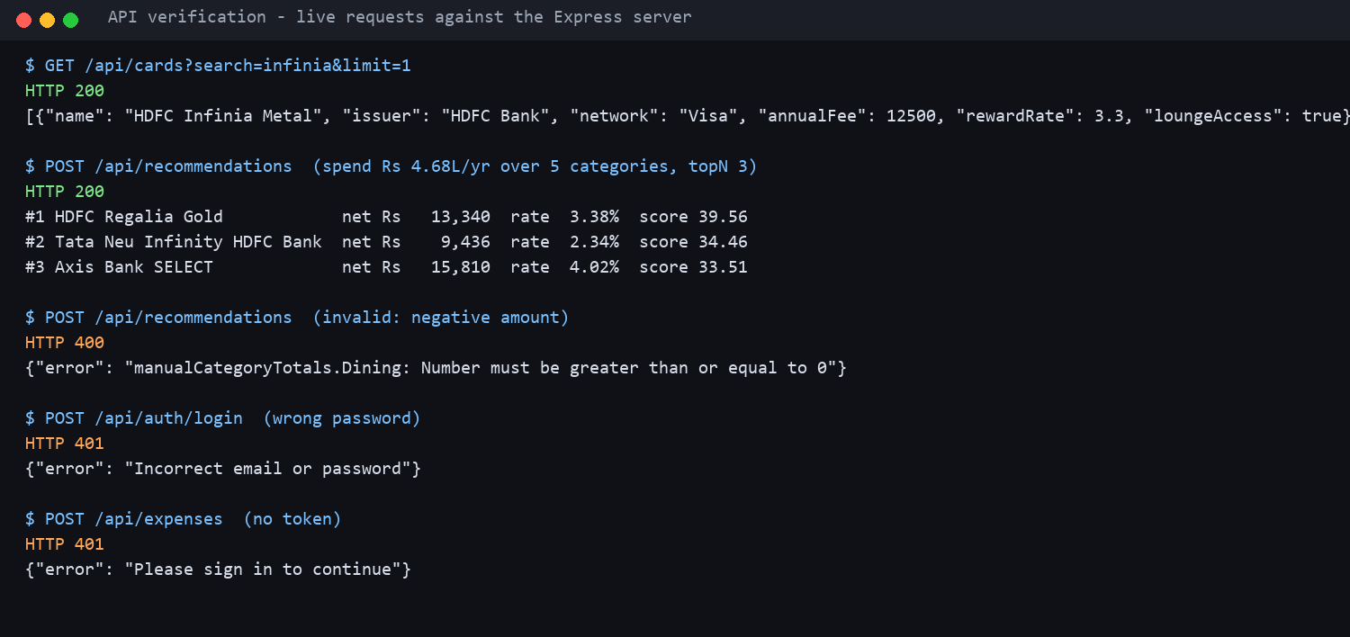
5 TESTING AND RESULTS
Live API checks
What was checked
Search and filters return correct cards
Top-3 ranking at realistic reward rates
Invalid input returns 400 with a message
Wrong password and missing token return 401
Postman and Compass were not used
SwipeRight | FSD Mini Project | MERN stack
16
Notes:
Rishi: Real requests to the running server. A catalogue search, a ranking whose top results sit at two to four percent effective rate, and three failure cases with the right status codes.

Slide 17
7 CHALLENGES
Problems we hit and how we fixed them
Inflated rewards
Enforced caps, 2% base ceiling, partner share, percent-of-spend scoring
PDF gave 0 or wrong rows
Amounts need paise, ordinal and month-name dates, first amount on a line
Salary counted as spend
Dr/Cr columns, suffixes and signs decide direction; debits only
Monthly vs yearly
Scale statement totals to 12 months by date span
Setup failures
Single MongoDB URI, auto-seeded catalogue, optional accounts
SwipeRight | FSD Mini Project | MERN stack
17
Notes:
Jeh: Five real problems. Inflated rewards were the big one, so most of the engine work went into caps and assumptions. PDF parsing needed paise-aware amounts and ordinal dates. CSV direction needed Dr/Cr handling.

Slide 18
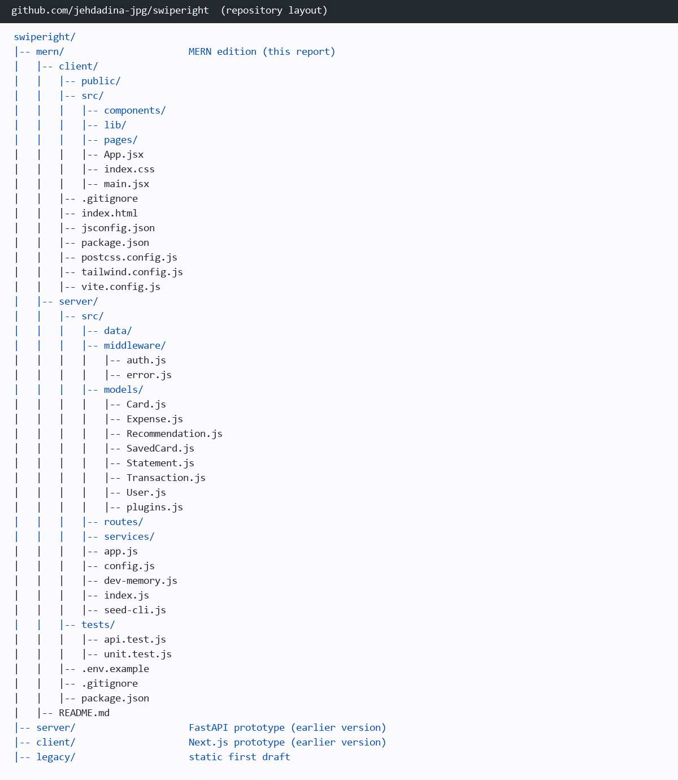
6-7 GITHUB AND TEAM
Repository, deployment and who built what
github.com/jehdadina-jpg/swiperight
Deployment: not deployed (N.A.). Runs locally; MONGODB_URI can point at MongoDB Atlas.
Jeh Dadina | 16010124038
Landing, dashboard, swipe deck; recommendation engine, statement parser, categoriser; card models and seed; engine and parser tests
Rishi Dadia | 16010124037
Directory, compare, saved, expenses and auth pages; auth, expense and shortlist routes; user models; API tests, report
SwipeRight | FSD Mini Project | MERN stack
18
Notes:
Rishi: The MERN edition is under the mern folder with its own server and client package files. It runs locally; it is not deployed, and the connection string means Atlas can be used without code changes.

Slide 19
8 CONCLUSION
Conclusion and future scope
What we delivered
What comes next
A MERN app that turns spending into five ranked, explained card matches.
64 cards, 13 categories, caps, milestones and fees applied.
JWT accounts, full CRUD with ownership checks, validated errors.
30 passing automated tests and a scripted browser walkthrough.
Deploy: Atlas, a Node host, CI that runs the tests.
Account Aggregator or OCR instead of manual uploads.
Trained categoriser; base rates and partner shares as data.
Admin console and front-end end-to-end tests.
SwipeRight | FSD Mini Project | MERN stack
19
Notes:
Jeh: Close on what we built and what is next. Then hand over to questions.

Slide 20
Thank you
Questions?
Jeh Dadina 16010124038 | Rishi Dadia 16010124037
github.com/jehdadina-jpg/swiperight
Notes:
Both: Thank the panel and take questions. Likely questions: why a 2% base ceiling, how statements are scaled to a year, and how ownership is enforced.

