Slide 1
LabOrch
A Computerized Orchestration Tool

Slide 2
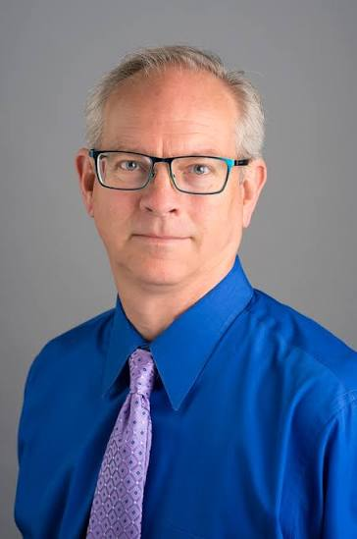
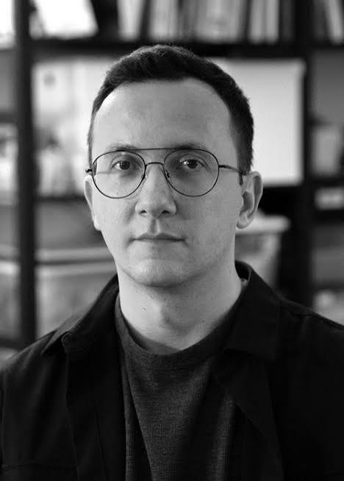

Who are we ?
Jim
François
Constantin

Slide 3
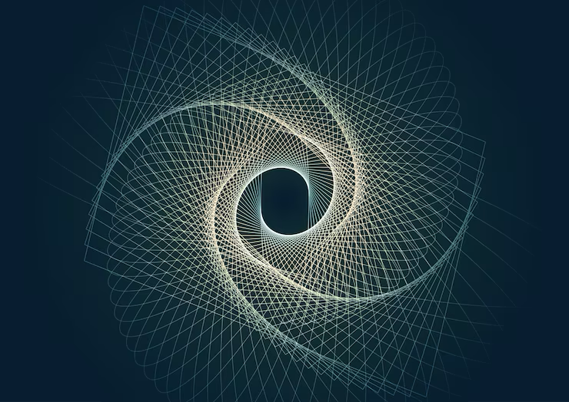
Objective
Provide a composer-friendly digital platform for:
Exploring,
generating, and
manipulating orchestral sound combinations.

Slide 4
Basic structure
Input
Sound bank: FFTs
LabOch
Imitation of a reference sound
Interpolation / Morphing
Output
Scores
Soundfiles
Creating sounds

Slide 5
Flexible interfaces
Intuitive interface
Numerical interface
Designed for users who prefer visual interaction via sliders, and descriptive controls.
Designed for users who prefer direct interaction with technical controls and quantitative data.

Slide 6

Function #1: Imitation
Upload a target sound
  LabOrch analyzes its resonance and timbral properties.
Select your instruments
Identify any performance constraints:
  Pitch, Dynamic, Articulation, Mode of performance….
Optionally, interact with and transform the resonance:
  Shift the main frequency bands, Change dynamic levels, Apply acoustic filters….

Slide 7

Function #2: Interpolation / Morphing
Provide two target sounds
  LabOrch generates orchestrations that interpolate or blend from one sound to the other.
User constraints :
  Number of interpolations
  Instrumentation
  Specified pitches (e.g., all interpolations must contain E5)
  Fixed or changing dynamics (e.g., crescendo between targets)
  Articulation or technique filters (e.g., all interpolations must use string harmonics)

Slide 8
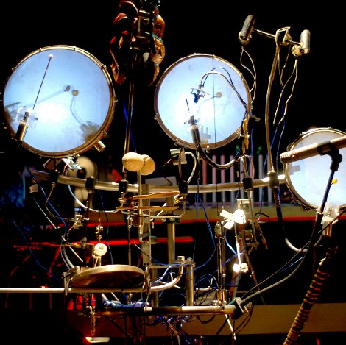
Function #3: Creative
LabOrch proposes orchestrations, based on a user’s input:
  Instrumentation
  Desired pitches
  Dynamic profile
  Mode of performance
  Spectral “area(s) of resonance.”

Slide 9
Dynamic output
Chord
Sustained
Pulsating at a specific MM
Texture
Layered of asynchronous durations
Split into multiple groups
Each with different tempo or articulation settings.
Export Options
Musical scores
DAW-compatible files
Spectral Visualization
View soundwave, spectrum, and/or spectrogram

Slide 10
Past experience…. -> Jim

