Slide 1
University of the Pacific
San Joaquin County Office of Educcation
Delta Sierra Science Project
AI Bootcamp
Day 4: 18 June 2020

Slide 2
Blogs and other resources
https://medium.com/
https://towardsdatascience.com/
https://www.kaggle.com/
https://datahack.analyticsvidhya.com/
https://www.kdnuggets.com/

Slide 3
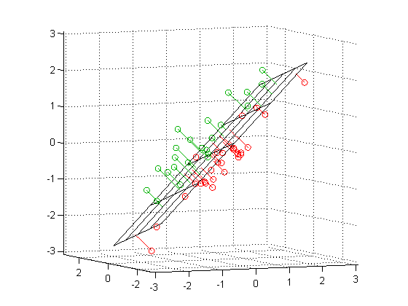
PCA
Principle Component Analysis

Slide 4
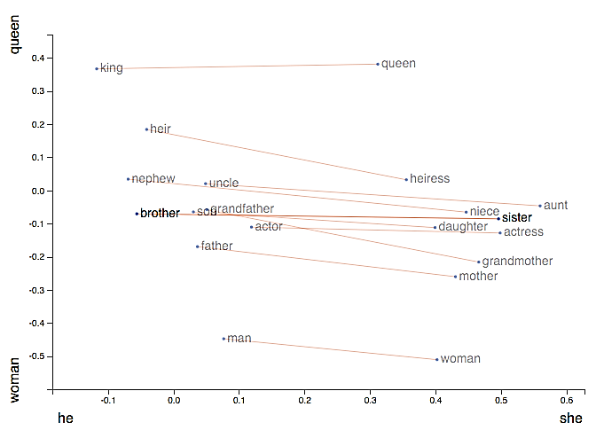
NLP :: Natural Language Processing
king - man + woman = queen
https://p.migdal.pl/2017/01/06/king-man-woman-queen-why.html
https://www.analyticsvidhya.com/blog/2017/06/word-embeddings-count-word2veec/

Slide 5
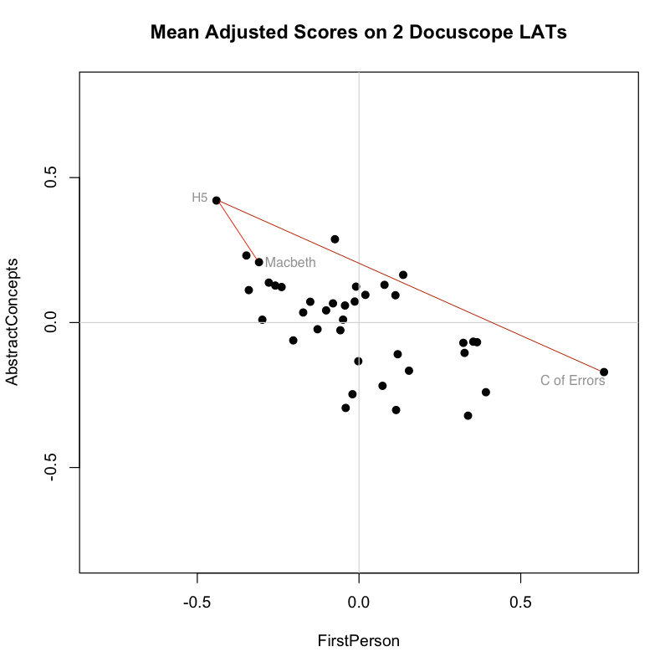
Shakespeare Plays
http://winedarksea.org/?p=2271

Slide 6
jhetrick@pacific.edu

