Slide 1
University of the Pacific
San Joaquin County Office of Educcation
Delta Sierra Science Project
AI Bootcamp
Day 3: 17 June 2020

Slide 2
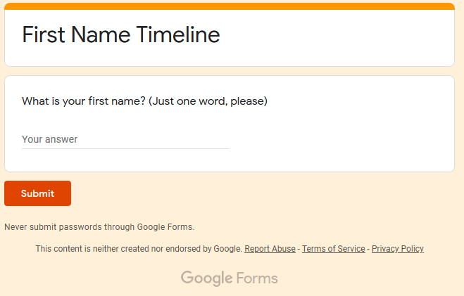
Visit: http://jhetrick.io/firstname
Enter: YOUR FIRST NAME (just one word)

Slide 3
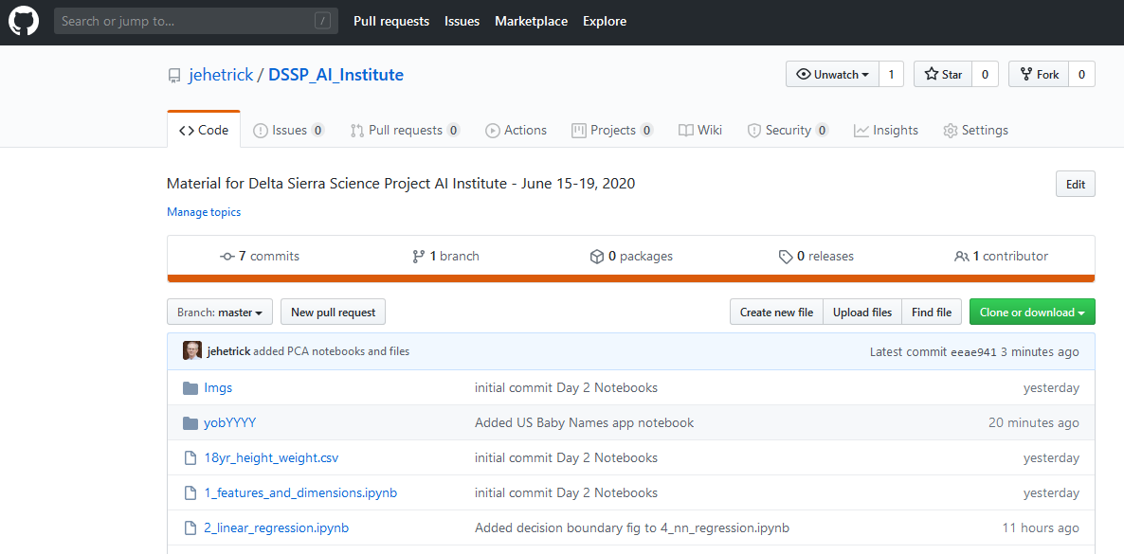
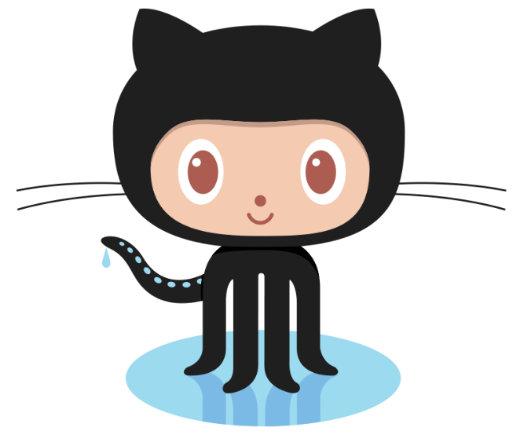
https://github.com/jehetrick/DSSP_AI_Institute
Github.com

Slide 4
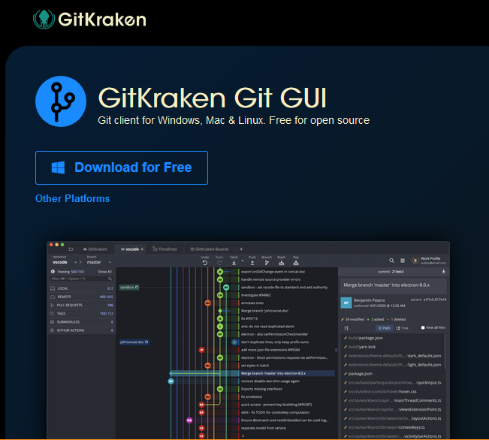

A GUI Github Client
gitkraken.com

Slide 5
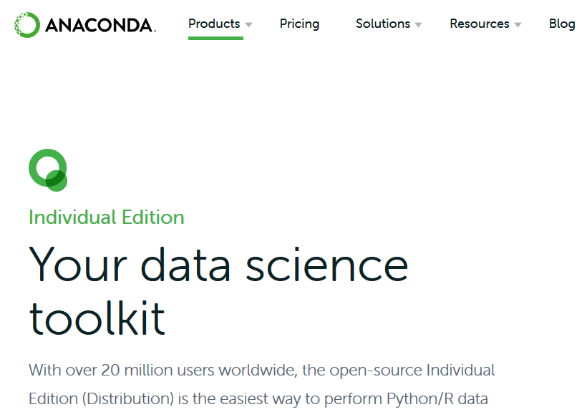


https://www.anaconda.com/products/individual

Slide 6
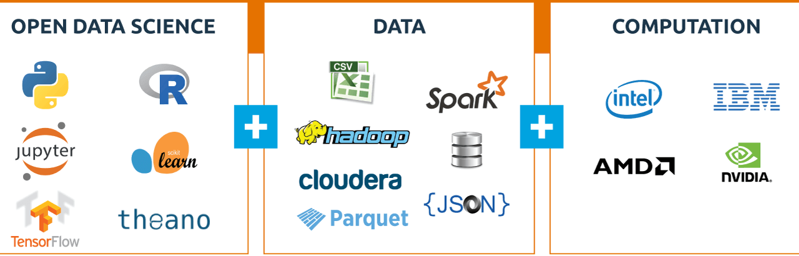

Slide 7
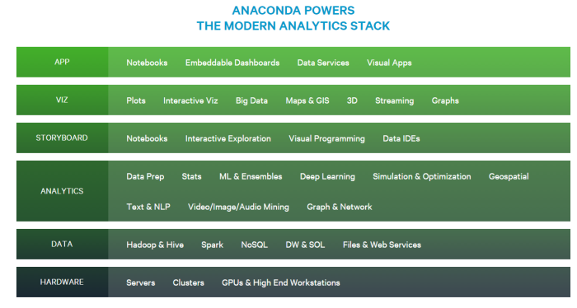

Slide 8
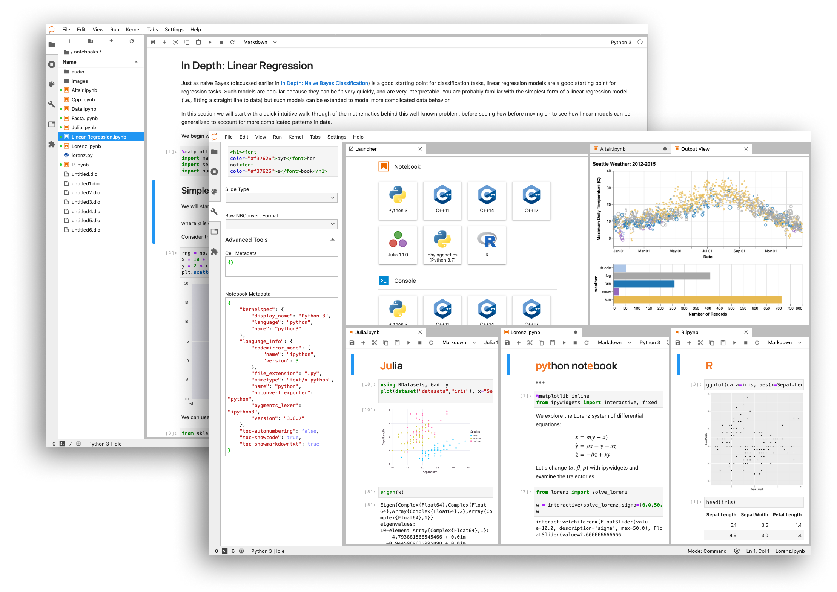

Free
with
Anaconda Python!

Slide 9

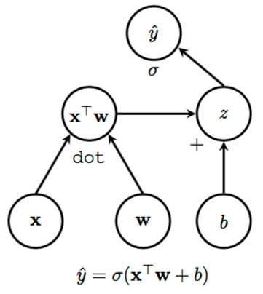
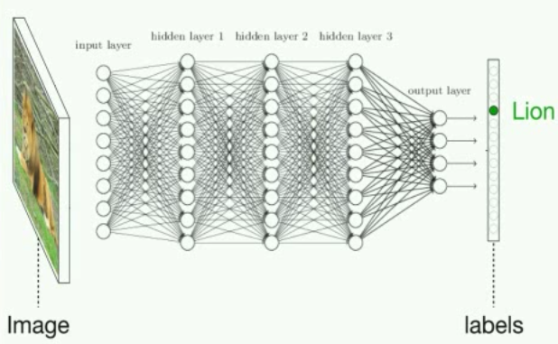
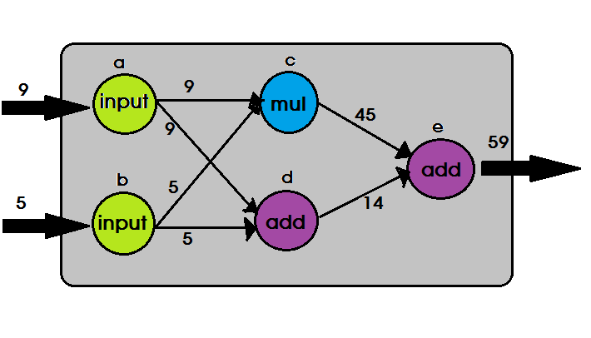

Slide 10
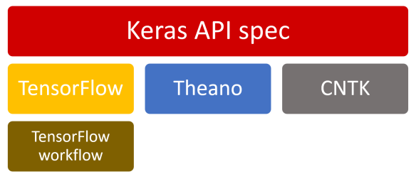
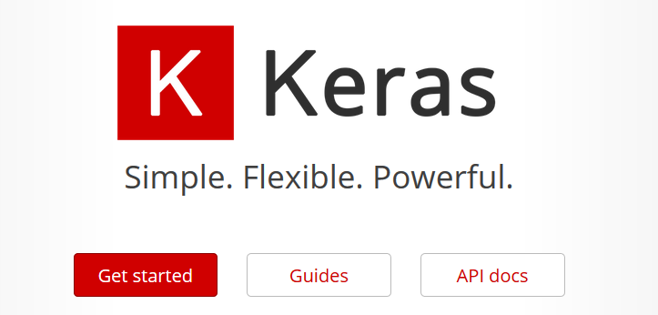
https://keras.io/

Slide 11
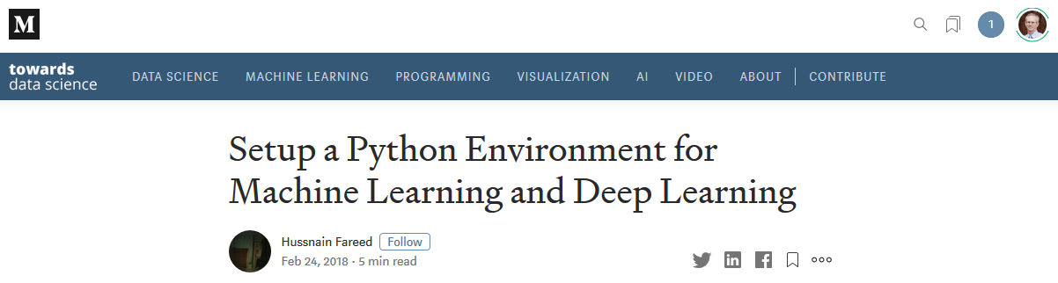
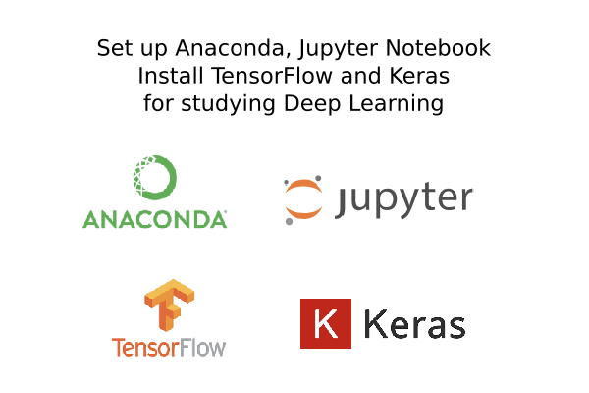
https://towardsdatascience.com/setup-an-environment-for-machine-learning-and-deep-learning-with-anaconda-in-windows-5d7134a3db10

