Slide 1


3.1415926535… How do you compute the value of π?
Throw darts!
Dr. Jim Hetrick
Professor of Physics and Data Science
jhetrick@pacific.edu
Apr 25, 2026

Slide 2




(Free!) Tools used today
+
+…
=
anaconda.com

Slide 3

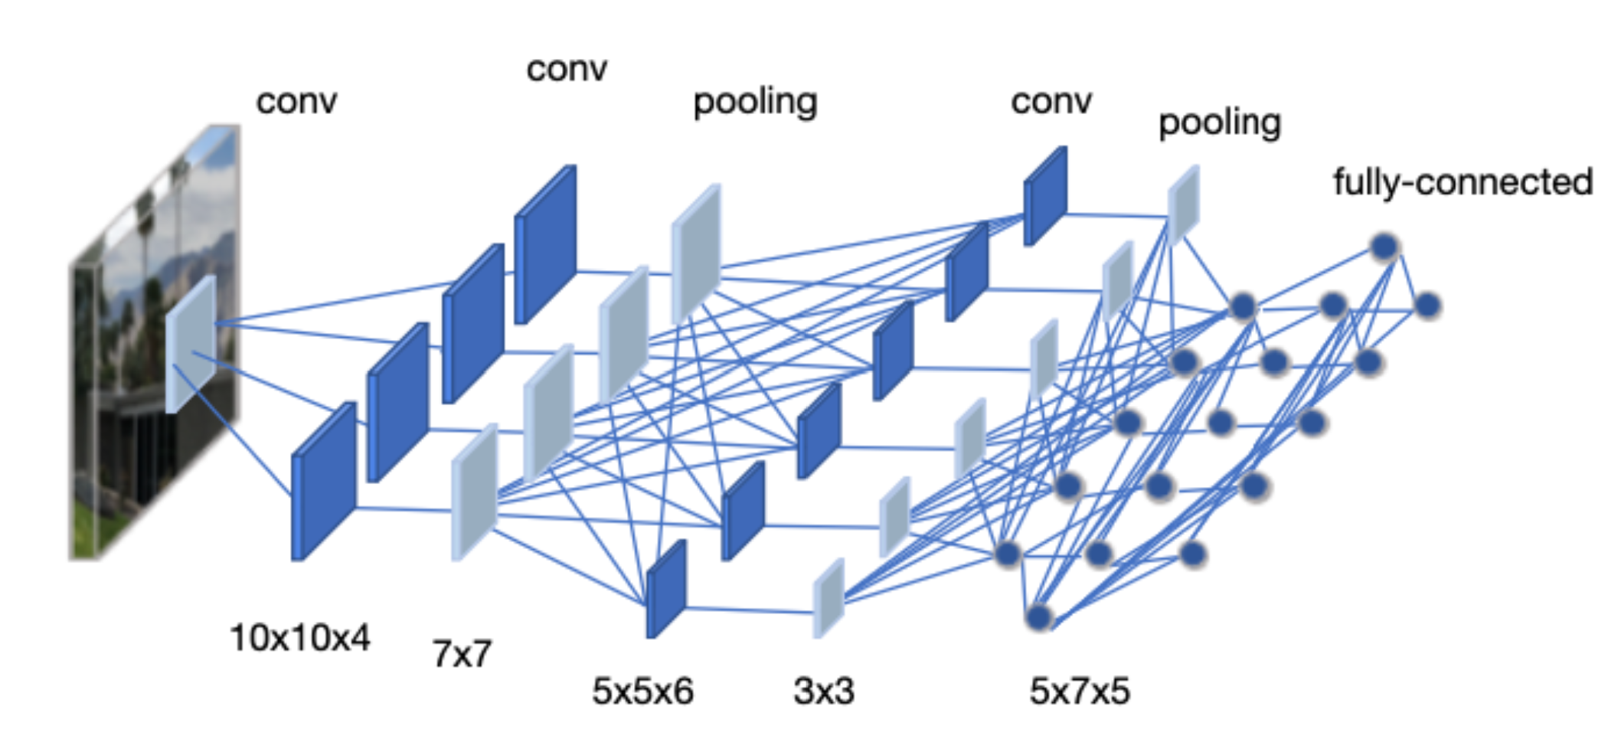
Math (and Math-ish) areas used today
Real Number Analysis
Geometry
Statistics -> Monte Carlo method
Programming (logic)
Linear Algebra (vectors, matrices, and tensors)
Data Visualization

Slide 4
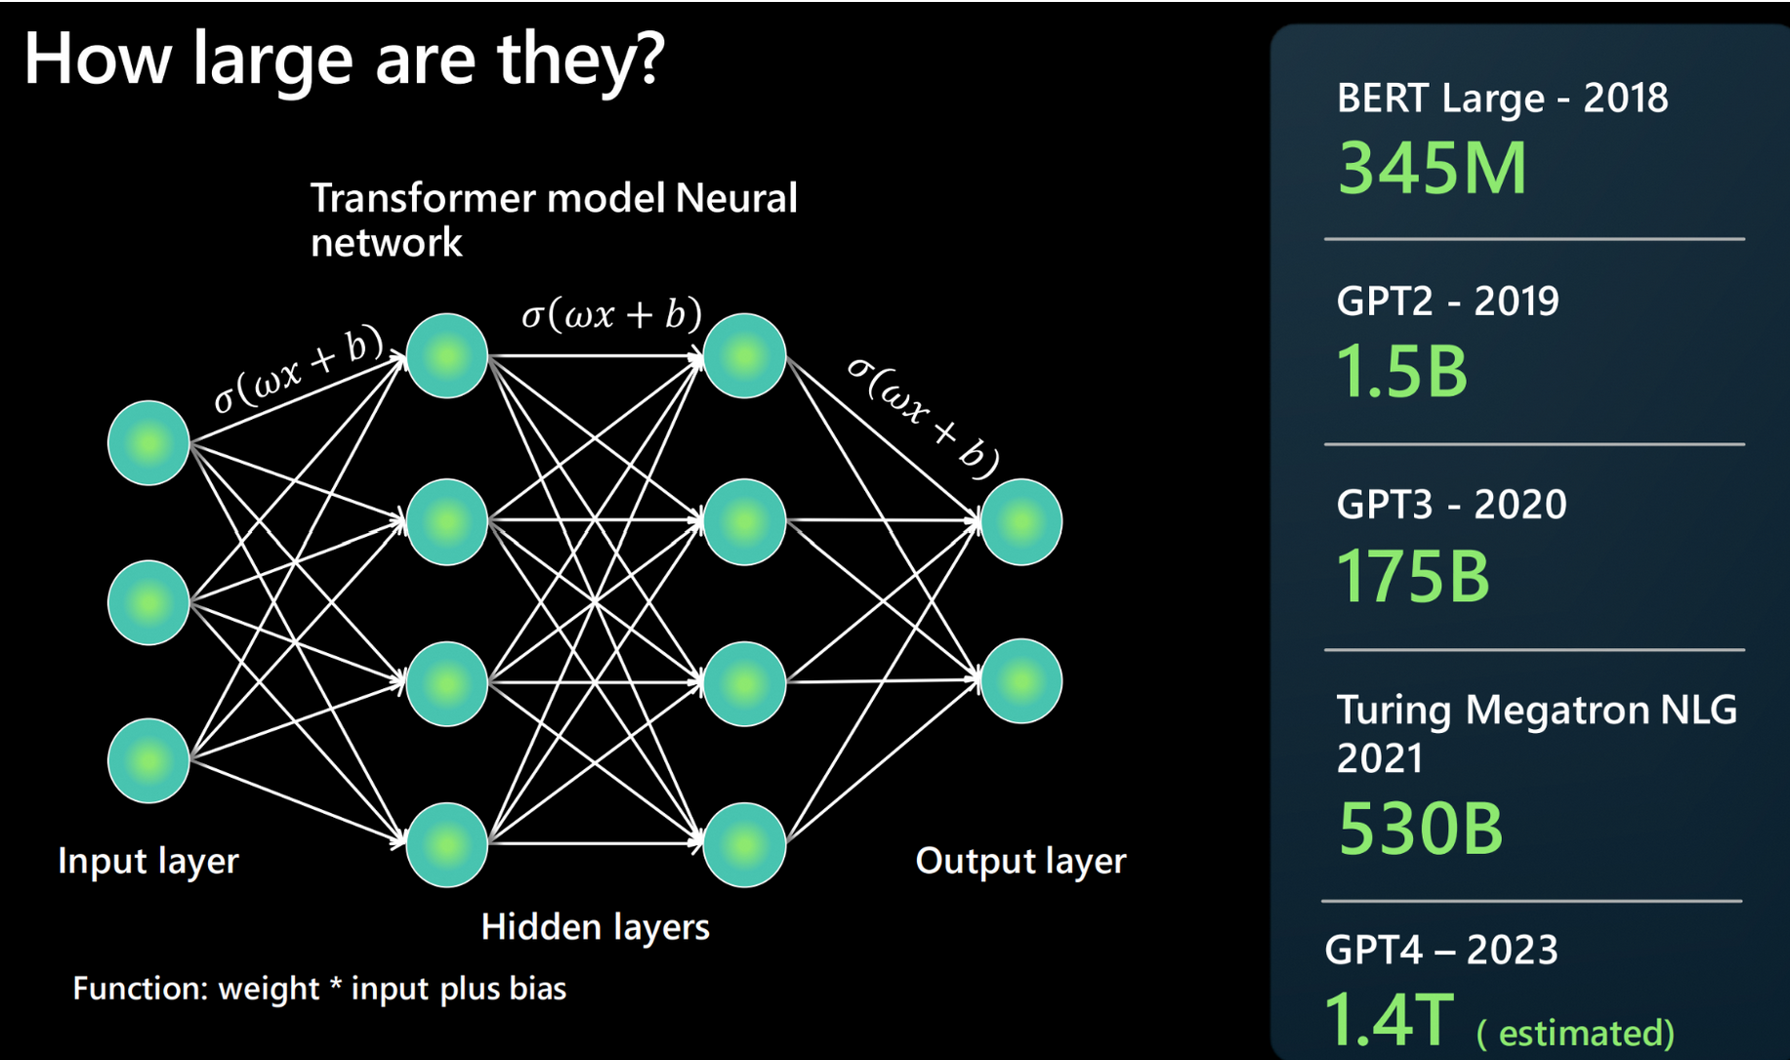

Slide 5

prompt>
I am giving a presentation on data science and monte carlo methods.
I want to point the participants (about 200) to a website where they can click a button to throw darts. When they click the button, the website will "throw 10 random darts" at a dart board. The dart board is a square of size 2x2. The web site needs to record 10 random x,y coordinates between -1 and 1 for both x and y in a file, updating the file with each participant's click. The webpage should display 10 additional points the 2x2 square, with a circle of radius 1 inside the square. Every time someone clicks the button on the webpage, 10 new points appear in the square and are recorded in the file. The webpage should also keep a running count of the fraction of points that lie inside the circle (i.e. have radius <= 1). Please provide an html page that implements this.
Add a "Clear" button to return the webpage to its inital 0 state, and a dropdown to allow the user to throw either 1,10,100,1000, or 10000 darts.

Slide 6
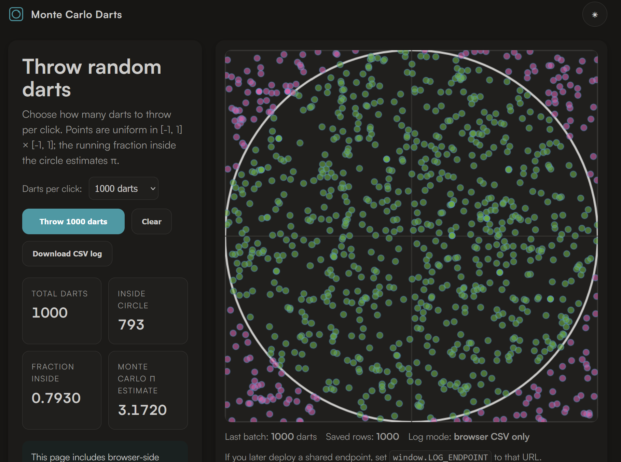

Jhetrick.io/MCpi

Slide 7
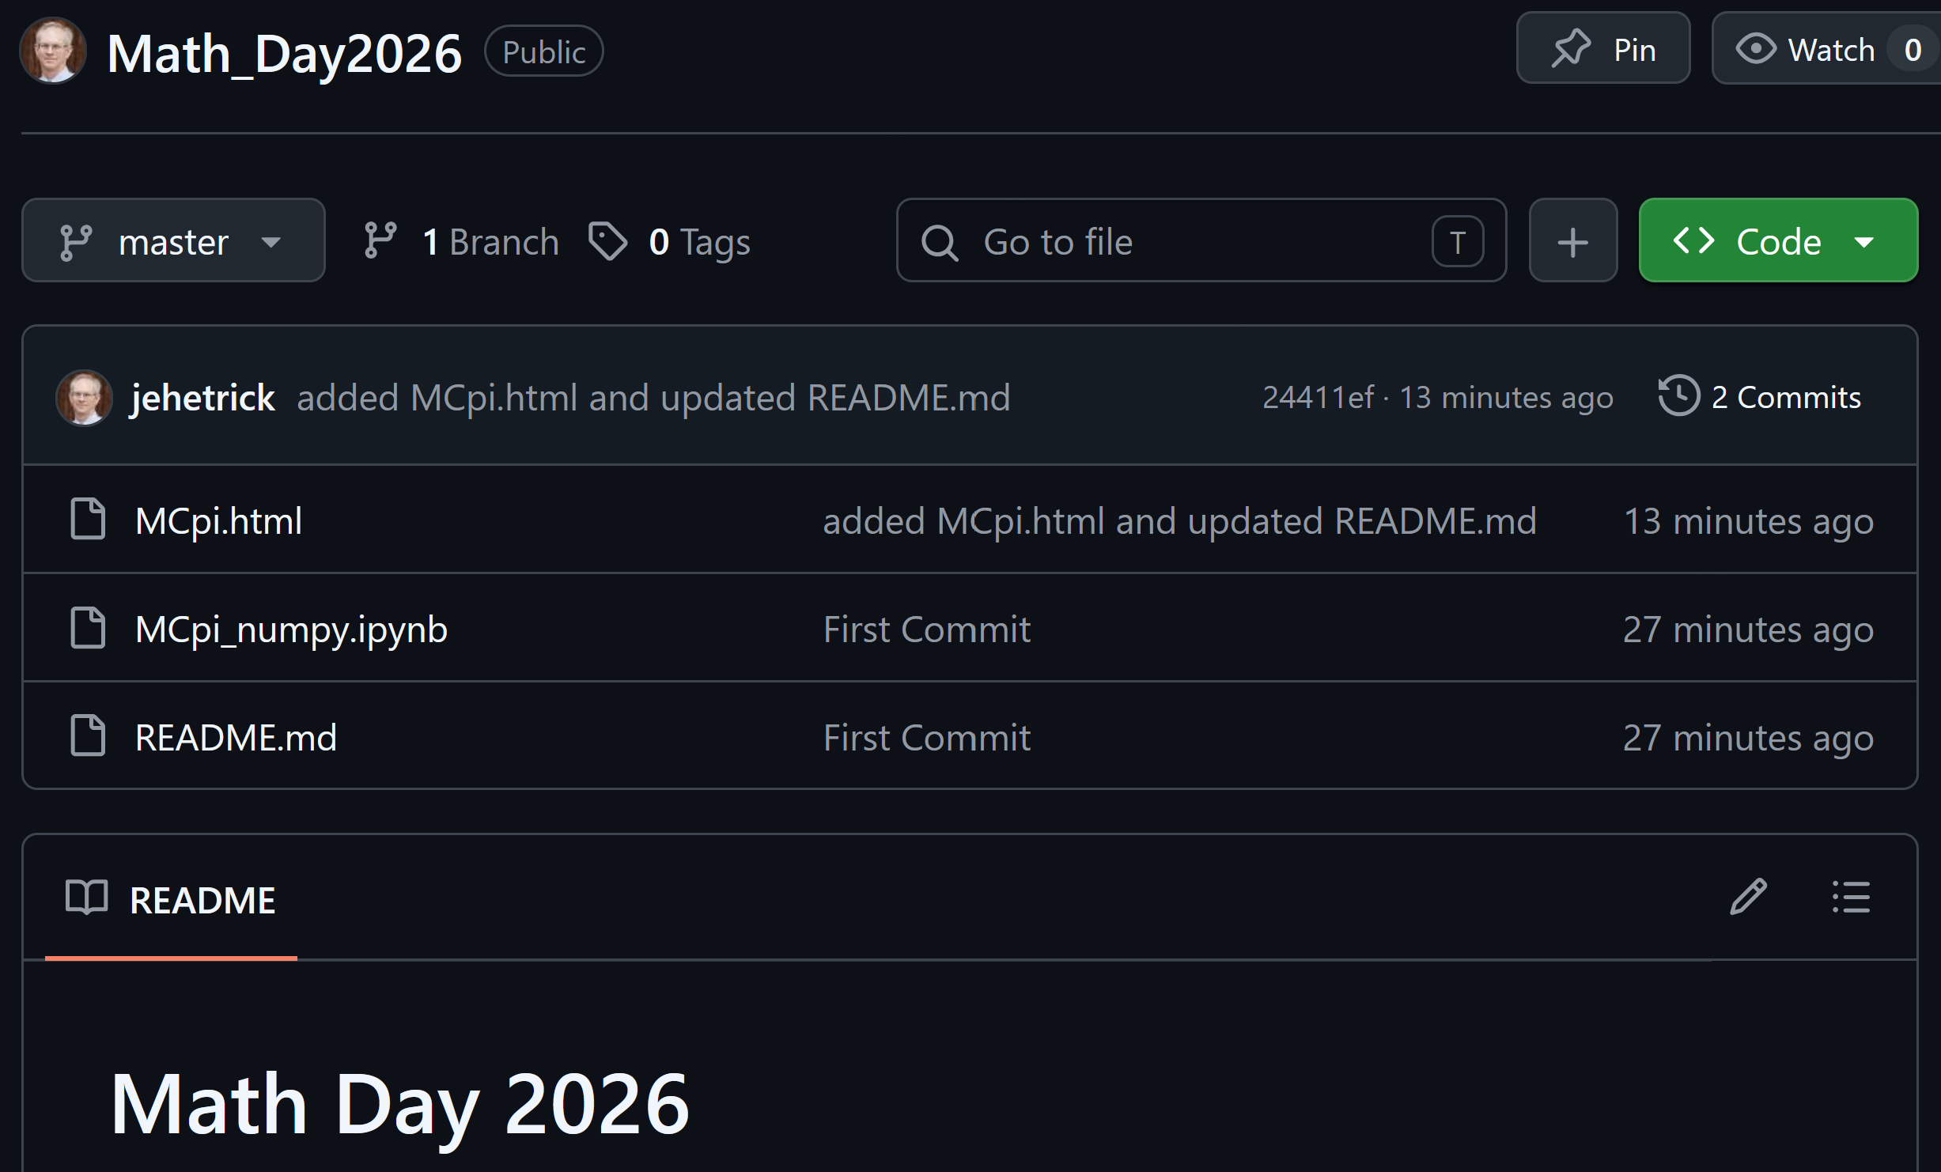

https://github.com/jehetrick/Math_Day2026

