Slide 1
Verification Framework
Test bench development and its validation
UCSD WES Cohort 9, All Rights Reserved.

Slide 2
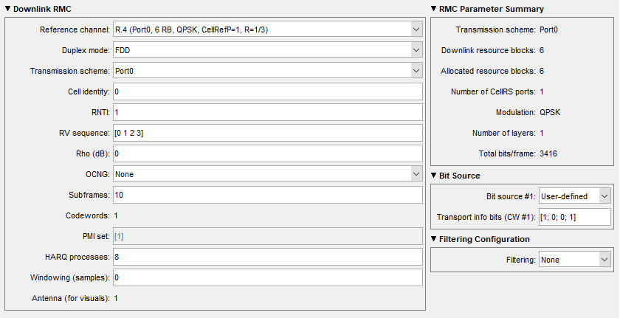
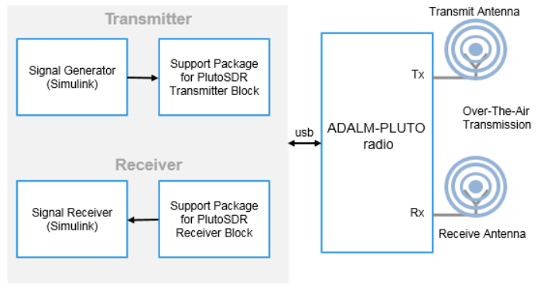
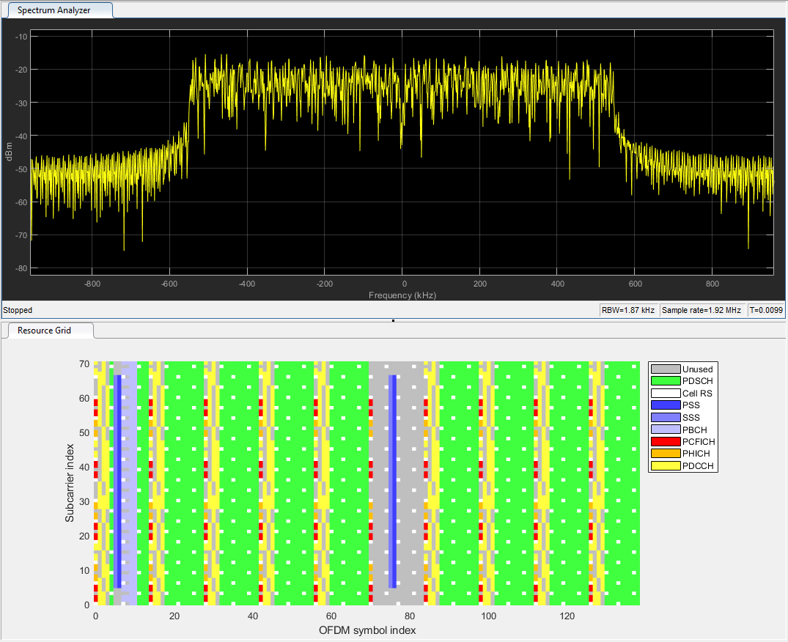
LTE Test Signal
Generate the LTE Downlink RMC waveform from LTE Waveform Generator in Matlab and export the waveform to Matlab and convert it IQ waveforms
RF coverage from 325 MHz to 3.8 GHz, with up to 20 MHz of instantaneous bandwidth
One transmitter and one receiver, half or full duplex
Reference Links:
https://github.com/analogdevicesinc/TransceiverToolbox/tree/pluto_lte_app/trx_examples/streaming/LTE_PA_App
https://plutosdr.org/lte-enb-transmitter-conformance-tests-using-adalm-pluto/
https://www.mathworks.com/help/supportpkg/plutoradio/ref/plutoreceiver.html
UCSD WES Cohort 9, All Rights Reserved.

Slide 3
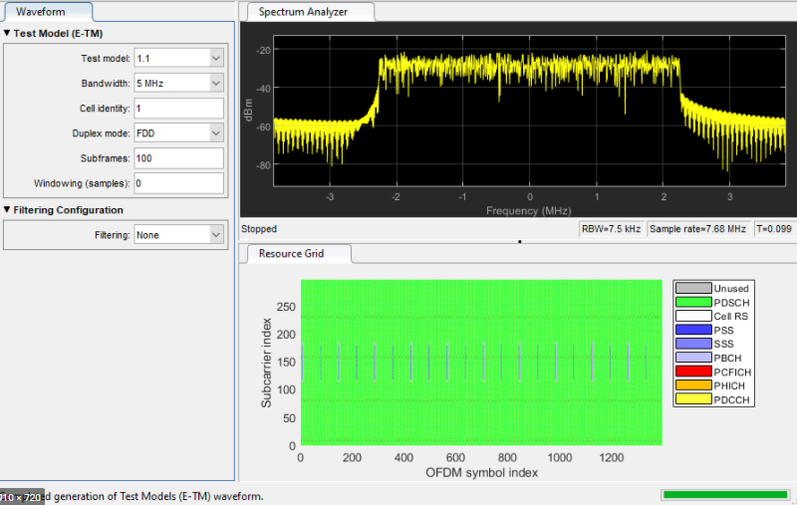
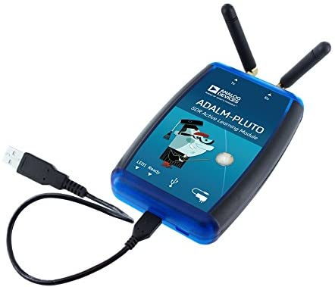
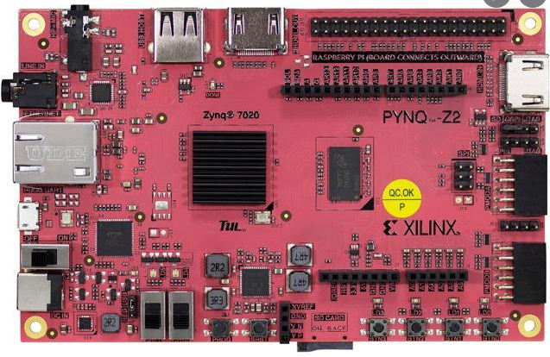
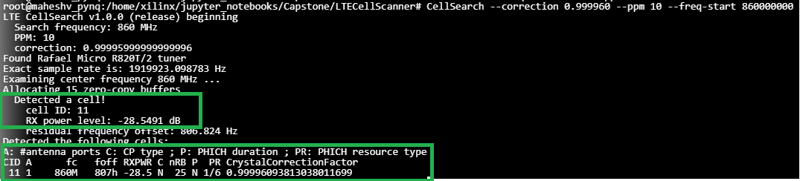
Test Bench Demo
UCSD WES Cohort 9, All Rights Reserved.
RTL
Digitizer
LTE Cell scanner open-source software from GitHub
First verified with NAR bands – 900MHz, able to detect different MIB’s from different Cells
Picked non-NAR region band – 860MHz to generate LTE Test signal
Generated LTE Test signal using Matlab– 5MHz, 25 RB, 64QAM, Cell ID: 11 with PSS, SSS, PBCH.
Exported this signal to MatLab to play from Pluto SDR
Play LTE test signal continuously from Pluto SDR and run cell search algorithm in PYNQ to capture the transmitted LTE test signal

Slide 4
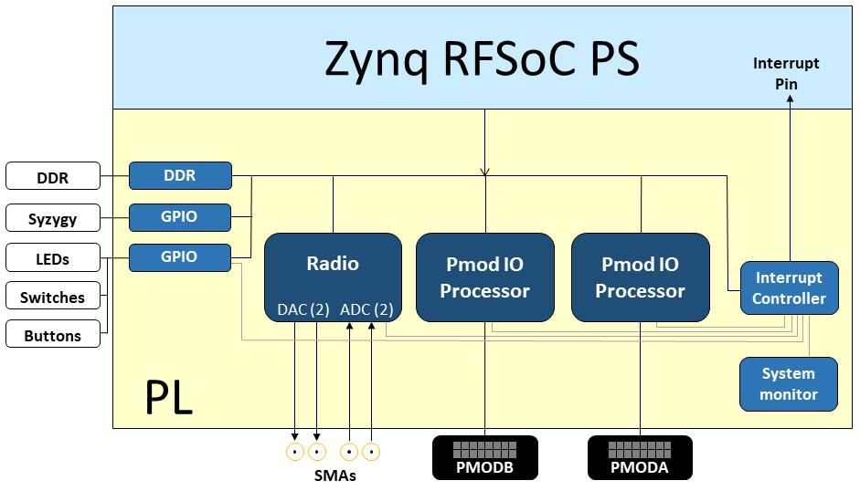
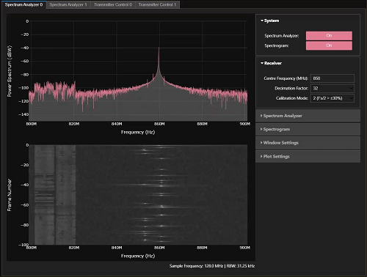
Spectrum Analyzer
RFSoC 2x2 overlays
The base overlay is included in the PYNQ image for the RFSoC 2x2 board
The base design includes a bitstream with IP which allows to use the RF ADCs and DACs on the board
Up to 2 GHz bandwidth for inspection
Inspect range 0 - 4.096 GHz
Adaptive bandwidth control and center frequency selection
Reprogrammable windowing
Hardware accelerated processing (time domain → frequency domain → power spectrum [dB])
PYNQ abstracted allowing Python to interface with the hardware
Plotly visualization of spectrum and spectrogram (waterfall)
Simple dashboard for more convenient control/visualization
Reference Links:
https://www.rfsoc-pynq.io/overlays.html
https://www.rfsoc-pynq.io/base_overlay.html
git clone https://github.com/Xilinx/RFSoC2x2-PYNQ.git
https://github.com/strath-sdr/rfsoc_sam
https://github.com/strath-sdr/rfsoc_ofdm
UCSD WES Cohort 9, All Rights Reserved.

