Slide 1


System Requirements and Configurations
ADC Configuration
Decimation
8x decimation in RF Soc. From 3932.16MHz to 491.52MHz.
256x decimation in our custom IP to achieve Fs of 1.92MHz at LTE Cell search IP.
NCO (Numerically Controlled Oscillator)
48-bit NCO per RF-ADC.
Mixer is programmed to fine mode.
ADC Fs is configured to 3932.16MHz as it is a multiple of 30.72MHz (LTE Rate). Reference ADC clock needed 491.52MHz.
RF SoC supports Fs in range of 1024 MHz - 4096 MHz.
Our LTE Cell search IP needs Fs of 1.92MHz.
NCO configured to down convert carrier frequency to DC.
Our System needs decimation of 2048.
UCSD WES Cohort 9, All Rights Reserved.
Notes:
Time: 20 Secs, Presenter: Jeff
There are three main components of the platform configuration.
1. ADC Sampling: The sampling rate of the on board ADC is configured to 3932.16MHz because it is multiple of LTE standard sampling rate.
2. Decimation: The hardware IP requires a sampling frequency of 1.92MHz. As a result, the system requires several stages of decimation.
3. Numerically Controlled Oscillator: The NCO is runtime configured to down convert the carrier frequency to DC.

Slide 2

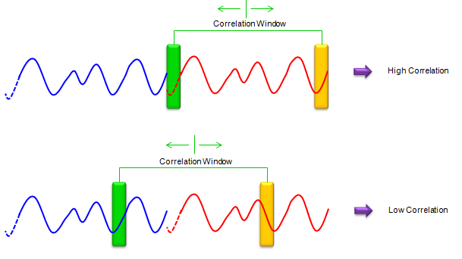
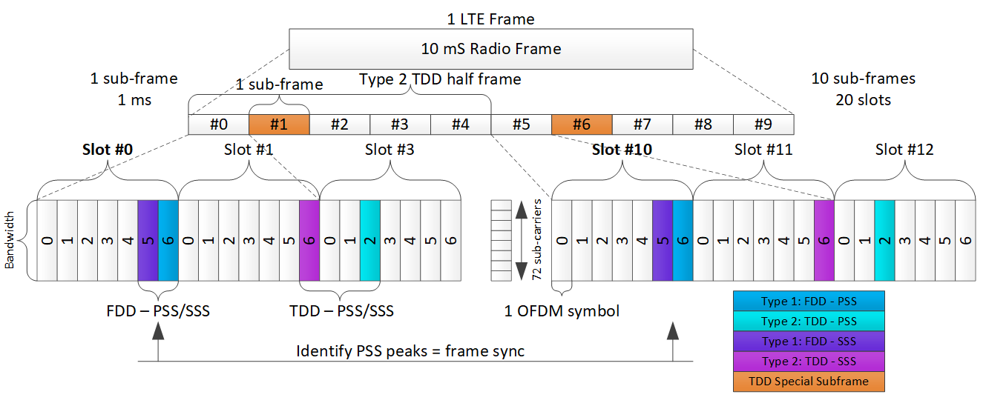
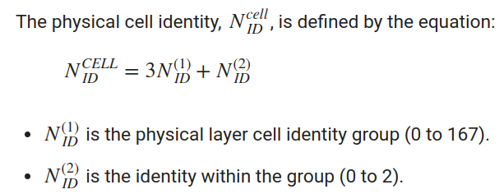
Main LTE Blocks – For Cell Search
CP Correlation
Cyclic Prefix is an exact copy of the last part of OFDM symbol
PSS
SSS
Correlation in frequency domain by taking 128-point FFT on Rx Symbol.
IFFT to get time domain sequences which reduces HW complexity.
3 Zadoff-Chu root sequences defined in Frequency domain.
Correlate Rx signal with 3 known time domain PSS sequences.
1 of 168 known sequences.
Polynomial based 3 binary sequences on Galois field.
UCSD WES Cohort 9, All Rights Reserved.
Notes:
Time: 40 Secs, Presenter: Jeff
CP, PSS and SSS correlations are the 3 main operations performed.
1. Cyclic Prefix is an exact copy of the last part of OFDM symbol, we used this property to estimate frequency offset.
PSS sequences have special properties used for correlation. The LTE standard defines 3 such sequences. The received PSS is detected by performing correlation between the input signal and all 3 possible sequences. The highest correlation peaks identify the PSS locations and provide input to generate the Cell ID.
3. There are 168 possible SSS sequences. After detecting the PSS, the SSS symbol locations become known. The hardware performs a 128 point FFT on this symbol. Correlating the 168 possible binary sequences with the SSS symbol identifies the physical layer cell identity group used for calculating the Cell ID.

Slide 3
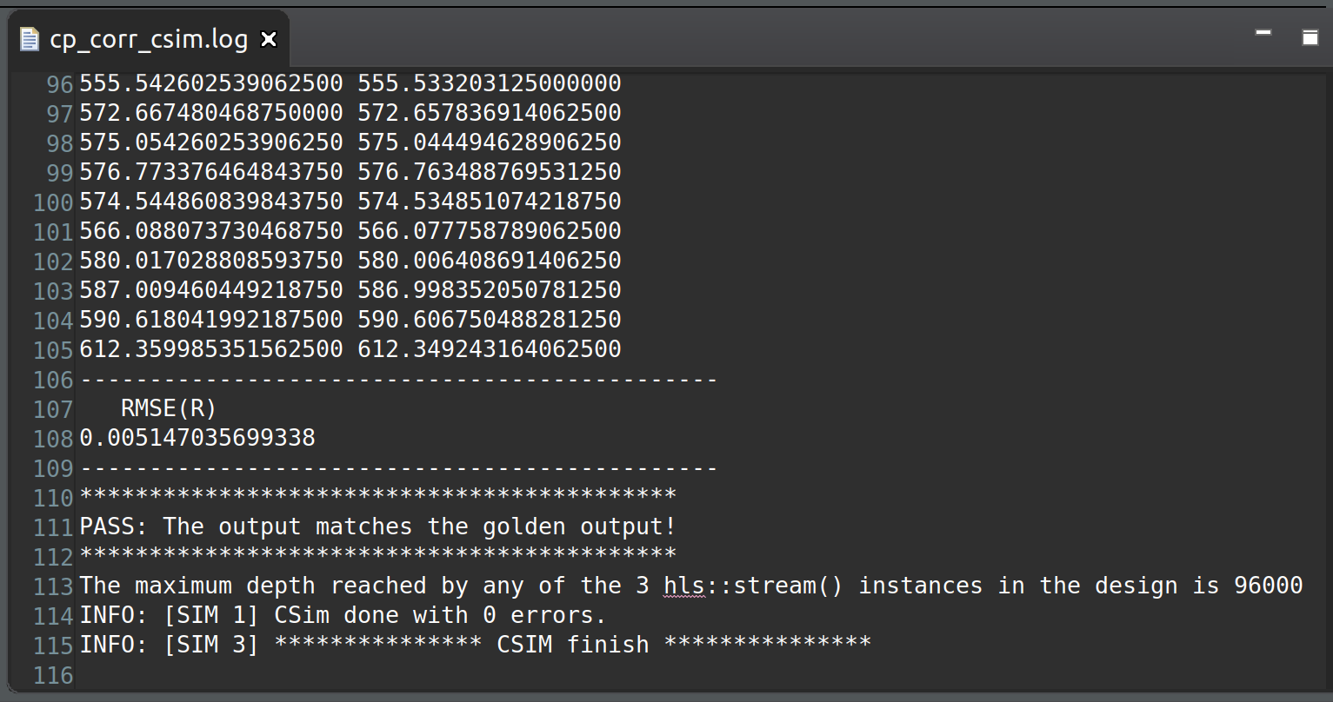
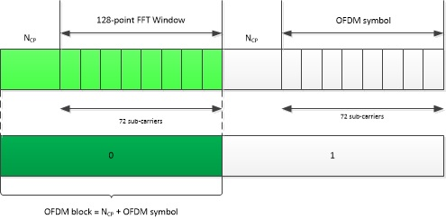

Frequency Estimation
Test Bench: Verified HLS code with Matlab Simulated results
Identify data to recover
f_{s} = 1.92MHz, OFDM symbol = 128 samples
N_{CP} > L, Channel impulse response
CP = Cyclic Prefix, reduce likelihood of Inter-symbol Interference (ISI)
UCSD WES Cohort 9, All Rights Reserved.
Notes:
CP Correlation, PSS and SSS are 3 main blocks of LTE Cell search.
To find the start of the OFDM Symbol we need to locate the Cyclic Prefix position in the LTE frame.
We know that cyclic Prefix is an exact copy of the last part of OFDM symbol, implemented algorithm in PL to achieve this.
We know, PSS is 62 symbols long. Need to perform complex multiplications with 3 sets of Zadoff-Chu root sequences, complex FFT and IFFT’s to get time domain sequences.
Secondary synchronization signals are one of 168 codes which are 62-bit sequences

Slide 4
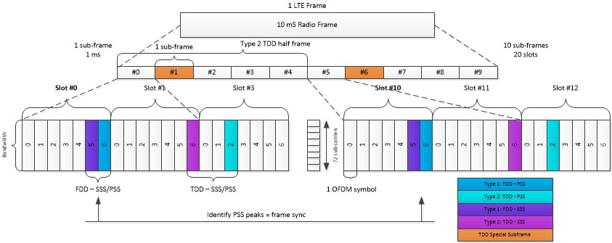
Synchronization
Structure of LTE frame
Identify 2 peaks over 10 slots (1 frame)
Keep searching for pair of peaks to maintain sync using threshold detect - maintain sync
Identify PSS / SSS to decode the Cell ID
UCSD WES Cohort 9, All Rights Reserved.
Notes:
CP Correlation, PSS and SSS are 3 main blocks of LTE Cell search.
To find the start of the OFDM Symbol we need to locate the Cyclic Prefix position in the LTE frame.
We know that cyclic Prefix is an exact copy of the last part of OFDM symbol, implemented algorithm in PL to achieve this.
We know, PSS is 62 symbols long. Need to perform complex multiplications with 3 sets of Zadoff-Chu root sequences, complex FFT and IFFT’s to get time domain sequences.
Secondary synchronization signals are one of 168 codes which are 62-bit sequences

Slide 5
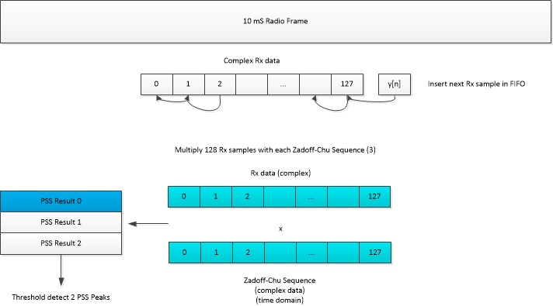
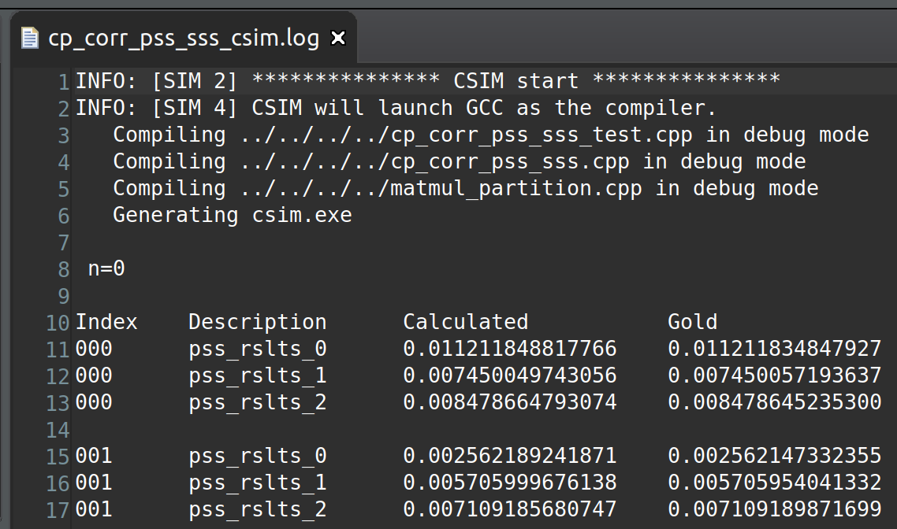
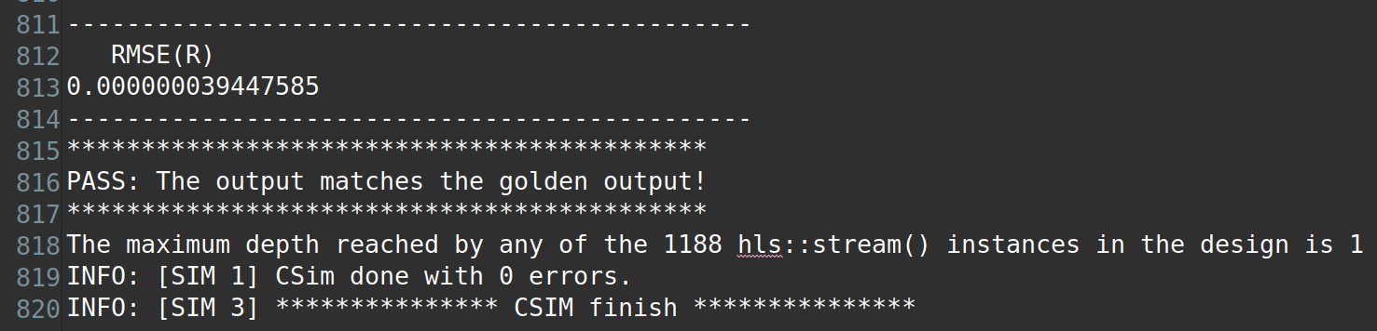
Synchronization - PSS
Test Bench: Verified HLS code with Matlab Simulated results
Identity within the group (0 to 2)
Identify known sequence in Rx data
1 of 3 possible Zadoff-Chu sequences
Part 1 of getting Physical Cell ID (504 Unique IDs)
Complex multiply: Rx data and Zadoff-Chu sequences (converted to time domain)
Threshold detection to determine correlation peaks
UCSD WES Cohort 9, All Rights Reserved.
Notes:
CP Correlation, PSS and SSS are 3 main blocks of LTE Cell search.
To find the start of the OFDM Symbol we need to locate the Cyclic Prefix position in the LTE frame.
We know that cyclic Prefix is an exact copy of the last part of OFDM symbol, implemented algorithm in PL to achieve this.
We know, PSS is 62 symbols long. Need to perform complex multiplications with 3 sets of Zadoff-Chu root sequences, complex FFT and IFFT’s to get time domain sequences.
Secondary synchronization signals are one of 168 codes which are 62-bit sequences

Slide 6
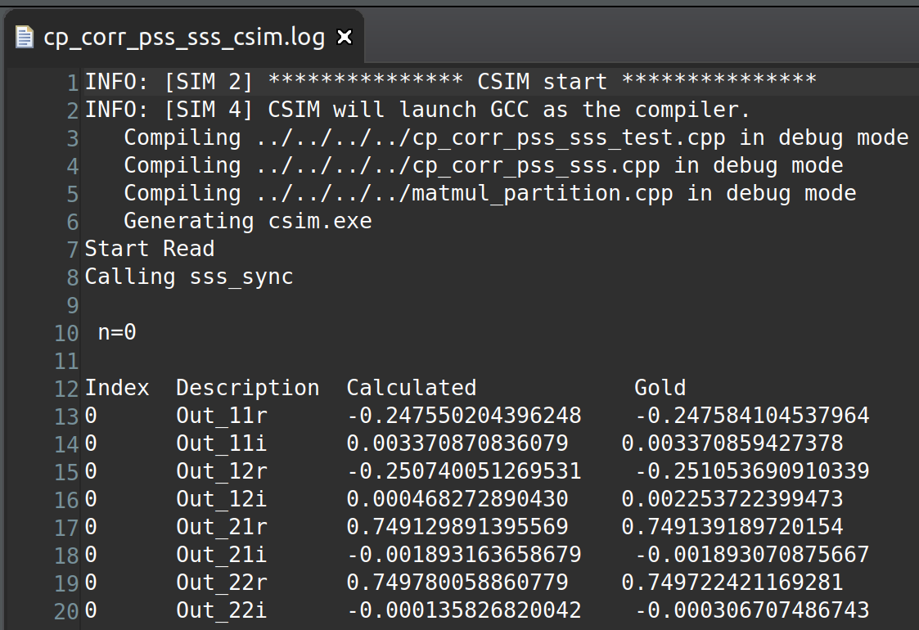
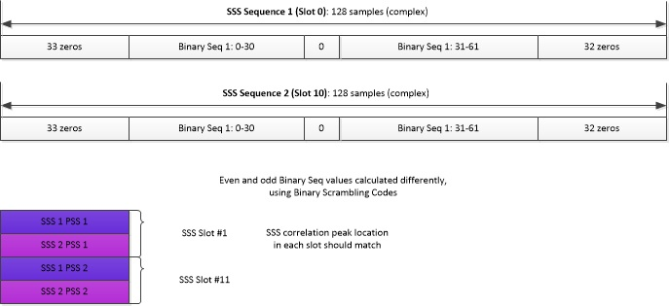
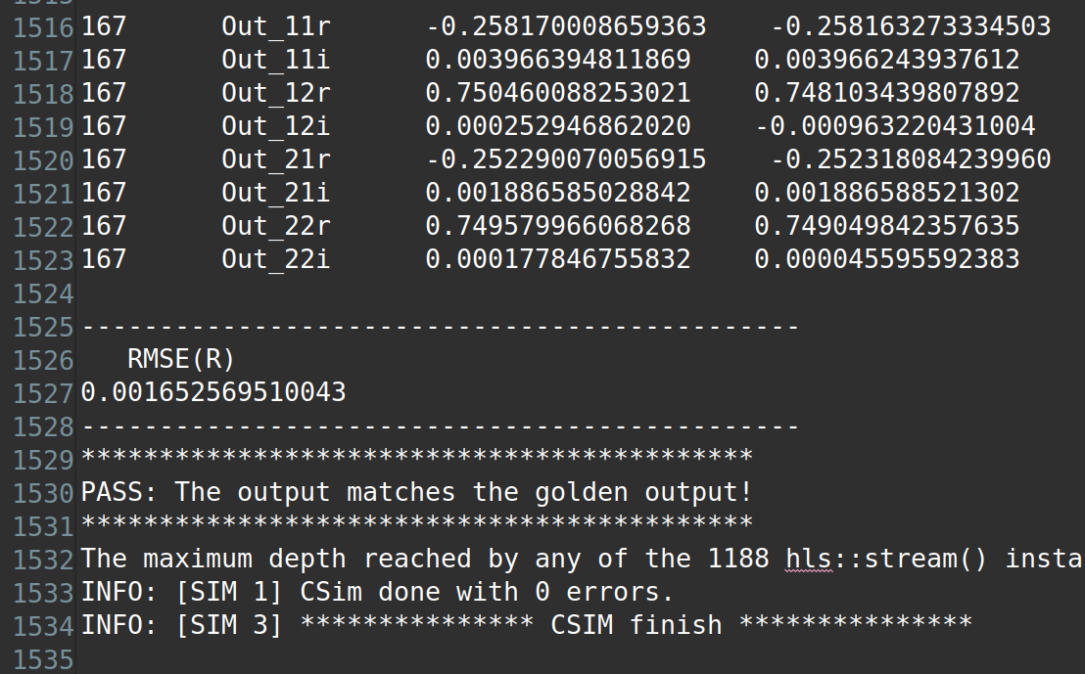
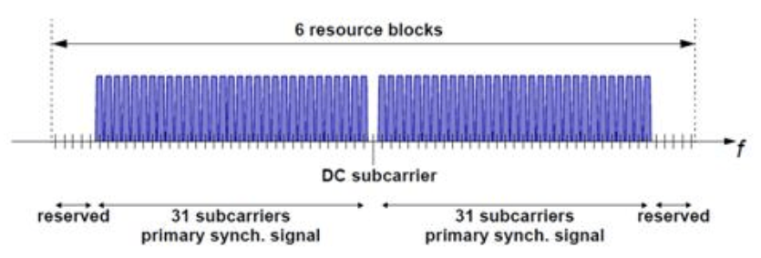
Synchronization - SSS
Test Bench: Verified HLS code with Matlab Simulated results
1 symbol: 128 samples
e.g. SSS 1 PSS 1 = SSS Seq 1 * PSS symbol samples
Physical layer cell identity group (0 to 167)
FFT to demodulate OFDM data
SSS Correlation: Multiply and accumulate 2 SSS Sequences (binary scrambling codes)
Demodulated Rx data
Threshold detection to determine correlation peaks
Peak location range [0 167] = physical layer identity group
UCSD WES Cohort 9, All Rights Reserved.
Notes:
CP Correlation, PSS and SSS are 3 main blocks of LTE Cell search.
To find the start of the OFDM Symbol we need to locate the Cyclic Prefix position in the LTE frame.
We know that cyclic Prefix is an exact copy of the last part of OFDM symbol, implemented algorithm in PL to achieve this.
We know, PSS is 62 symbols long. Need to perform complex multiplications with 3 sets of Zadoff-Chu root sequences, complex FFT and IFFT’s to get time domain sequences.
Secondary synchronization signals are one of 168 codes which are 62-bit sequences

