Slide 1
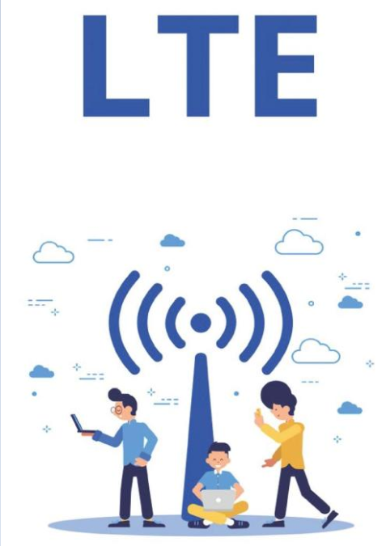
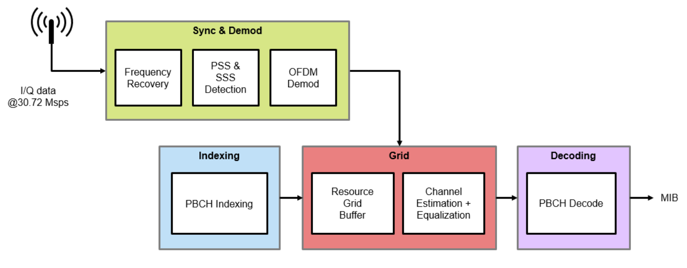
Project: LTE Cell Search Cohort 9
Team: The Correlators
Jeffrey High
Mahesh Valavala
Satish Nichanametla Shubhadip Paul
UCSD WES Cohort 9, All Rights Reserved.
Notes:
Time: 5 Secs. Presenter: Mahesh
Hello Everyone, our project goal is to develop an embedded system that performs LTE cell search. Let’s hop over to content of the project.
1

Slide 2

What is LTE Cell search about?
UCSD WES Cohort 9, All Rights Reserved.
LTE stands for Long Term Evolution and referred as 4G LTE. It's a standard for wireless data transmission.
A Physical Cell ID (PCI) is an important parameter to establish connection with LTE network
Establish time and frequency synchronization with LTE signals and extract cell ID.
To decode LTE cell ID, Primary Synchronization Signal (PSS) and Secondary Synchronization Signal (SSS) signals should be decoded.
Xilinx Zynq® UltraScale+™ RFSoC with giga sample RF data converters is used.
Notes:
Time: 40 Secs, Presenter: Mahesh
1. What is LTE Cell search about? LTE stands for Long Term Evolution and referred as 4G LTE. It's a standard for wireless data transmission. In LTE standard, Cell ID is an important parameter to establish connection with LTE network.
2. Cell search and selection is the first step taken by cell phone in attempting to gain access to an LTE network. LTE standard provides Primary Synchronization Signals and Secondary Synchronization Signals to aid the cell search process.
3. With that said, our project goal is to receive LTE signals and establish time and frequency synchronization and extract cell ID.
4. Xilinx RFSoC is used for this project which helps to directly move from RF domain to the digital domain.

Slide 3

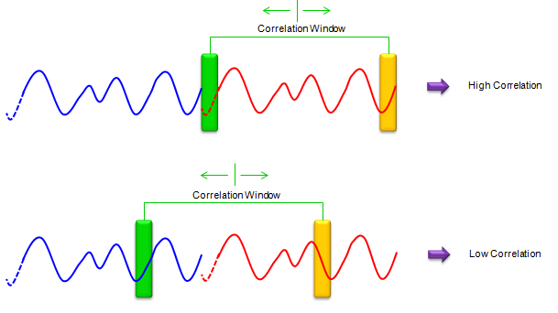
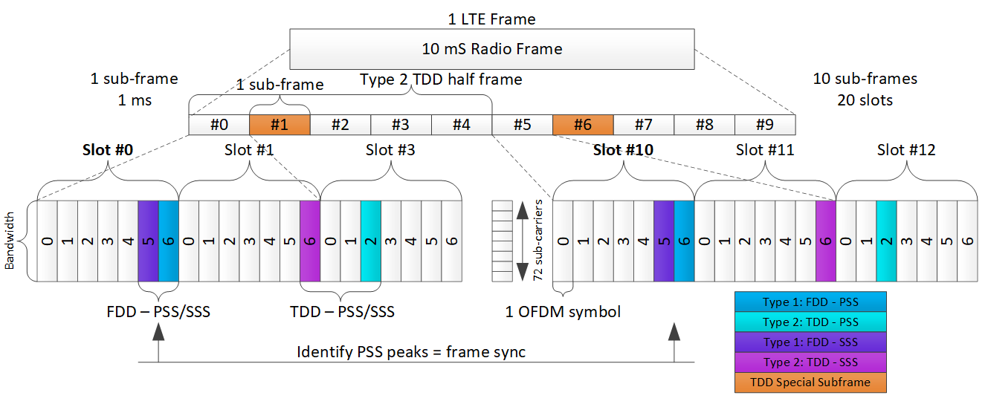
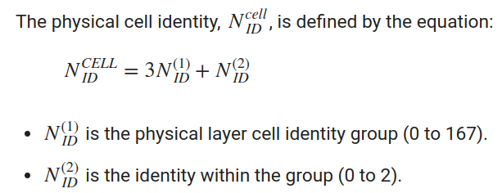
Main LTE Blocks – For Cell Search
UCSD WES Cohort 9, All Rights Reserved.
CP Correlation
Cyclic Prefix is an exact copy of the last part of OFDM symbol
PSS
SSS
Correlation in frequency domain by taking 128-point FFT on Rx Symbol.
IFFT to get time domain sequences which reduces HW complexity.
3 Zadoff-Chu root sequences defined in Frequency domain.
Correlate Rx signal with 3 known time domain PSS sequences.
1 of 168 known sequences.
Polynomial based 3 binary sequences on Galois field.
Notes:
Time: 40 Secs, Presenter: Jeff
CP, PSS and SSS correlations are the 3 main operations performed.
1. Cyclic Prefix is an exact copy of the last part of OFDM symbol, we used this property to estimate frequency offset.
PSS sequences have special properties used for correlation. The LTE standard defines 3 such sequences. The received PSS is detected by performing correlation between the input signal and all 3 possible sequences. The highest correlation peaks identify the PSS locations and provide input to generate the Cell ID.
3. There are 168 possible SSS sequences. After detecting the PSS, the SSS symbol locations become known. The hardware performs a 128 point FFT on this symbol. Correlating the 168 possible binary sequences with the SSS symbol identifies the physical layer cell identity group used for calculating the Cell ID.

Slide 4

System Requirements and Configurations
UCSD WES Cohort 9, All Rights Reserved.
ADC Configuration
Decimation
8x decimation in RF Soc. From 3932.16MHz to 491.52MHz.
256x decimation in our custom IP to achieve Fs of 1.92MHz at LTE Cell search IP.
NCO (Numerically Controlled Oscillator)
48-bit NCO per RF-ADC.
Mixer is programmed to fine mode.
ADC Fs is configured to 3932.16MHz as it is a multiple of 30.72MHz (LTE Rate). Reference ADC clock needed 491.52MHz.
RF SoC supports Fs in range of 1024 MHz - 4096 MHz.
Our LTE Cell search IP needs Fs of 1.92MHz.
NCO configured to down convert carrier frequency to DC.
Our System needs decimation of 2048.
Notes:
Time: 20 Secs, Presenter: Jeff
There are three main components of the platform configuration.
1. ADC Sampling: The sampling rate of the on board ADC is configured to 3932.16MHz because it is multiple of LTE standard sampling rate.
2. Decimation: The hardware IP requires a sampling frequency of 1.92MHz. As a result, the system requires several stages of decimation.
3. Numerically Controlled Oscillator: The NCO is runtime configured to down convert the carrier frequency to DC.

Slide 5
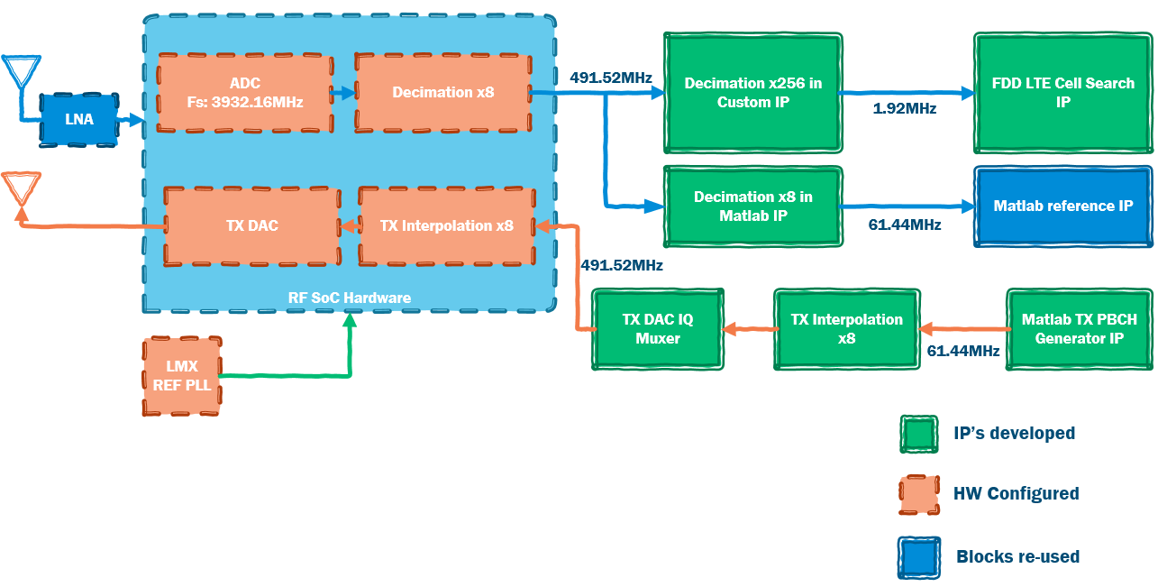
UCSD WES Cohort 9, All Rights Reserved.
LTE Cell Search - System Block Diagram
Notes:
Time: 40 Secs, Presenter: Satish
Our system supports, two modes, loop back and receiver only mode.
In Rx path, we receive LTE signal at approximately 3GHz sampling rate with NCO(numerically controlled oscillator) configured to carrier frequency. Our system needs a total decimation factor of 2048 of which RF Soc is configured to perform 8x decimation and the rest is performed in our custom IP. LTE cell search IP performs frequency and timing synchronization to extract Cell ID using CP, PSS and SSS information.
Tx path has two main functionalities, first one is interpolating LTE waveform and the second one is muxing I/Q onto a single channel.
5

Slide 6
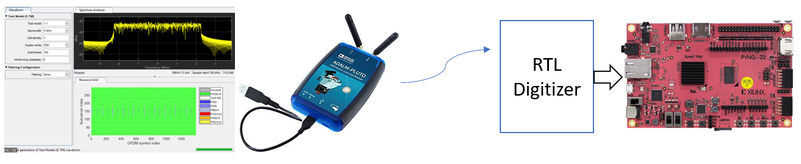
UCSD WES Cohort 9, All Rights Reserved.
LTE waveform from DAC loop back
Single Tone/CW and LTE waveform testing at various carrier frequencies.
Wireless testing with LTE waveform
LTE Cell Search Test Bench
Loop Back Mode
External Signal Generator
Pluto SDR
LTE Cell Search Test Setups
Notes:
Time: 20 Secs Presenter: Satish
For Test Bench, we brought up 3 different types of test setups
1. First one is loopback, where generated LTE waveform from DAC is fed back into ADC via SMA cables
2. Initially results with loopback mode were not as expected so we had to use external signal generator to isolate issues with platform level settings. That’s our second setup.
3. Pluto SDR setup is used for wireless testing with LTE waveform
6

Slide 7
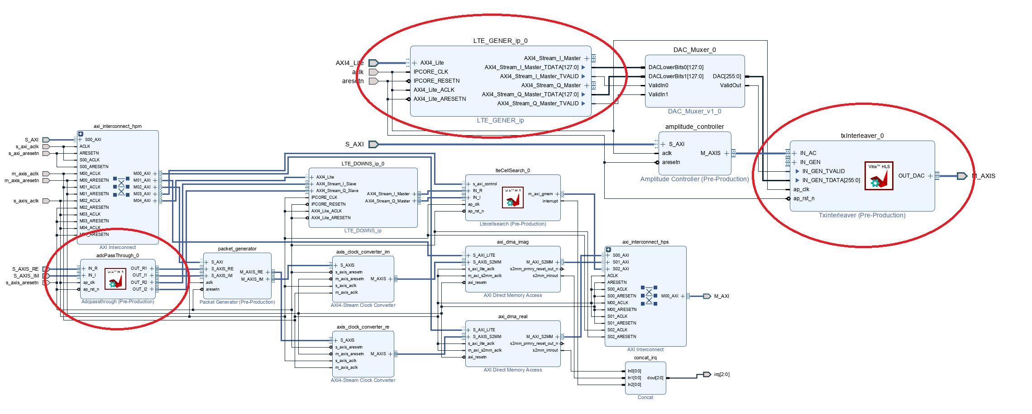

UCSD WES Cohort 9, All Rights Reserved.
FPGA IP Research
Enablement Modules :
Tx Signal Generator
Tx Inter Leaver
Rx Pass Through
VITIS HLS
Blocks - Rx Pass Through, Tx Inter Leaver
Matlab Simulink
Blocks - TX Signal Generator
IPs to be developed on FPGA and their development platforms, reference models
Notes:
Time: 20 Secs, Presenter: Shubhadip
The initial challenge we had at hand was to decide what IPs were to be developed and how to develop those…
First was a set of Enablement IPs of which Rx Pass through and TX interleaver had to be developed in VITIS as Simulink did not support 256-bit data-types needed by DAC.
The TX LTE Signal Generator needed for loopback testing was planned to be developed in Simulink so that we could leverage Matlab to generate LTE waveforms.
7

Slide 8
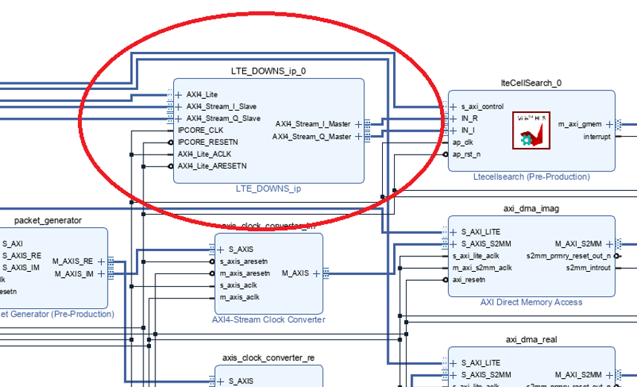
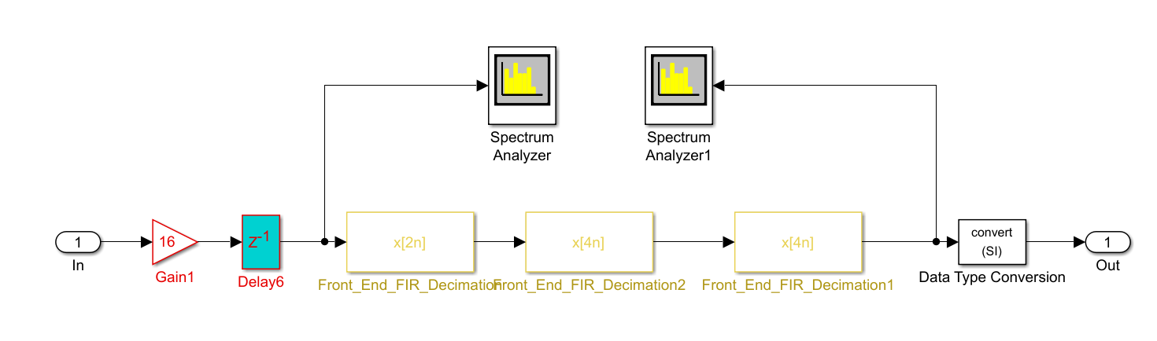
FPGA IP Research (cont’d..)
UCSD WES Cohort 9, All Rights Reserved.
Front End Module
Simulink Design
Developed using Simulink Cascade Filters
Packed ADC samples.
8 I/Q samples
Designed with MATLAB filter designer
Fs = 491.52MHz.
Outputs 1.92MHz I/Q samples
Notes:
Time: 10 Secs, Presenter: Shubhadip
Then we needed an ADC Front End which would do upto 256x decimation using a cascade of FIR filters. We planned to develop the Filters using Matlab filter designer and then generate the IP block using Simulink.
8

Slide 9
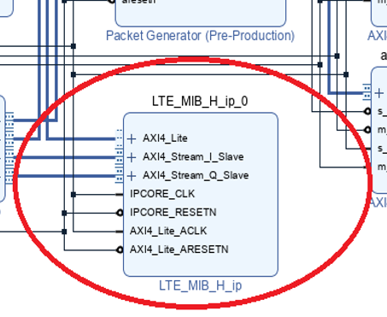
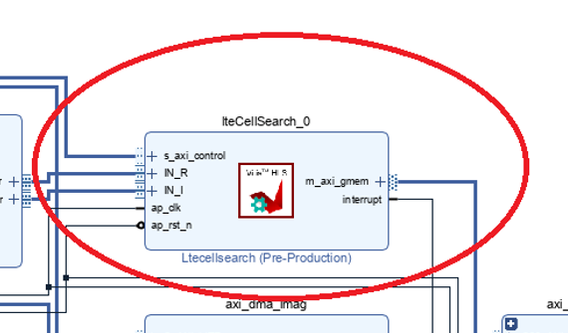
FPGA IP Research (cont’d..)
UCSD WES Cohort 9, All Rights Reserved.
Reference Module
1. Benchmark IP on CH #1
2. Used for validating the setup
3. Decided to use Simulink LTE MIB detector design
Custom Module
1. Own custom cell search algorithm on CH #2.
2. Used MATLAB to develop algorithms
3. Used VITIS HLS to implement algorithms.
Notes:
Time: 15 Secs, Presenter: Shubhadip
Then out of the 2 Primary IPs, we planned on developing the Reference IP using Simulink by leveraging the LTE HDL Cell Search Reference Design.
Our own Custom IP was planned to be developed in VITIS, as we were are more familiar with implementing algorithms on HLS.
9

Slide 10
Overlay Research
UCSD WES Cohort 9, All Rights Reserved.
Base Overlay:
1. RF SoC PYNQ image has default Base overlay.
2. The base design allows generation of bitstream with IPs to use RF ADC’s and DAC’s.
VIVADO IP Integration:
1. Added our HW IPs to base overlay and rebuild the base overlay.
2. Used ‘base.tcl’ script to generate VIVADO project with IP Integrator for the base overlay where we added our IPs.
RF Data Converters:
PYNQ Base image has notebooks to interact with Radio IP subsystem in the base overlay which allowed us to control RF Data Converters.
01_rf_dataconverter_intro.ipynb
02_rf_spectrum_analysis.ipynb
Choosing a reference overlay for RFSoC2x2 and application for implementing Cell Search
Notes:
Time: 15 Secs, Presenter: Shubhadip
Once we had the individual modules to be developed figured out, the next step was to zero down on a VIVADO overlay that we could build upon and add our modes to it.
For this we concluded on using the PYNQ Base Overlay as it provided all the low level IP blocks and Jupyter Notebooks to configure the ADC, platform settings and the RF Data Converter.
10

Slide 11

Challenges
UCSD WES Cohort 9, All Rights Reserved.
ADC Clock
IP Restart Algorithms
NCO Configurations
Bug in PYNQ base overlay wrapper NCO settings.
Fs of 3932.16MHz needed a reference clock of 491.52MHz.
Used TIC Pro TI software to generate the register settings for reference clock
In order scan over frequency, algorithms should have the ability to restart after tuning to a new frequency.
Found base reference host SW not supporting mixer in fine mode.
Register settings for this reference clock are not available
Need to ensure the IP restart would not stall design
Notes:
Time: 20 Secs, Presenter: Mahesh
We faced multiple challenges in this project, some of them are
1. Not able to find the reference LMX PLL register settings for ADC reference clock of 491.52MHz, Used TIC Pro TI software to generate the register settings for reference clock
2. Found Bug in PYNQ base overlay wrapper where it is not updating the NCO settings even though IP is supporting. Corrected it and able to configure the NCO.

Slide 12
UCSD WES Cohort 9, All Rights Reserved.
Thanks! Prof. Ryan Kastner Prof. Fred Harris Prof. John Eldon Patrick Ling
References
[1] https://www.rfsoc-pynq.io/overlays.html
[2] https://www.rfsoc-pynq.io/base_overlay.html
[3] https://github.com/Xilinx/RFSoC2x2-PYNQ.git
[4] https://github.com/strath-sdr/rfsoc_sam
[5] https://github.com/strath-sdr/rfsoc_ofdm
[6] https://www.mathworks.com/help/wireless-hdl/ug/lte-hdl-cell-search.html
[7] https://www.mathworks.com/help/lte/ug/synchronization-signals-pss-and-sss.html
[8] https://ieeexplore.ieee.org/document/599949
[9] https://www.mathworks.com/help/lte/ug/cell-search-mib-and-sib1-recovery.html
[10] https://www.sharetechnote.com/html/FrameStructure_DL.html#Overview

