Slide 1
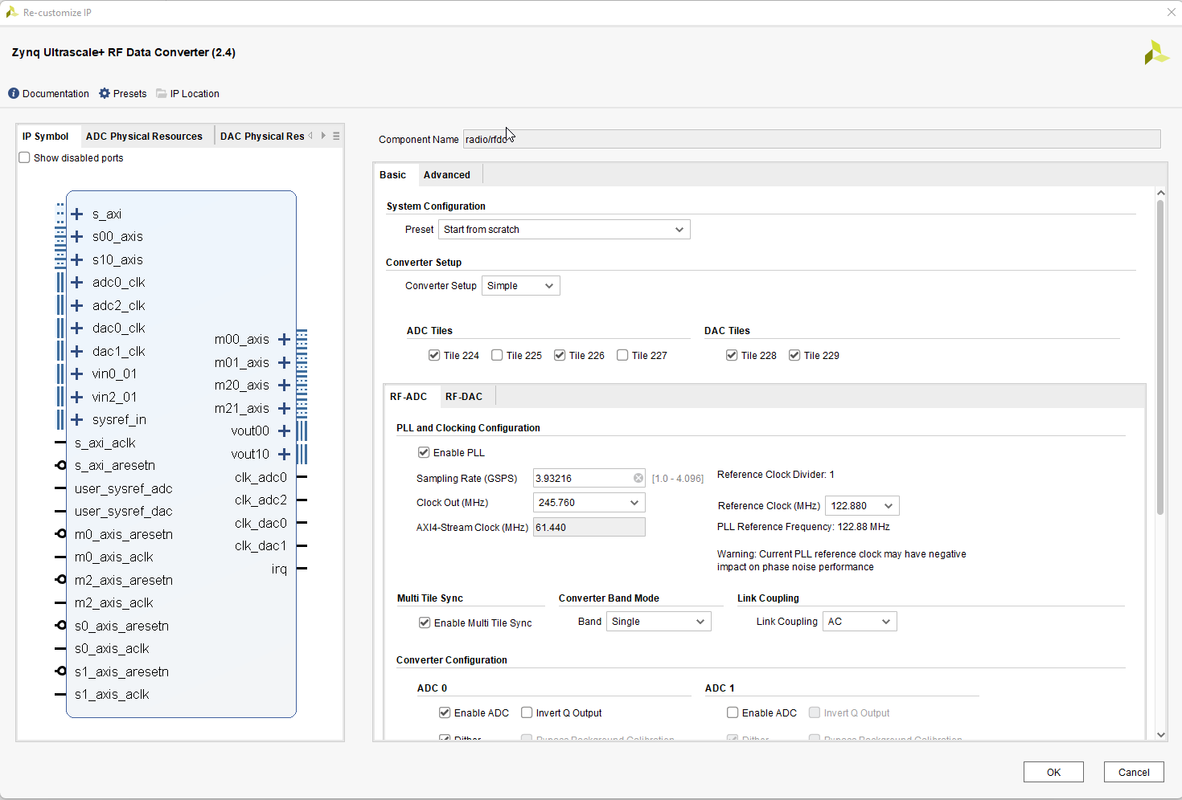
LTE Cell Search:
RF Soc - RF Data converter ADC/DAC configurations:

Slide 2
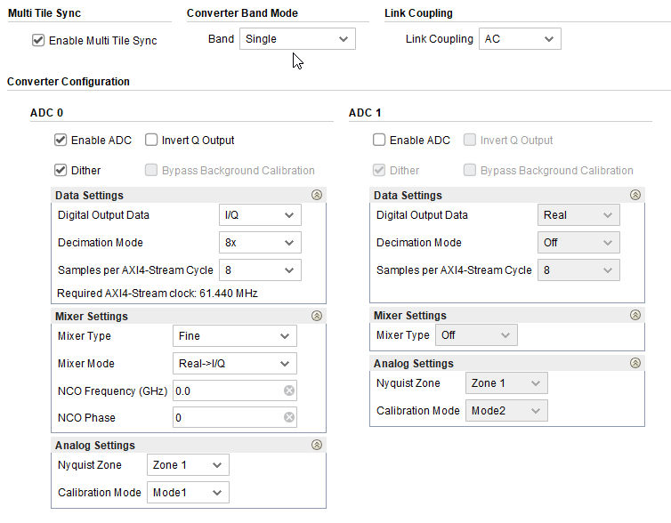
LTE Cell Search:
RF Soc - RF Data converter ADC/DAC configurations:

Slide 3
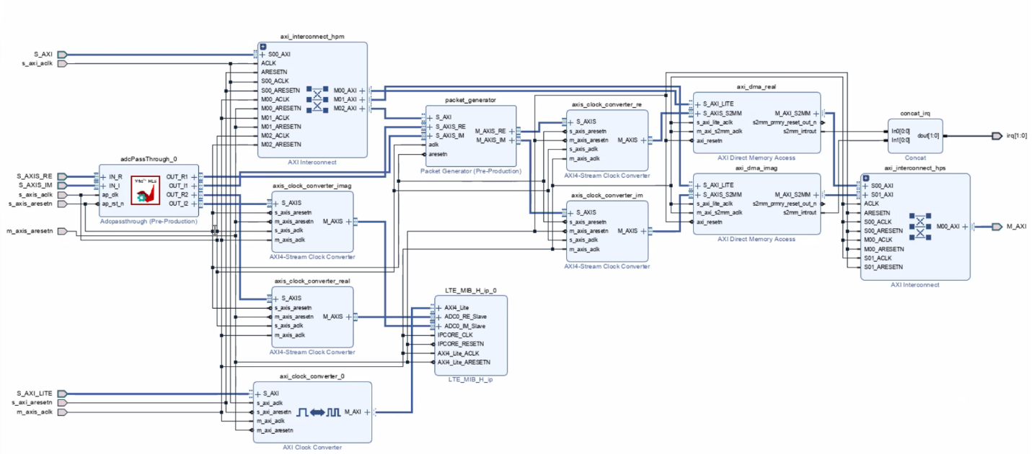
LTE Cell Search:
Figure showing the Vivado block diagram for Matlab Simulink implementation:

Slide 4
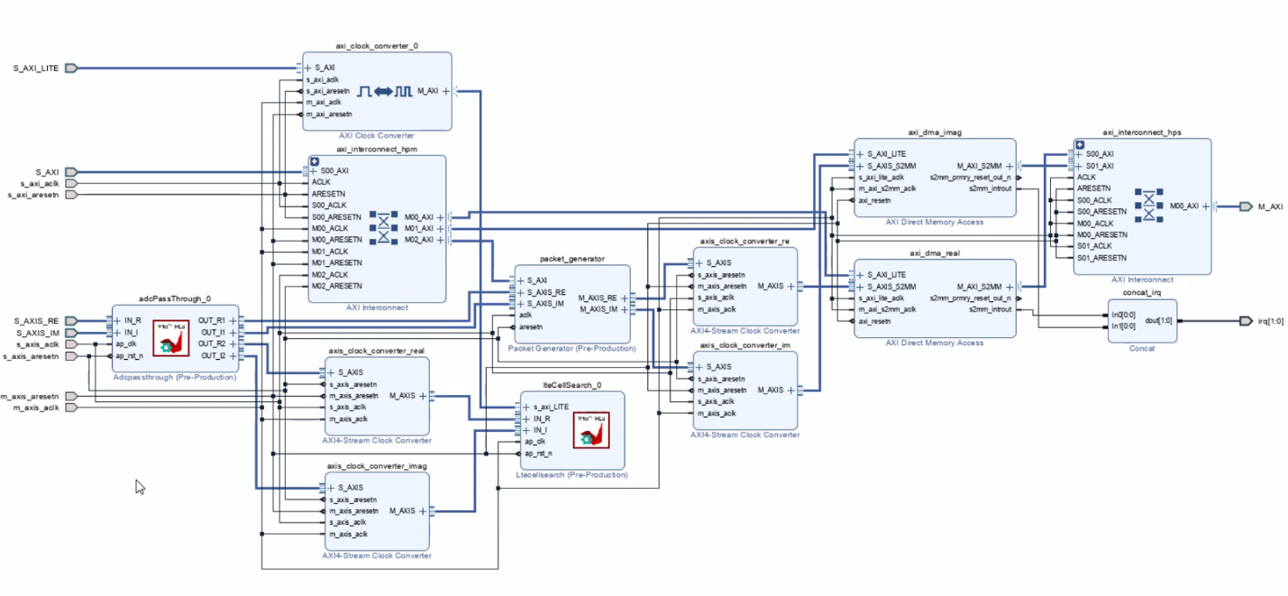
LTE Cell Search:
Figure showing the Vivado block diagram for Vitis Custom implementation:

