Slide 1
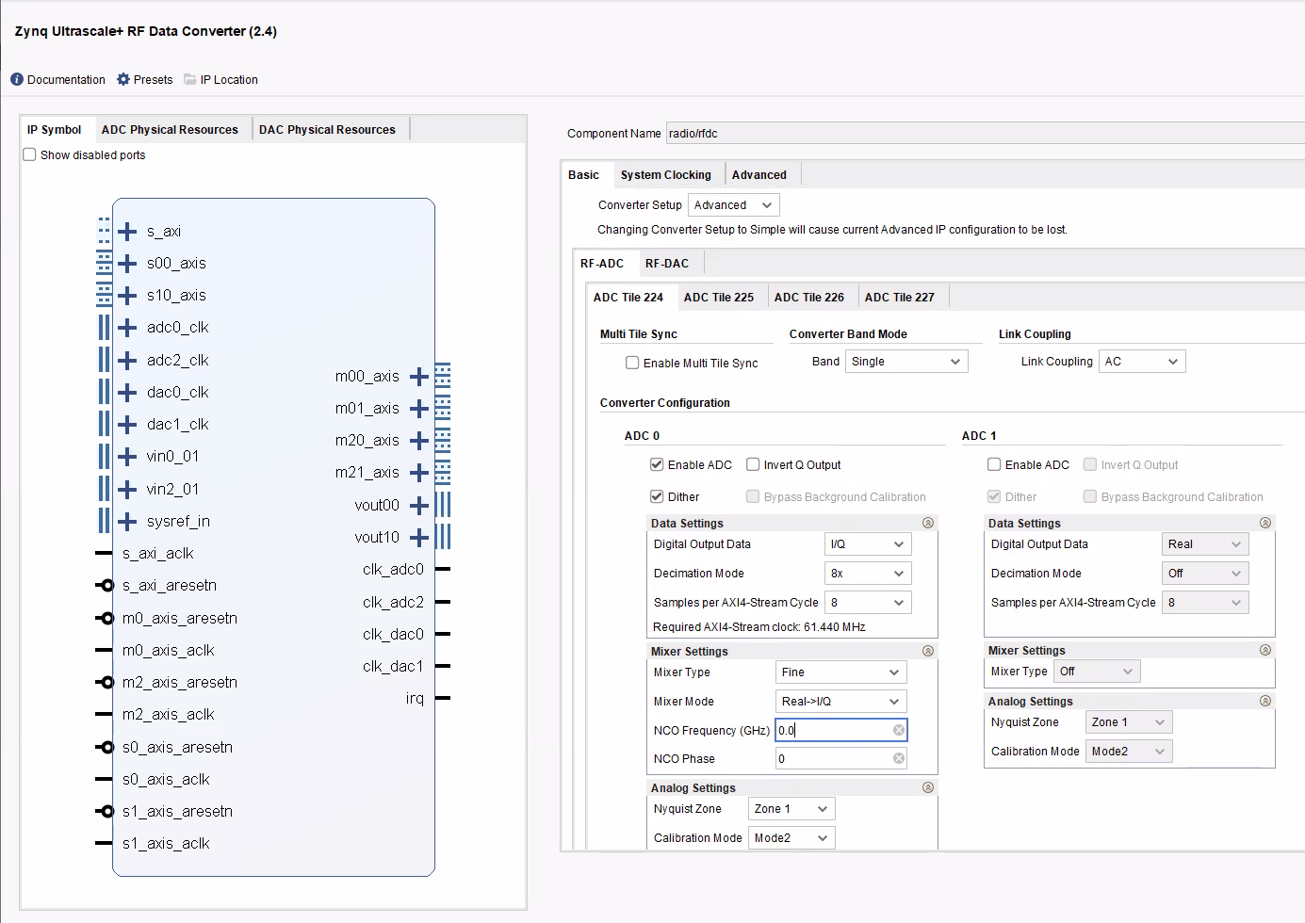
LTE Cell Search:
RF Soc - RF Data converter ADC Configurations:

Slide 2
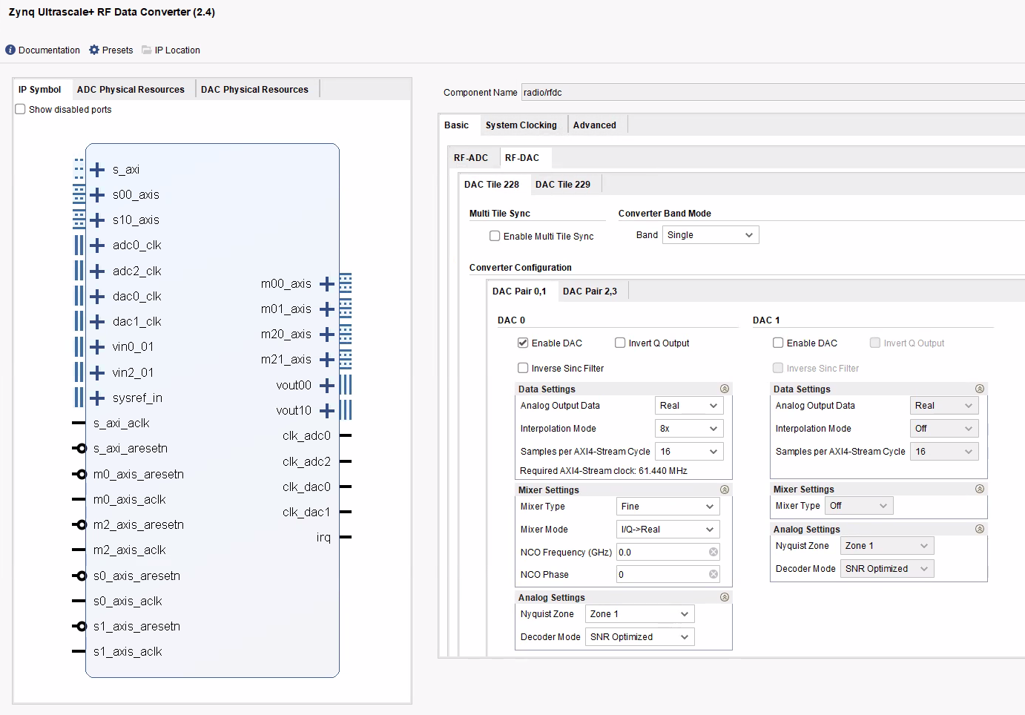
LTE Cell Search:
RF Soc - RF Data converter DAC configurations:

Slide 3
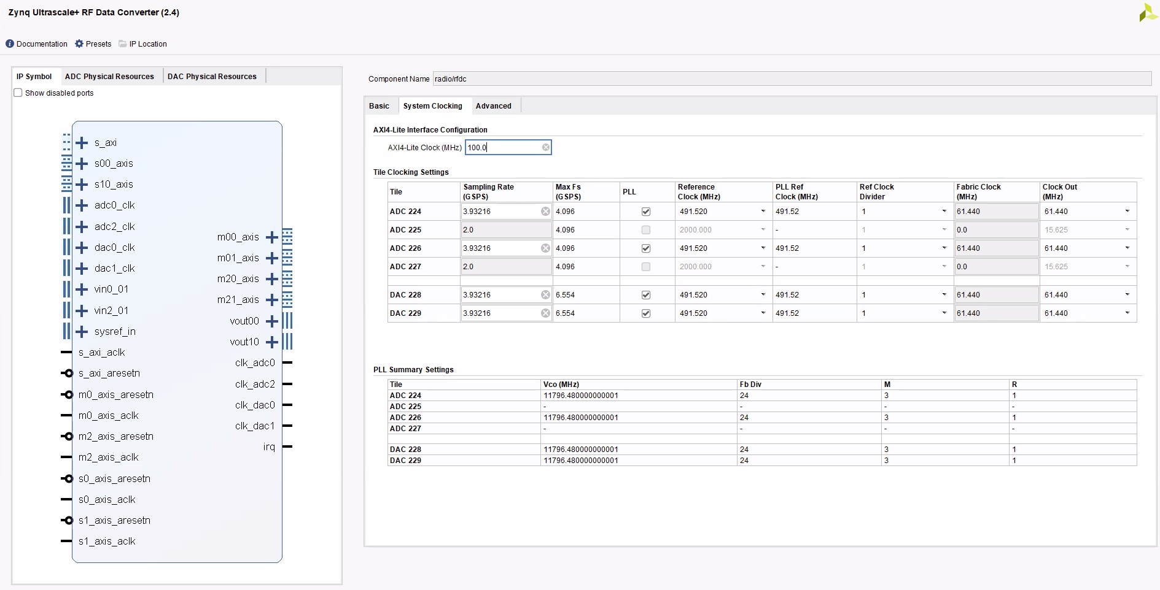
LTE Cell Search:
RF Soc - RF Data converter ADC/DAC Clock Configurations:

Slide 4
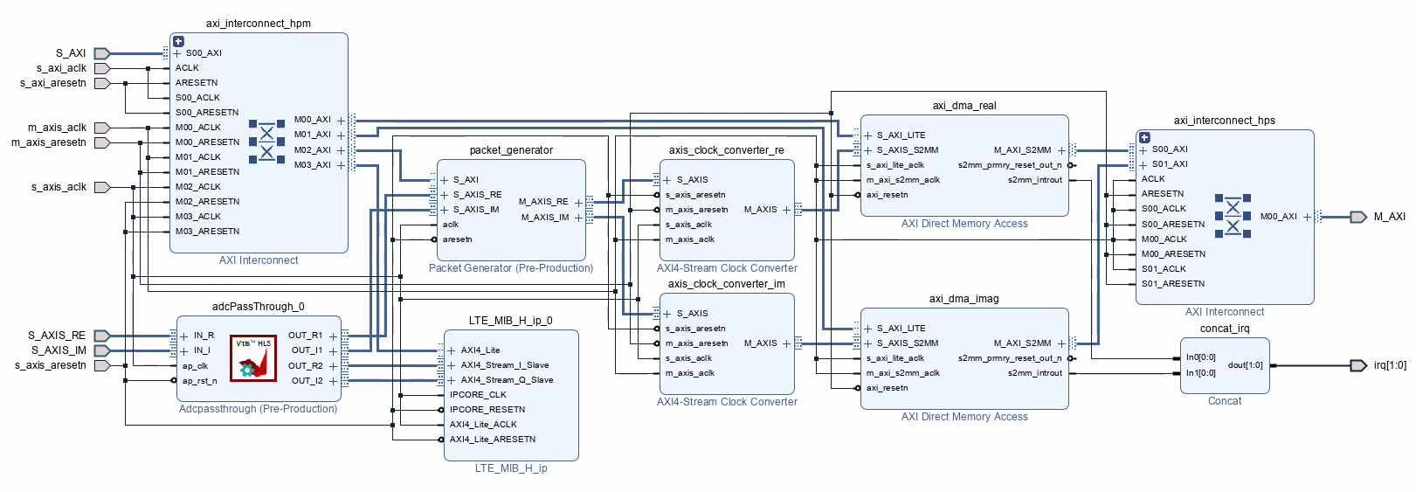
LTE Cell Search:
Vivado Block Diagram for Vitis Receiver: Reference Simulink Implementation

Slide 5
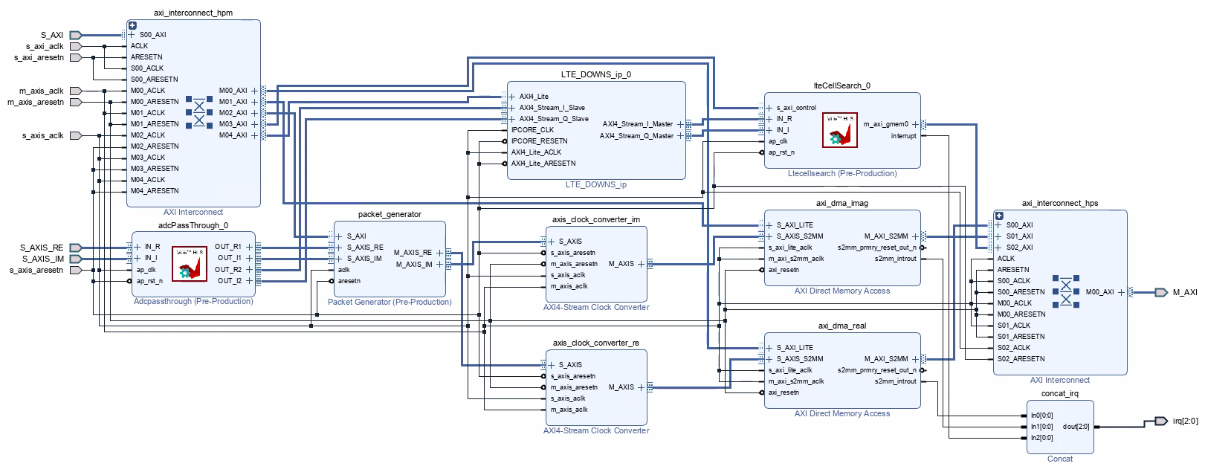
LTE Cell Search:
Vivado Block Diagram for Vitis Receiver: Custom implementation

Slide 6
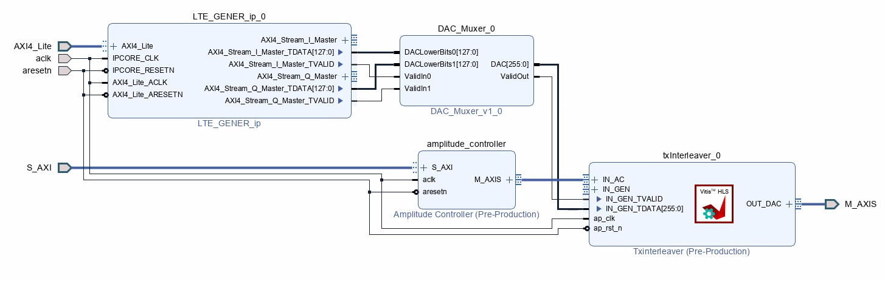
LTE Cell Search:
Vivado Block Diagram for Transmitter: Loopback Mode

