Slide 1
LTE Cell Search:
Initial Project Setup and Configuration
Board File – Parts selection (Vivado Project Setup)
Board File Installation Instructions: https://www.rfsoc-pynq.io/board_files.html
Steps used in this project (instructions/script out of date based on Vivado version)
Download: https://github.com/Xilinx/XilinxBoardStore/tree/2020.1/boards/Xilinx/rfsoc2x2/
Linux path to place files prior to starting/running Vivado: /tools/Xilinx/Vivado/2020.2/data/boards/board_files/rfsoc2x2/1.1
New Project: Browse Board tab menu (not Parts) to locate the board file configuration.
Follow Installation Instructions:
Linux steps may vary to generate similar results
https://github.com/jehigh-sd/LTE_Cell_Search/tree/main/HARDWARE

Slide 2
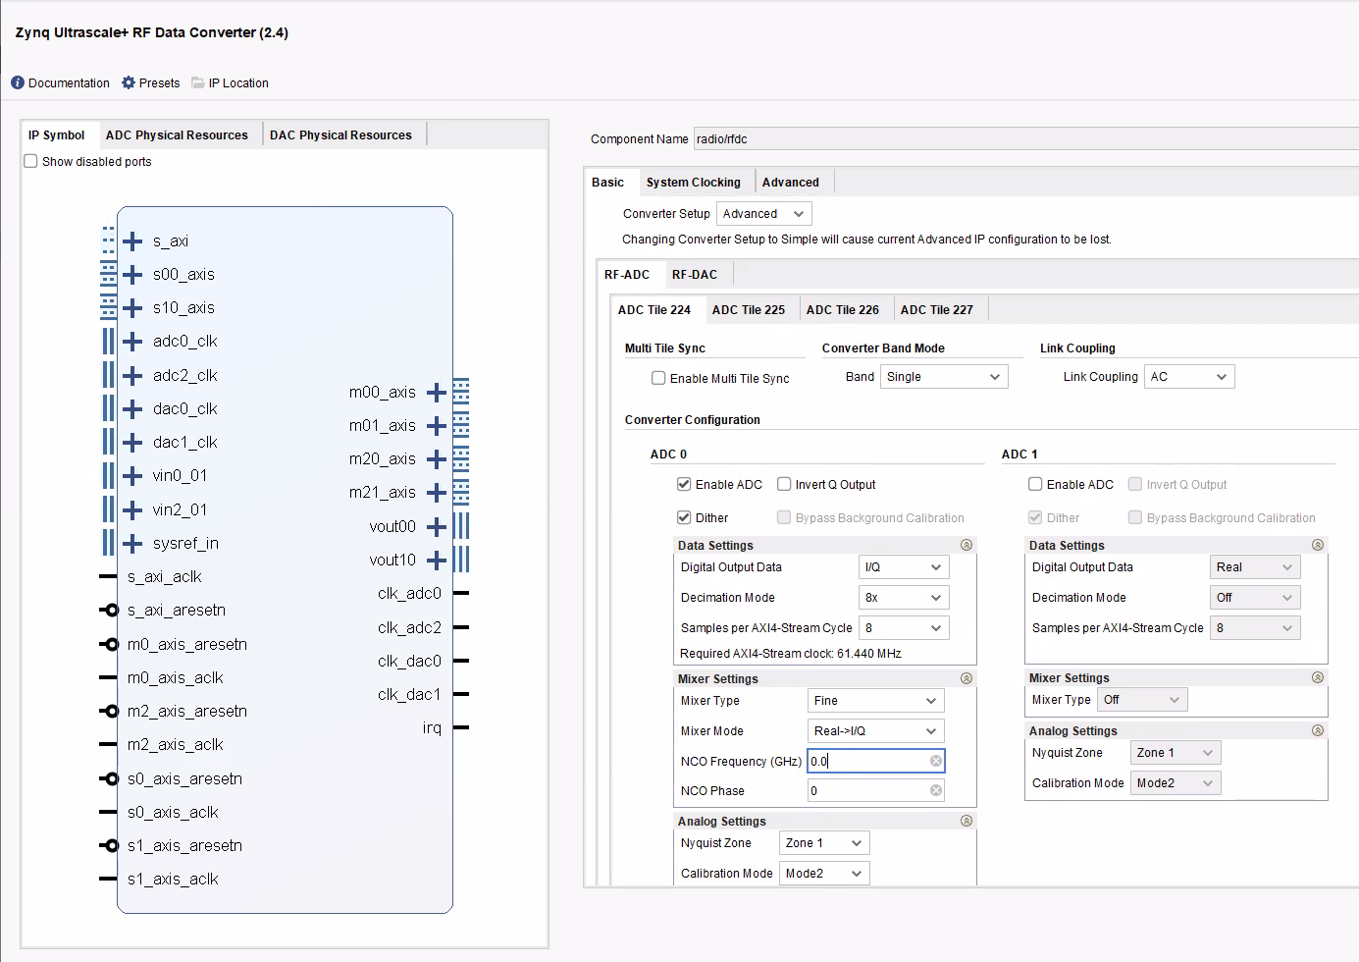
LTE Cell Search:
RF Soc - RF Data converter ADC Configurations:

Slide 3
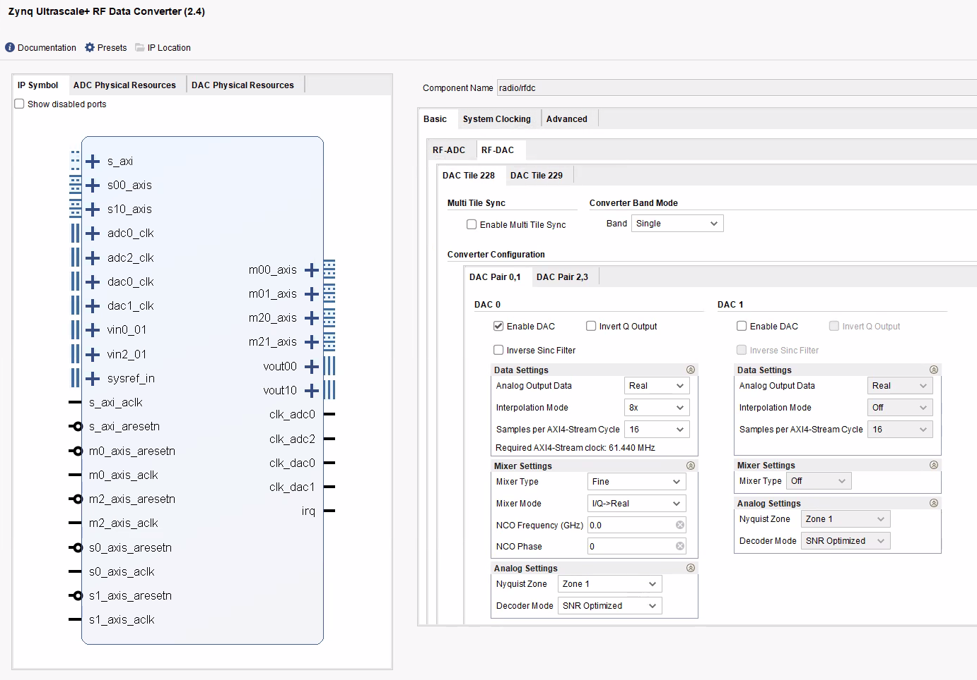
LTE Cell Search:
RF Soc - RF Data converter DAC configurations:

Slide 4
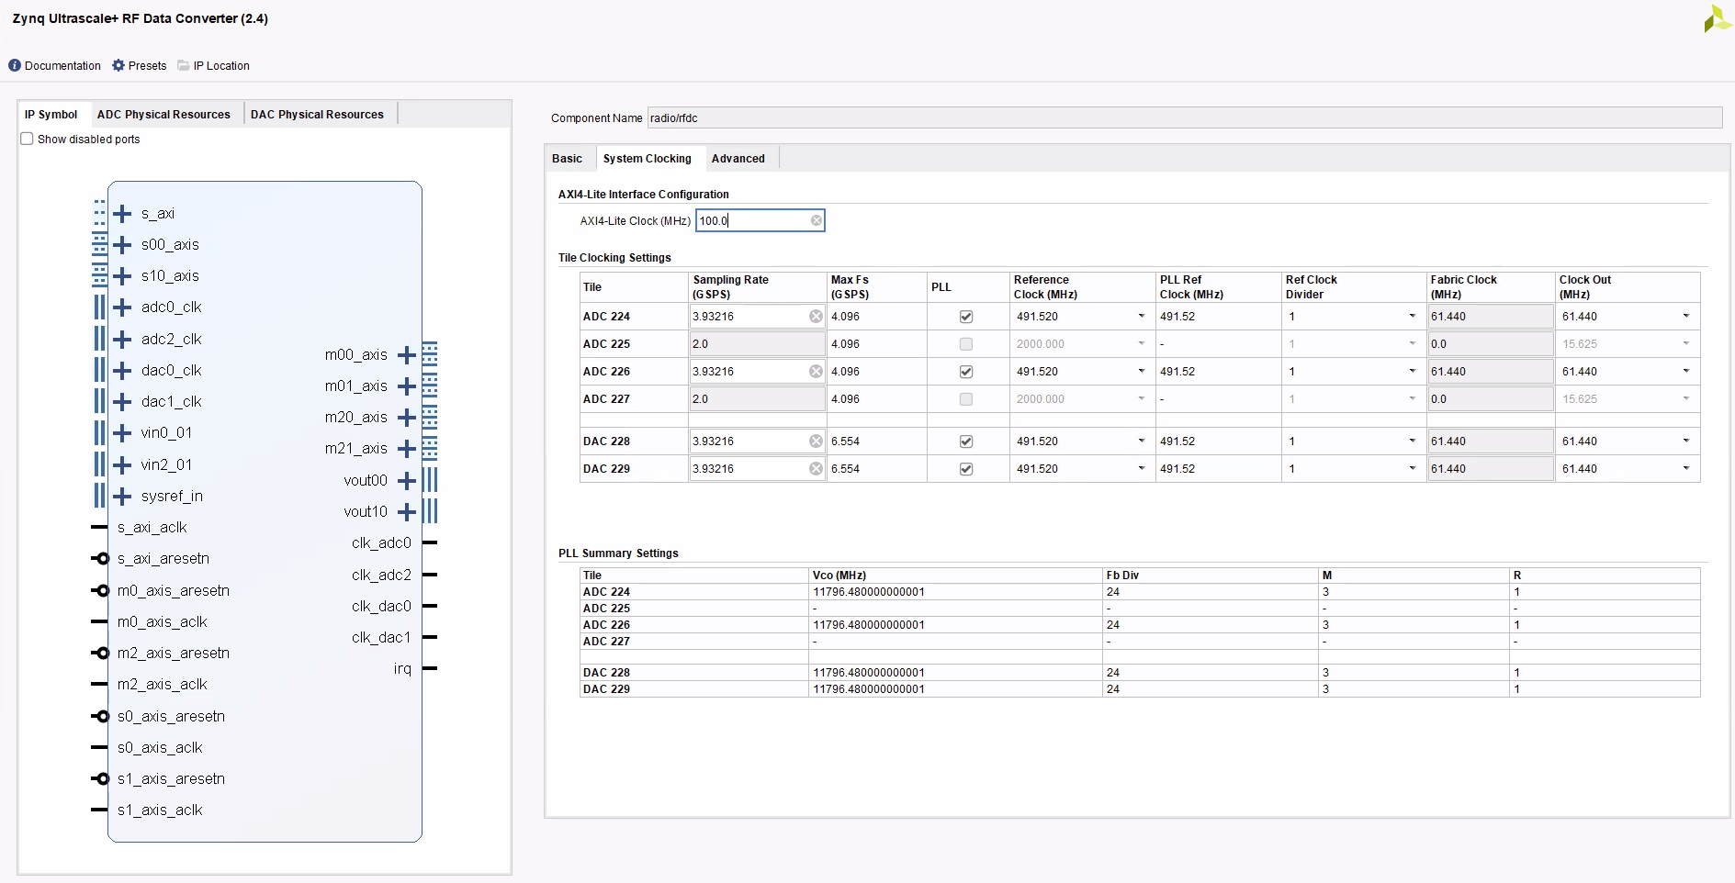
LTE Cell Search:
RF Soc - RF Data converter ADC/DAC Clock Configurations:

Slide 5
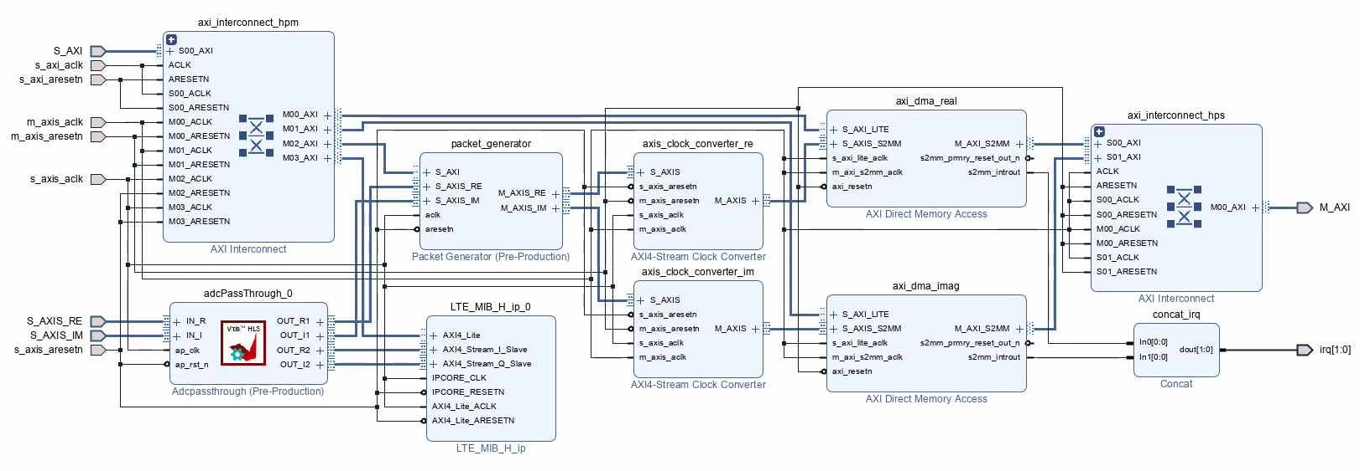
LTE Cell Search:
Vivado Block Diagram for Vitis Receiver: Reference Simulink Implementation

Slide 6
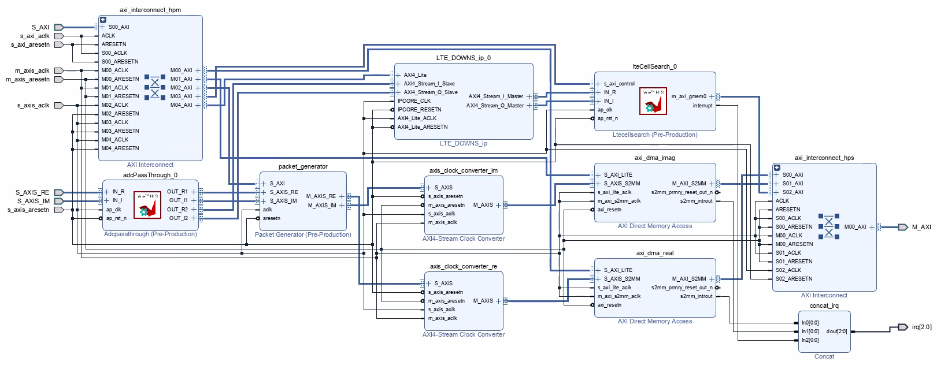
LTE Cell Search:
Vivado Block Diagram for Vitis Receiver: Custom implementation

Slide 7
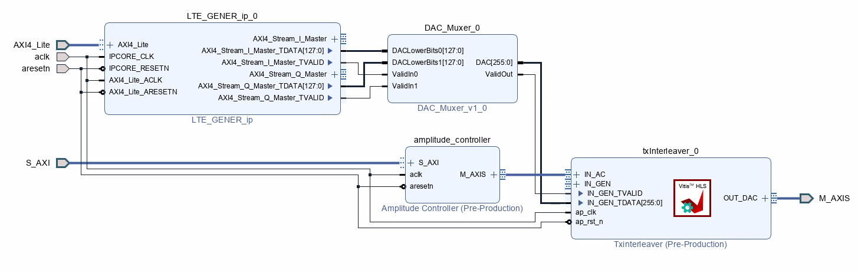
LTE Cell Search:
Vivado Block Diagram for Transmitter: Loopback Mode

