Slide 1

Establishing Ownership
of a Product’s
Documentation
Joshua Ehlers (they/them)

Slide 2

Presentation agenda
Speaker introduction and this talk’s intended audience
A writer’s support system
Five steps towards ownership
What comes next?

Slide 3
Meet the speaker
Introductions, this talk’s intended audience, and my definition of ownership

Slide 4
Introduction
Who am I?
Josh(ua) Ehlers
They/them pronouns
Seattle resident
11 years experience in tech writing
2011: Rockwell Automation
2014: Blizzard Entertainment
2020: Google

Slide 5
Intended audience
Who is this for?
Few years experience in the industry
Little to no experience as a ‘lead’ writer
Desires input on content strategies
Ownership is fast-approaching
Promotion
New job or title
Necessity
Horrible prank?

Slide 6
Let’s talk ownership
What does it mean to own documentation for a product?
Main writer for the product
Can make decisions on content strategy
Subject matter expert for that product’s docs
Caveats
Other writers may work on your product
You may need to build content strategy entirely
People management or team leadership not required

Slide 7
Meet my ‘special guest’
All good stories have an audience-surrogate

Slide 8

Special guest
Meet Jackie
Tech writer
Three years experience
New addition to team
Product set to launch soon*
No writer during development
*About six months after onboarding

Slide 9
Your support system
Discover the people and things that will help you along your journey

Slide 10
Support for a writer
Members of the product team
Project managers
Product managers
Engineering leads
Members of the writing team
Your manager
Other mid-level or senior writers
Non-sentient support
Style guides

Slide 11
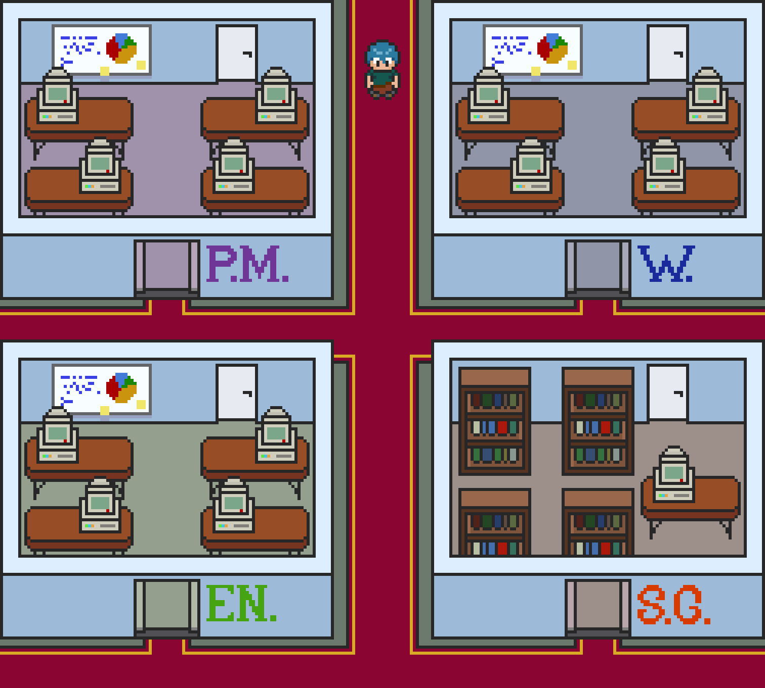
Jackie’s overworld

Slide 12
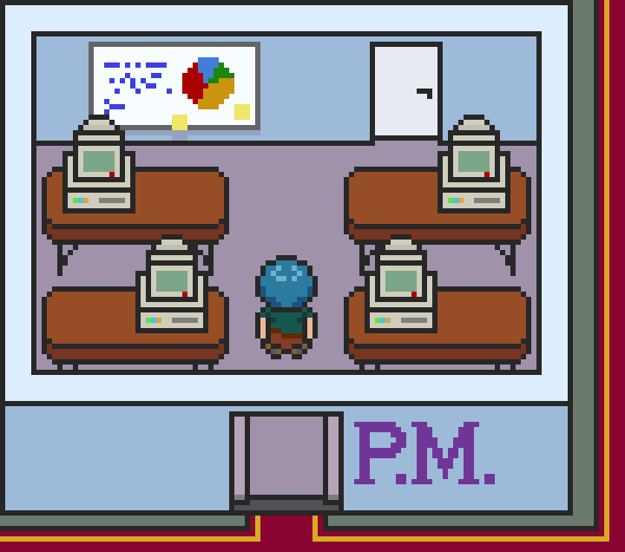
Project and product managers
What they can provide
Timelines for features and launches
Scope of the project
Product design documents
User journeys
Other points of contact for the product

Slide 13
Project and product managers
How to work with a PM or a PM
Keep asking questions
Schedule regular sync meetings
Have a place they can check for wordless updates
Establish your content processes
Earliest point of inclusion
Time estimates for request sizes
Typical review process for content
Localization needs and time for full localization

Slide 14
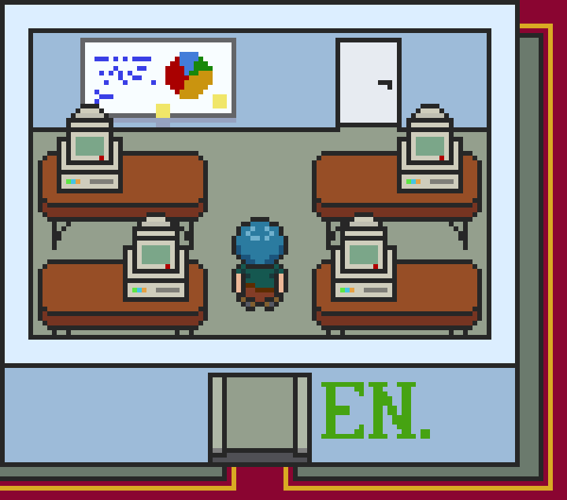
Engineering and tech leads
What they can provide
Primary subject matter experts (SME) for product
Code resources and access to them
Detailed information on procedures
Test accounts
Test builds
Code samples or UX items
In some cases

Slide 15
Engineering and tech leads
How to work with leads
Have PMs set up an introduction
Hold regular syncs
Possibly the same one as the PM sync
Reach out beyond leads to other engineers
Respect their time
Establish boundaries

Slide 16
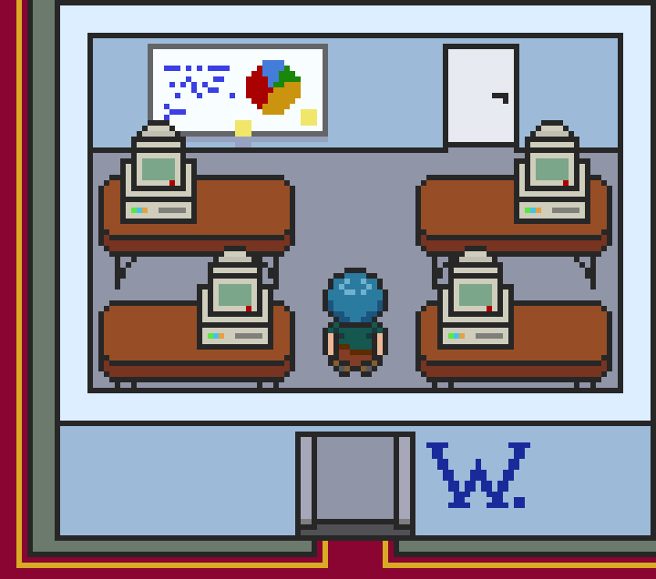
Writers and editors
Likely above mid-level (III, senior, lead, etc.)
What they can provide
Guidance for new product doc creation
Advice for working with product teams
Dependencies for your publishing site
Assistance with writing and publishing if needed

Slide 17
Writers and editors
How to work with writers and editors
Ask questions
So many questions
Literally all of the questions
Understand that critiques and edits come from a place of necessity
Have discussions about why the Oxford comma is important, or when to use an em dash.

Slide 18
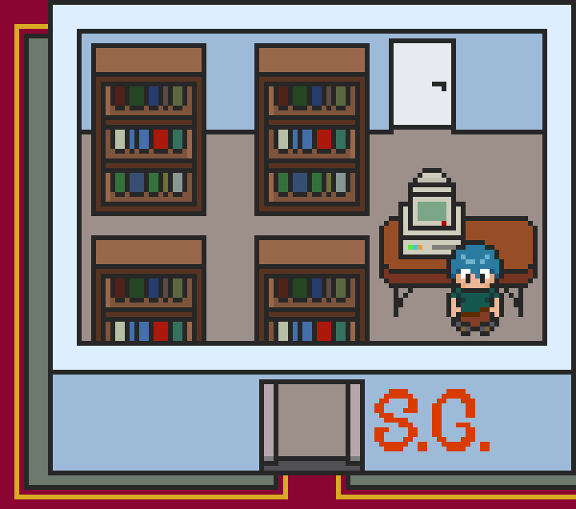
Style guides
What they provide
Guidance on how to write copy for your company
A word list with correct and incorrect terminology
Advice on how to write for specific audiences
Developers, admins, end users, etc.

Slide 19
Establishing ownership
The core of this story, and our hero’s journey

Slide 20
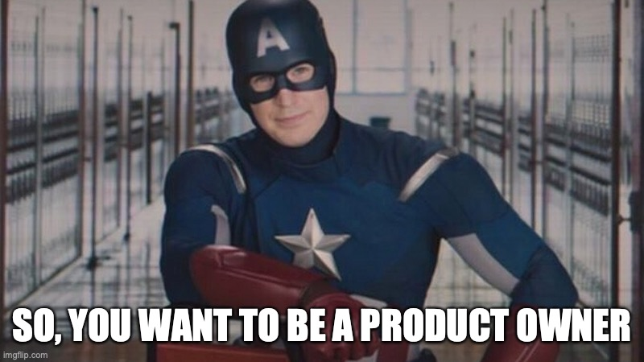

Slide 21
Five steps towards ownership
Exploration
What already exists?
Identification
What do I need to create?
Organization
How does this all fit together?
Creation
Does this cover everything?
Continuation
What now?

Slide 22
Step one: Identification
There’s (almost) always content, even if it’s on post-it notes
Expect to look through:
Engineering notes and documentation
Production details (like meeting minutes)
Timelines and workstream updates
Pre-production design docs
And so on…
Talk to your SMEs and PMs early and often
Don’t panic if there’s not much
…yet
Keep your schedule open for immediate work or collaboration

Slide 23

Let’s identify with Jackie
Oh dear, that’s a lot of legal pads
Lots of upcoming meetings
Auditing may take a while
Will mention need for more digital tracking

Slide 24
Step two: Exploration
You know what you have, find what you don’t
Start building out content strategy
Study other products and their documentation
Deep dives into:
Planning boards
Source cod
Changelists and version histories
Prepare to present your results to stakeholders before moving on

Slide 25

Let’s explore with Jackie
Presenting results to PMs, leads, and her manager
Still more planning meetings
Results of preliminary content strategy
Keeping room in her schedule for current work

Slide 26
Step three: Organization
Should have a solid idea of what will fill your initial documentation
Content that exists and just needs minor edits
Content from notes, bugs, etc. that needs refactoring
Content that does not exist, but needs to
Supplementary content (API reference, glossary, tutorials, etc.)
Other writers enter the picture in a big way
Organize your content in a way that aligns with others

Slide 27
Step three: Organization
Content strategy expands to cover:
Table of contents
Navigation bars and menus
Back-end directory structure
Landing pages
Etc.
Visual mockups or wireframes may help

Slide 28

Let’s organize with Jackie
Had a UX designer help with mockup
TOC structure uses new concepts
Gets final sign-off from stakeholders

Slide 29
Step four: Creation
You become the SME (in a sense)
Content strategy becomes reality
Keep notes, presentations, mockups, and so on for reference
Track your work in a way that works for you
Consistency is key
It may seem near the end, but ask more questions than before
As always, keep gaps in your priorities
Likely longest active step
Notes:
RE: Consistency
Brand names should always look the same. Product names, customer names, variables, examples, etc.

Slide 30
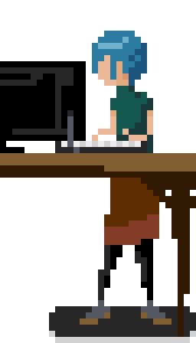
Let’s create with Jackie
We’ve all been here, hunched and tired of typing
At least she has a sit/stand desk
Based on previous steps, she has about two solid work weeks ahead
Let her manager and PMs know things may slip depending on launch slate

Slide 31
Step five: Continuation
Does this step really ever end?*
Expand content strategy to account for ongoing production and living docs
Reinforce your methodology through feature and product updates
Lock-in those collaboration processes
Lead time
Points of contact
Wordless/meetingless updates
*Oh, it goes on and on my friends…
Notes:
RE: Consistency
Brand names should always look the same. Product names, customer names, variables, examples, etc.

Slide 32
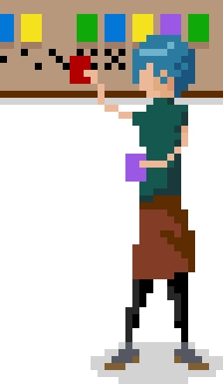
Let’s continue with Jackie
Old-school techniques work well for her
Doc work planned out for a while
Launch coming up means time to reorder things

Slide 33

Say good night, Jackie
Good night, Jackie
Product launches without incident
Some planned ‘establishing’ content missed launch
No docs required for launch approval slipped
Will be busy for a while
Has started to explore content strategy as a potential move

Slide 34
What comes next
The epilogue and appendices to guide you when this story ends

Slide 35
Where do we go from here?
Easy, just keep content up to date!
Right?
Not really. But, while you’re on that path of thought:
Devise a plan to keep content current
Regular review cycles work well
Write down your strategies, processes, and areas of improvement
The starting point of a future transition plan
Consider pitching your work to others

Slide 36
Thank you for attending!
Reach out if you want to talk more:
Email: joshua.ehlers@gmail.com
Twitter: @jehlers42
I’m also available as a guest for podcasts, blogs, or other tech comm social media
Helpful resources:
https://idratherbewriting.com
https://www.writethedocs.org/guide/writing/style-guides/
Don’t forget to fill out the survey for my talk
Enjoy the rest of your Summit!

Slide 37
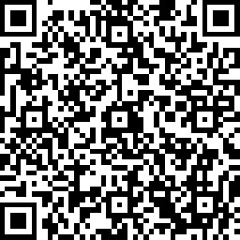
Presentation survey

