Slide 1






MEDICA
Team Members: Megha Yadav [ML BACKEND]
Tanisha Jain [BACKEND FRONTEND]
Niharika Rawat [UI UX]
Disclaimer: The content is curated for educational purposes only.
Notes:
Slides: Prepare a short slide deck (10-12 slides) summarizing the project objectives, methodology, and key results.

Slide 2

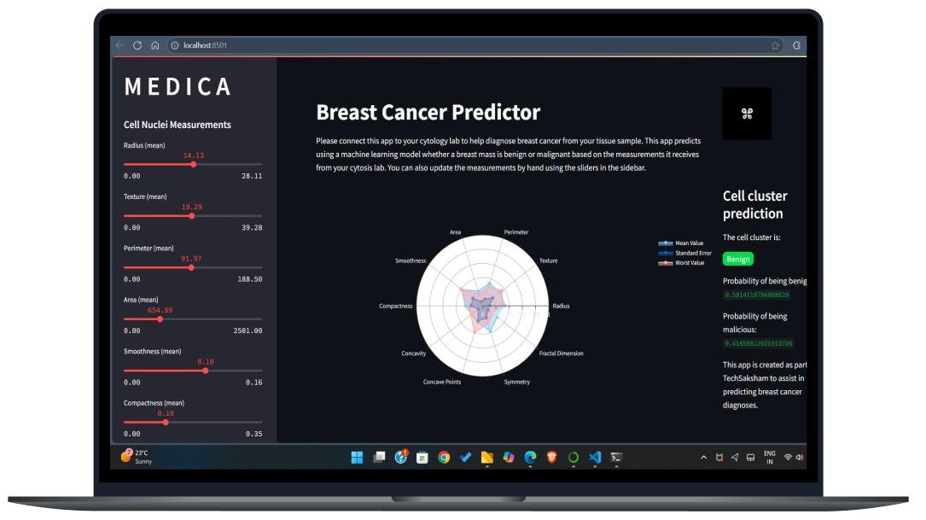
M E D I C A
Abstract
Challenges
Breast cancer is one of the leading causes of mortality among women worldwide.
High false positive/negative rates can lead to misdiagnosis.
Interactive Web Application
A Streamlit-based dashboard that allows users to input data, visualize results, and receive real-time predictions.
ML-Powered Prediction Model
Logistic regression model trained to classify breast masses as benign or malignant with 97.36% accuracy.

Slide 3
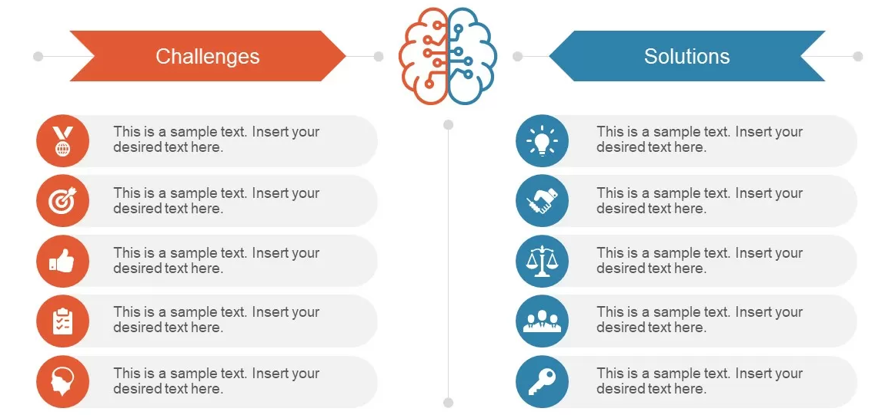
M E D I C A
Traditional methods are time-consuming and require expert evaluation.
Early detection using AI-powered predictive modeling.
High false positive/negative rates can lead to misdiagnosis.
Improved accuracy with machine learning algorithms reducing false results..
Limited accessibility to advanced diagnostic tools in remote areas.
Standardized and objective diagnosis using automated analysis.
Variability in diagnosis due to human interpretation errors.
Cloud-based deployment for accessibility in remote areas. [F.S]
Difficulty in integrating AI-based solutions with existing medical systems.
Seamless integration with existing medical systems via APIs. [F.S]

Slide 4
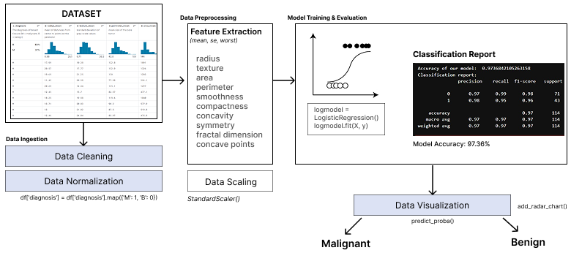
System Architecture
M E D I C A
DATASET: Breast Cancer Wisconsin Data

Slide 5
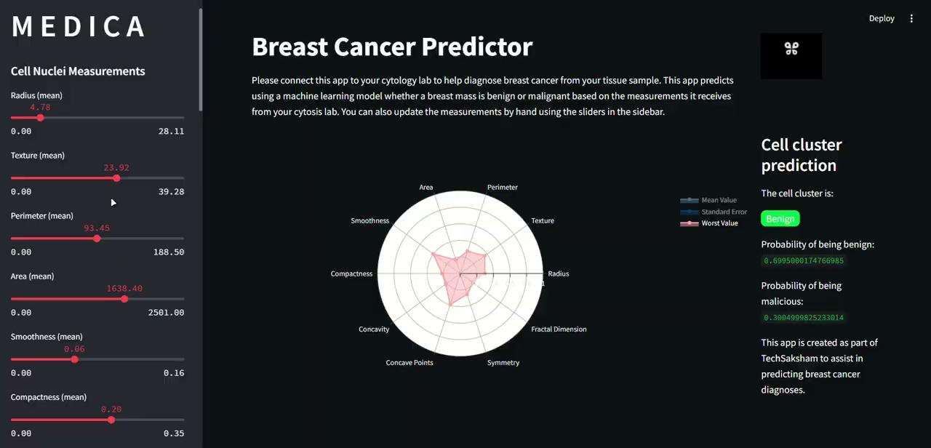
Live Demo of Project
M E D I C A

Slide 6
Future Scope
M E D I C A
🔍
Hyperparameter Optimization:
Improve accuracy (97.36%+) using GridSearchCV to fine-tune model parameters
☁
Microsoft Azure Deployment:
Scale the model using Azure Machine Learning for seamless cloud integration.
🧬
Advanced Cytology Lab Integration:
Develop an enhanced AI model that works directly with lab equipment for real-time diagnosis.
📊
Multi source data fusion:
Combine cytology results with MRI, ultrasound, and patient history for comprehensive diagnosis.

Slide 7
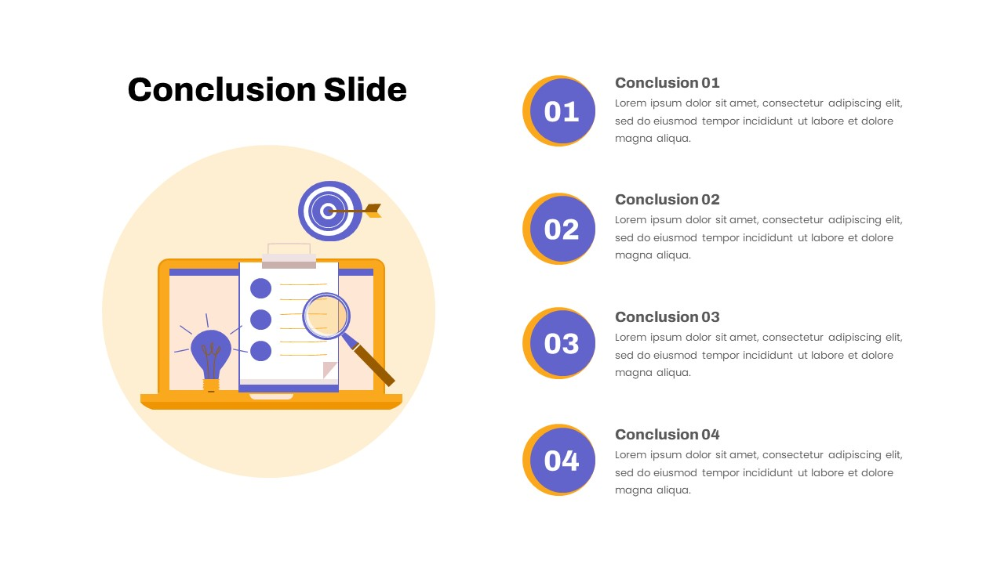
Summary of the Project
Developed an AI-powered breast cancer prediction system to assist in medical diagnosis.
Achieved 97.36% accuracy, demonstrating the effectiveness of the model.
Key Insights & Learnings
ML can enhance early detection and support medical professionals.
Visual analytics improve interpretability and decision-making.
Future Scope
Deploy on Microsoft Azure and Integrate with cytology labs for real-time data processing and an advanced model..
Final Takeaway
This project showcases the potential of AI in healthcare, paving the way for more accurate and efficient diagnosis systems.
M E D I C A
Conclusion

