Slide 1
Frequency
Sang Yup Lee

Slide 2
Frequency
Process
1) Obtain text data
2) Text preprocessing
3) 특정 품사의 단어 추출하기
4) Frequency
1) To obtain text data
For this, we try to web-scrape the following article from the New York Times
https://www.nytimes.com/2017/06/12/well/live/having-friends-is-good-for-you.html

Slide 3
Frequency (cont’d)
2) Text preprocessing
Main steps
Get the article content
Preprocessing
Text cleaning (remove symbols/marks)
Case conversion
Tokenization (nltk를 이용하면 된다)
Parts of Speech (POS) tagging (품사 tagging)
특정 품사 단어 추출 (e.g., 명사)
Lemmatization (원형 찾기, ‘Lamma’가 원형을 의미한다)
Removing stopwords (불용어)
Count words
use the ‘Counter’ module
See ‘English_preprocessing.ipynb’

Slide 4
Frequency – 한글
Process
Obtain news articles
Text preprocessing
Text cleaning (remove symbols/marks)
형태소 분석
특정 품사 단어 추출 (e.g., 명사)
Removing stopwords (불용어)
Count words
use the ‘Counter’ module
See ‘Korean_preprocessing.ipynb’

Slide 5
Exercise
Example article
비트코인 관련 기사
http://news.naver.com/main/read.nhn?mode=LSD&mid=sec&sid1=101&oid=277&aid=0004164498

Slide 6
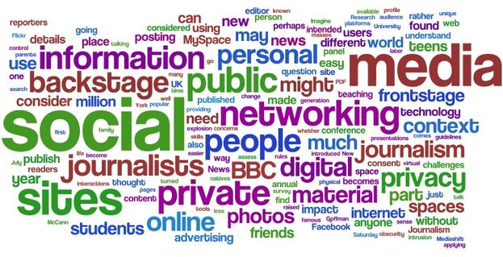
Word cloud

Slide 7
Word cloud
Word cloud
Installation
Method 1
pip install wordcloud or,
conda install -c https://conda.anaconda.org/amueller wordcloud
Method 2
Download the wordcloud module from
http://www.lfd.uci.edu/~gohlke/pythonlibs/#wordcloud
After downloading the file, on a CMD window you need to move to the folder where the file is save at
At the folder, please type the following command on the window
pip install wordcloud-1.2.1-cp36-cp36m-win_amd64.whl
Document
https://github.com/amueller/word_cloud

Slide 8
Word cloud
Examples
English text
“Wordcloud_En.ipynb”
Korean text
“Wordcloud_Kr.ipynb”

Slide 9
Q & A

