Slide 1
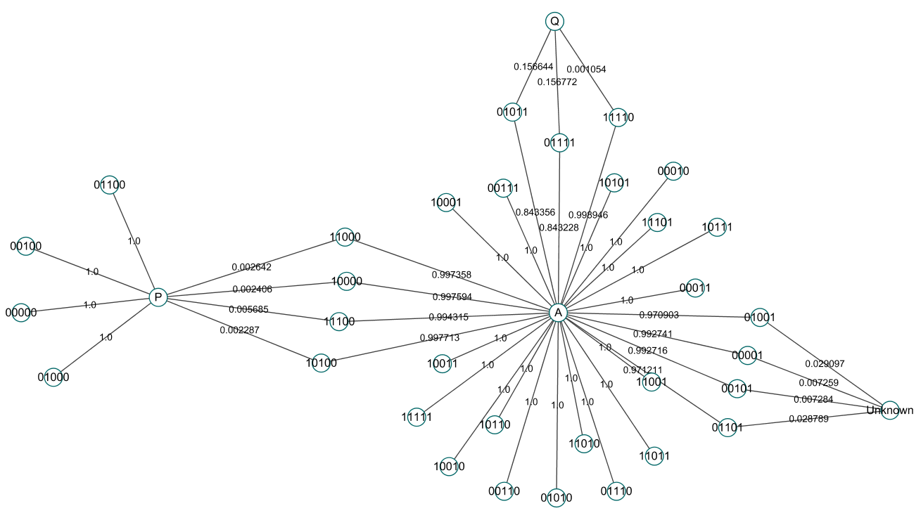
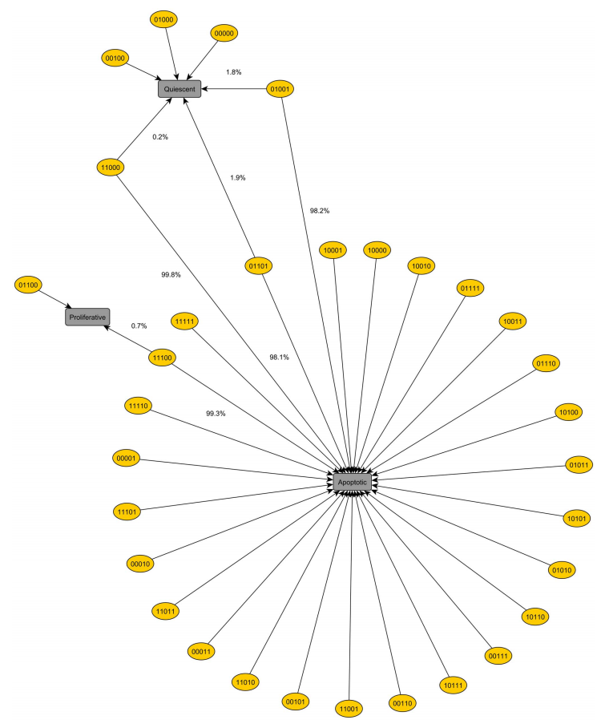
a
a
b
b
Input = {
'State_Mutagen' : False,
'State_GFs': False,
'State_Nutrients': False,
'State_TNFalpha': False,
'State_Hypoxia': False,
'State_Gli': True,
}
Figure 1. (ver1)

Slide 2
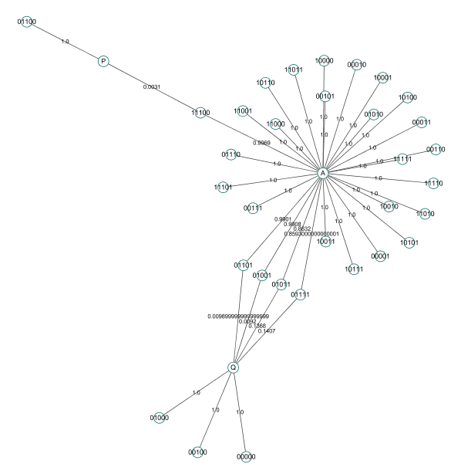
b
a
Input = {
'State_Mutagen' : False,
'State_GFs': False,
'State_Nutrients': False,
'State_TNFalpha': False,
'State_Hypoxia': False,
'State_Gli': False,
}
Figure 1. (ver2)

Slide 3
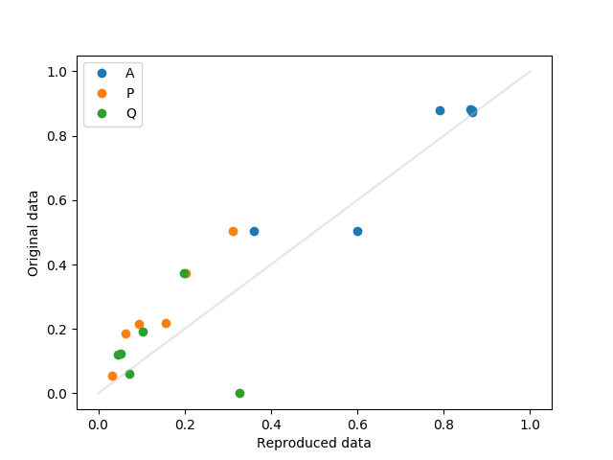
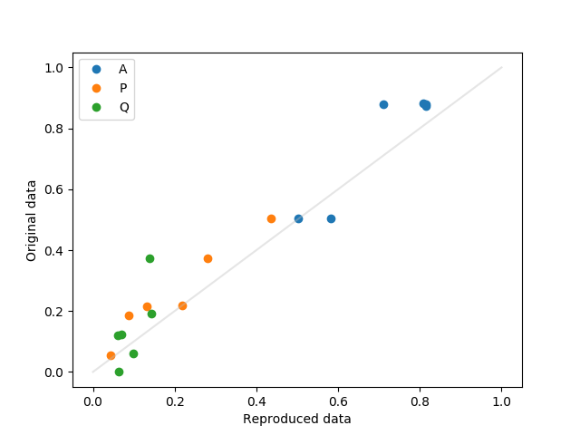
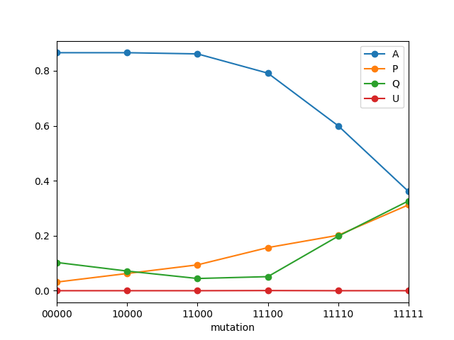
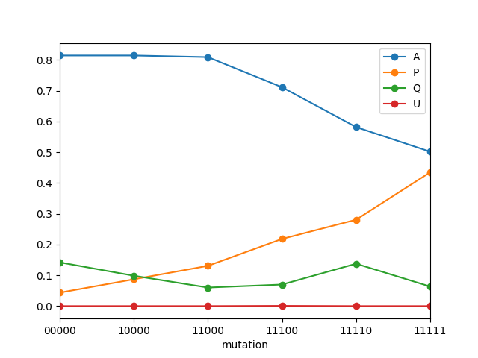
All combinations of input conditions
All combinations without Hypoxia
Basin ratio of attractor
free | apc | ras | smad | pten | p53
← Benign
Malignant→

