Slide 1
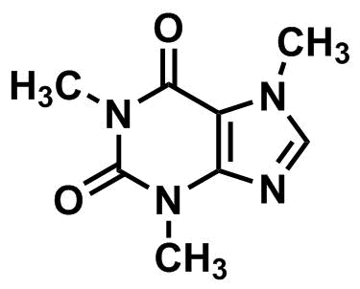

DOSE ME
A SHOT OF
CAFFEINE
A SHOT OF CAFFEINE
PROMOTES POSTING

